Slide 1
Reduce Transitive Redundancy in CFL Reachability
Pei Xu
Supervised By Yulei Sui
Program Analysis Group
University of Technology Sydney (UTS)

Slide 2
Reference
Reps. (1998). Program analysis via graph reachability. Information and Software Technology, 40(11), 701–726. https://doi.org/10.1016/S0950-5849(98)00093-7
YUXIANG LEI, YULEI SUI, SHUO DING, and QIRUN ZHANG Taming Transitive Redundancy for Context-Free Language Reachability

Slide 3
Overview
Basic CFL Solving
Transitive Relation
Partial Order CFL Reachabilty
Online Cycle Collapse

Slide 4
CFL Reachability Framework
CFL Reachability is a fundamental framework in Static Analysis.
By a set of production rules:
A -> b c
When there are paths contains “b” label and “c” label edge, a additional edge labelled “A” where be added to the graph.

Slide 5
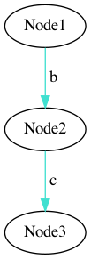
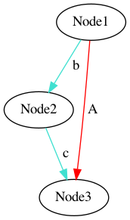
Edge Derivation Example:
A -> b c

Slide 6
Formal Definition:
A CFL-reachability instance:
Reach⟨CFG, 𝐺⟩
Context Free Grammar:
CFG = ⟨Σ , 𝑁 , 𝑃, 𝑆⟩ ( Σ = 𝑁 ∪ 𝑇 )
Edge labeled graph:
𝐺 = ⟨𝑉 , 𝐸⟩. Initially, 𝐺 contains only edges labeled by terminals.

Slide 7
Transitive Relation:
A := A A

Slide 8
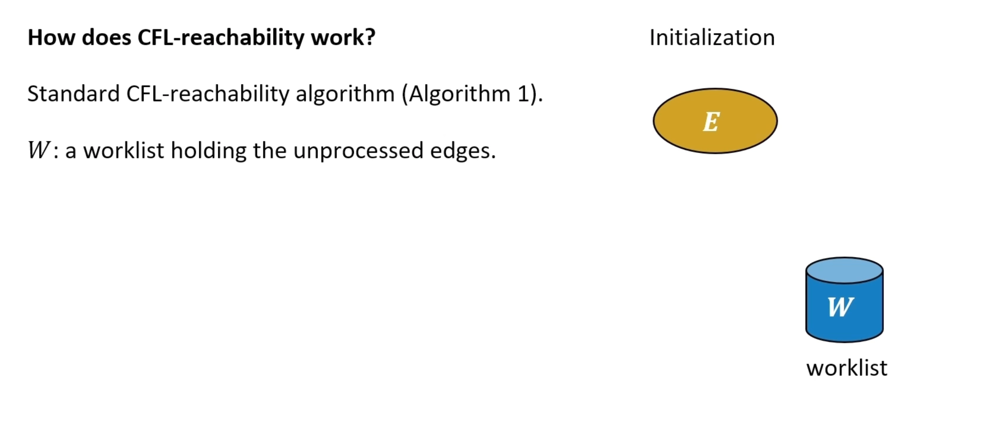

Slide 9
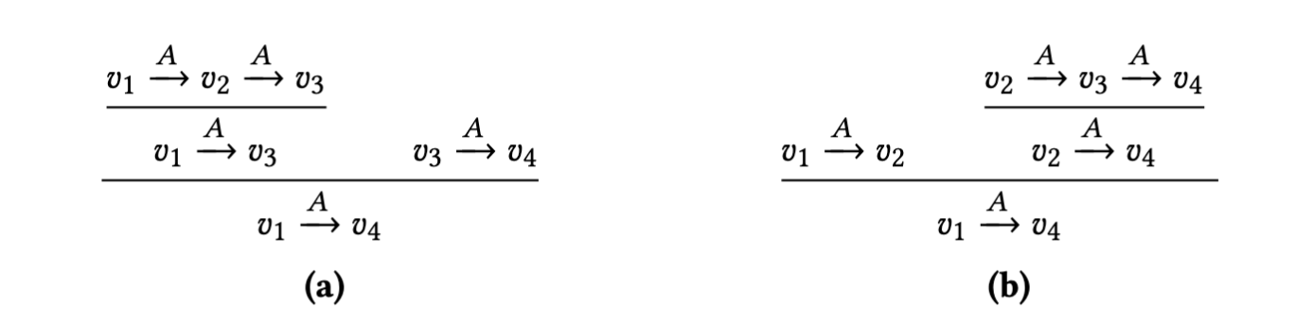
Redundancy Example:

Slide 10
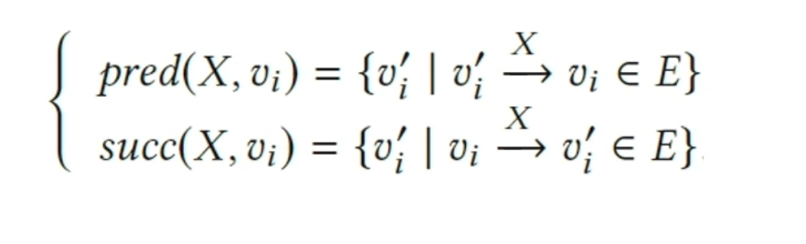
PARTIALLY ORDERED CFL-REACHABILITY (POCR)
Hybrid Graph Representation

Slide 11
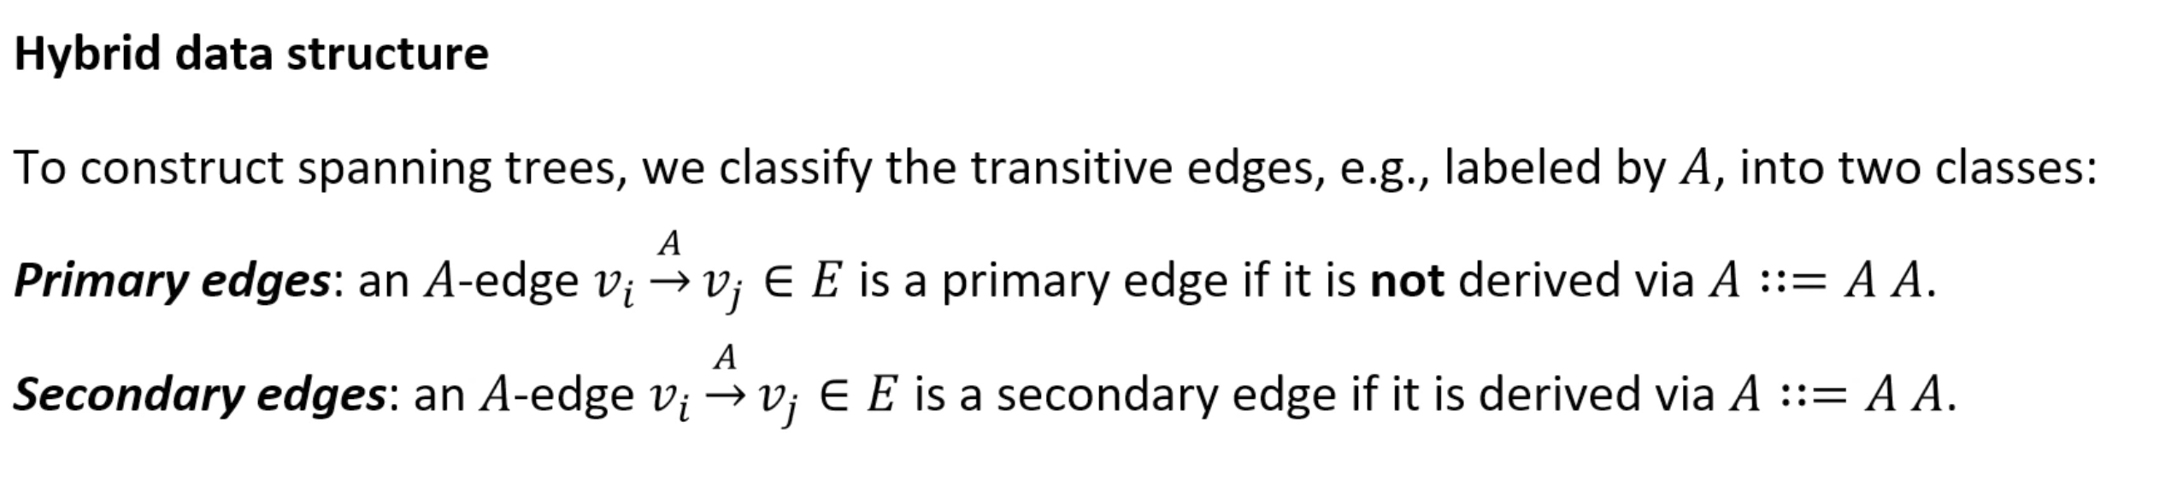
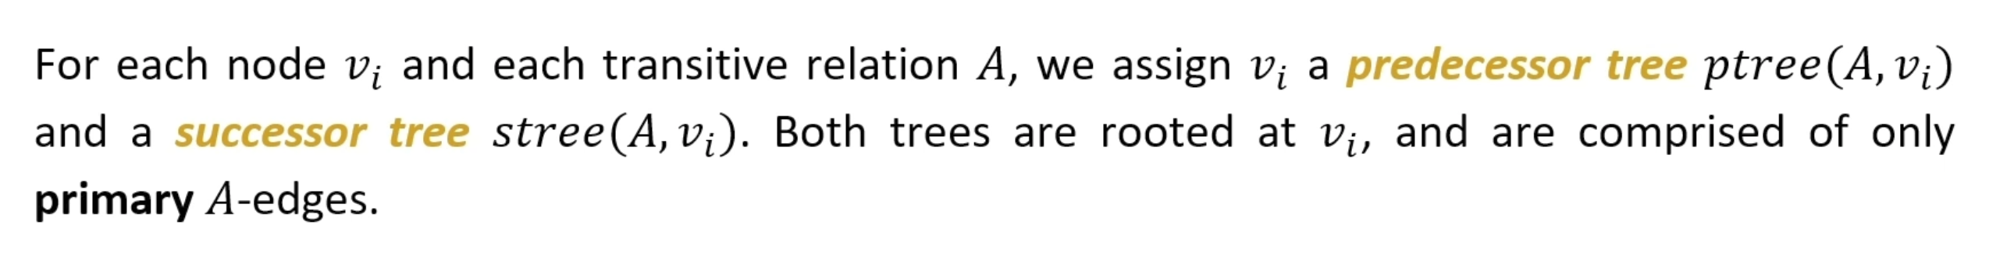

Slide 12
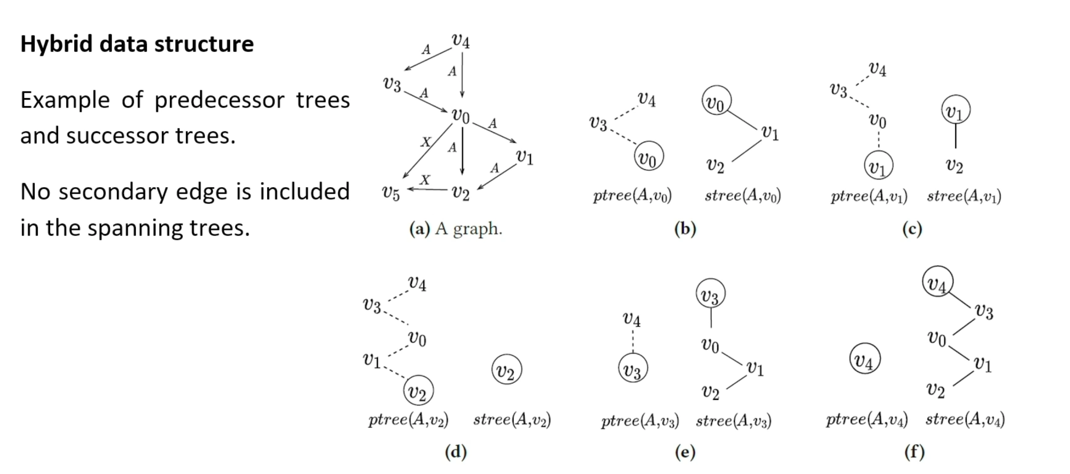

Slide 13
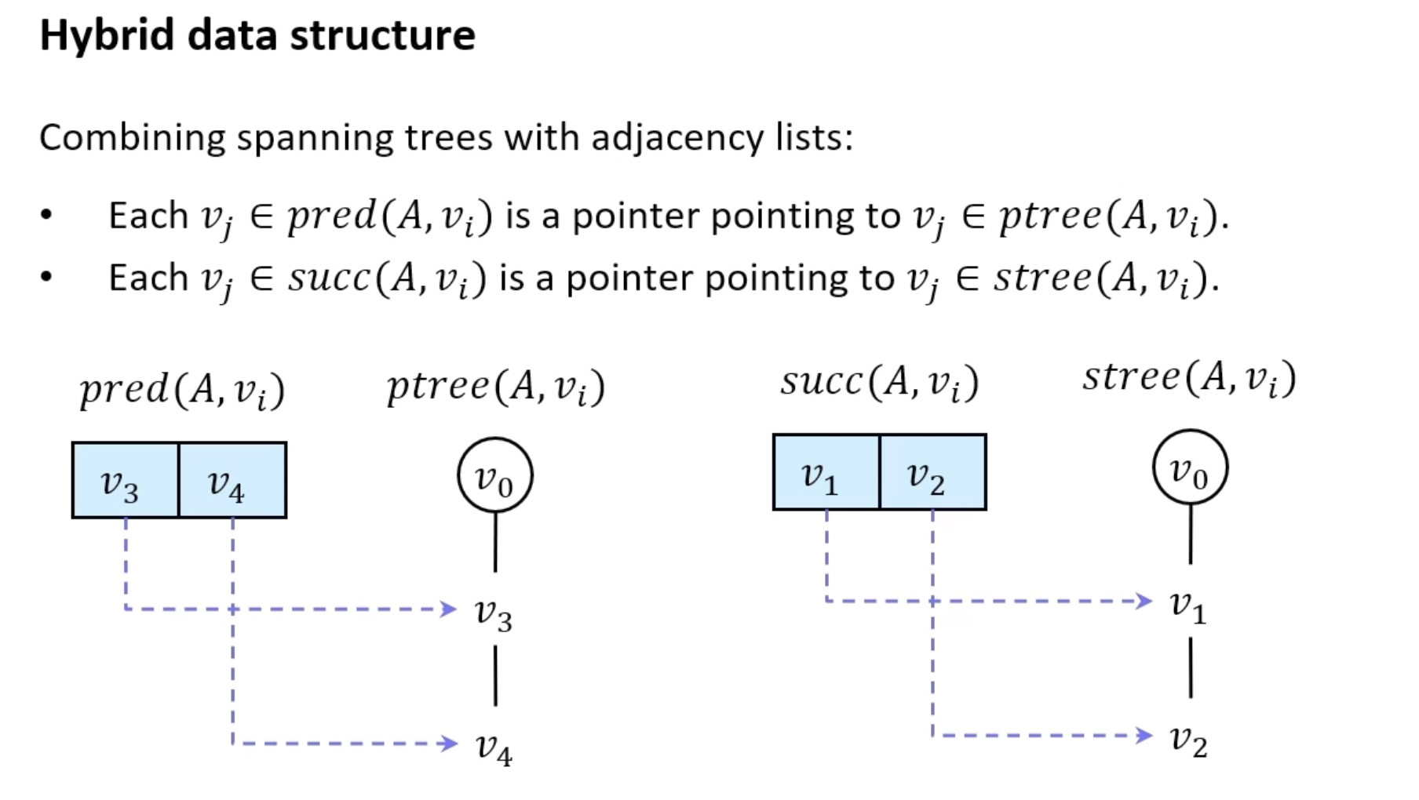

Slide 14
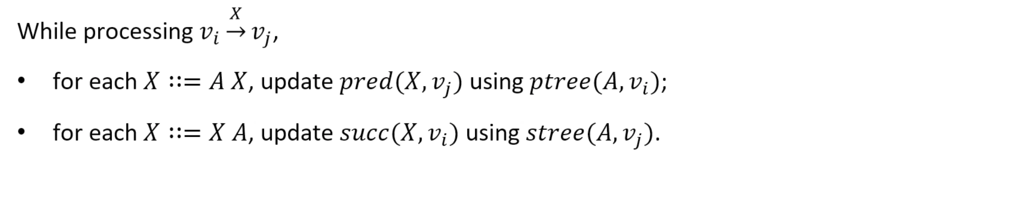
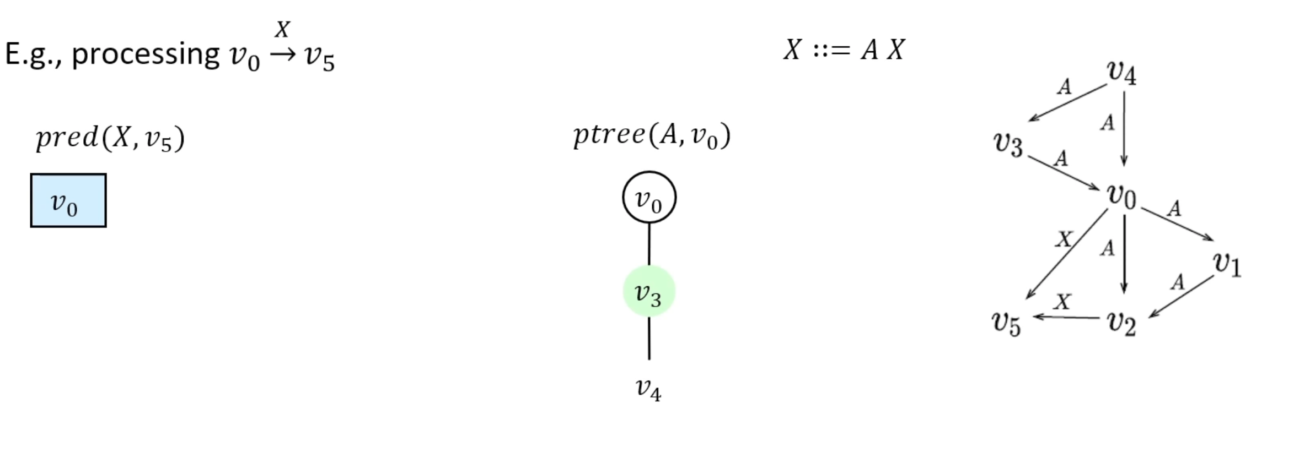

Slide 15
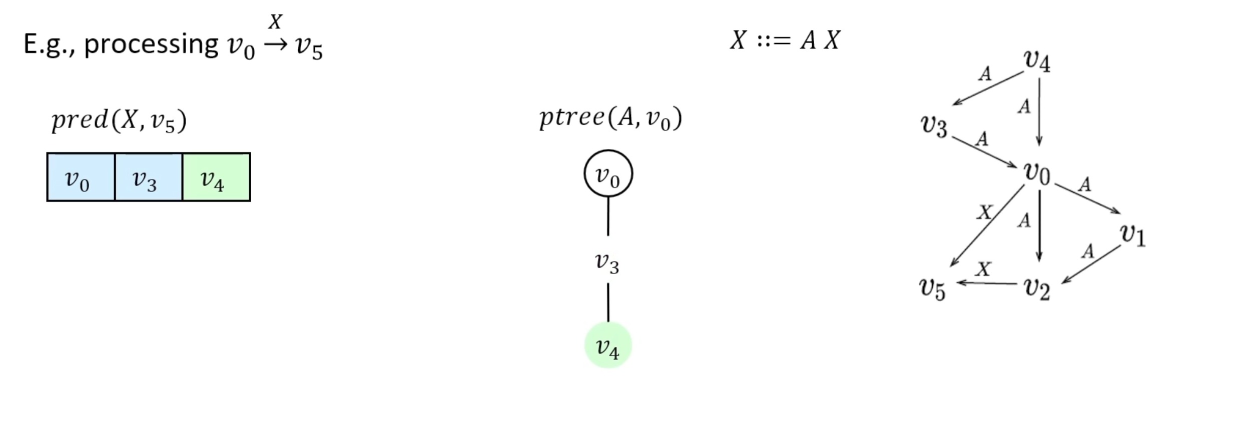

Slide 16
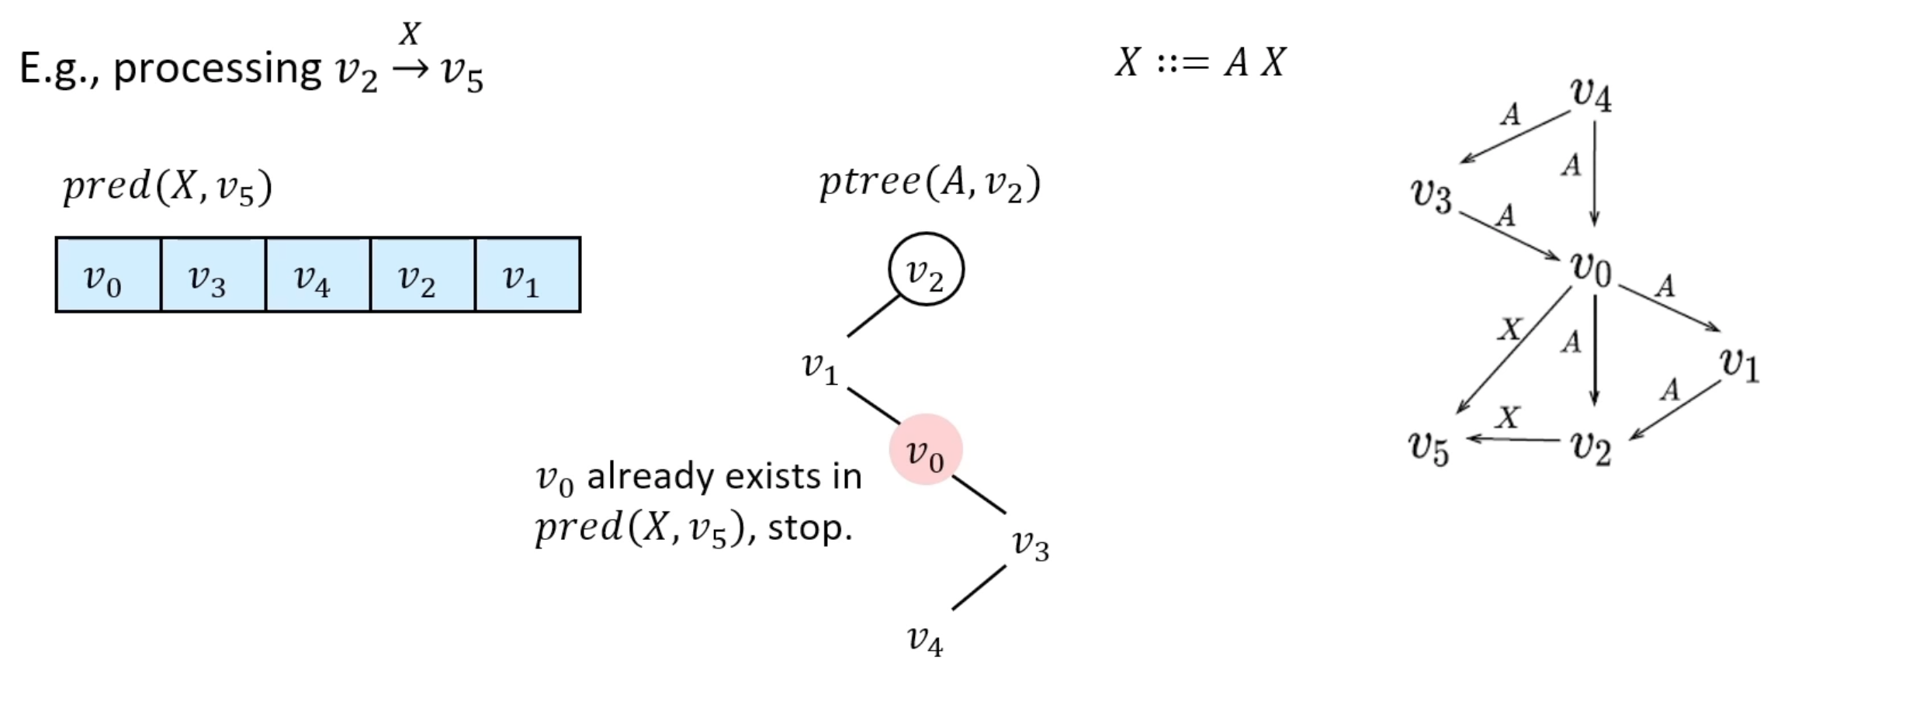

Slide 17
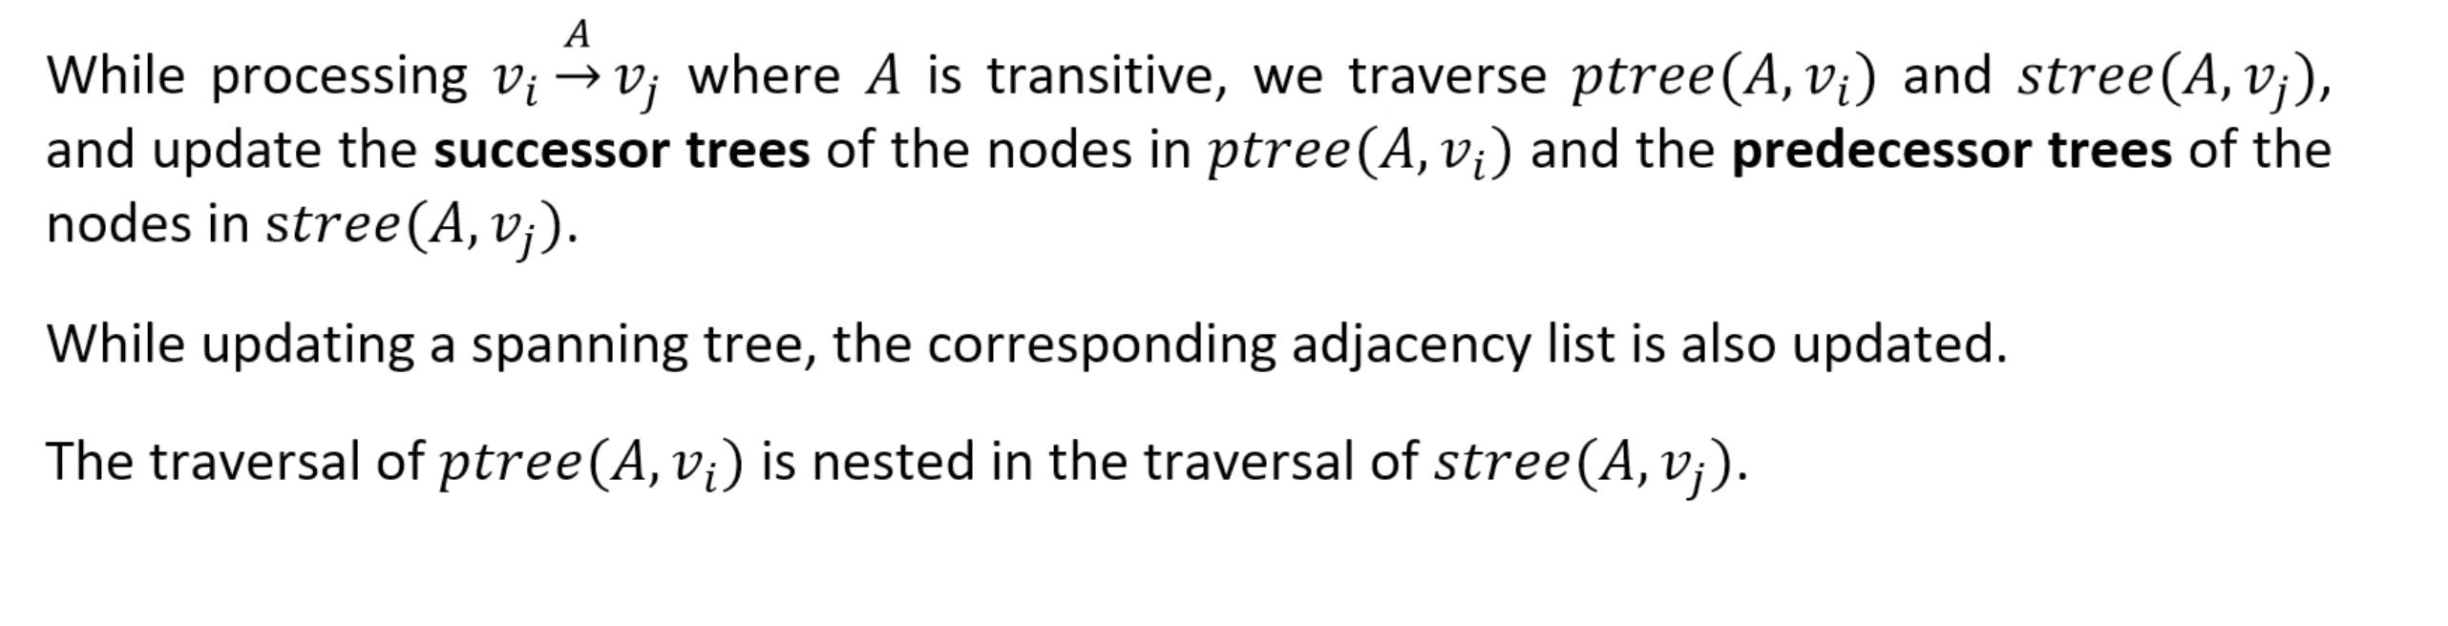

Slide 18
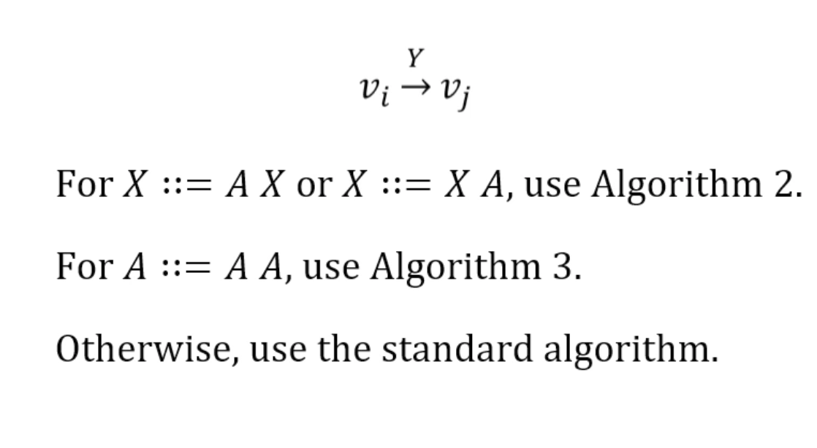

Slide 19
Thank you!

