Slide 1

Fault Localization in Android using Failure-Inducing Event (FLiAD)
Hsu Myat Win

Slide 2
Content
Background
Related Work and Limitation
Problem and Contribution
Our Approach
Motivation
FLiAD

Slide 3
Background
Fault Localization (FL)
Android Nature – Why is FL difficult?

Slide 4

Fault Localization (FL)
Identifying the locations of faults in a program
Manually fault localization is time-consuming

Slide 5
Android Nature – Why is FL difficult?
Several entry points via various channels using Intent messaging object
An asynchronous event-driven feature that allows foreground and background processes
Intent entry -not only from same apps but also from other apps
Events -not only UI event, but also component’s lifecycle callback event

Slide 6
Related Works
&
Limitation

Slide 7
Related Works in Android
Paper | Limitation
AndroidSlicer finds fault using backward dynamic slicing | More suspicious space No lifecycle awareness model
MZoltar helps to produce bug analysis report automatically based on spectrum-based fault localization | Not finding fault directly
FUSION fills the gap between developers and reporters by improving bug reporting system in Android | Not finding fault directly

Slide 8
Problem
&
Contribution

Slide 9
Problem | Contribution
More suspicious space No Lifecycle awareness | FLiAD – a lifecycle-awareness tool which provides more direct and sensitive faulty code in Android using “Failure-Inducing Event”
Asynchronous events nature (Several events which either related or not related to the root cause, can be triggered before the program failed) | Event-based test case - a re-usable practice on the instrumented apps by allowing testers to focus specific events on testing Event-based delta debugging - a re-usable comprehensive technique by advising developers to know event, which can switch the program’s failure, is coming from their own application or the external application.
Multiple-entry point via Intent (when, how and what data transferred via intent is depending not on event registered, but also life-cycle callback triggered) | Failure-inducing events in the essence of time to detect real-time context

Slide 10
Our Approach
Failure-Inducing Code Block
Event-based Delta Debugging
Dynamic Slicing (Ds)

Slide 11
Failure-Inducing Code Block – Compute faulty code (Intersection of forward and backward slicing)
Failed test case (seq: of events)
Minimum failed test case (seq: of events)
App
App
BWDs
AdrSl
Failure-inducing event
FWDs
Error/exception
Error/exception
Faulty code
BWDs – backward dynamic slicing
AdrSl – AndroidSlicer
FWDs – forward dynamic slicing
Notes:
To reduce sequence of events, we use Delta Debugging method
To extract related program statements, we use slicing

Slide 12
Failure-Inducing Code Block
To reduce sequence of events and to produce “Failure-Inducing Event”, we use “Event-Based Delta Debugging”
To collect related program statements, we use “Dynamic Slicing”

Slide 13
Our Approach
Failure-Inducing Code Block
Event-based Delta Debugging
Dynamic Slicing (Ds)

Slide 14
Delta Debugging (DelD)
DelD – minimizing
DelD – isolating

Slide 15
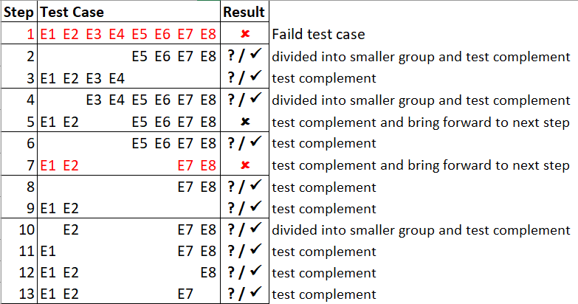
Event-based DelD - Min
Hsu’s research
DelD-Min - Systematically narrowing down failure-inducing circumstances (Inputs/ test cases/ events) until a minimal set remains. In our case, sequence of events (SoE).
How to evaluate?
Passed test case (✓)
No exception/error/crash
Failed test case ()
Same exception/error and same backtrace (stack traces)
Unresolved test case (?)
Same exception/error and different backtrace (stack traces)
Different exception/error

Slide 16
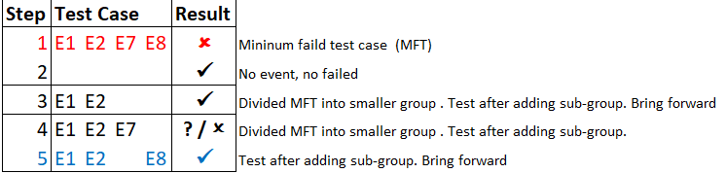
Hsu’s research
Event-based DelD - Iso
DelD-Iso - Finding failure-inducing event by finding difference between minimum failure test case (min failure-making SoE) and maximum successful test case (max success-making SoE) within min failure-making SoE
Events for Failed Test Case
Events for Successful Test Case
Failure-Inducing Event
Notes:
A backtrace is a summary of how your program got where it is. In computing, a stack trace (also called stack backtrace or stack traceback) is a report of the active stack frames at a certain point in time during the execution of a program.
A stack trace shows a list of method calls that lead to the exception being thrown, together with the filenames and line numbers where the calls happened.
While your app is running in debug mode on a connected device, Android Studio prints and highlights stack traces in the logcat view,
Debugging an app often requires working with stack traces. A stack trace is generated whenever your app crashes because of an error or an exception. You can also print a stack trace at any point in your app code using methods such as Thread.dumpStack().

Slide 17
Our Approach
Failure-Inducing Code Block
Event-based Delta Debugging
Dynamic Slicing (Ds)

Slide 18
Slicing
A technique to slice a group of program statements in the program
Basic Criteria
a variable “v”
at a point “p”
(eg; v = a+1; )
Other Criteria
an input “i”* such as data, time, test cases and so on.
Useful for testing to debugging to security

Slide 19
Slicing – Program Dependence Graph
Data Dependence
Define & Use
Eg;
Control Dependence
Initiator & Follower
Eg;
1
1:
2:
int a=0;
int b=a + 1;
(defined)
(used)
data dependence
2
1:
2:
If(found)
System.out.println(“Hello”);
(Initiator)
(Follower)
1
control dependence
2

Slide 20
Ways of Slicing
Forward Slicing – starting from criteria point onwards
(the statements of the program which are affected by the slicing criterion)
Backward Slicing – starting from criteria point backwards
(the statements of the program which can have some effect on the slicing criterion)

Slide 21
Example for Slicing (Forward Vs Backward)
Blue – data dependence
Pink – control dependence
1:
2:
3:
4:
5:
x = 1;
y = 2;
z = y-2;
r = x;
z = x + y;
1
2
3
4
5
Figure 1: A program fragment to be sliced
Criteria : variable x at point "Line1"
Criteria : variable z at point "Line5"
1:
4:
5:
x = 1;
r = x;
z = x + y;
1
1:
2:
5:
x = 1;
y = 2;
z = x + y;
1
2
4
5
5
Figure 2: The forward slice result
Figure 3: The backward slice result

Slide 22
Types of Slicing
Static Slicing
Program line/ code for every possible execution pattern
Dynamic Slicing
All run-time effective program lines/code

Slide 23
Example for Slicing (Static Vs Dynamic)
Blue – data dependence
Pink – control dependence
3
1:
2:
3:
4:
5:
6:
int n = Integer.parseInt(System.console().readLine());
int x = 0;
if(n>0)
{x = n - 1 ; }
else if(n<0)
{x = n + 1; }
1
4
5
2
6
Figure 1: A program fragment to be sliced
Figure 2: Static Slicing
If input value “-5”
If input value “5”
3
1
1
4
5
2
6
2
Figure 3(a): Dynamic Slicing
Figure 3(b): Dynamic Slicing

Slide 24
Event - Data Dependence (DD)
Data Dependence among events
Eg; Event 2 (E2) is data-dependence on Event 1 (E1) when node (instance of instruction) S_{2t} in E2 is data-dependent on node (instance of instruction) S_{1t} in E1 if registered object o₂ in S_{2t} depend on registered object o₁ defined in S_{1t} at time t.
E1
Int a = 1;
E2
b = a;
E2
E1
S_{2t}
S_{1t}
S_{1t}
S_{2t}
d
$$d_{o2−o1}$$

Slide 25
Event - Control Dependence (CD)
Control Dependence among events
Direct-initiate or Indirect-initiate
Direct- control (Lifecycle awareness)
Data-aware control (while component is running)

Slide 26
1. Direct-initiate or Indirect-initiate
Eg; Event 2 (E2) is control-dependence on Event 1 (E1) when Event 1 (E1) directly or indirectly initiates Event 2 (E2) .
[startActivity (directly initiate) , startActivityForResult (indirectly initiate)]
ActivityOne.java
E1
Intent i = new Intent (this, ActivityTwo.class);
startActivity(i);
E2
E1
c
ActivityTwo.java
E2
….

Slide 27
2. Direct-Control
Eg; Event 2 (E2) is control-dependence on Event 1 (E1) when Event 1 (E1) let Event 2 (E2) start by finishing itself. [onPause , onDestroy, …]
ActivityOne.java
E2
E1
onCreate(){
Intent i = new Intent (this, ActivityTwo.class);
startActivity(i); }
E1
onPause(){}
c
“When activity B is launched in front of activity A, onPause callback will be invoked on A. B will not be created until A's onPause() returns, so be sure to not do anything lengthy here.”
https://developer.android.com/reference/android/app/Activity#onPause()
ActivityTwo.java
E2
….

Slide 28
3. Data-aware control
While component is in running state, all non-lifecycles events can be invoked asynchronously.
Eg; Event 2 (E2) is control-dependence on Event 1 (E1) if Event 2 (E2) is data-dependence on Event 1 (E1)

Slide 29
Motivation

Slide 30
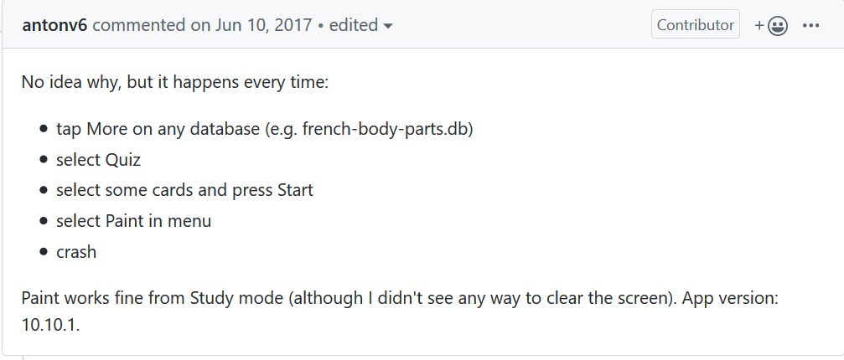
Example
https://github.com/helloworld1/AnyMemo/issues/440

Slide 31
Example - AnyMemo
Video

Slide 32
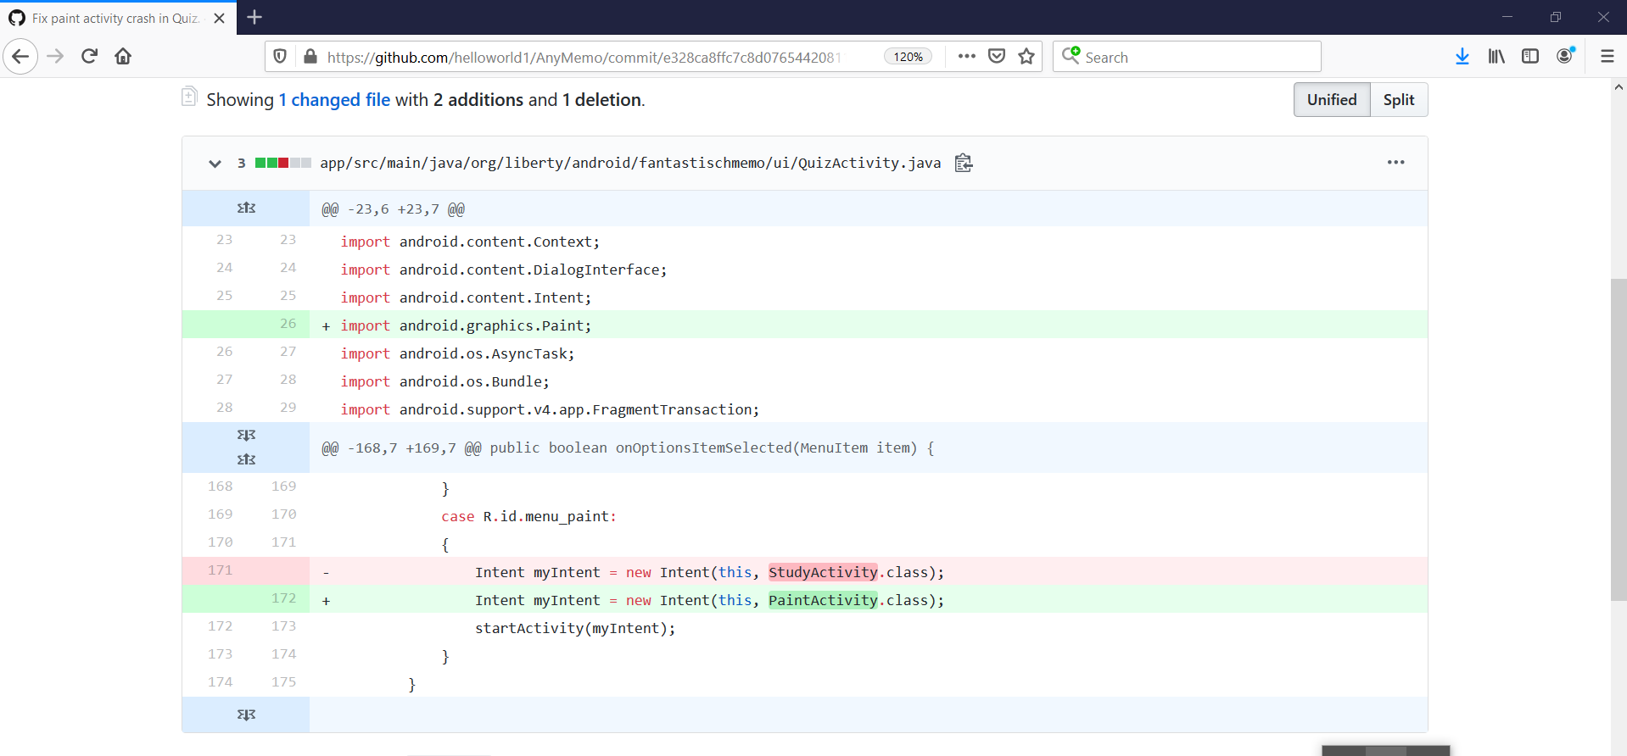

Slide 33
Stack Trace
2020-02-23 23:31:15.843 9231-9247/org.liberty.android.fantastischmemodev E/eglCodecCommon: glUtilsParamSize: unknow param 0x00008cdf
2020-02-23 23:31:15.843 9231-9247/org.liberty.android.fantastischmemodev E/eglCodecCommon: glUtilsParamSize: unknow param 0x00008824
2020-02-23 23:31:27.174 9231-9231/org.liberty.android.fantastischmemodev E/AndroidRuntime: FATAL EXCEPTION: main
Process: org.liberty.android.fantastischmemodev, PID: 9231
java.lang.RuntimeException: Unable to start activity ComponentInfo{org.liberty.android.fantastischmemodev/org.liberty.android.fantastischmemo.ui.StudyActivity}: java.lang.NullPointerException: Attempt to invoke virtual method 'int java.lang.String.compareTo(java.lang.String)' on a null object reference
at android.app.ActivityThread.performLaunchActivity(ActivityThread.java:2665)
at android.app.ActivityThread.handleLaunchActivity(ActivityThread.java:2726)
at android.app.ActivityThread.-wrap12(ActivityThread.java)
at android.app.ActivityThread$H.handleMessage(ActivityThread.java:1477)
at android.os.Handler.dispatchMessage(Handler.java:102)
at android.os.Looper.loop(Looper.java:154)
at android.app.ActivityThread.main(ActivityThread.java:6119)
at java.lang.reflect.Method.invoke(Native Method)
at com.android.internal.os.ZygoteInit$MethodAndArgsCaller.run(ZygoteInit.java:886)
at com.android.internal.os.ZygoteInit.main(ZygoteInit.java:776)
Caused by: java.lang.NullPointerException: Attempt to invoke virtual method 'int java.lang.String.compareTo(java.lang.String)' on a null object reference
at org.liberty.android.fantastischmemo.common.AnyMemoDBOpenHelperManager$1.compare(AnyMemoDBOpenHelperManager.java)
at org.liberty.android.fantastischmemo.common.AnyMemoDBOpenHelperManager$1.compare(AnyMemoDBOpenHelperManager.java)
at java.util.TreeMap.getEntryUsingComparator(TreeMap.java:377)
at java.util.TreeMap.getEntry(TreeMap.java:346)
at java.util.TreeMap.containsKey(TreeMap.java:233)
at java.util.Collections$SynchronizedMap.containsKey(Collections.java:2308)
at org.liberty.android.fantastischmemo.common.AnyMemoDBOpenHelperManager.getHelper(AnyMemoDBOpenHelperManager.java)
at org.liberty.android.fantastischmemo.ui.QACardActivity.startInit(QACardActivity.java)
at org.liberty.android.fantastischmemo.ui.StudyActivity.onCreate(StudyActivity.java)
at android.app.Activity.performCreate(Activity.java:6679)
at android.app.Instrumentation.callActivityOnCreate(Instrumentation.java:1118)
at android.app.ActivityThread.performLaunchActivity(ActivityThread.java:2618)
at android.app.ActivityThread.handleLaunchActivity(ActivityThread.java:2726)
at android.app.ActivityThread.-wrap12(ActivityThread.java)
at android.app.ActivityThread$H.handleMessage(ActivityThread.java:1477)
at android.os.Handler.dispatchMessage(Handler.java:102)
at android.os.Looper.loop(Looper.java:154)
at android.app.ActivityThread.main(ActivityThread.java:6119)
at java.lang.reflect.Method.invoke(Native Method)
at com.android.internal.os.ZygoteInit$MethodAndArgsCaller.run(ZygoteInit.java:886)
at com.android.internal.os.ZygoteInit.main(ZygoteInit.java:776)
QuizActivity.java
public boolean onOptionsItemSelected(MenuItem item) {
case R.id.menu_paint:
{
Intent myIntent = new Intent(this, StudyActivity.class);
startActivity(myIntent);
} }
StudyActivity.java
public boolean onCreate(..) {
return lhs.compareTo(rhs); }

Slide 34
AnyMemo – Reducing SoE by using Event-Based DelD
Minimum failed test case (seq: of events)
AnyMemo
Failure-inducing event
Error/exception
Minimum failed test case (seq: of events) – 51 events*
Maximum successful test case (seq: of events) – 46 events*
Failure-inducing event – 5 events
(QuizActivity.onOptionsItemSelected,…, StudyActivity.onCreate )

Slide 35
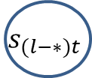

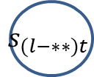

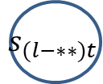
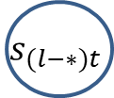





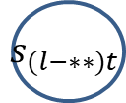
AndroidSlicer Vs FLiAD
AnyMemo–Collecting related statements using Ds and Finding faulty code
onCreate
QuizActivity.java
AMApplication
public boolean onOptionsItemSelected(MenuItem item) {
case R.id.menu_paint:
{
Intent myIntent = new Intent(this, StudyActivity.class);
startActivity(myIntent);
} }
…..
$$s_{(l−∗∗)t}$$
$$s_{(l−∗)t}$$
onCreateOptionsMenu
StudyActivity.java
onLoadFinished
public boolean onCreate(..) {
return lhs.compareTo(rhs); }
$$s_{lt}$$
onPostInit
QuizActivity
onOptionsItemSelected
onOptionsItemSelected
onOptionsItemSelected
$$s_{(l−∗∗)t}$$
$$s_{(l−∗∗)t}$$
$$s_{(l−∗∗)t}$$
$$s_{(l−∗)t}$$
$$s_{(l−∗)t}$$
$$s_{(l−∗)t}$$
onCreate
onCreate
onCreate
StudyActivity
$$s_{lt}$$
$$s_{lt}$$
$$s_{lt}$$
* , ** - any number
Data dependence – blue doted line
Control dependence – solid pink line
(1) Backward Ds
(2) Forward Ds
(3)Intersection (FLiAD)

Slide 36
FLiAD | AndroidSlicer | Stack Trace
Reduced slices including bug location | More slices | Not shown class and function holding bug

Slide 37
FLiAD
Overall Algorithm & Architecture
DelDmin - Algorithm
DelDiso - Algorithm
BWDs - Algorithm
FWDs - Algorithm
Experiment

Slide 38
Overall - Algorithm
1:
2:
3:
4:
5:
6:
7:
8:
9:
10:
11:
12:
Step 1: Generate a seq: of events FSoE which makes program failed
FSoE(E1,E2,E3…,En)
Step 2: Generate a minimum seq: of events ΔFSoE which makes program failed
ΔFSoE(E1,E2,E3…,En-) = DelDmin (FSoE)
Step 3: Compute failure-inducing event/s ΔFiE
ΔFiE = DelDiso (ΔFSoE)
Step 4: Generate backward dynamic slice SLBW
SLBW = SliceBWD (ΔFSoE, CriterionBW)
Step 5: Generate forward dynamic slice SLFW
, SLFW = SliceFWD (ΔFSoE, ΔFiE, CriterionFW)
Step 6: Compute intersection
FCHOP = SLBW ∩ SLFW

Slide 39
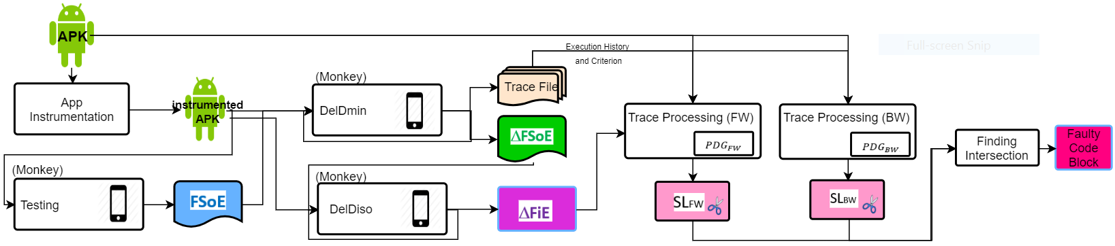
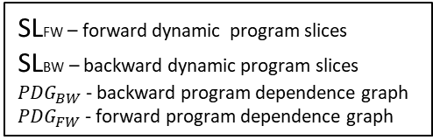
FLiAD - Architecture
Producing Failure-Making SoE
Simplifying Failure-Making SoE and Isolating Failure-Inducing Event
Dynamic Slicing
Calculating Intersection code block
FSoE - Failure-Making sequence of events
DelDmin – Delta Debugging minimum
DelDiso – Delta Debugging isolation
ΔFSoE - Minimum failure-making sequence of events
ΔFiE - Failure-Inducing event
Maximum success-making Sequence of Events
SLFW – forward dynamic program slices
SLBW – backward dynamic program slices
${PDG}_{BW}$ - backward program dependence graph
${PDG}_{FW}$ - forward program dependence graph

Slide 40
Experiment
How much “FLiAD” reduce size of suspicious block compared to other tools (AndroidSlicer,..)?
How much reliable “FLiAD” regarding accuracy?

Slide 41
Q & A

