Slide 1
Fault Localization in Android
Hsu Myat Win

Slide 2
Content
Part 1 : Background - General
What is fault localization (FL)?
Why does FL occur? Why/When is FL important?
Techniques and Approaches of FL
Overall Architecture of Android
Why is FL difficult in Android?
Limitation of existing works
Part 2 : Background – Formal Method
What is Slicing?
Ways of Slicing
Example
Types of Slicing
Divide and Conquer
Dynamic Vs D&C (Conditioned Slicing)
Part 3 : Hsu’s research – Fault Localization in Android (FL in Android)
Problems to be addressed
Ideas to solve Problems
Model
Example 1 – Calculator App (Extra Slices)
Example 2 – SimpleNote App (LifeCycle Awareness)
Example 3 – Activity Diary App (Order Violation)
Example 4– *App (Context Sensitivity)

Slide 3
Part 1 : Background - General
What is fault localization (FL)?
Why does FL occur? Why/When is FL important?
Techniques and Approaches of FL
Overall Architecture of Android
Why is FL difficult in Android?
Limitation of existing works

Slide 4
What is Fault Localization (FL)?
Finding a defect or mistake in the system
Essential in the correction and prevention process in SDLC.
It can be conducted
during the testing stage before system roll-out
monitoring process while system is on-live.
Part 1

Slide 5
Why does FL occur?
It can happen because of
incomplete data, or
misbehaving flow
Why/When is FL important?
Why - Reliability and Quality of system
When - If a system has integrated sub-systems or external applications
Part 1

Slide 6
Techniques/Approaches of FL
Techniques in Java
Methodology
Calculations/ Probability
Approaches in Java
starting from logging detail information and tracking back until the suspicious code line is found
gathering the required information to reach a wrong place. For instance, it is template or model or pattern-based
However, it is controversial to define which method is the best to use because the effectiveness of using the technique depends on the nature of programming language.
Part 1

Slide 7
Overall Architecture of Android
Four Basic Components
Activities : user interface helping to accept and show information to the user
Services : to run long-running operations either background or foreground
Content Providers : to hold data for create, update, delete
Broadcast Receiver : to receive data upon triggering notification event
Part 1

Slide 8
Overall Architecture of Android
CallBacks : to inform a class synchronous / asynchronous if some work in another class is done
Eg; onCreate, onStop and so on.
Part 1

Slide 9
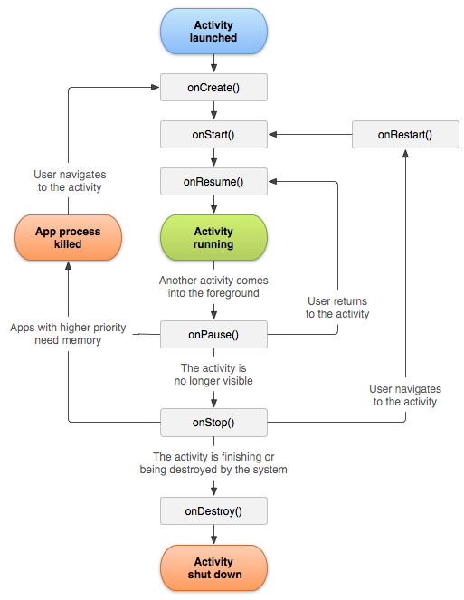
Figure: Activity LifeCycle
Part 1

Slide 10
Overall Architecture of Android
Message Passing among Components
IPC : inter-process communication
RPC : remote procedure calls / invokes methods
Static calls / static fields
IPC
Intent : a messaging object among diff: components
Multiple Entry Points
Concurrent Run
Part 1

Slide 11
Why is FL difficult in Android?
Due to unpredictable IPC/RPC nature and several entry points, it is impossible to get the precise standardized figure to track down with the traditional Java tool.
It is difficult to tell which statement hold exception/error/fault when different components are working together concurrently.
Part 1

Slide 12
Limitation of Existing Work
Paper | Technique | Limitation
RunDroid |  | no information stated about the fault localization process because RunDroid targets to help to improve fault localization
AndroidSlicer | Dynamic Slicing | Extra suspicious spaces / extra slices (Example 1) no checking for lifecyle and no boundary to trace (Example 2) no checking for order violation bcoz of (Example 3) No static tracking and limitation of slicing technique which cannot identify `missing initialisation of variable’ no flow/context sensitive analysis (Example 4) no checking for return parameter
Part 1

Slide 13
Part 2 : Background – Formal Method
What is Slicing?
Ways of Slicing
Example
Types of Slicing
Divide and Conquer
Dynamic Vs D&C (Conditioned Slicing)
“AndroidSicer” Architecture Vs “FL in Android (Hsu)” Architecture

Slide 14
Slicing
A technique to slice a group of program statements in the program
Basic Criteria
a variable “v”
at a point “p”
(eg; v = a+1; )
Other Criteria
an input “i”* such as data, time, test cases and so on.
Useful for testing to debugging to security
Part 2

Slide 15
Ways of Slicing
Forward Slicing – starting from criteria point onwards
(the statements of the program which are affected by the slicing criterion)
Backward Slicing – starting from criteria point backwards
(the statements of the program which can have some effect on the slicing criterion)
Part 2

Slide 16
Example for Slicing
Line1:
Line2:
Line3:
Line4:
Line5:
x = 1;
y = 2;
z = y-2;
r = x;
z = x+y;
Line1:
Line2:
Line5:
x = 1;
y = 2;
z = x+y;
Figure 1: A program fragment to be backward sliced
Figure 2: The backward slice result
Criteria : variable z at point "Line5"
Part 2

Slide 17
Types of Slicing
Static Slicing
Program line/ code for every possible execution pattern
Dynamic Slicing
All run-time effective program lines/code
Multi-Slicing
Parallel Running after decoupling as much as possible
Conditioned Slicing**
Based on condition (eg; “if”)
Similar to “Divide and Conquer”
Useful to reduce Dynamic Slices
Which one is the best?
It is depending on goal/ objective
Can combined more than one types
In my opinion,
Static is for security analysis
Dynamic is for asynchronous nature
Multi-Slicing is to improve performance
Conditioned Slicing is for reducing suspicious space
and give handful amount to handle
Part 2

Slide 18
Divide & Conquer
Three steps
Divide problem into sub-problems
Find the solution / sub-solution
Combine the reasons
Recursion*
Part 2

Slide 19
Dynamic Slicing Vs Conditioned Slicing @ Divide & Conquer
 | if (x || y) |  | if (x && y)
 | Dyn | ConS | Dyn | ConS
x is true y is true | S(x and y) | S(x and y) | S(x and y) | S(x and y)
x is true y is false | S(x and y) | S(x) | S(x and y) | S(y)
x is false y is true | S(x and y) | S(y) | S(x and y) | S(x)
x is false y is false | S(x and y) | S(x and y) | S(x and y) | S(x and y)
S(*) means “Slices of” . Conditioned Slicing cannot handle if use same variable twice (eg; if (x & ((y & z) | !y))) . It might need basic domain knowledge.
Part 2

Slide 20
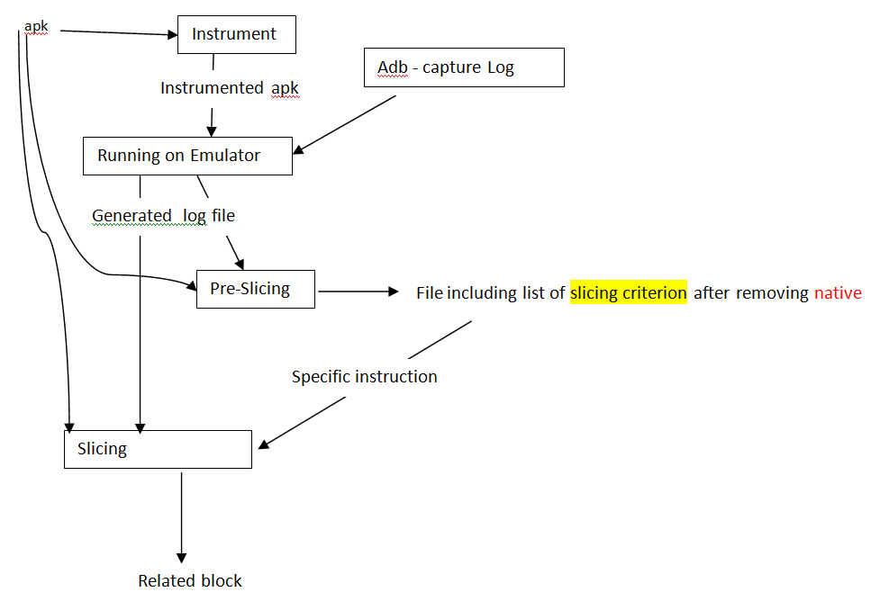
AndroidSlicer - Architecture
Part 2

Slide 21
Enhanced AndroidSlicer @ FL in Android
Slicing
AndroidSlicer | FL in Android (Hsu’s research)
Dynamic Slicing | Conditioned Slicing @ Divide & Conquer
Slicing Criteria time, statement, variable | Slicing Criteria event, statement, variable Variable dependent, statement, variable
Data Dependence Intent Level eg; Intent I = new Intent(); | Data Dependence Extra Level (*) eg; Intent I = new Intent(); I.putExtra(“Var1”,1); I.putExtra(“Var2”,2);
Part 2

Slide 22
Content
Part 3 : Hsu’s research – Fault Localization in Android (FL in Android)
Problems to be addressed
Ideas to solve Problems
Model
Example 1 – Calculator App (Extra Slices)
AndroidSlicer Vs “FL in Android”
Example 2– SimpleNote App (LifeCycle Awareness)
AndroidSlicer Vs “FL in Android”
Example 3– ActivityDiary App (Order Violation)
?
Example 4– * Apps (Context Sensitivity)
AndroidSlicer Vs “FL in Android”

Slide 23
Problems to be Addressed
Manual Fault Localization is time consuming
Prior researches for fault localization have targeted
Each component level
Extra suspicious space
No LifeCycle awareness
Missing of handling ICC related issue (order violation)
No context sensitive
Part 3

Slide 24
Ideas to solve Problems
Problems | Technique | Why?
Manual Fault Localization | Localizing fault will be done automatically | To reduce time
To localize fault | Divide and Conquer (Conditioned Slicing) Divide based on Variable dependent at the point of interest** Events which affect the point of interest** Conquer* | To reduce suspicious space To detect context sensitive To improve accuracy/efficiency
To find ICC error (Future work – maybe) | Comparing Static Vs Dynamic flow using “Happen-Before” (HB) after Multi-Slicing | To check the order violation
**I gonna do static analysis first *before running dynamic
*I gonna use same registered based tracking like AndroidSlicer & ?
Part 3

Slide 25
Model
Div (i , s, v)
“i” – Variable dependent
(at the point of condition branch or at the point of interest)
- input event @ callback
“s” – statement which is point of interest
“v” – variable holding fault value
Part 3

Slide 26
Example 1 : Calculator App (Extra Slices)
Source Code
Video
How working at backend for above video
“AndroidSlicer” Vs “FL in Android”
Based on Variable dependent
Based on Event
Fix
“AndroidSlicer” Vs “FL in Android”
(%) of reducing suspicious space
Part 3

Slide 27
public class MainActivity extends Activity {
protected void onCreate(Bundle savedInstanceState) {
initControlListener();
}
private void onNumberButtonClicked(String pos) {
result = resultTextView.getText().toString();
}
private void onOperatorButtonClicked(String operator) {
tmp = resultTextView.getText().toString();
}
private void onEqualButtonClicked() {
int res = 0;
int number = Integer.valueOf(tmp);
int number2 = Integer.valueOf(result);
switch (operator) {
case "+": res = number + number2; break;
}
result = String.valueOf(res);
}
}
Part 3

Slide 28
Example : Calculator App
Video – scenario (1+2 = 3)
Part 3

Slide 29
Example : Calculator App (scenario – backend work)
Action | Event Triggered | res | result | operand | tmp | number2 | number
Click "1"
onNumberButtonClicked
1
Click "+"
onOperatorButtonClicked
1
+
1
Click "2"
onNumberButtonClicked
2
+
1
Click "="
onEqualButtonClicked
3
3
+
1
2
1
Click "="
onEqualButtonClicked
4
4
+
1
3
1
Point of interest is “res = number + number2; break;”
Variable is “res”
Part 3

Slide 30
“AndroidSlicer” Vs “FL in Android”
AndroidSlicer uses “Dynamic Slicing”
FL uses “D&C based on “Variable dependent”
Point of interest is “res = number + number2; break;”
Variable is “res”

Slide 31
AndroidSlicer
public class MainActivity extends Activity {
protected void onCreate(Bundle savedInstanceState) {
initControlListener();
}
private void onNumberButtonClicked(String pos) {
result = resultTextView.getText().toString();
}
private void onOperatorButtonClicked(String operator) {
tmp = resultTextView.getText().toString();
}
private void onEqualButtonClicked() {
int res = 0;
int number = Integer.valueOf(tmp);
int number2 = Integer.valueOf(result);
switch (operator) {
case "+": res = number + number2; break;
}
result = String.valueOf(res);
}
}
Part 3

Slide 32
FL in Android
Div (i , s, v)
“i” is “Variable dependent”
“s” is Point of interest which is
res = number + number 2;
“v” is “res”
Variable dependent
number
number2
Part 3

Slide 33
FL in Android – based on variable dependent number2
public class MainActivity extends Activity {
protected void onCreate(Bundle savedInstanceState) {
initControlListener();
}
private void onNumberButtonClicked(String pos) {
result = resultTextView.getText().toString();
}
private void onOperatorButtonClicked(String operator) {
tmp = resultTextView.getText().toString();
}
private void onEqualButtonClicked() {
int res = 0;
int number = Integer.valueOf(tmp);
int number2 = Integer.valueOf(result);
switch (operator) {
case "+": res = number + number2; break;
}
result = String.valueOf(res);
}
}
Part 3

Slide 34
FL in Android – based on variable dependent number
public class MainActivity extends Activity {
protected void onCreate(Bundle savedInstanceState) {
initControlListener();
}
private void onNumberButtonClicked(String pos) {
result = resultTextView.getText().toString();
}
private void onOperatorButtonClicked(String operator) {
tmp = resultTextView.getText().toString();
}
private void onEqualButtonClicked() {
int res = 0;
int number = Integer.valueOf(tmp);
int number2 = Integer.valueOf(result);
switch (operator) {
case "+": res = number + number2; break;
}
result = String.valueOf(res);
}
}
Part 3

Slide 35
“AndroidSlicer” Vs “FL in Android”
AndroidSlicer uses “Dynamic Slicing”
FL uses “D&C based on Event”

Slide 36
“AndroidSlicer”
Action | Event Triggered | res | result | operand | tmp | number2 | number
Click "1"
onNumberButtonClicked
1
Click "+"
onOperatorButtonClicked
1
+
1
Click "2"
onNumberButtonClicked
2
+
1
Click "="
onEqualButtonClicked
3
3
+
1
2
1
Click "="
onEqualButtonClicked
4
4
+
1
3
1
Control Dependence – “Sequential” or “Initiated by”
Part 3

Slide 37
FL in Android
Div (i , s, v)
“i” is “Event”
“s” is Point of interest which is
res = number + number 2;
“v” is “res”
Event
onNumberButtonClicked
onOperatorButtonClicked
onEqualButtonClicked
Part 3

Slide 38
“FL in Android based on Event”
FL in Android – for variable dependent number/tmp
Action | Event Triggered | res | result | operand | tmp | number2 | number
Click "+"
onOperatorButtonClicked
1
+
1
Click "="
onEqualButtonClicked
3
3
+
1
2
1
Click "="
onEqualButtonClicked
4
4
+
1
3
1
Part 3

Slide 39
“FL in Android based on Event”
FL in Android – for variable dependent number2/result
Action | Event Triggered | res | result | operand | tmp | number2 | number
Click "1"
onNumberButtonClicked
1
Click "2"
onNumberButtonClicked
2
+
1
Click "="
onEqualButtonClicked
3
3
+
1
2
1
Click "="
onEqualButtonClicked
4
4
+
1
3
1
Part 3

Slide 40
Fix
public class MainActivity extends Activity {
private void onNumberButtonClicked(String pos) {
result = resultTextView.getText().toString();
}
private void onOperatorButtonClicked(String operator) {
tmp = resultTextView.getText().toString();
}
private void onEqualButtonClicked() {
int res = 0;
int number = Integer.valueOf(tmp);
int number2 = Integer.valueOf(result);
switch (operator) {
case "+": res = number + number2; break;
}
result = String.valueOf(res);
}
}
tmp="";//fixed
Part 3

Slide 41
“AndroidSlicer” Vs “FL in Android” (%) reducing suspicious space
Event based (?)
Total no: of Events | Suspicious space @ no: of Events |  | Efficiency (%) Accuracy (%) Performance (%) (?)
 | AndroidSlicer | Event based D&C (FL in Android)
5 | 5 @ 100% | 3 @ 60%
Variable dependent based
Total no: of program lines | No: of variable dependent | Suspicious space @ no: of Lines |  |  | Efficiency (%) Accuracy (%) Performance (%) (?)
 |  | AndroidSlicer | Variable based D&C – tmp (FL in Android) | Variable based D&C – result (FL in Android)
150 | 2 | 9 @ 6% | 7 @ 4.6% | 4 @ 2.6%
Part 3

Slide 42
Example 2: SimpleNote App (LifeCycle Awareness)
Video
Error Log
Backend Log
“AndroidSlicer” Vs “FL in Android”
(%) of reducing suspicious space
Part 3

Slide 43
Example : SimpleNote App
Video
Part 3

Slide 44
Error Log
Caused by: java.lang.NullPointerException: Attempt to read from field 'long com.automattic.simplenote.utils.TagsAdapter$TagMenuItem.id' on a null object reference
at com.automattic.simplenote.NotesActivity.filterListBySelectedTag(NotesActivity.java:414)
at com.automattic.simplenote.NotesActivity.onResume(NotesActivity.java:244)
Part 3

Slide 45
BackEnd Log
Cf Excep In: onCreate
Cf Excep In: set mSelectedTag with default value
Cf Excep In: onResume
Cf Excep In: filterListBySelectedTag
Cf Excep In: onPause
Cf Excep In: onResume
Cf Excep In: filterListBySelectedTag
Cf Excep In: onPause
Cf Excep In: onResume
Cf Excep In: filterListBySelectedTag
Cf Excep In: filterListBySelectedTag
Cf Excep In: ClickingSetting
Cf Excep In: onPause
Cf Excep In: onResume
Cf Excep In: filterListBySelectedTag
Part 3

Slide 46
FL in Android
Div (i , s, v)
“i” is “Event”
“s” is Point of interest which is
Statement holding “NullPointerException”
“v” is “mSelectedTag holding null value”
Part 3

Slide 47
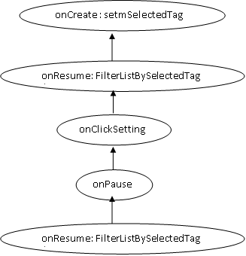
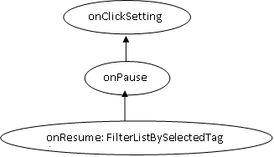
“AndroidSlicer” Vs “FL in Android”
AndroidSlicer
FL in Android
Lifecycle awareness
Part 3

Slide 48
“AndroidSlicer” Vs “FL in Android” (%) of reducing suspicious space
Event based
Total no: of Events | Suspicious space @ no: of Events |  | Efficiency (%) Accuracy (%) Performance (%) (?)
 | AndroidSlicer | Event based D&C (FL in Android)
5 | 5 @ 100% | 3 @ 60%
Part 3

Slide 49
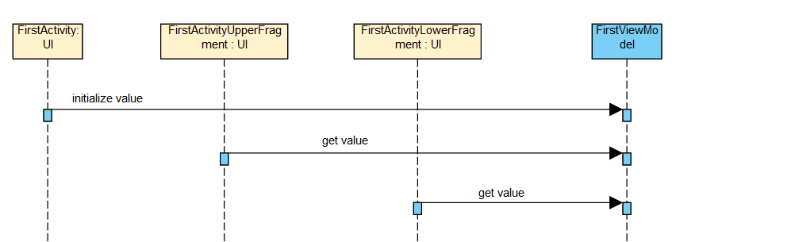
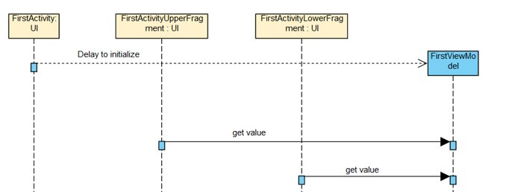
Example 3 – ActivityDiary App (Order Violation)
Normal Flow
Violation Flow
Part 3

Slide 50
Example 4 - *App (Context Sensitivity)
Source Code
Part 3

Slide 51
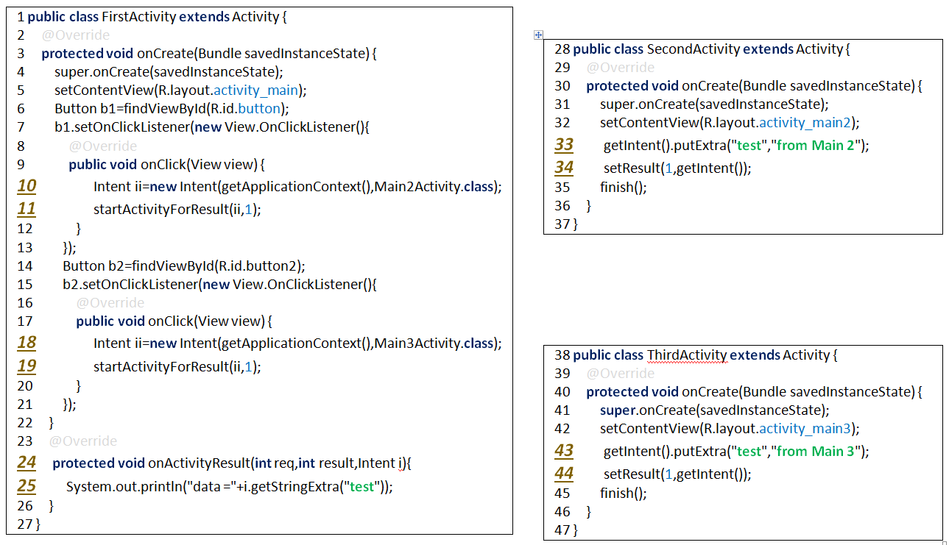


N₀
N₁
1a
N_{0a}
2
N_{0b}
1b
N₂
2
N₃
Part 2

Slide 52
Q & A

