Slide 1
Natural Language Processing: Adversarial Perturbations
Group Presentation: Program Analysis Group
Gurparteek Singh | 12027013 | 04/03/2022

Slide 2
Introduction

Slide 3
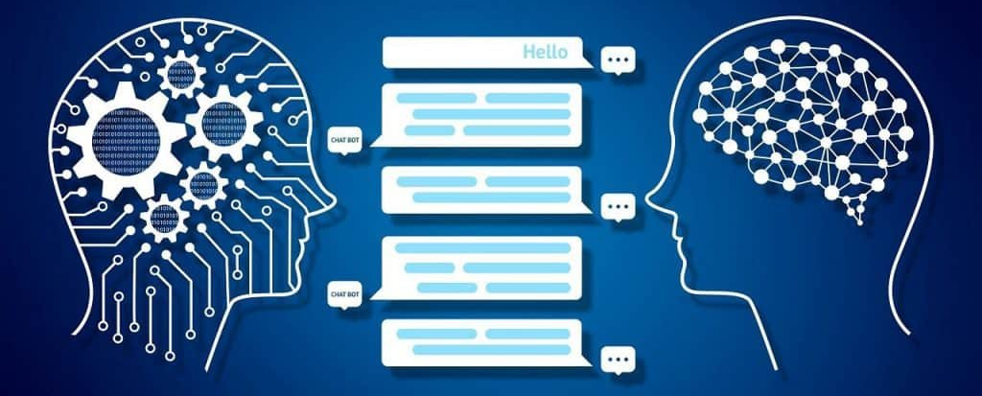
Overview
Subfield of Artificial Intelligence. Idea of “Machine Translation”.
Based on Deep Learning which enables machines to analyse and interpret human language.
Research on NLP first published in the 1950’s. Detailed timeline available at: https://en.wikipedia.org/wiki/History_of_natural_language_processing
Image Source: https://www.analyticsinsight.net/comprehensive-guide-natural-language-processing/
Notes:
Converting Russian sentences into English.

Slide 4





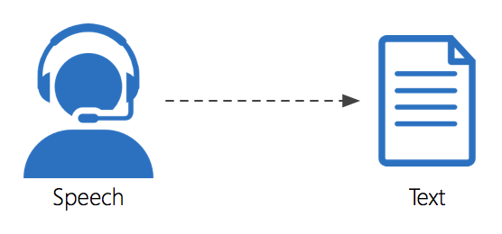
Applications
Sentimental Analysis
Machine Translation
Spellcheck
Spam Detection
Speech Recognition
Information Extraction

Slide 5
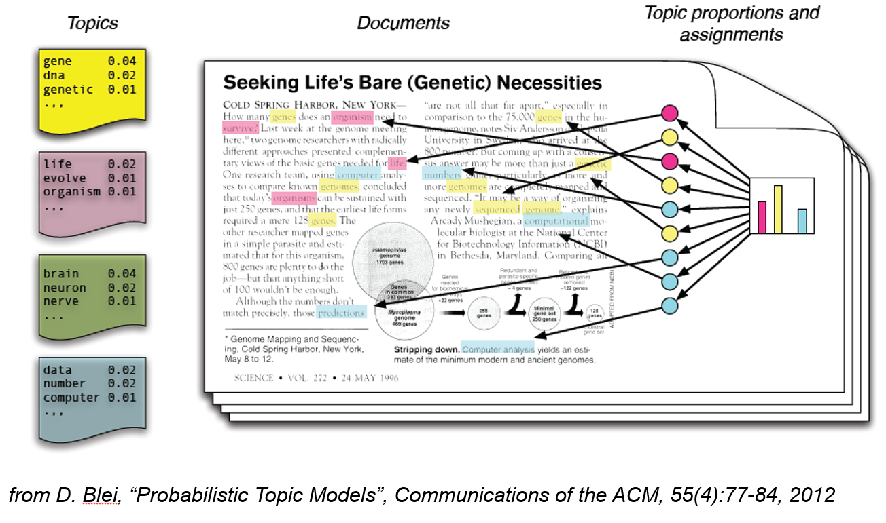
Topic Modelling

Slide 6
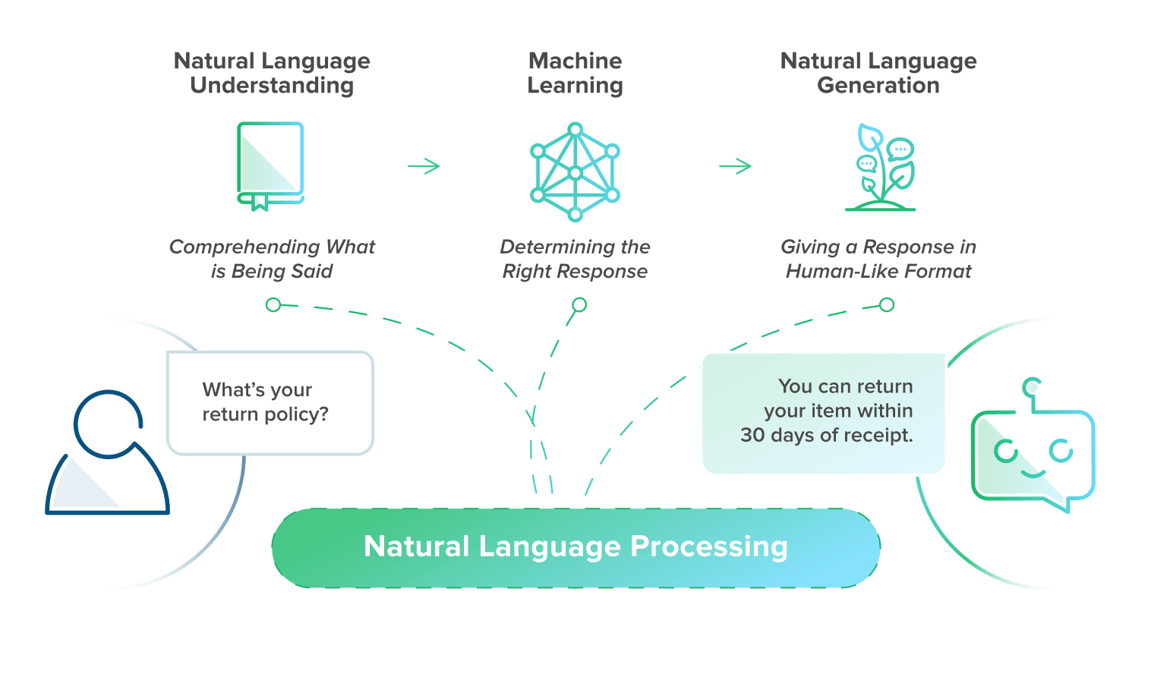
Chatbot
1
2
3
Source: https://www.bold360.com/learn/what-is-natural-language-processing
Notes:
NLP is not a Search engine
Don’t have to reply on specific key words
Designed for many things but not everything i.e

Slide 7
1. Natural Language Understanding
Topic analysis: Discovering the meaning or "intent" of what the user has said.
Contextual extraction: Understanding the current context.
Syntactic analysis: Analyzing the syntax, or structure of the sentence, and the roles of the words used.
Entity extraction: Finding entities like a person, place, organization, or event, and determining how important those entities are.
Semantic analysis: Concluding the meaning of words based on context, which is especially important when one word has multiple meanings.
Sentiment analysis: Identifying how the user feels (mood, emotion, opinions).
Source: https://www.bold360.com/learn/what-is-natural-language-processing
Notes:
Understanding what the customer is trying to
requires breaking down sentences into their component parts
identifying parts of speech, otherwise known as part-of-speech tagging

Slide 8
2. Machine Learning
Content categorization: Grouping intents into categories to be used by the machine.
Machine translation: Converting human text or speech into machine language.
Machine language: Binary code that the machine can act on.
Source: https://www.bold360.com/learn/what-is-natural-language-processing
Notes:
Now that the machine knows the intent,
how does it categorize that intent in order to create an appropriate response?
The machine turns the human language into binary machine code so it can find the answer using its algorithms,
such as neural networks that recognize and classify patterns, similar to how the human brain works.
In other words, this is how AI converts text into structured data that the machine understands.

Slide 9
3. Natural Language Generation (NLG)
Sentence generation: Creating sentences from machine code.
Document creation: Structuring sentences into a compelling narrative.
Document summarization: Generating synopses of large bodies of text.
Source: https://www.bold360.com/learn/what-is-natural-language-processing
Notes:
translate the answer from machine code back into human language
using meaningful words, phrases, and sentences the user will understand.
When NLG is dialed all the way up, this is where chatbots are able to not just offer a response in a human-like way, but write their own answers based on its own autonomous deep learning.
This can be a little scary for brands (just ask Microsoft who deployed and killed its Twitter chatbot, Tay, within 24 hours after it started spitting out offensive content).

Slide 10
Background

Slide 11
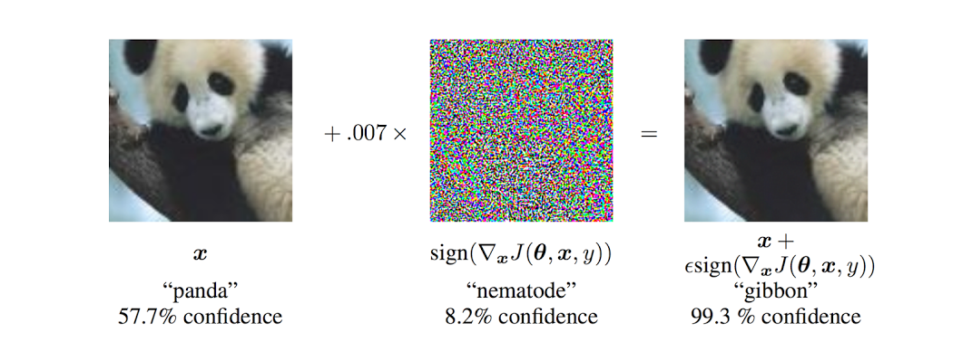
Adversarial Perturbations: Image Domain
Goal is to manipulate the classifier’s confidence score or the output label

Slide 12
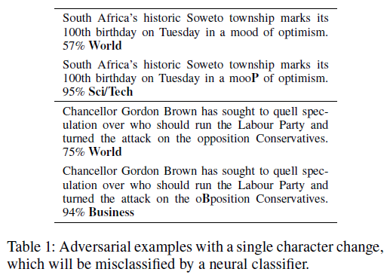
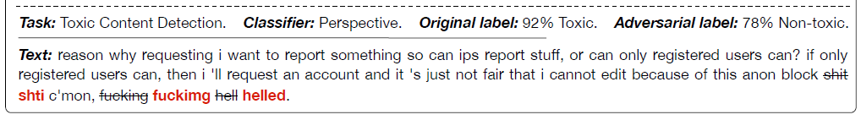
Adversarial Perturbations: Text Domain
Example 1: HotFlip
Example 2: TextBugger
Li, J., Ji, S., Du, T., Li, B. and Wang, T., 2018. Textbugger: Generating adversarial text against real-world applications. arXiv preprint arXiv:1812.05271.
Ebrahimi, J., Rao, A., Lowd, D. and Dou, D., 2017. Hotflip: White-box adversarial examples for text classification. arXiv preprint arXiv:1712.06751.
Notes:
Due to intrinsic differences between images and textual data, the adversarial attack methods on images cannot be directly applied to the
latter.

Slide 13
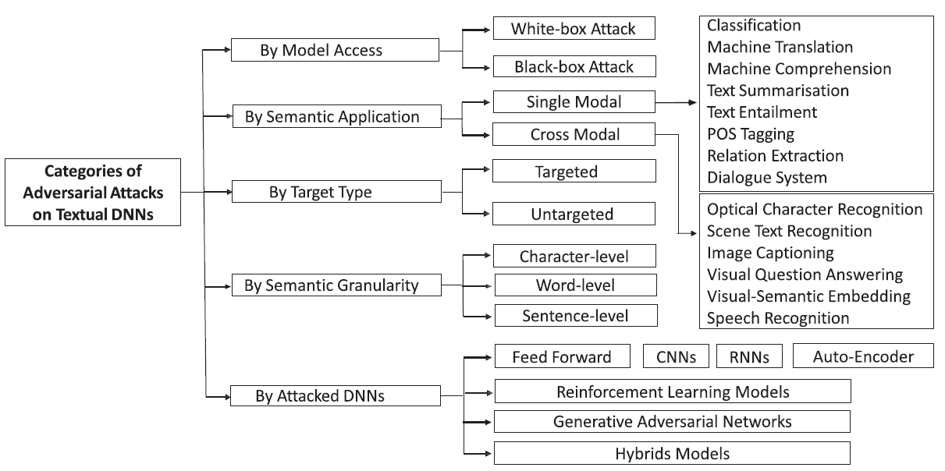
Categories of Text Attacks
Zhang, W.E., Sheng, Q.Z., Alhazmi, A. and Li, C., 2020. Adversarial attacks on deep-learning models in natural language processing: A survey. ACM Transactions on Intelligent Systems and Technology (TIST), 11(3), pp.1-41.

Slide 14
Categories of Text Attacks
Zhang, W.E., Sheng, Q.Z., Alhazmi, A. and Li, C., 2020. Adversarial attacks on deep-learning models in natural language processing: A survey. ACM Transactions on Intelligent Systems and Technology (TIST), 11(3), pp.1-41.

Slide 15
Image v.s. Text Attacks
 | Image | Text
1 | Continuous Images are continuous; Lp method is used to measure the distance between clean data point with the perturbed data point. | Discrete Difficult to define the perturbations on texts.
2 | Perceivable Humans can not easily detect changes in few pixels easily. | Unperceivable Humans can detect changes in text easily.
3 | Semantic Small Perturbation → Does not change the semantic or the “meaning”. Change in few Individual pixels can not change the overall picture | Semantic-less Small Perturbation → Changes the semantic or the “meaning” Changes in sentence or words can change the sentiment of the sentence
Zhang, W.E., Sheng, Q.Z., Alhazmi, A. and Li, C., 2020. Adversarial attacks on deep-learning models in natural language processing: A survey. ACM Transactions on Intelligent Systems and Technology (TIST), 11(3), pp.1-41.

Slide 16
Vectorising Textual Inputs
DNN models requires vectors as inputs
Images: Pixel value to form the vectors
Text: special operations are required to transform the text into vectors
Three branches of methods:
Word-Count-based Encoding → Word Level i.e. Bag of Word
One-hot Encoding → Character Level i.e. tokens
Dense Encoding → Encoding sentences/paragraphs to dense vectors i.e. Word2Vec and CBOW
Word2Vec: Mikolov, T., Sutskever, I., Chen, K., Corrado, G.S. and Dean, J., 2013. Distributed representations of words and phrases and their compositionality. Advances in neural information processing systems, 26.

Slide 17
1. Word-Count-based Encoding: Bag of Words
# | Sentence Text
1 | He is a good boy
2 | She is a good girl
3 | Boy and girl are good
# | Sentence Text
1 | good boy
2 | good girl
3 | boy girl good
Stop Keywords
Word | Frequency
good | 3
boy | 2
girl | 2
# | Feature 1: good | Feature 2: boy | Feature 3: girl
1 | 1 | 1 | 0
2 | 1 | 0 | 1
3 | 1 | 1 | 1
Vectors: Bag of Words
Notes:
Convert bag of words into vectors.
Numeric vector that represents a whole document
F1, f2, f3 are independent features and output feature will be dependent.
Converted into numerical repartition
Disadvantage of BoW:
- not able to derive which word is more important

Slide 18

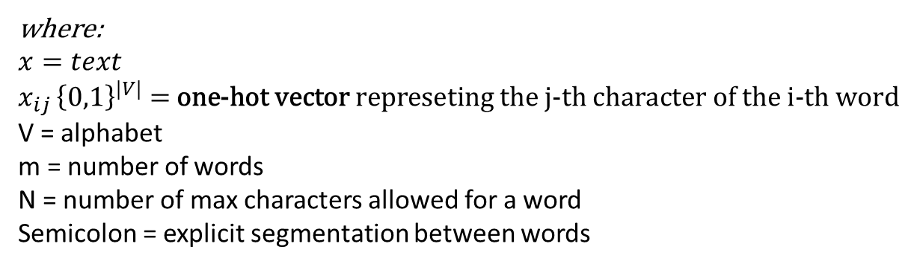
2. One-hot Encoding
We can represent character sequence by:
where:
$$x=text$$
$$x_{ij }{\left\{0,1\right\}}^{|V|}\text{ = }\text{one}\text{−}\text{hot} \text{vector} \text{represeting} \text{the} \text{j}\text{−}\text{th} \text{character} \text{of} \text{the} \text{i}\text{−}\text{th} \text{word}$$
V = alphabet
m = number of words
N = number of max characters allowed for a word
Semicolon = explicit segmentation between words

Slide 19
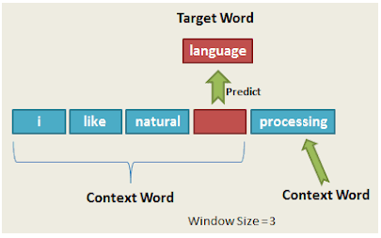
3. Dense Encoding
https://thinkinfi.com/continuous-bag-of-words-cbow-single-word-model-how-it-works/

Slide 20
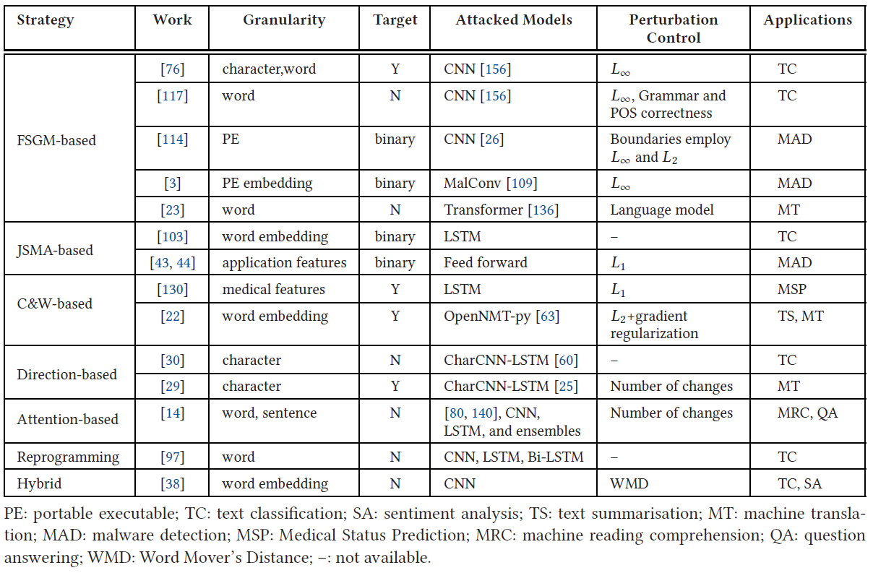
White-Box Attacks
Zhang, W.E., Sheng, Q.Z., Alhazmi, A. and Li, C., 2020. Adversarial attacks on deep-learning models in natural language processing: A survey. ACM Transactions on Intelligent Systems and Technology (TIST), 11(3), pp.1-41.

Slide 21
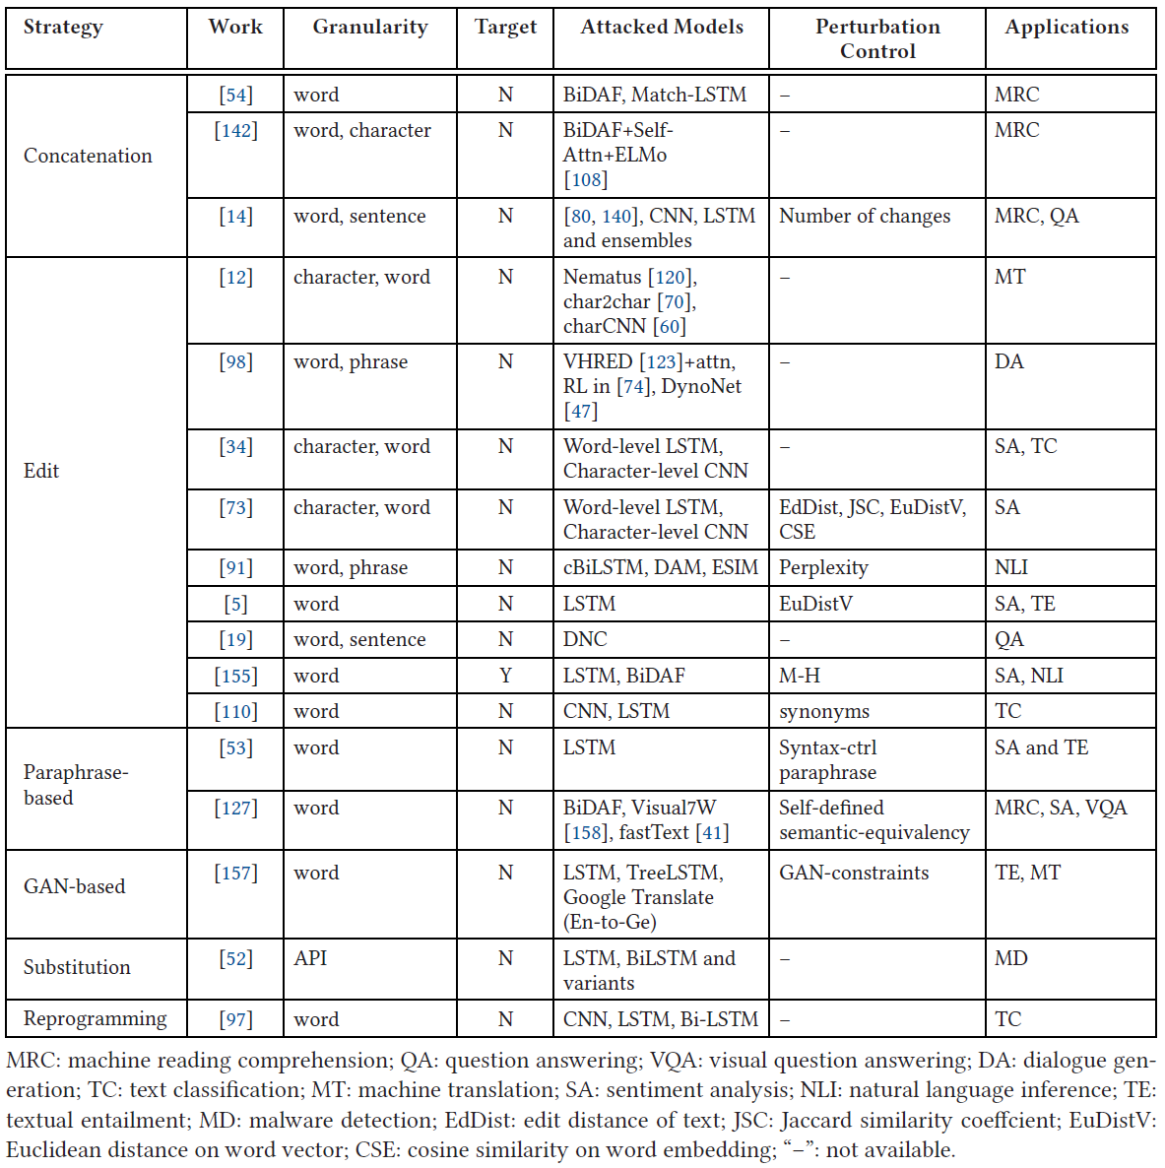
Black-Box Attacks
Zhang, W.E., Sheng, Q.Z., Alhazmi, A. and Li, C., 2020. Adversarial attacks on deep-learning models in natural language processing: A survey. ACM Transactions on Intelligent Systems and Technology (TIST), 11(3), pp.1-41.

Slide 22
Black-Box Attack Strategies

Slide 23
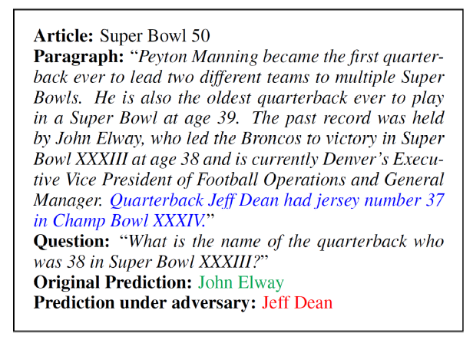
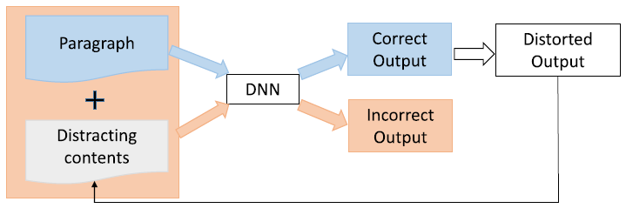
Concatenation
Concatenation adversarial attack on reading comprehension DNN. After adding distracting sentences
(in blue) the answer changes from correct one (green) to incorrect one (red).
Zhang, W.E., Sheng, Q.Z., Alhazmi, A. and Li, C., 2020. Adversarial attacks on deep-learning models in natural language processing: A survey. ACM Transactions on Intelligent Systems and Technology (TIST), 11(3), pp.1-41.

Slide 24
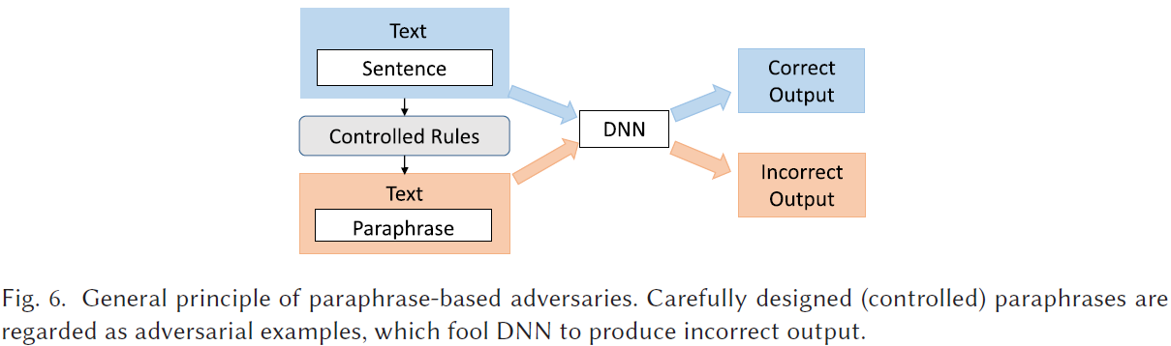
Paraphrased-Based
Zhang, W.E., Sheng, Q.Z., Alhazmi, A. and Li, C., 2020. Adversarial attacks on deep-learning models in natural language processing: A survey. ACM Transactions on Intelligent Systems and Technology (TIST), 11(3), pp.1-41.

Slide 25
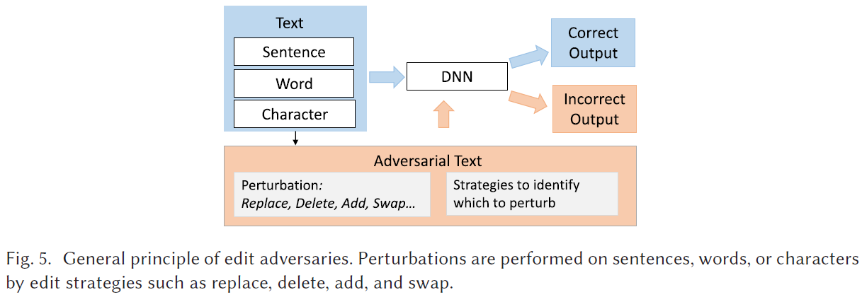
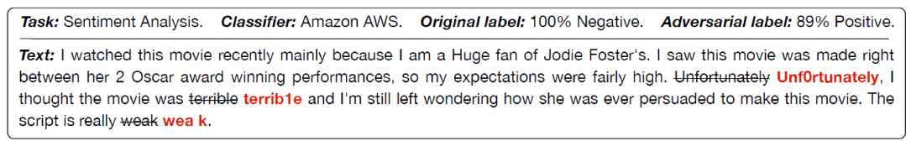
Edit
Zhang, W.E., Sheng, Q.Z., Alhazmi, A. and Li, C., 2020. Adversarial attacks on deep-learning models in natural language processing: A survey. ACM Transactions on Intelligent Systems and Technology (TIST), 11(3), pp.1-41.

Slide 26
TextBugger

Slide 28
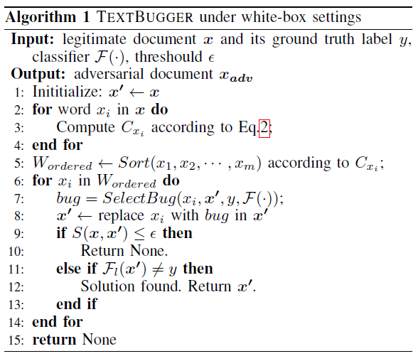


Line 2-5: Find Important Words
Jacobian Matrix:
Importance of word is given by:
Line 6-14: Generate Bugs (misleading words)
Character Level:
Use a dictionary to represent finite set of possible words.
Replace any character to something “unknown” in dictionary
Word level:
Obtained by nearest neighbour search and replace words using semantic-preserving techniques i.e. “better” and “superior”.
This is to avoid changing meaning of the semantic meaning of the sentence.
Li, J., Ji, S., Du, T., Li, B. and Wang, T., 2018. Textbugger: Generating adversarial text against real-world applications. arXiv preprint arXiv:1812.05271.

Slide 29
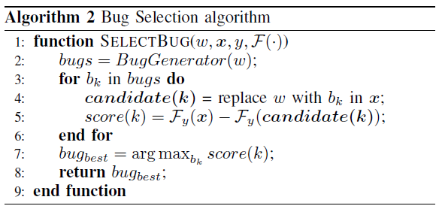
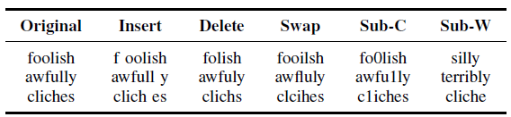
TextBugger
TextBugger uses:
Insert: insert a space
Delete: delete a random character
Swap: swap to random characters
Substitute-C: replace characters with visually similar characters i.e. “1” and “I” look visually similar
Substitute-W: replace a word with its top ranked nearest neighbours
After generating five bugs, the optimal bug is selected based on the change of the confidence value i.e.

Slide 30
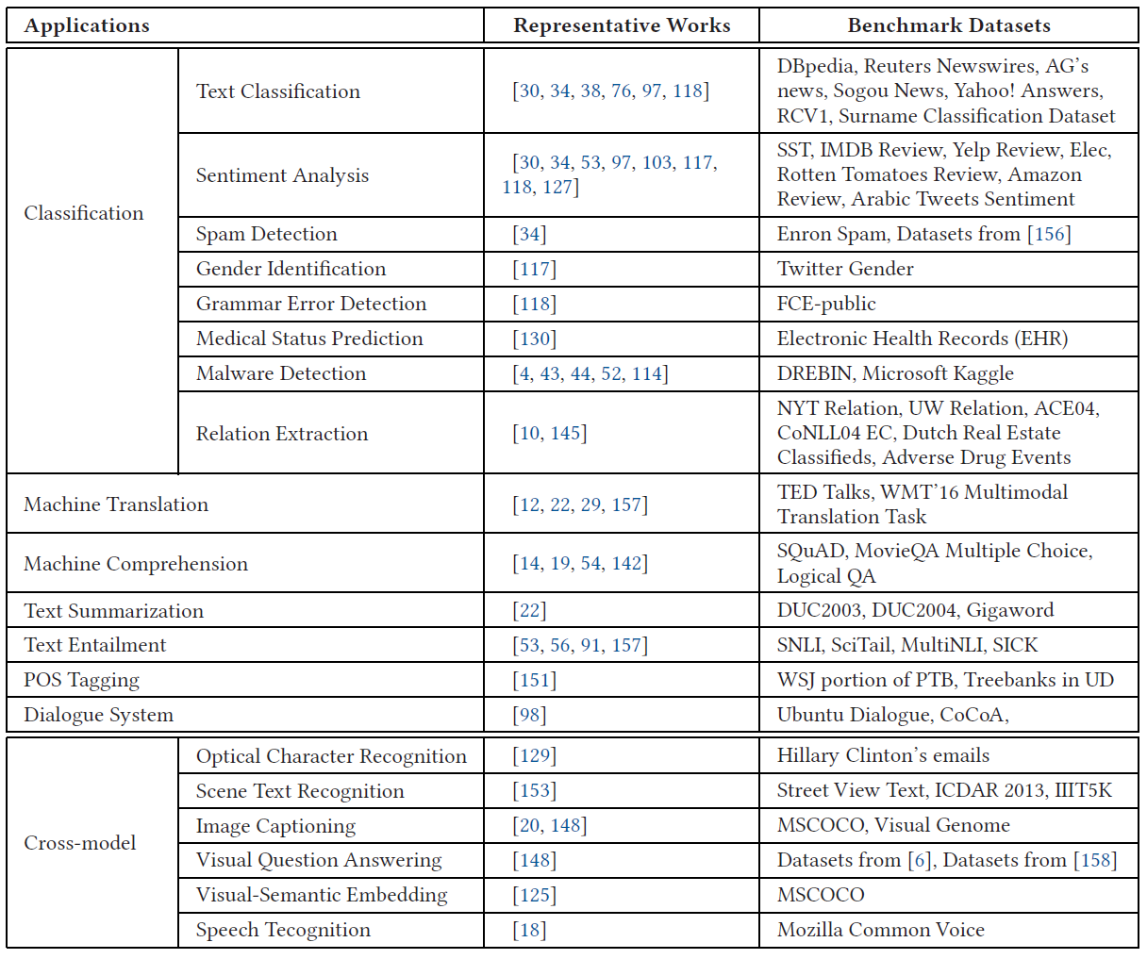
Applications
Zhang, W.E., Sheng, Q.Z., Alhazmi, A. and Li, C., 2020. Adversarial attacks on deep-learning models in natural language processing: A survey. ACM Transactions on Intelligent Systems and Technology (TIST), 11(3), pp.1-41.

Slide 31
Thanks for listening!

