Slide 1
How User Interface affects the test generation for Android Apps?
Hsu Myat Win
Notes:
https://conf.researchr.org/program/issta-2021/program-issta-2021/
Lifecycle related issue
https://conf.researchr.org/track/icse-2021/icse-2021-papers?#program
selenium
https://www.softwaretestinghelp.com/behavior-driven-development-bdd-tools/
https://medium.com/gumtree-dev-team/android-bdd-with-cucumber-and-espresso-the-full-guide-9c20cfcb8535

Slide 2
Content
Introduction
Software testing
Android mobile testing – Why difficult
Literature Review and Existing Efforts
Limitation of Existing works
Motivating Example

Slide 3
Introduction - Software testing
To identify any errors, gaps or missing requirement versus the actual requirement.
Introduction - Mobile testing
To ensure the quality of Android applications
To increase the satisfaction of end-users

Slide 4
Introduction - Android Mobile testing - Why difficult?
87% of smart phone market share (as of 2016) and different GUI
Non-deterministic execution environments
A sequence of events (a test) may lead to success or failure in unpredictable ways

Slide 5
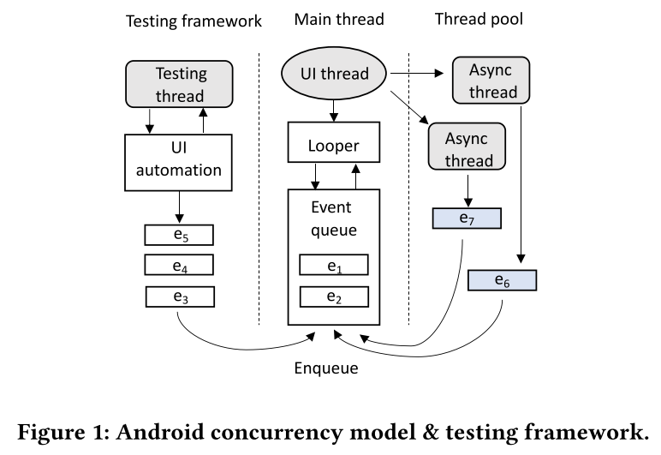
Intro - Android Mobile testing - Why difficult?
𝑒1, 𝑒2,.. are events.
Events are a useful way to collect data about a user's interaction with interactive components of Applications.
Main thread (UI Thread) : maintains an event queue and a looper associated with the event queue.
Event queue: adds UI or system events that are generated by users or the system
Looper : dequeues events in a sequential order and dispatches them to corresponding handlers for processing. (FIFO)
Aysnc thread: prevent non-responsive threads from blocking the GUI, long-running tasks such as network access are offloaded to async threads. Once these tasks are finished, async threads post an event marked in blue in Figure 1 to the main thread, which updates results to GUI objects.
Testing thread: A GUI test often runs in a separated thread maintained by a testing framework such as Espresso.
Notes:
Activities : An activity represents a single screen with a user interface just like window or frame of Java.Android activity is the subclass of ContextThemeWrapper class.
A service is a component that runs in the background to perform long-running operations without needing to interact with the user and it works even if application is destroyed. A service can essentially take two states −
A content provider component supplies data from one application to others on request. Such requests are handled by the methods of the ContentResolver class. A content provider can use different ways to store its data and the data can be stored in a database, in files, or even over a network.
Broadcast Receivers simply respond to broadcast messages from other applications or from the system itself. These messages are sometime called events or intents. For example, applications can also initiate broadcasts to let other applications know that some data has been downloaded to the device and is available for them to use, so this is broadcast receiver who will intercept this communication and will initiate appropriate action.
The looper is responsible for keeping the thread alive. It is a kind of worker that serves a MessageQueue for the current thread. The looper dequeues events in a sequential order and dispatches them to corresponding handlers for processing. Android adopts the single-UI-thread model where only the main thread can access the GUI objects.
Figure 1 depicts the Android hybrid event-driven concurrency model as well as the Android GUI testing framework. Every app has a main thread (also called UIthread), which maintains an event queue and a looper associated with the event queue. UI or system events that are generated by users or the system are added into the event queue. The looper dequeues events in a sequential order and dispatches them to corresponding handlers for processing. Android adopts the single-UI-thread model where only the main thread can access the GUI objects. To prevent non-responsive threads from blocking the GUI, long-running tasks such as network access are offloaded to async threads. Once these tasks are finished, async threads post an event marked in blue in Figure 1 to the main thread, which updates results to GUI objects. However, this concurrency model can lead to event racing. As shown in Figure 1, the main thread and async threads run concurrently. When an async thread finishes a task and posts an async event is nondeterministic, depending on the current execution environment. Consequently, the order of events processed by the main thread is non-deterministic as well. In the example shown in Figure 1, there are multiple possible orders which might occur in the execution such as <𝑒1, 𝑒2, 𝑒6, 𝑒3, 𝑒4, 𝑒5, 𝑒7> and <𝑒1, 𝑒2, 𝑒3, 𝑒4, 𝑒5, 𝑒6, 𝑒7>.
A GUI test often runs in a separated thread maintained by a testing framework such as Espresso.
Android provides testing frameworks for developers to write GUI tests, which simulate user interactions to exercise app functionalities. GUI tests run on physical devices or emulators and interact with UI interface to generate events. To achieve more reliable tests, testing frameworks provide a set of mechanisms to synchronize test automation interactions with the user interface. For instance, when method onView() is invoked in a test, Espresso waits to perform the corresponding UI action or assertion until the event queue is empty and some async threads (e.g., AsyncTask instance) are terminated and user-defined resources are idling.
The difference between GUI and CLI is that the GUI allows the user to interact with the system using graphical elements such as windows, icons, menus while the CLI allows the user to interact with the system using commands.

Slide 6
Literature Review
Search-based [6] [7]
Evolution / Genetic Algorithm (inserting mutant) (eg; < , > )
Random [1] [2][3]
Apps are exercised by injecting arbitrary or contextual events. (such as clicks, touches, or gestures, as well as a number of system-level events.)
Monkey [3] is Google’s official testing tool for Android apps.
Model-based[4][5]
App event sequences are generated according to models which are manually constructed, or extracted from project artefacts such as source code, XML configuration files and UI runtime state.
Notes:
Model-based : predefined

Slide 7
Literature Review (contd.)
Learning-based
machine learning to learn a model of the user interface, and uses this model to discover unexplored states.
Program analysis-based
Notes:
One possible approach is to generate a single, very long sequence of events in a random fashion [1].
[1] 2018. Monkey. (2018). https://developer.android.com/studio/test/monkey
[2] Shauvik Roy Choudhary, Alessandra Gorla, and Alessandro Orso. 2015. Automated Test Input Generation for Android: Are We There Yet? (E). In Proceedings ofthe 2015 30th IEEE/ACM International Conference on Automated Software Engineering (ASE) (ASE ’15). 429–440. https://doi.org/10.1109/ASE.2015.89
[3] Aravind Machiry, Rohan Tahiliani, and Mayur Naik. 2013. Dynodroid: An Input Generation System for Android Apps. In Proceedings ofthe 2013 9th Joint Meeting on Foundations ofSoftware Engineering (ESEC/FSE 2013). 224–234.
[4] Tianxiao Gu, Chengnian Sun, Xiaoxing Ma, Chun Cao, Chang Xu, Yuan Yao, Qirun Zhang, Jian Lu, and Zhendong Su. 2019. Practical GUI testing of Android applications via model abstraction and refinement. In Proceedings ofthe 41stInternational Conference on Software Engineering, ICSE 2019, Montreal, QC, Canada, May 25-31, 2019. IEEE / ACM, 269–280. https://doi.org/10.1109/ICSE.2019.00042
[5] Ting Su, Guozhu Meng, Yuting Chen, KeWu,Weiming Yang, Yao Yao, Geguang Pu, Yang Liu, and Zhendong Su. 2017. Guided, Stochastic Model-based GUI Testing of Android Apps. In Proceedings ofthe 2017 11th Joint Meeting on Foundations of Software Engineering (ESEC/FSE 2017). ACM, New York, NY, USA, 245–256.

Slide 8
Limitation of Existing Works
No testing approach by analysing User Interface for Android apps
Android User Interface
Android - UI Layouts (eg; Linear Layout)
Android - UI Controls (eg; Button)
…

Slide 9
Motivation
The probability of triggering the crash that requires specific ordering events sequence is inversely proportioned to the simplicity of the GUI structure
with many buttons in a single GUI screen, the probability of triggering the crash that requires specific ordering of event sequence is low.
Notes:
Difficult to get the event sequence to cause the app to crash
It only means that with many buttons in a single GUI screen, the probability of triggering the crash that requires specific ordering of event sequence is low.

Slide 10
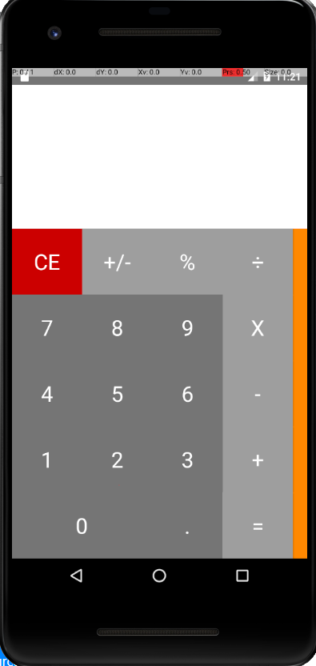
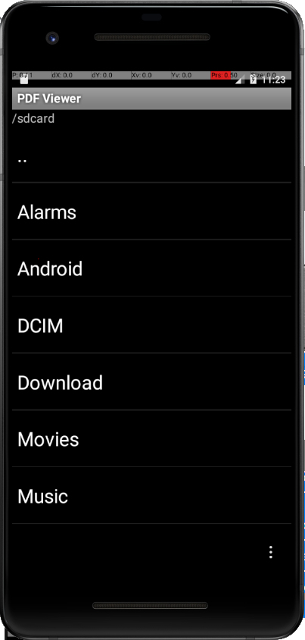

Calculator App : 18 buttons occupying almost one-third of the whole screen
APV PDF Viewer : seven items in ListView
Apps | Original event sequence | Failure-inducing event sequence | (%)
APV PDF Viewer | 2 | 1 | 50
Calculator | 59 | 1 | 98

Slide 11
Reference
[1] 2018. Monkey. (2018). https://developer.android.com/studio/test/monkey
[2] Shauvik Roy Choudhary, Alessandra Gorla, and Alessandro Orso. 2015. Automated Test Input Generation for Android: Are We There Yet? (E). In Proceedings ofthe 2015 30th IEEE/ACM International Conference on Automated Software Engineering (ASE) (ASE ’15). 429–440. https://doi.org/10.1109/ASE.2015.89
[3] Aravind Machiry, Rohan Tahiliani, and Mayur Naik. 2013. Dynodroid: An Input Generation System for Android Apps. In Proceedings ofthe 2013 9th Joint Meeting on Foundations ofSoftware Engineering (ESEC/FSE 2013). 224–234.
[4] Tianxiao Gu, Chengnian Sun, Xiaoxing Ma, Chun Cao, Chang Xu, Yuan Yao, Qirun Zhang, Jian Lu, and Zhendong Su. 2019. Practical GUI testing of Android applications via model abstraction and refinement. In Proceedings ofthe 41stInternational Conference on Software Engineering, ICSE 2019, Montreal, QC, Canada, May 25-31, 2019. IEEE / ACM, 269–280. https://doi.org/10.1109/ICSE.2019.00042
[5] Ting Su, Guozhu Meng, Yuting Chen, KeWu,Weiming Yang, Yao Yao, Geguang Pu, Yang Liu, and Zhendong Su. 2017. Guided, Stochastic Model-based GUI Testing of Android Apps. In Proceedings ofthe 2017 11th Joint Meeting on Foundations of Software Engineering (ESEC/FSE 2017). ACM, New York, NY, USA, 245–256.
[6] Riyadh Mahmood, Nariman Mirzaei, and Sam Malek. 2014. EvoDroid: Segmented Evolutionary Testing of Android Apps. In Proceedings ofthe 22Nd ACMSIGSOFT International Symposium on Foundations ofSoftware Engineering (FSE 2014). 599– 609.
[7] Ke Mao, Mark Harman, and Yue Jia. 2016. Sapienz: Multi-objective Automated Testing for Android Applications. In Proceedings ofthe 25th International Symposium on Software Testing and Analysis (ISSTA 2016). ACM, New York, NY, USA, 94–105.

Slide 12
Thank you

