Slide 1
CFL Reachability on SVF & C++ Field Sensitive Alias Analysis Client
Pei Xu
Supervised By Yulei Sui
Program Analysis Group
University of Technology Sydney (UTS)
1 July

Slide 2
Reference
Reps. (1998). Program analysis via graph reachability. Information and Software Technology, 40(11), 701–726. https://doi.org/10.1016/S0950-5849(98)00093-7
YUXIANG LEI, YULEI SUI, SHUO DING, and QIRUN ZHANG Taming Transitive Redundancy for Context-Free Language Reachability
Zheng, & Rugina, R. (2008). Demand-driven alias analysis for C. Conference Record of the Annual ACM Symposium on Principles of Programming Languages, 197–208. https://doi.org/10.1145/1328438.1328464
Sui, & Xue, J. (2016). SVF: interprocedural static value-flow analysis in LLVM. Proceedings of CC 2016: The 25th International Conference on Compiler Construction, 265–266. https://doi.org/10.1145/2892208.2892235

Slide 3
CFL Reachability Framework
CFL Reachability is a fundamental framework in Static Analysis.
By a set of production rules:
A -> b c
When there are paths contains “b” label and “c” label edge, a additional edge labelled “A” where be added to the graph.

Slide 4
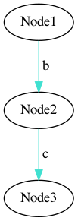
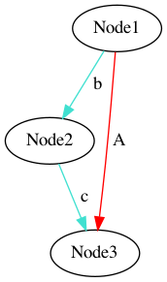
Edge Derivation Example:
A -> b c

Slide 5
Formal Definition:
A CFL-reachability instance:
Reach⟨CFG, 𝐺⟩
Context Free Grammar:
CFG = ⟨Σ , 𝑁 , 𝑃, 𝑆⟩ ( Σ = 𝑁 ∪ 𝑇 )
Edge labeled graph:
𝐺 = ⟨𝑉 , 𝐸⟩. Initially, 𝐺 contains only edges labeled by terminals.

Slide 6
Solver:
Input
Output
Graph
Solver
Solved
Graph
CFG

Slide 7
Standard CFL Solver (Grammar Normalization):
CFG
Normalizer
BNF
CFG
Binary Normal Formal:
1.A -> X0
1.X0 -> ε | X0 c
2.A -> X1
2.X1 -> ε | d
3.A -> b X2
3.X -> c d
Extended Backus–Naur form (EBNF):
1.A -> c *
2.A -> d ?
3.A -> b c d
…
4. A -> ( e f d) *
Introduce temporary production:
1.X0 -> ε | X0 c
2.X1 -> ε | d
3.X2-> c d
* The form of grammar will affect the efficiency of solving

Slide 8
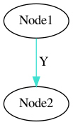
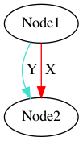
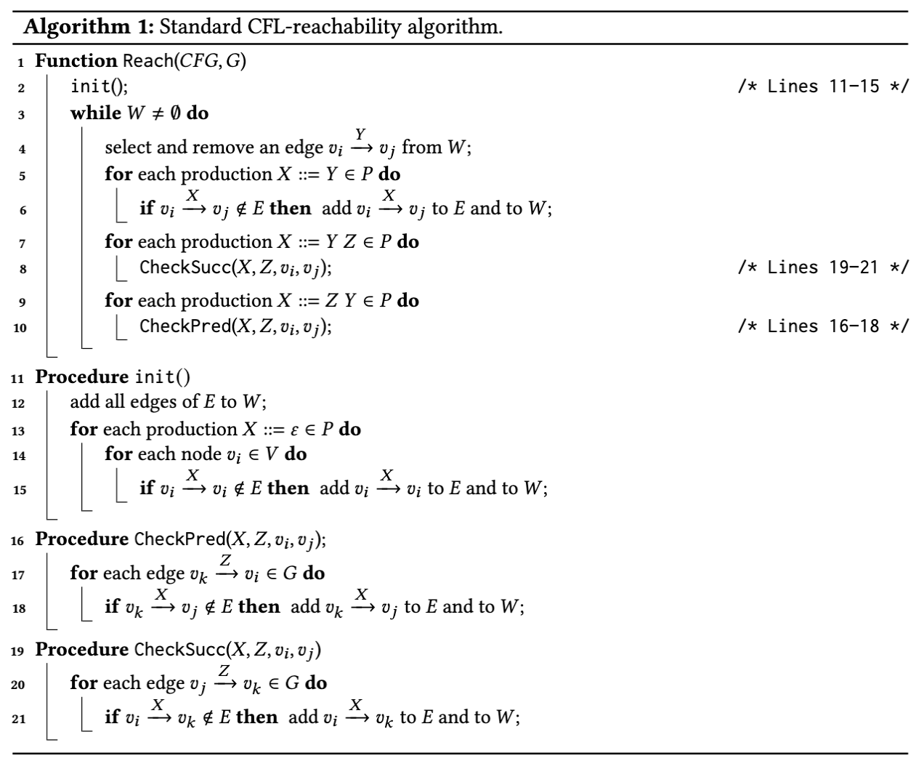


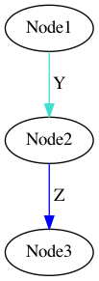
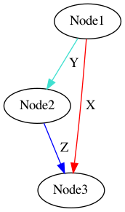
Standard CFL Solver:
X -> Y
X -> ε
X -> Y Z

Slide 9
Alias Analyze C++
All previous CFL Reachability graph representation of C++, are in the form of program expression graph, which only contains copy and reference and dereference, and do not have Gep and Vgep representation for field sensitive and do not share the same precise as Anderson field sensitive analyze.
This implementation using directly from PAG, Vgep stands for Gep for variable offset.
By add all possible Gep edge from Vgep, field of variable offset will be alias to all other fields.

Slide 10
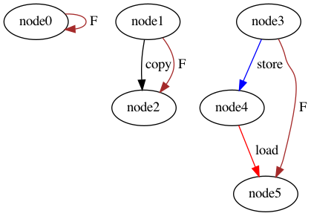
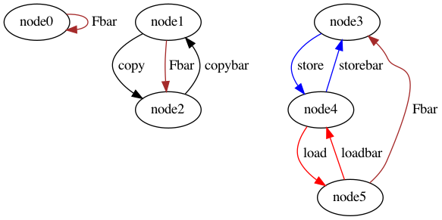
PAG Representation: Rules explanation – F (Value Flows to)
F -> epsilon
F -> F Copy
F -> F Store V Load
Fbar -> epsilon;
Fbar -> Copybar Fbar;
Fbar -> Loadbar V Storebar Fbar;

Slide 11
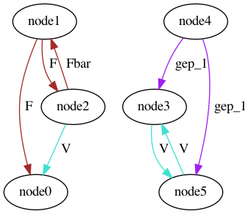
PAG Representation: Rules explanation – V
V -> Fbar V F
V -> Addrbar Addr
V -> Gepbar_i V Gep_i

Slide 12
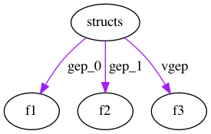
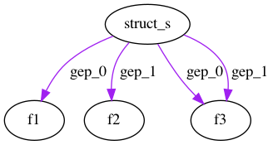
PAG Representation: Rules explanation – Vgep
Gep_i -> Vgep

Slide 13
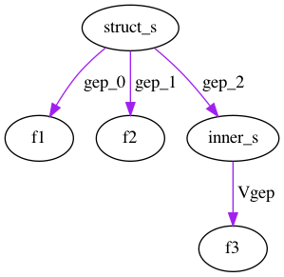
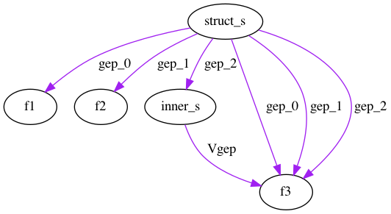
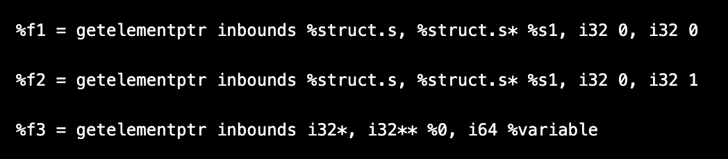
Vgep Nested Structure:
Gep_j -> Gep_i F Vgep;

Slide 14
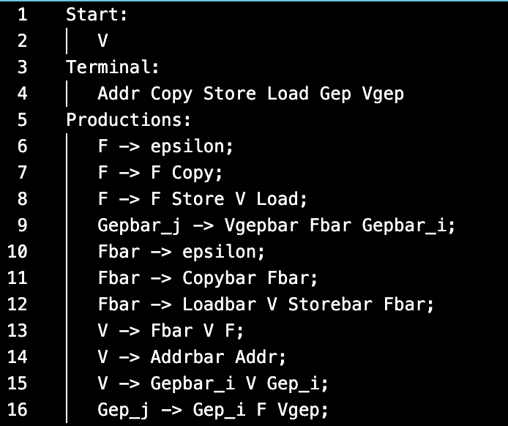
Implementation on SVF :
Grammar Text
Grammar Builder
Grammar Base
Symbol Struct{
u32_t kind: 8
u32_t attribute: 16
u32_t variable attribute: 8
}
Terminal to Kind Map:
{Addr:0} {Copy:1} {Store:2} {Load:3} {Gep:4} {Vgep: 5}
{Addrbar: ..} …
(correct terminal kind map ensure the graph label is matched with grammar)
Nonterminal to Kind Map:
{V: 6} { F: 7} {Fbar: 8}…

Slide 15
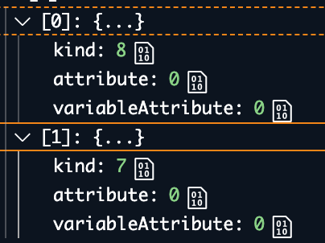
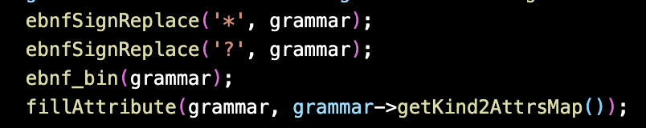
Grammar Normalization:
Grammar Base
Grammar Normalizer
CFL
Grammar
Production :
Symbol Symbol …

Slide 16
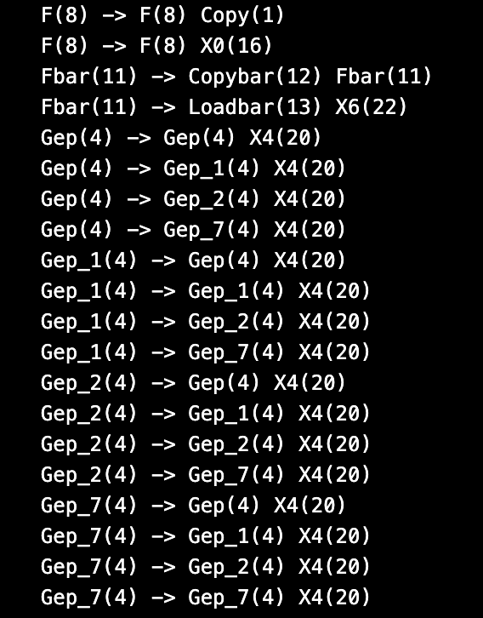
CFL Grammar:
All Production at most two symbol on the right-hand side
Gep_i, ‘i’ variable attribute has been expanded to every possible attribute in graph in this case,
Gep_0, Gep_1, Gep_4, Gep_7
Gep_i -> Gep_j X4
One Production with different variable attribute with get cartesian product of all possible attribute.

Slide 17
Build CFL Graph:
Dot
input
CFL Graph Builder
Const
Graph
Alias CFL Graph Builder
CFL
Graph
…
…

Slide 18
CFL Solver:
Input
Output
Solver
Graph
Solved
Graph
…
CFL
Grammar

Slide 19
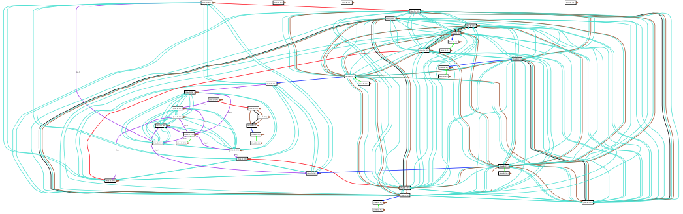

Slide 20
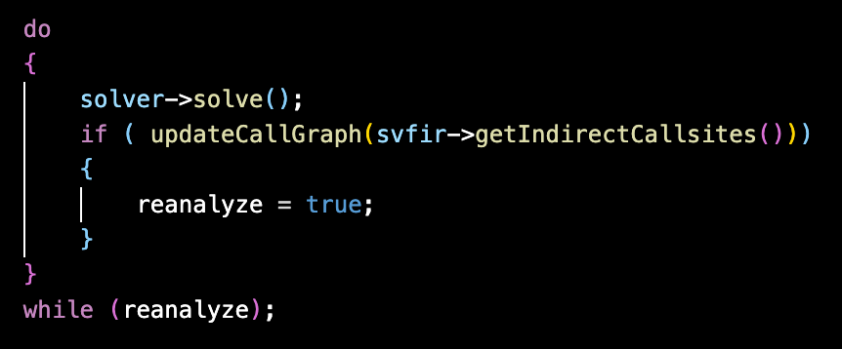
Indirection Call Reanalyze:

Slide 21
Continue to:
Grammar Rewrite
Incremental Solver

Slide 22
Summary
Modular Design of CFL Reachability instance on SVF, and Vgep Reanalyze for increasing precision.

Slide 23
Thank you!

Slide 24
Review:
1. Bring more context on why we need to use CFL Reachability, provide an through simple example to go through, then introduce the more complex Alias Analysis.
2. Similarity on Floyd-warshall algorithm.

