Slide 1
Fault Injection for CPS
Dinghua Wang
Notes:
PHD student of joint-program between UTS-SuSTech

Slide 2
Content
Introduction and Background - What is the CPS ?
Faults in CPS
Existing work and my idea
Notes:
just to give you a brief overview of CPS
Introduce faults in CPS that are different from general operating systems

Slide 3
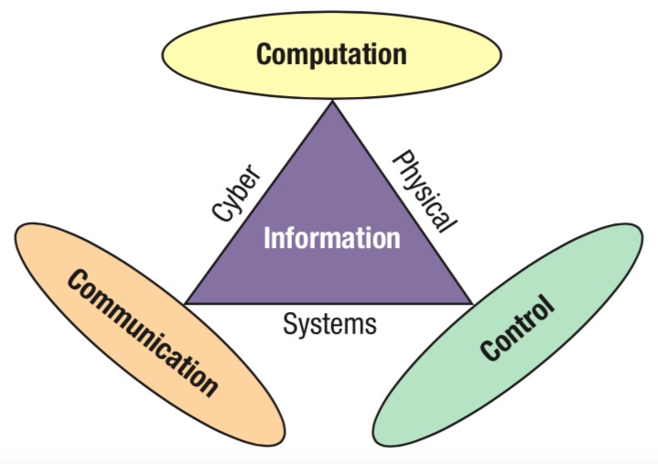
What is the CPS ?
Cyber ​​physical systems (CPS) is a next-generation intelligent system that integrates computing, communication, and control.

Slide 4
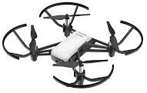
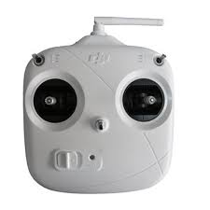
What is the CPS ?
For Unmanned Aerial Vehicle(UAV, a typical CPS):
communication
control
control
communication
Notes:
To better understand this, I will give an example here
When uav is in automatic or semi-automatic mode, it will control itself
There is also communication inside the drone

Slide 5
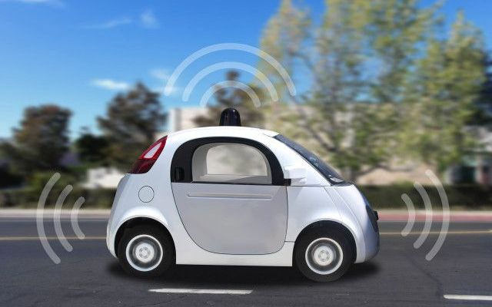

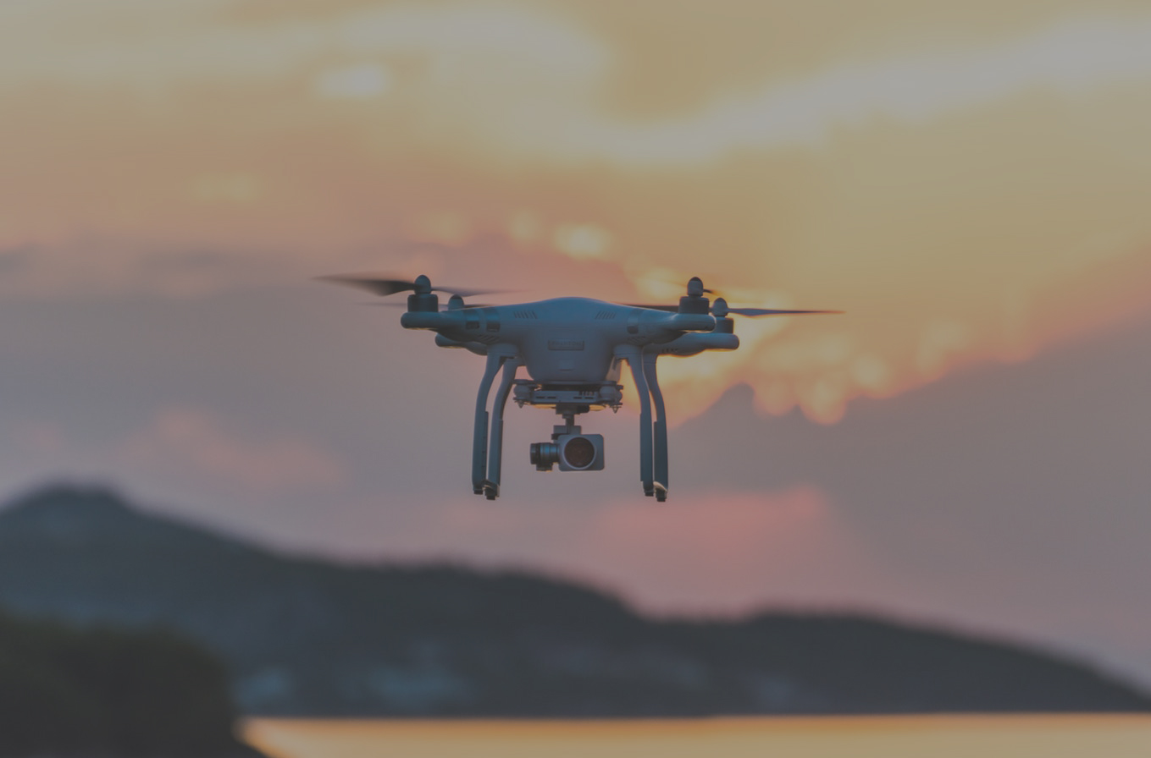
The examples of CPS
Notes:
We can all call these systems – the cps
So what are the features of cps

Slide 6
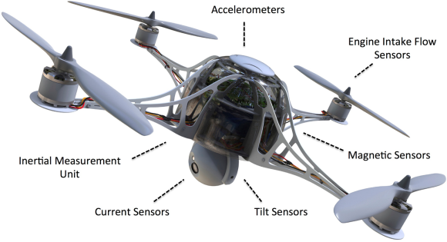
The features of CPS
Rich sensors
GPS
Camera sensor
Magnetic sensor
.
.
.
Notes:
Both robots and uavs have a large number of sensors
These sensors give cps the ability to sense the physical environment， and to sense itself， like

Slide 7
The features of CPS
context-aware
The system is cognizant of its environment
Notes:
Like I just said, the rich sensors will help cps sense the physical environment
Contexts is the environmental data obtained from sensors. such as temperature, speed, and location are

Slide 8
The features of CPS
Self-adaptive
The CPS makes reaction based on context information
Notes:
Just like uav can balance in the wind by itself

Slide 9

Faults in CPS
The dependability of a CPS can be affected by multiple factors:
context inconsistency
software bugs
uncertainty
Notes:
There are three factors can affect the dependability of cps

Slide 10
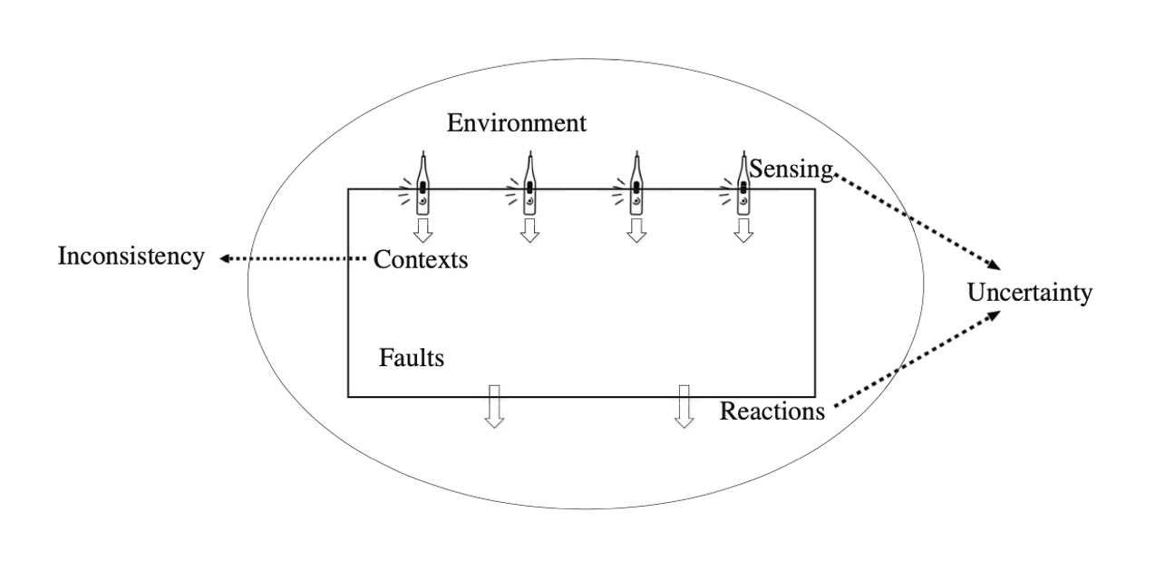
Context Inconsistency
Software bugs
context inconsistency:
Due to uncontrollable environmental noises, these obtained contexts may be contaminated or imprecise, which can result in context inconsistencies
Notes:
Contexts such as temperature, speed, and location are obtained from sensors.

Slide 11
Software Bugs in CPS
Software bugs
Software bugs in CPS:
Many of these bugs cannot be effectively detected by existing quality assurance techniques for traditional software.
Notes:
For example, some software bugs can only be triggered under specific environment

Slide 12
Uncertainty
Software bugs
Uncertainty:
These devices(e.g., sensors, actuators..) can be unreliable and defective in reality.
Notes:
CPS closely interact with complex and dynamic environments through devices that can probe and adapt to environmental changes (e.g., sensors and actuators). These devices can be unreliable and defective in reality. Such uncertain factors could negatively affect environmental interactions, jeopardizing the dependability of pervasive computing systems.

Slide 13
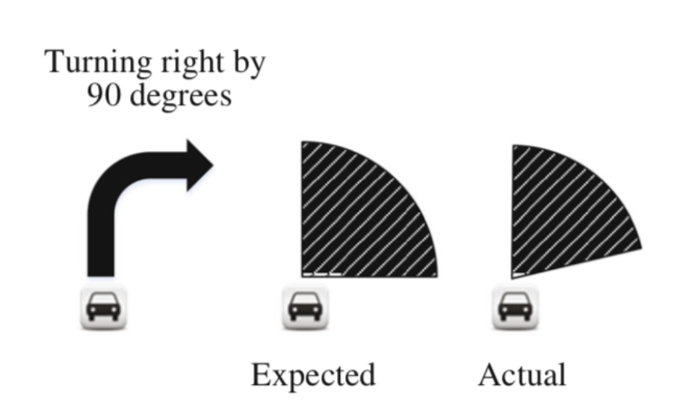
An Example of Uncertainty
Notes:
smart driving system thinks car turns 90 degrees，but because of the unreliable of the device ，The car only turned, say 89.5 degrees，There will be a 0.5-degree error, With each turn, errors accumulate. This will be a big problem.

Slide 14
Existing work - A System Identification based Oracle for Control-CPS Software Fault Localization
This paper proposes an AR-SI based oracle for Control-CPS fault localization.
He Z, Chen Y, Huang E, et al. A system identification based Oracle for control-CPS software fault localization[C]//2019 IEEE/ACM 41st International Conference on Software Engineering (ICSE). IEEE, 2019: 116-127.
Notes:
Through the above description, I hope you have a general understanding of CPS and its faults.
This is a paper published in icse2019

Slide 15
Existing work - A System Identification based Oracle for Control-CPS Software Fault Localization
autoregressive system identification (AR-SI)
The AR-SI can predict the physical trajectory of UAV. That is, we can use the AR-SI prediction
as an oracle.
He Z, Chen Y, Huang E, et al. A system identification based Oracle for control-CPS software fault localization[C]//2019 IEEE/ACM 41st International Conference on Software Engineering (ICSE). IEEE, 2019: 116-127.

Slide 16
Existing work - A System Identification based Oracle for Control-CPS Software Fault Localization
Faults Injection
Simulation
Run AR-SI
Code traces
SFL
He Z, Chen Y, Huang E, et al. A system identification based Oracle for control-CPS software fault localization[C]//2019 IEEE/ACM 41st International Conference on Software Engineering (ICSE). IEEE, 2019: 116-127.
Notes:
Their basic idea is shown in the figure
First they will inject the faults into system and simulate the system.

Slide 17
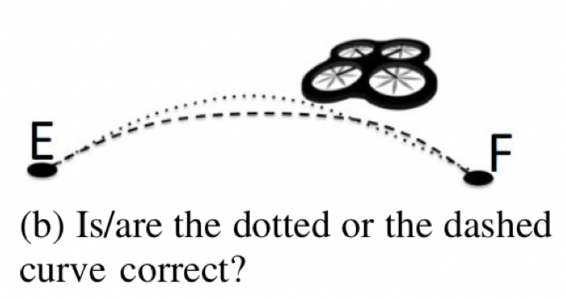
Existing work - A System Identification based Oracle for Control-CPS Software Fault Localization
Same task with two different physical trajectories
He Z, Chen Y, Huang E, et al. A system identification based Oracle for control-CPS software fault localization[C]//2019 IEEE/ACM 41st International Conference on Software Engineering (ICSE). IEEE, 2019: 116-127.
Notes:
The UAV outputs are physical trajectories
So how to judge the right or wrong of the physical trajectory

Slide 18
Existing work - A System Identification based Oracle for Control-CPS Software Fault Localization
Human oracles are still widely used in CPS SFL
He Z, Chen Y, Huang E, et al. A system identification based Oracle for control-CPS software fault localization[C]//2019 IEEE/ACM 41st International Conference on Software Engineering (ICSE). IEEE, 2019: 116-127.
Notes:
The common solution is still judged by people

Slide 19
Existing work - A System Identification based Oracle for Control-CPS Software Fault Localization
This paper aims to find another approach to deterministically and automatically
generate better oracles for a large category of control-CPSs’ software fault localization
Key domain feature:
when noises are under control, the control-CPS is designed to move smoothly
He Z, Chen Y, Huang E, et al. A system identification based Oracle for control-CPS software fault localization[C]//2019 IEEE/ACM 41st International Conference on Software Engineering (ICSE). IEEE, 2019: 116-127.

Slide 20
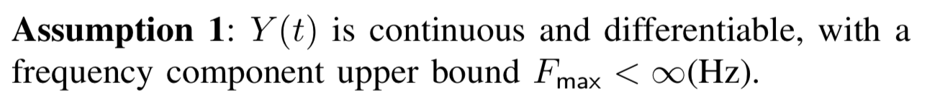








Existing work - A System Identification based Oracle for Control-CPS Software Fault Localization
User
$$U(t)$$
CPS
Simulator
$$Y(t)$$
$Y_{i}$ (period: $∆$)
$$U(t)$$
is the user input to the CPS
$$Y(t)$$
is the output of the physical plant
In this paper, is the physical trajectories
$$Y(t)$$
$$∆$$
is the period of $Y_{i}$
(because the communication signal is the digital signal)

Slide 21
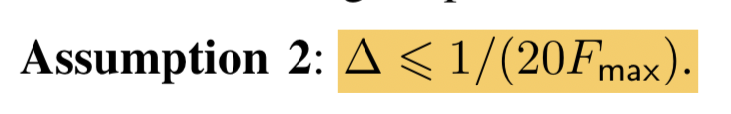
Existing work - A System Identification based Oracle for Control-CPS Software Fault Localization
User
$$U(t)$$
CPS
Simulator
$$Y(t)$$
$Y_{i}$ (period: $∆$)
$$U(t)$$
is the user input to the CPS
$$Y(t)$$
is the output of the physical plant
In this paper, is the physical trajectories
$$Y(t)$$
$$∆$$
is the period of $Y_{i}$
(because the communication signal is the digital signal)
Notes:
this means the cyber subsystem must sample fast enough so that the physical subsystem can regard it as if a continuous signal processor.

Slide 22
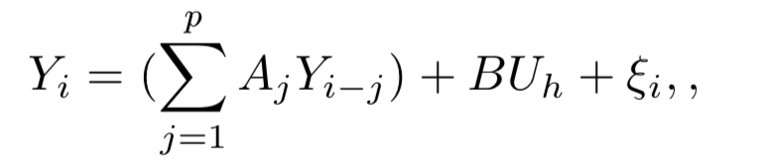


Existing work - A System Identification based Oracle for Control-CPS Software Fault Localization
autoregressive system identification (AR-SI)
is a preset constant
A,B and are the parameters to be identified
He Z, Chen Y, Huang E, et al. A system identification based Oracle for control-CPS software fault localization[C]//2019 IEEE/ACM 41st International Conference on Software Engineering (ICSE). IEEE, 2019: 116-127.
Notes:
Calculate parameters from p real trajectory data,
I just gave a brief explanation here

Slide 23
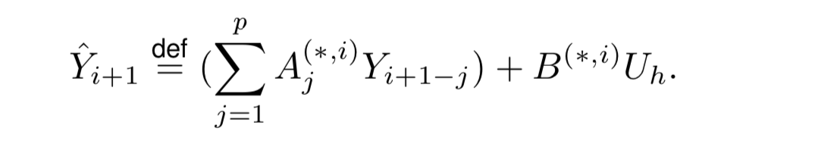
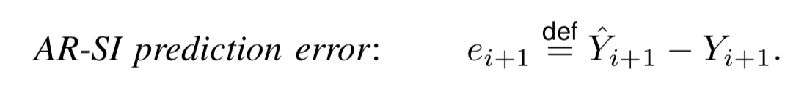
Existing work - A System Identification based Oracle for Control-CPS Software Fault Localization
autoregressive system identification (AR-SI)
He Z, Chen Y, Huang E, et al. A system identification based Oracle for control-CPS software fault localization[C]//2019 IEEE/ACM 41st International Conference on Software Engineering (ICSE). IEEE, 2019: 116-127.

Slide 24
Existing work - A System Identification based Oracle for Control-CPS Software Fault Localization
Step 1 | Initialization
Step 2 | Task 1: Emulate the CPS using the emulation platform, ‘user’ input U(t), and code trace. Task 2: Run AR-SI in the parallel with CPS emulation. Calculate the AR-SI prediction and log it.
Step 3 | When the emulation ends, check if the AR-SI prediction contains outlier. If so, label code trace as ‘incorrect’
Step 4 | If enough code traces are collected, terminate
Step 1 | Same as AR-SI based Oracle –Step 1
Step 2 | Same as AR-SI based Oracle – Step 2-Task 1
Step 3 | Use human oracle to judge the correctness of physical trajectory and label the corresponding code trace.
Step 4 | Same as AR-SI based Oracle – Step 4
The solution of AR-SI based Oracle
The solution of Human Oracle
He Z, Chen Y, Huang E, et al. A system identification based Oracle for control-CPS software fault localization[C]//2019 IEEE/ACM 41st International Conference on Software Engineering (ICSE). IEEE, 2019: 116-127.

Slide 25
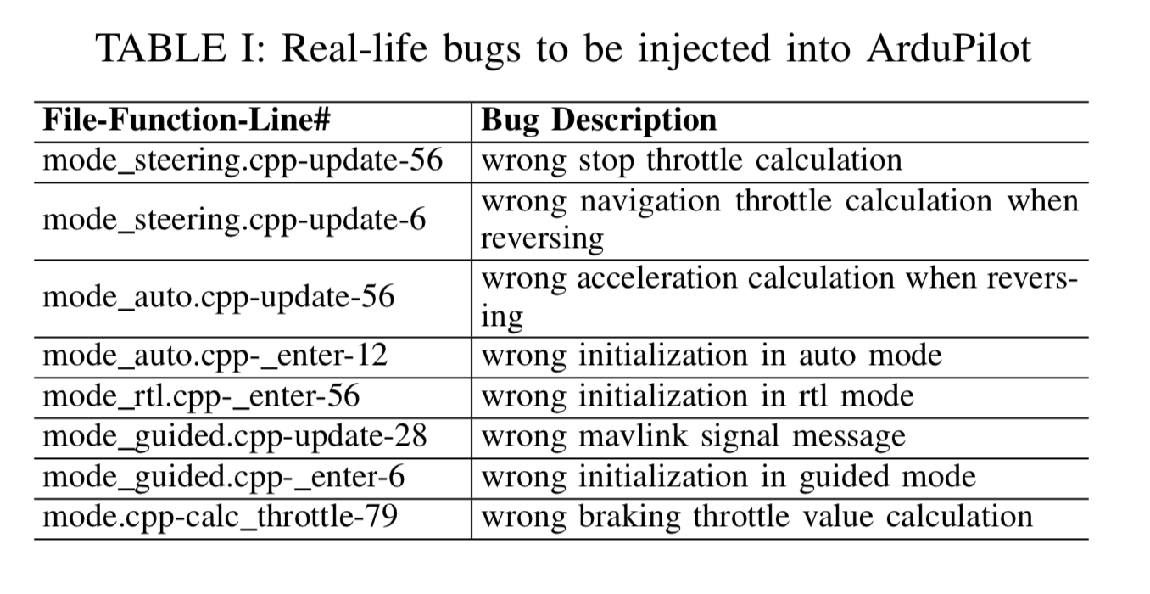
Existing work - A System Identification based Oracle for Control-CPS Software Fault Localization
He Z, Chen Y, Huang E, et al. A system identification based Oracle for control-CPS software fault localization[C]//2019 IEEE/ACM 41st International Conference on Software Engineering (ICSE). IEEE, 2019: 116-127.

Slide 26
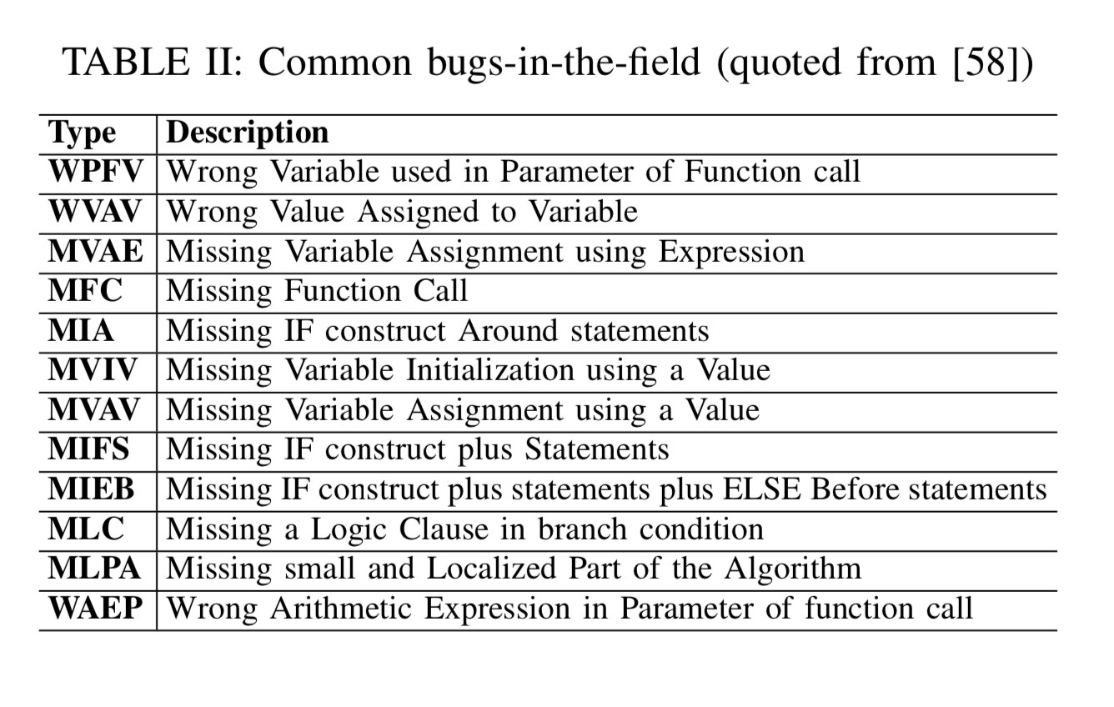
Existing work - A System Identification based Oracle for Control-CPS Software Fault Localization
He Z, Chen Y, Huang E, et al. A system identification based Oracle for control-CPS software fault localization[C]//2019 IEEE/ACM 41st International Conference on Software Engineering (ICSE). IEEE, 2019: 116-127.

Slide 27
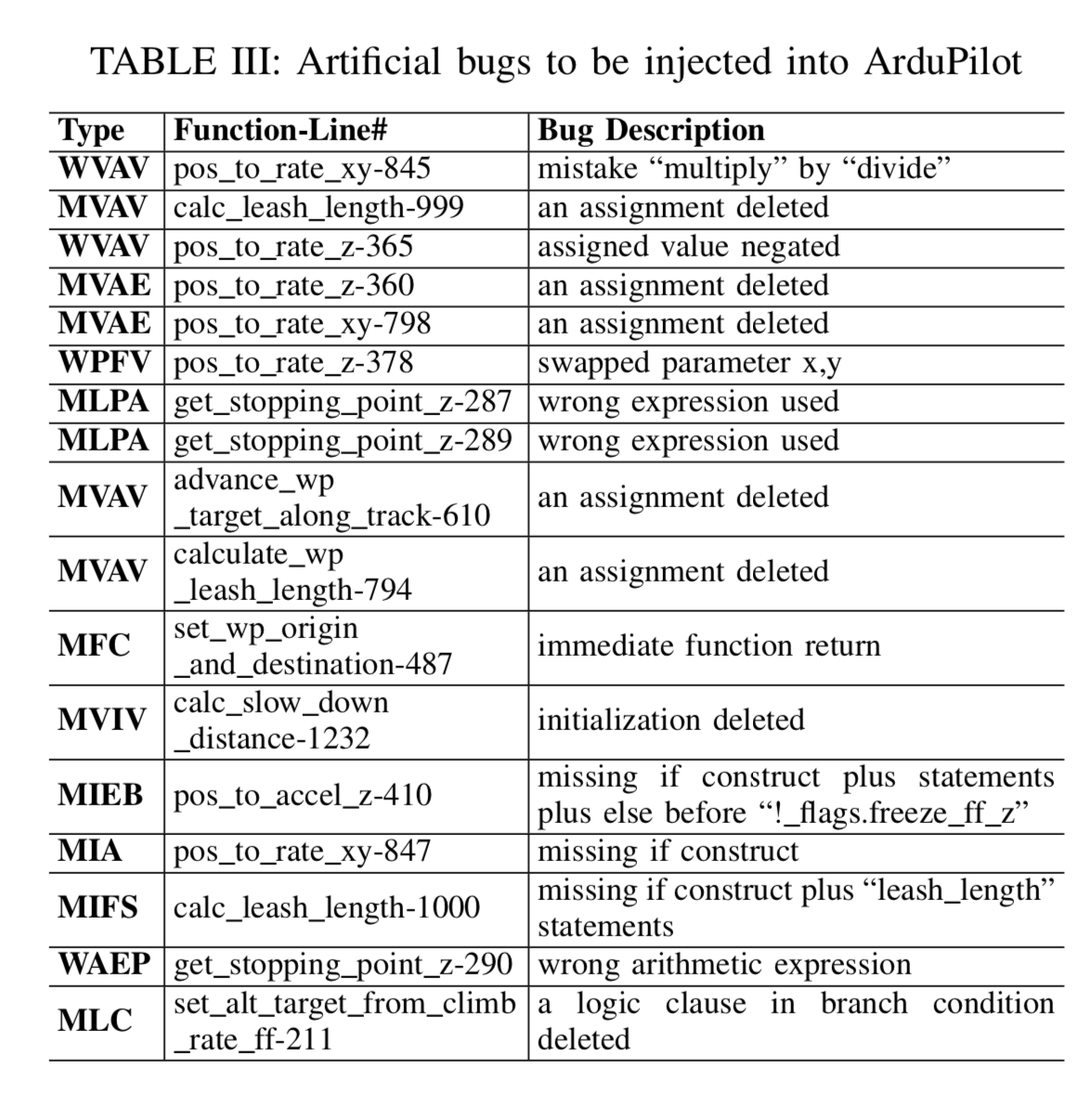
Existing work - A System Identification based Oracle for Control-CPS Software Fault Localization
He Z, Chen Y, Huang E, et al. A system identification based Oracle for control-CPS software fault localization[C]//2019 IEEE/ACM 41st International Conference on Software Engineering (ICSE). IEEE, 2019: 116-127.

Slide 28

My idea

Slide 29
Limitations of the Existing Work
1. The physical trajectories need to be continuous and differentiable – due to the AR-SI
2. The trajectories only contain two dimensions
3. Did not perform fault injection for the characteristics of CPS
He Z, Chen Y, Huang E, et al. A system identification based Oracle for control-CPS software fault localization[C]//2019 IEEE/ACM 41st International Conference on Software Engineering (ICSE). IEEE, 2019: 116-127.

Slide 30
Our Aims
Generate better oracles to improve the accuracy of fault localization
No need to be limited by physical trajectories, provide more data(e.g.. GPS, battery power, CPU&RAM ) for fault localization.
Fault injection with CPS characteristics

Slide 31
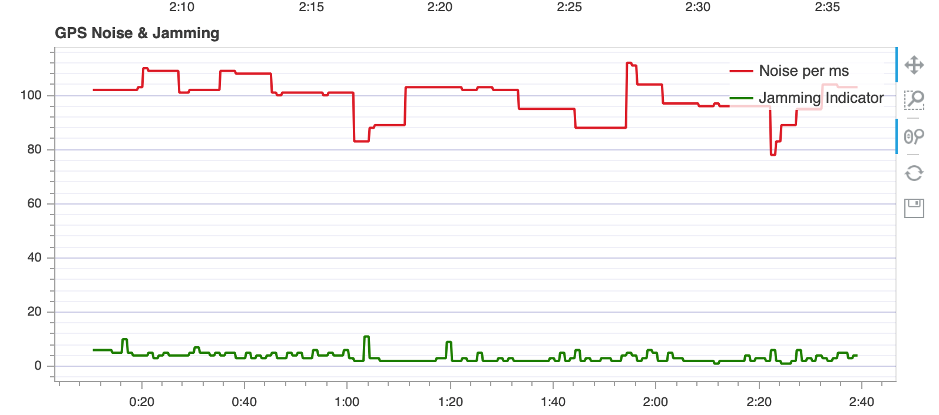
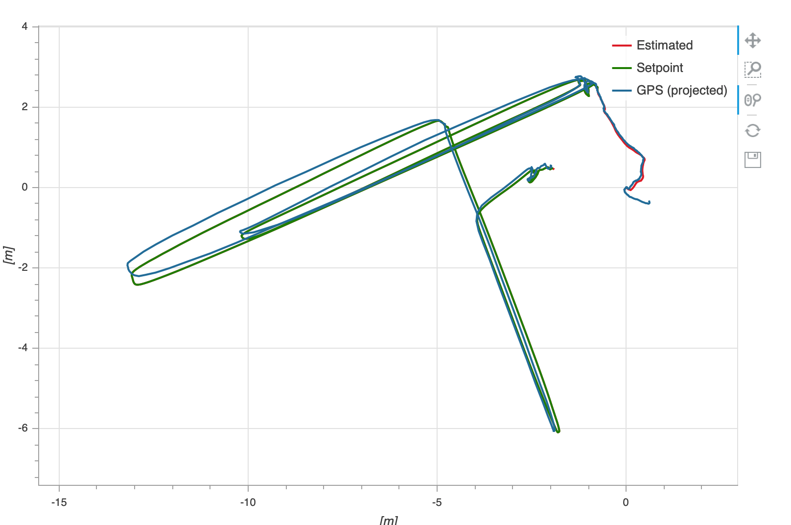
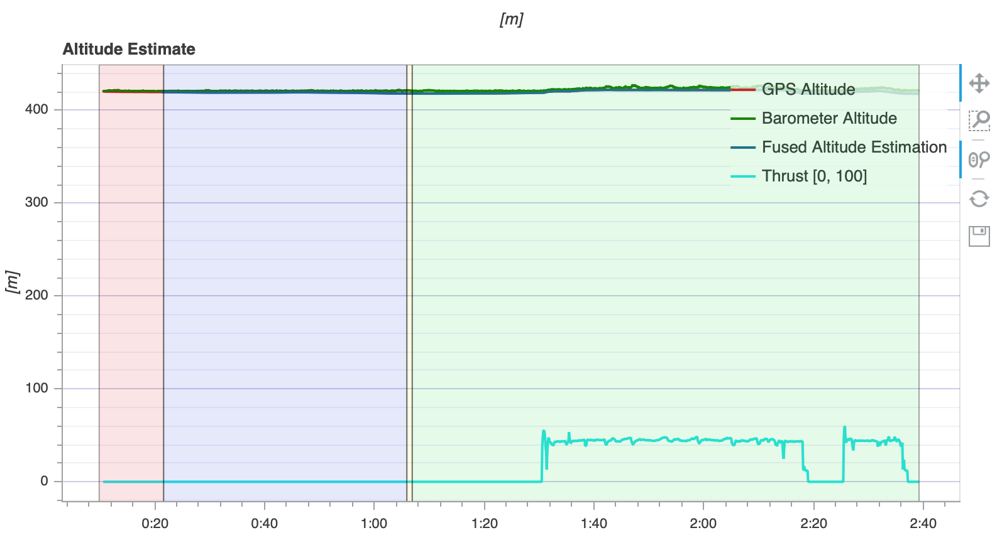
My idea
1. The trajectories only contain two dimensions
- flight logs

Slide 32
My idea
The physical trajectories need to be continuous and differentiable –
due to the AR-SI
- machine learning
Based on machine learning, we can train the required model from the flight logs data without
being limited by the physical trajectory

Slide 33
My idea
3. Did not perform fault injection for the characteristics of CPS
- Mutation analysis for UAV:
computation : Rotation matrix , Euler angles, Quaternions..
communication: uORB, MAVLink..
control: att_control，pos_control, rate_control, PID control..

Slide 34
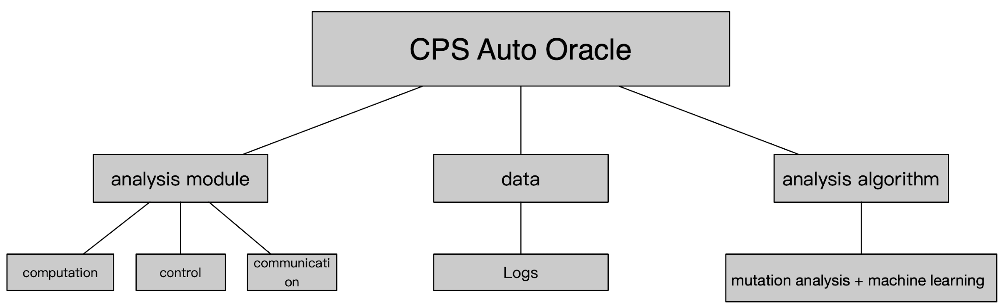
My idea

Slide 35
My idea
Fault injection by using mutation analysis
Generate logs in simulator
Train the ML model based on logs
Fault localization

Slide 36
Thank you！
Q&A

