Slide 1
Rethinking Incremental and Parallel Pointer Analysis
Pei Xu
Supervised By Yulei Sui
Program Analysis Group
University of Technology Sydney (UTS)
21 April

Slide 2
Reference
Liu, B., et al. (2019). "Rethinking incremental and parallel pointer analysis." ACM Transactions on Programming Languages and Systems 41(1).

Slide 3
Introduction
Pointer analysis is at the heart of most interprocedural program analyses. However, scaling pointer analysis to large programs is extremely challenging.
Incremental Algorithms
Parallel Algorithms
Trade of Speed and Precision

Slide 4
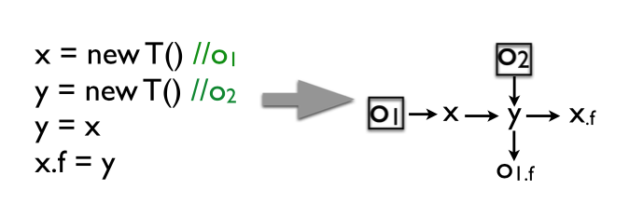
Anderson’s Pointer Analysis

Slide 5
Anderson’s Pointer Analysis
pts(x) = {o1}
pts(y) = {o1,o2}
pts(x.f ) = {o1,o2}.

Slide 6
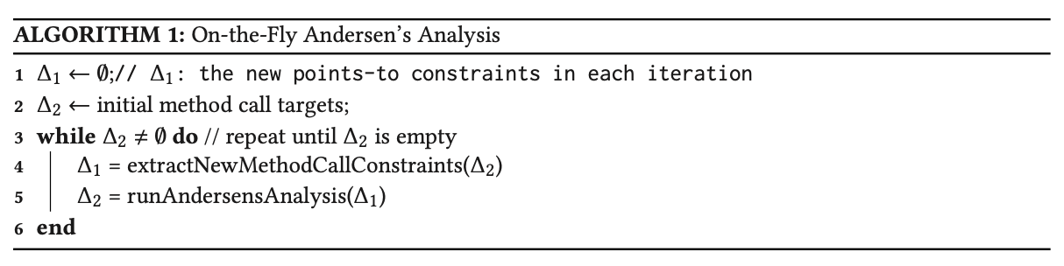
Anderson’s Pointer Analysis

Slide 7
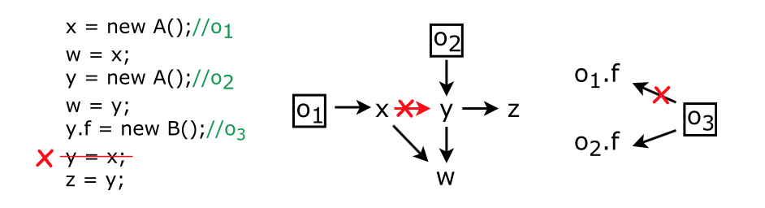
EXISTING INCREMENTAL ALGORITHMS
Insertion
Deletion

Slide 8
EXISTING INCREMENTAL ALGORITHMS
Reset-Recompute Algorithm
Reachability-Based Algorithm

Slide 9
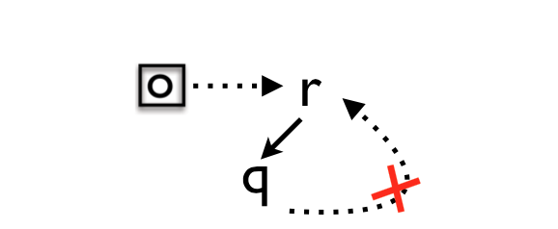
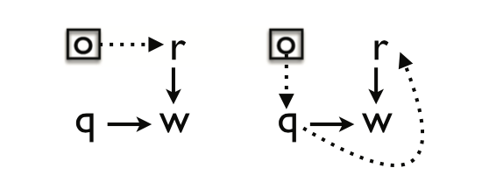
NEW INCREMENTAL ALGORITHMS

Slide 10
Incoming Edge
Consider an acyclic PAG and a pointer node q of which an object o ∈ pts(q). If q has an incoming neighbor r (that is, there exists an edge r → q) and o ∈ pts (r ), then there must exist a path from o to r without going through q.

Slide 11
Outcoming Propagation
Consider an acyclic PAG and a pointer node q of which an object o ∈ pts(q). Assume that q has an outgoing neighbor w (i.e., there exists an edge q → w) and w has an incoming neighbor r (different from q) such that o ∈ pts(r). If r cannot reach q, then at least one of the following two conditions (or both) must hold in the PAG:

Slide 12
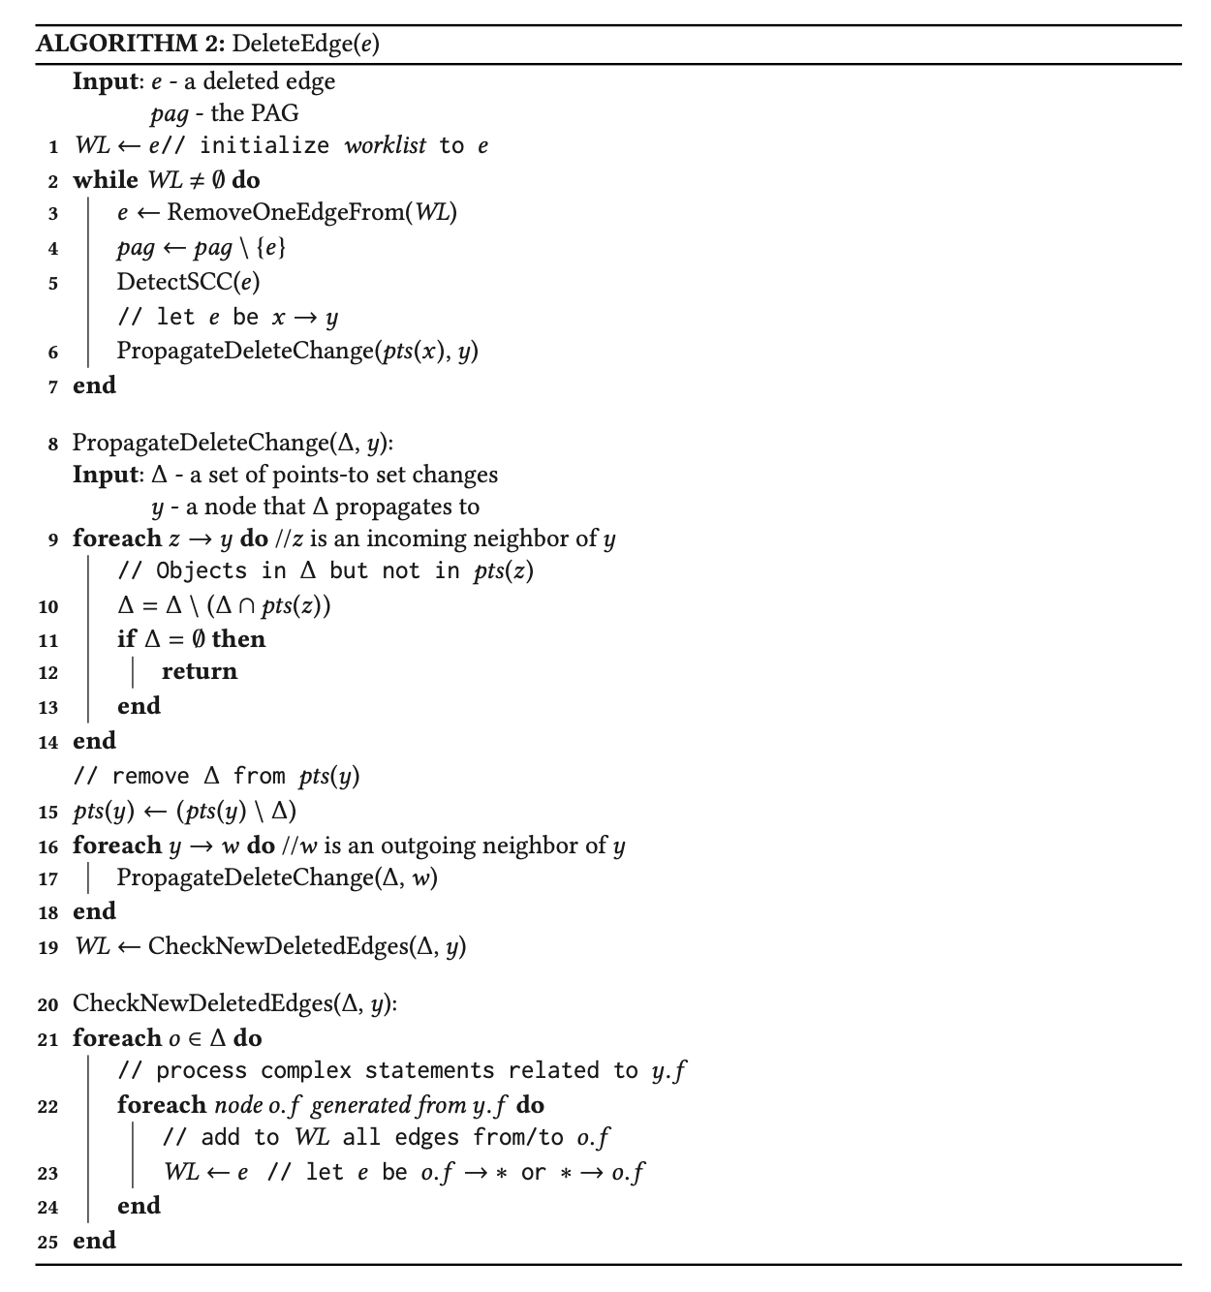

Slide 13
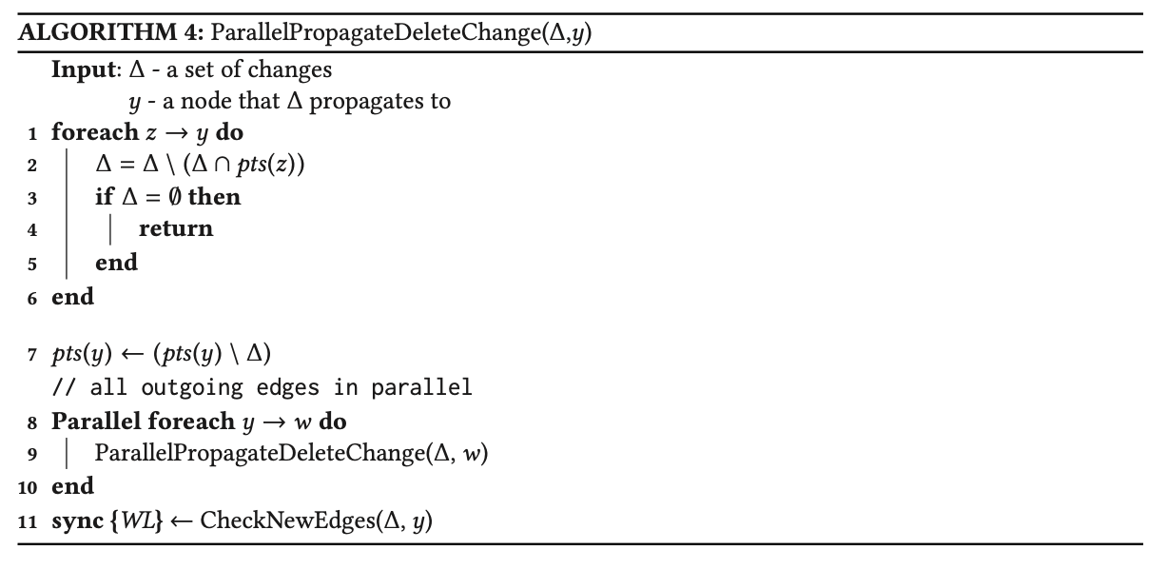

Slide 14
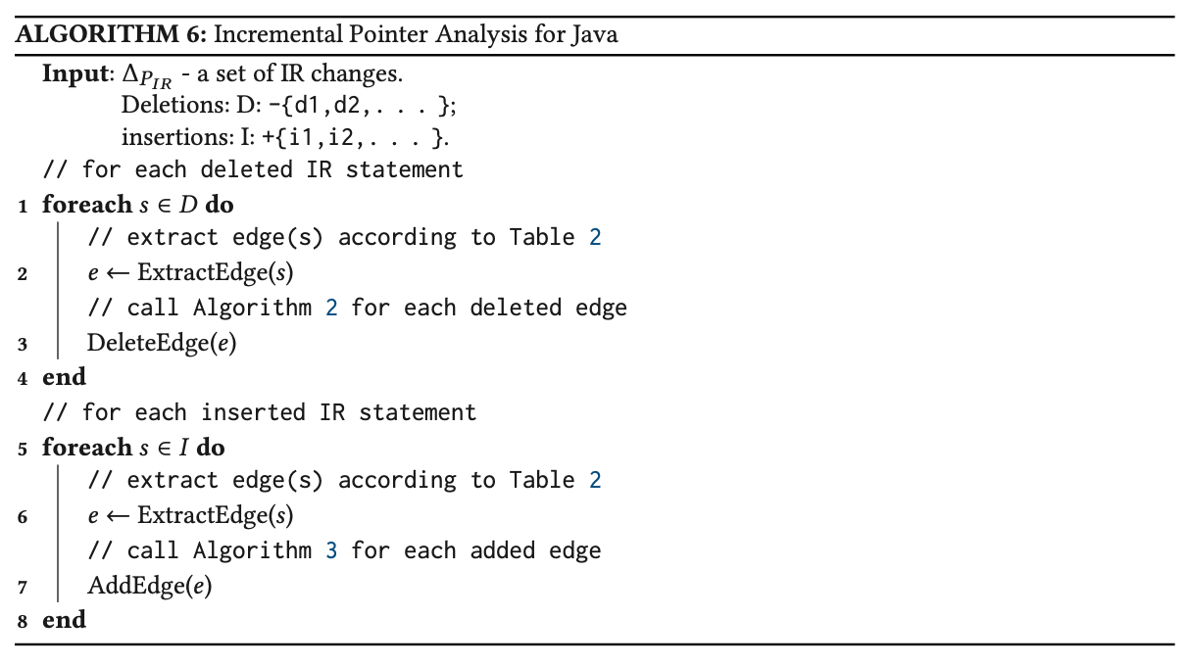

Slide 15
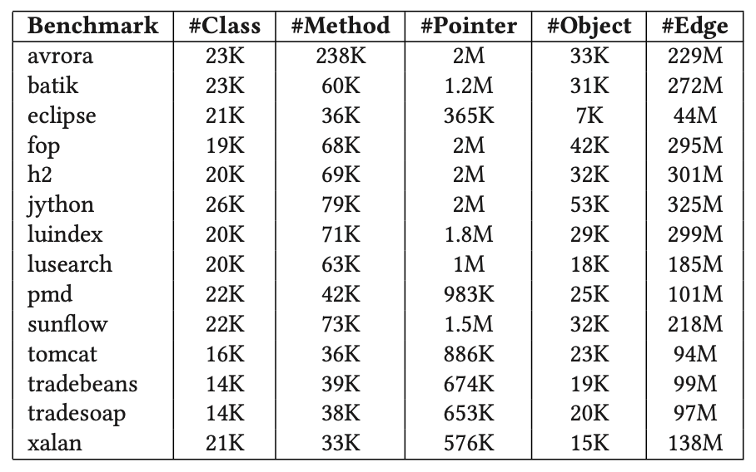

Slide 16
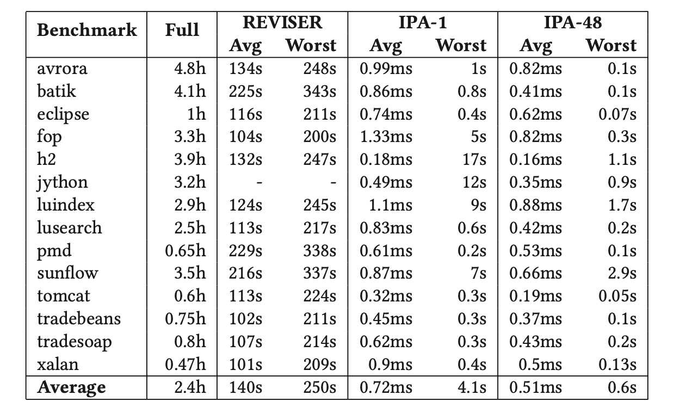
Evaluation

Slide 17
Summary
Design and Implementation of a new incremental pointer analysis, IPA, which significantly improves the scalability of the state of the art. by fundamental properties of the on-the-fly Andersen-style pointer analysis, our new algorithms do not incur redundant computations or require expensive graph reachability analysis, and it is parallel.

