Slide 1
Node Package ManageR
NPM

Slide 2
About NODE
It’s built on the V8 JavaScript runtime.
written in C++
Originally, it was intended as a server environment for applications, but developers started using it to create tools to aid them in task automation.

Slide 3
The package manager
It provides an interface to get the
modules you want (and need)
It is a way to manage your dependencies.

Slide 4
Installing packages
A package is something used in
your projects (like React or Babel)
All your packages are installed under /node_modules.

Slide 5
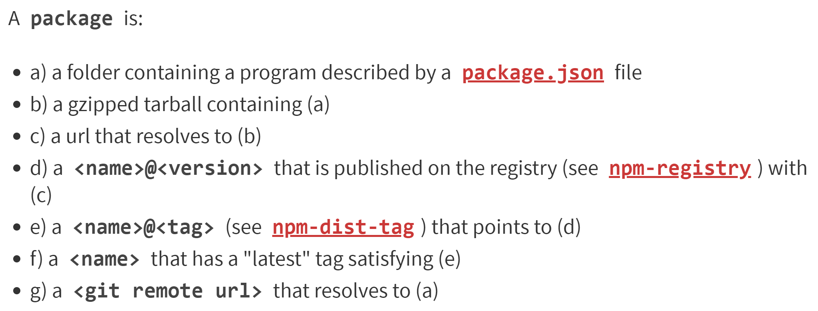
packages

Slide 6
Npm Install
To install a package use npm install
npm install express
npm i express

Slide 7
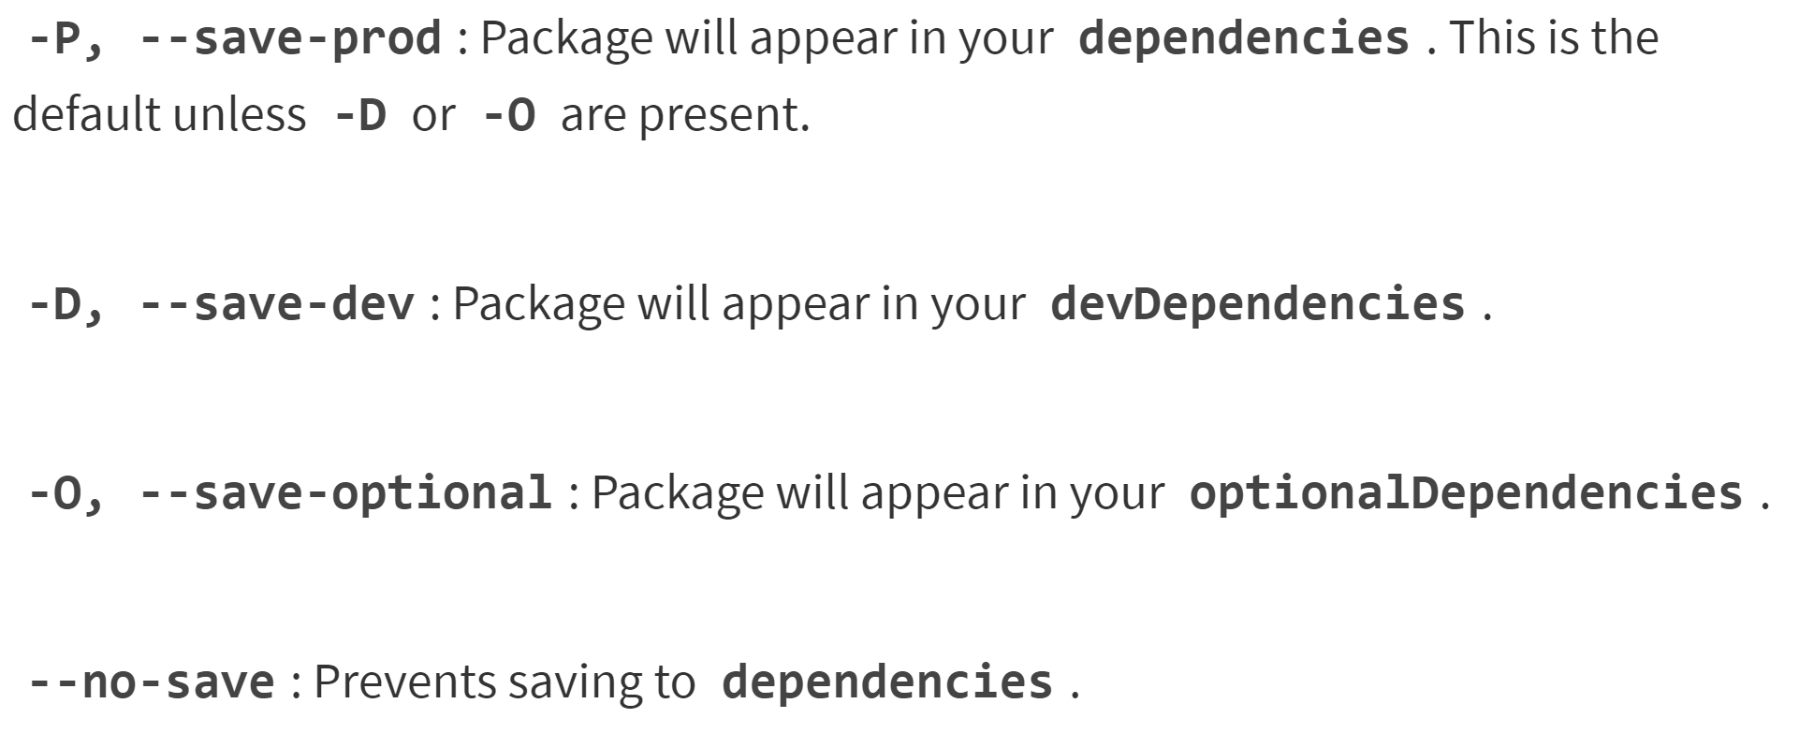
Install & save
To update your package.json use one

Slide 8
Global
Globally installed (-g) modules means its for every node application on that machine.

Slide 9
Locally?
You can install your modules only in the application, they will be placed in the /node_modules folder.

Slide 10
Limiting the verbosity
Set this command line argument:
--depth=0

Slide 11
Dev dependencies
Modules that you only need for development, and not when you move to production.

Slide 12
package-lock.json
It describes the exact tree that was generated, such that subsequent installs are able to generate identical trees, regardless of intermediate dependency updates

Slide 13
Alias’ed commands
npm i <package> – install local package
npm i -g <package> – install global package
npm un <package> – uninstall local package
npm up – npm update packages
npm t – run tests
npm ls – list installed modules

