Slide 1
CS763
Secure By Design

Slide 2
Example: Project Portal
Project Portal is part of an online project based learning platform. The purpose is to :
To create a community to discuss and share
To facilitate learning and collaboration
Beyond a single course
At the program level
Inter-discipline
The main functionalities are
Publicize completed or ongoing projects
Make project searchable and taggable

Slide 3
Another Example: Blackboard
A web based learning environment and course management system.
All our courses are hosted on Blackboard.
Main functionalities:
Manage course related content, assignments, tools
Manage users based on courses

Slide 4
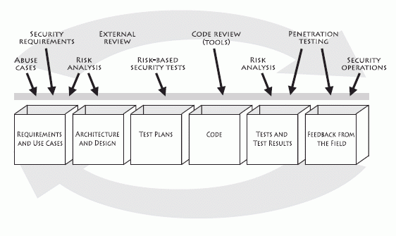
Touchpoints

Slide 5
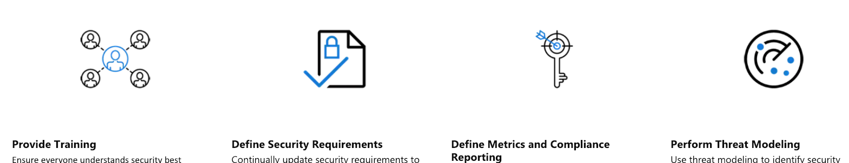
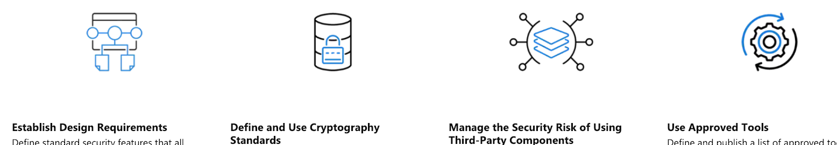
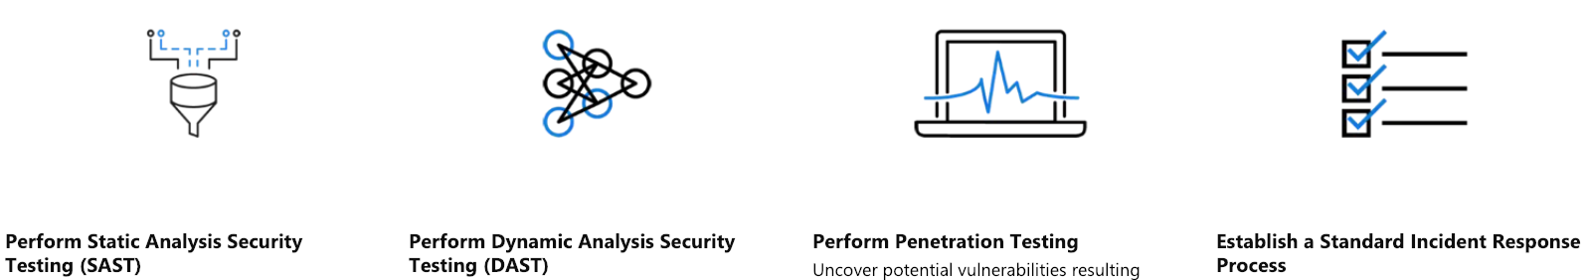
SDL Practices

Slide 6
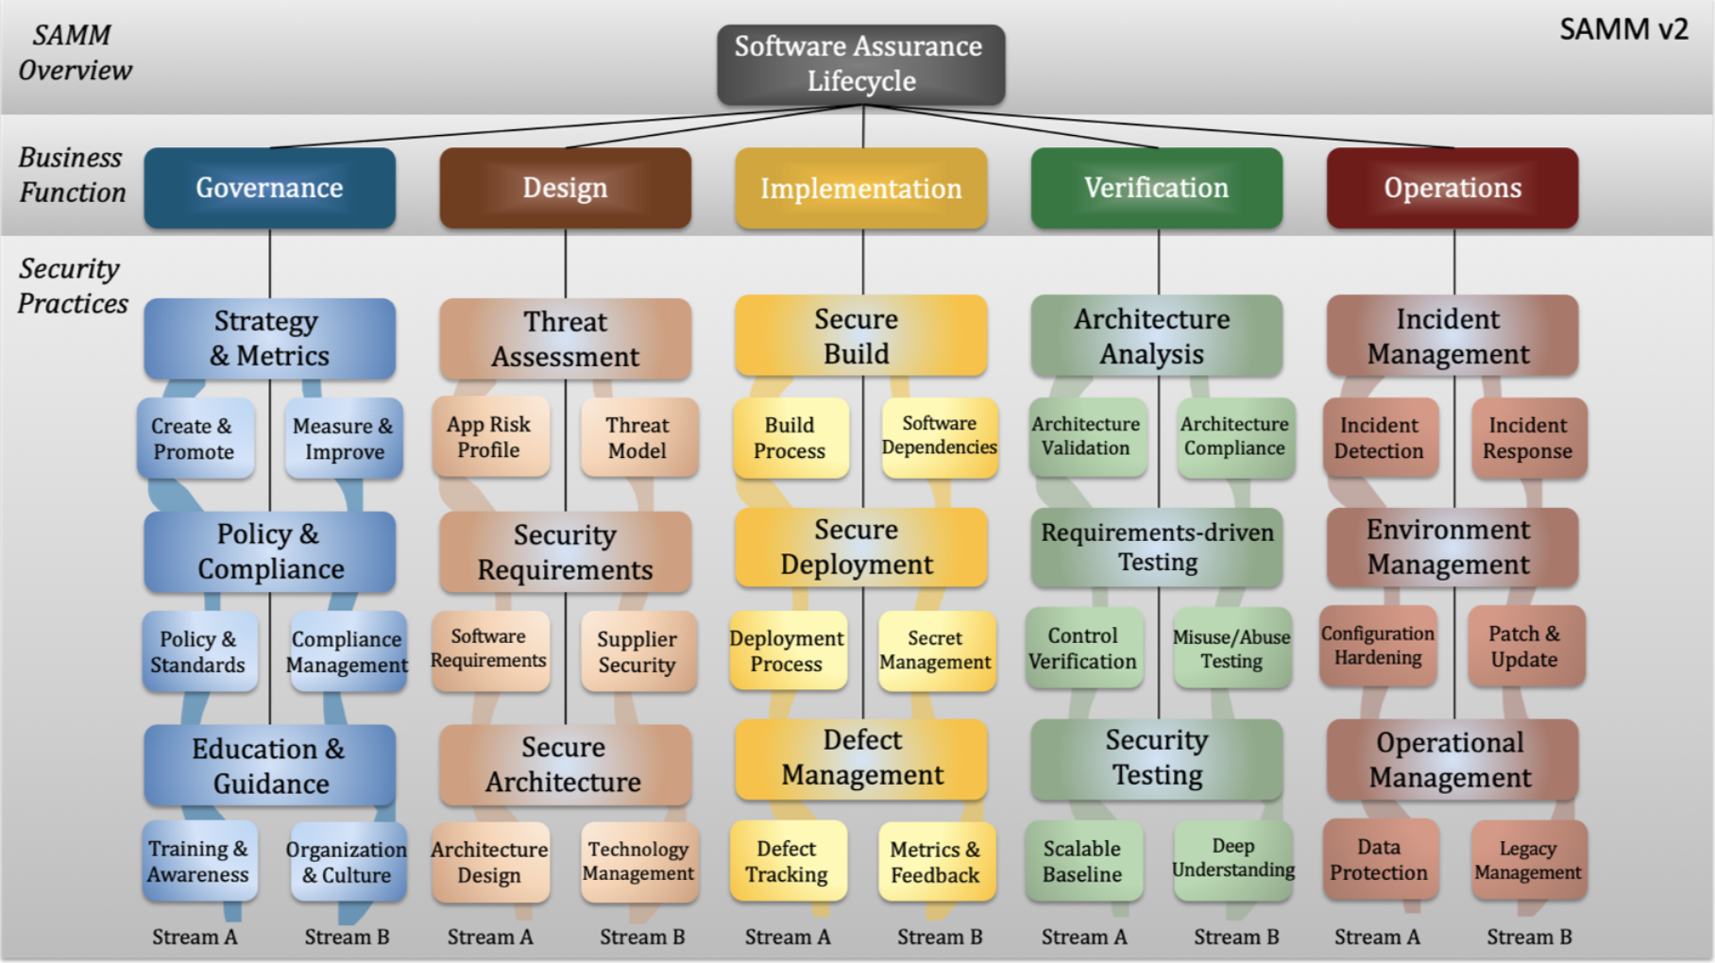
OWASP SAMM

Slide 7
Requirement Analysis
Elicit and analyze requirements of the system (what the customer wants)
It is challenging as the customers usually do not know exactly what they want at the beginning
Two types of requirements:
Functional requirements (features): What can the system do?
Nonfunctional requirements (constraints or qualities)
The website should be available 99% of time.
The website should be accessed in different browser such as safari, IE and chrome
User cases or user stories (in Agile) are used to represent requirements .

Slide 8
Requirement Analysis
Elicit and analyze requirements of the system (what the customer wants)
It is challenging as the customers usually do not know exactly what they want at the beginning
Two types of requirements:
Functional requirements (features): What can the system do?
Nonfunctional requirements (constraints or qualities)
The website should be available 99% of time.
The website should be accessed in different browser such as safari, IE and chrome
User cases or user stories (in Agile) are used to represent requirements .
Security requirements can be either functional or nonfunctional requirements.

Slide 9
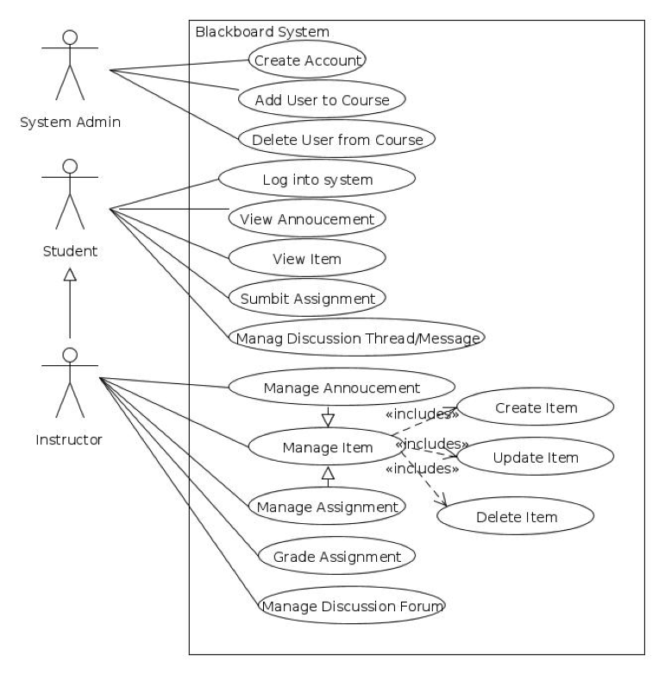
Use Case Model
Use case Model: a functional model to define what the system can do.
Use case diagram: show the relationship between use cases and actors
Use case description: the detail information of each use case.

Slide 10
An Example of Use Case Description
Name: Submit assignment
Participating actor: Student
Entry condition: The student has registered the course, successfully logged into the system, and is accessing the assignment page.
Exit condition: The student submits assignment successfully or error message is displayed.
Flow of events:
1. The Student clicks the corresponding assignment.
2. The system displays the assignment submission page
3. The student uploads the attachment, and writes comments.
4. The student clicks the submit button.
5. The system checks if the submission date is within 7 days after the deadline, and if the user has submitted less than 3 times.
(a) If true, the system displays a message to indicate that the submission is successful.
(b) Otherwise display an error message to the user

Slide 11
User Stories (Project Portal)
Functional requirements:
As a project author, I can create a project so that other people can see it.
As a project author, I can edit my project information so that I can provide correct information.
As an instructor, I can post the assignments on the blackboard, so that students can work on them.

Slide 12
Design
Application domain - > Solution domain
A representation/model of the software to be built.
Implement the requirements by designating the projected parts of the implementation
Should be easily translated to code by programmers
A set of documents/diagrams
High-level (architecture) and detailed design
Detailed design is tightly coupled with implementation (in Agile).

Slide 13
Design
Software Architecture
Architecture styles: client server, MVC, Tiered architecture, SoA, microservices, REST ….
Architecture diagrams, DFD (Data Flow Diagrams)
Detailed Design
Detailed Object Design (Class diagrams)
Algorithms
Database schema
...

Slide 14
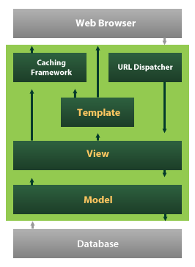
Architecture Styles

Slide 15
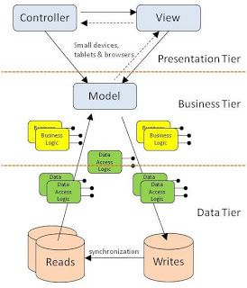
Architecture Styles
http://criticaltechnology.blogspot.com/2011/10/mvc-in-three-tier-architecture.html

Slide 16
Security Requirements
Derived from basic information security goals CIA
Confidentiality:
Project details can only be viewed by the owner of the project.
A student’s grade information can only be seen by that student, and the instructor.
Integrity:
Project details can only be modified by the owner of the project
The grade can only be modified by the instructor.
Availability:
All users can access user data and project data. General users can view data
All students can access their registered course content.

Slide 17
Security Requirements
Derived from security Mechanisms AAA
Need an authentication scheme such as a login functionality using username and password
Need a proper authorization scheme to specify who can do what. For example, a role based access control is needed in blackboard to distinguish the privileges of instructors and students.
Need a proper audit scheme to know who did what and when. For example, all modification events are logged.

Slide 18
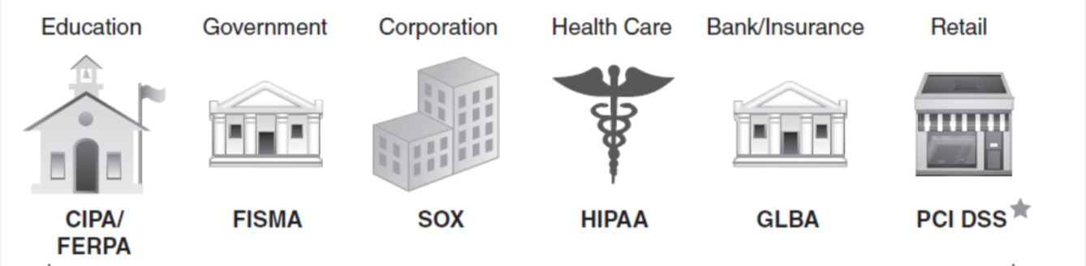
Security Requirements
Privacy Requirements
Is any PII data collected? Is it necessary?
Who can access it? How is it stored?
Notice and consent
User control
Child protection
Cookie usage
Legal control

Slide 19
Security Requirements
SMART (Specific, Measurable, Achievable, Relevant, Time bound) to INVEST (Independent, Negotiable, Valuable, Estimable, Small or sizable, Testable)
Derived from
Business Logic
Internal standards
The legal and industry standards
Previous incidents, and known threats.
Risk analysis
Structured and prioritized
Security requirement framework
Supplier security
Trade off between security and other -abilities?

Slide 20
Abuse Cases/Abuser Stories
Think of cases that a security requirement can be broken
Either accidentally by a legitimate user (Misuse case)
Or Intentionally by an attacker (Abuse case)
Abuse cases are opposite of use cases
Abuser stories are opposite of user stories.

Slide 21
Abuser Stories
As a project owner, I can edit my project information so that I can provide the most updated information.
As a malicious user, I want to modify other people’s projects information so that I can use their projects for my purpose.
As a reviewer, I can rate other projects so that I can provide my opinion to others.
As a malicious reviewers, I can repeatedly rate the same projects so that I can control other projects’ ratings.

Slide 22
Abuse Cases
For each use case, think about possible ways to misuse/abuse it.
Start with likely scenarios and known attack patterns.
E.g. SQL injection, MITM, XSS, Snooping , Phish, ...
Do an attacker analysis
Create an attack tree
Add additional mitigation use cases

Slide 23
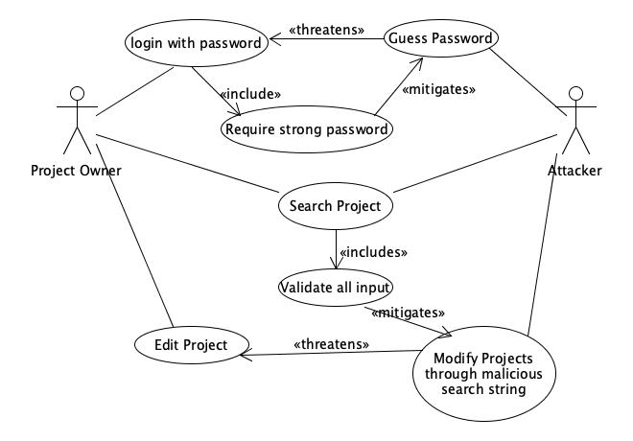
Abuse Case Example
UMLet: a tool to draw use cases and other UML diagrams. http://www.umlet.com/umletino/umletino.html

Slide 24
Attacker Model
Attackers on the same network
Eavesdropping information
Attackers on the same machine
Get information through cache, or cookie
Malicious users
Anonymous user
Malicious project owners
Malicious project viewers

Slide 25
Discussion

Slide 26
Attack Tree
Use the attacker’s goal as the root and describe different ways to achieve it in a hierarchical way.
Each goal can be a tree. Think all possible attacks to achieve the goal.
Compare and rank the attack based on its risk
Check the assumption of each attack.
Schneier’s article on attack tree: https://www.schneier.com/academic/archives/1999/12/attack_trees.html

Slide 27
Attack Tree
Post change directly on view page
Bypass the authentication
spoof as the project owner
Obtain the credential from network
Unauthorized user modifies project data
Obtain the database credential using dictionary attack
access the database on the server directly
Database misconfig (no password, or use default password)

Slide 28
Architecture Risk Analysis
The high level software architecture is very helpful.
Help understand components and their interactions with the environment.
Even some basic information will be helpful: language, port, service, accounts, third-party components, privilege, access control.
Three steps:
Attack resistance analysis, Ambiguity analysis, Weakness analysis (of external software dependencies)
knowledge
knowledge of attack patterns and exploit graphs, design principles, security issues in commonly used frameworks and other third-party components

Slide 29
Architecture Risk Analysis
Explicitly link system-level concerns to probability and impact measures that matter to the organization building the software
Look at software risk analysis on a component-by-component, tier-by-tier, environment-by-environment level

Slide 30
Architecture Resistance Analysis
Identify general flaws using secure design literature and checklists (e.g STRIDE , top 10 design flaws, common vulnerability list)
Map attack patterns using either the results of abuse case development or a list of attack patterns
Identify risks in the architecture based on the use of checklists.
Understand and demonstrate the viability of these known attacks.

Slide 31
Attack Patterns
Talk directly with the server,
Target high privileged programs and files
Make use of configuration path
User supplied global variables
Session
Script injection, command injection...
Buffer overflow
String format overflow
...

Slide 32
Attack Surface
Attack vector: a path or route used by the adversary to gain access to the target (asset)
Attack vectors enable attackers to exploit vulnerabilities
system actions externally visible to the system
system resources accessed or modified by each action
The sum of the "attack vectors" where an unauthorized user (the "attacker") can try to enter data to or extract data from an environment.
Keeping the attack surface as small as possible

Slide 33
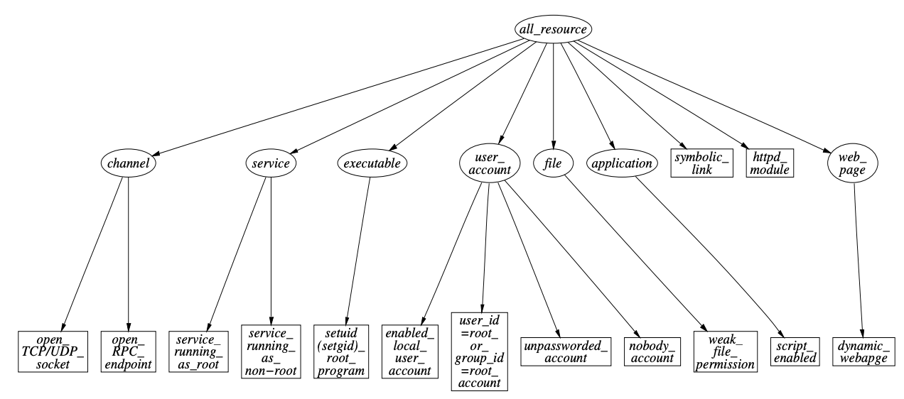
Linux Attack Mapping
Manadhata, Pratyusa (2008). An Attack Surface Metric (PDF).
^ Manadhata, Pratyusa; Wing, Jeannette M. "Measuring a System's Attack Surface" (PDF).
Manadata P. and Wing, J. M. , Measuring a System’s Attack Surface. January 2004

Slide 34
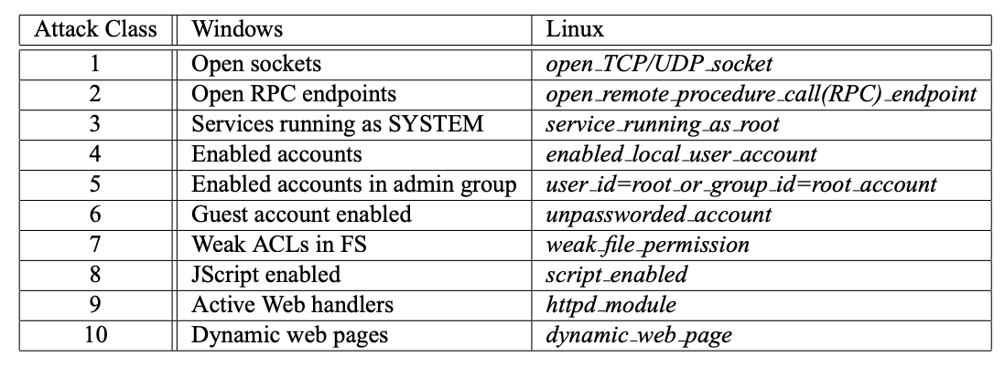
Linux and Windows Attack Classes Mapping
Manadata P. and Wing, J. M. , Measuring a System’s Attack Surface. January 2004

Slide 35
Application Attack Surface
Entry/exit points:
UI forms and fields HTTP headers and cookies APIs Files Databases Other local storage Email or other kinds of messages Run-time arguments ....
Types: Login/authentication entry points Admin interfaces Inquiries and search functions Data entry (CRUD) forms Business workflows Transactional interfaces/APIs Operational command and monitoring interfaces/APIs Interfaces with other applications/systems .
https://www.owasp.org/index.php?title=Attack_Surface_Analysis_Cheat_Sheet&oldid=156006

Slide 36
Application Attack Surface
the sum of all paths for data/commands into and out of the application, and
the code that protects these paths (including resource connection and authentication, authorization, activity logging, data validation and encoding), and
all valuable data used in the application, including secrets and keys, intellectual property, critical business data, personal data and PII, and
the code that protects these data (including encryption and checksums, access auditing, and data integrity and operational security controls).

Slide 37
Threat modeling
Threat: anything can exploit a vulnerability intentionally or accidentally, and obtain, damage or destroy an asset. Things that we are protect against.
Risk: the potential for loss, damage or destruction of an asset as a result of a threat exploiting a vulnerability.
Threat modeling provides assumptions about bad guys (system environment and capabilities of attackers). It is part of architectural risk analysis
Sometime it is used interchangeably with vulnerability or risk.
Some use threat modeling to mean (architectural) risk analysis.

Slide 38
Threat Modeling
Explicitly enumerate and prioritize all potential threats that jeopardize the security of a system
Start with identifying valuable assets and system components. Also consider environment change. For example, new technology emerges and old security solution is not secure anymore.
Each component in the system is evaluated based on its exposure, capabilities, threats, and attack surface. The analyst iterates through all components and identifies, on a per-component basis, all possible inputs, defining valid actions and possible threats.
For each identified threat, the necessary preconditions are mapped along with the associated risk and impact.
Each identified threat in the model can be handled through a defined mitigation or by accepting the risk if the cost of the mitigation outweighs the risk times impact.

Slide 39
Threat Modeling
What are valuable assets?
Project Portal: Project data, user data, host server
Blackboard: course content, assignment, grade information, user data
What are components in the system?
Users
Browser
Users’ machine
Web server
Database

Slide 40
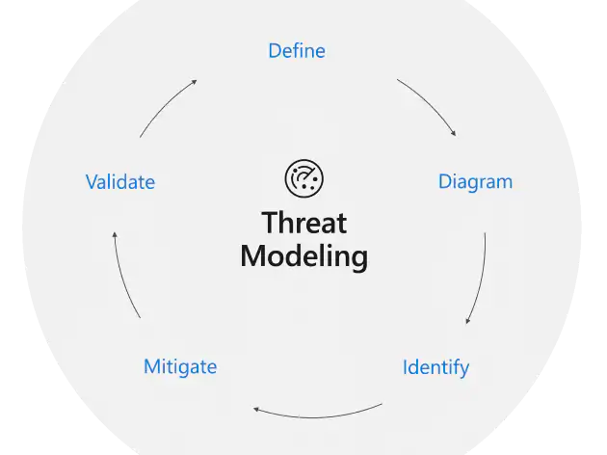
Microsoft Threat Modeling
Defining security requirements.
Creating an application diagram.
E.g. Data flow diagram
Identifying threats.
E.g. Using the STRIDE model
Mitigating threats.
Validating that threats have been mitigated.
https://www.microsoft.com/en-us/securityengineering/sdl/threatmodeling

Slide 41
STRIDE
Spoofing | Authentication | Pretend to be others | password
Tampering | Integrity | Grade is modified by an attacker | Digital signature, Access control
Repudiation | Non-repudiation(Audit) | I didn’t post that thread | Logging, digital signature
Information disclosure | Confidentiality | Students’ grade is viewed by another student | Encryption, Access control
Denial of service | Availability | Blackboard is not accessible | Load balancer Elastic designer Firewall
Elevation of privilege | Authorization | A student to instructor | Sandbox Roles, access control firewall

Slide 42
Mitigations
Auditing and Logging: Who did what and when?
Authentication: Who are you?
Authorization: What can you do?
Configuration Management: how your application handles these operational issues?
Cryptography: How are you keeping confidentiality and integrity?
Exception Management: How to fail?
Input Validation: How to filter, scrub, or reject input before additional processing?
Sensitive Data: How to protect data either in memory, over the network, or in persistent stores?
Session Management: How to handle and protect user sessions?

Slide 43
Tools
Microsoft Threat Modeling Tool: https://www.microsoft.com/en-us/securityengineering/sdl/threatmodeling
OWASP Dragon: https://owasp.org/www-project-threat-dragon/

Slide 44

IEEE CSD How to Avoid Top 10 Design Flaws
https://ieeecs-media.computer.org/media/technical-activities/CYBSI/docs/Top-10-Flaws.pdf
IEEE Center for Secure Design was created by IEEE Computer Society in 2014
The foundational workshop gathered software security expertise from industry, academia, and government to discuss common design flaws and came up with a top 10 list.
Design flaws can be harder to identify than implement bugs.

Slide 45
IEEE CSD How to Avoid Top 10 Design Flaws
Earn or Give, but Never Assume, Trust
Who to trust? (users, applications, clients, servers, oses, hardware … )
Malicious users or insiders, social engineering attacks,
Clients are less trustworthy than servers. Security controls in clients can lead to compromise.
Apps are less trustworthy than OS. Lower privilege for applications.
Always validate inputs
Limit damage of untrusted components (e.g. sandbox apps)
Multi-level protection
Use an Authentication Mechanism that Cannot be Bypassed or Tampered With
Strong password policy
Password only is not enough. Use multi-factor authentication
Reauthenticate whenever changing
Timeout always
IDs and tokens should not contain any meaningful information and unforgeable
A dedicated check point
Securely store identification information
Balance usability and security
Trust

Slide 46
IEEE CSD How to Avoid Top 10 Design Flaws
Authorize after You Authenticate
Proper access control is essential
Deny by default
Revoke authorization after expiration
Separation of privilege, higher privileged operations need more checks
Use MAC for higher security requirements
Strictly Separate Data and Control Instructions, and Never Process Control Instructions Received from Untrusted Sources .
Can lead to memory corruption vulnerabilities at the lower level (e.g. buffer overflow)
Can lead to injection vulnerabilities at the higher level
Use of reflection and eval can be very risky.
Define an Approach that Ensures all Data are Explicitly Validated
Do not trust any input
Centralized validation mechanisms
Ensure that it cannot be bypassed
Use common libraries, implementation language level types
Explicitly validate for “nearby “ code

Slide 47
Security Principles - Restrictiveness
CSEC 2017 (Cybersecurity Curricular Guideline) proposes 14 design principles in three categories.
Least Privilege: just enough privileges to complete the task
Fail-safe defaults/fail securely: deny access by default unless explicitly grant
Complete mediation: validate every access
Separation (of domains/duties): should not grant access to a resource or take a security relevant action, based on a single condition.
Minimize trust (Reluctance to trust): check all inputs and all security relevant actions.

Slide 48
IEEE CSD How to Avoid Top 10 Design Flaws
https://www.computer.org/cms/CYBSI/docs/Top-10-Flaws.pdf
Use Cryptography Correctly
Do not implement your own crypto algorithms
Choose right algorithms and libraries and use right parameters
Poor key management.
Randomness that is not random.
Failure to allow for algorithm adaptation and evolution
Avoid security by obscurity
Identify Sensitive Data and How They Should Be Handled
Based on regulation, policy, user requirements etc.
Include PII, keys, sensor data and user input
Include both data at rest and in transit

Slide 49
IEEE CSD How to Avoid Top 10 Design Flaws
https://cecs.wright.edu/~pmateti/Courses/4420/Lectures/SecSoftware/Top-10-Flaws-2014-pm.pdf
Always Consider the Users
Consider different types of users
Usability (simple UI)
Apply least astonishment
Understand How Integrating External Components Changes Your Attack Surface
Include in the threat model
Isolate
Minimize unused functionality
Find a proper one
Check default
Be Flexible When Considering Future Changes to Objects and Actors
Design for changes

Slide 50
Security Principles - Simplicity
Economy of Mechanism
Security features should be as simple as possible
Least Common Mechanism
The sharing of resources should be reduced as much as possible
Least Astonishment
security features of software, and security mechanisms it implements, should be designed so that their operation is as logical and simple as possible.

Slide 51
Security Principles - Methodology
Open Design
security of software, and of what that software provides, should not depend on the secrecy of its design or implementation.
Layering
modules at a given layer interact only with modules in the layers immediately above and below it. reduce access points, enforcing the principle of separation
Abstraction
hide the internals of each layer, making only the interfaces available, this enables you to change how a layer carries out its tasks without affecting components at other layers.
Modularity
software as a collection of cooperating components(modules), each module interface is an abstraction.
Complete linkage
security design and implementation link to the security specification
Design for iteration
plan the design in such a way that it can be changed, if needed.

Slide 52
Security Principles - Others
Defense in depth
Find the weakest link
Audit sensitive events
Fix security issues correctly

Slide 53
Iterative Approach
Requirement analysis and design can be done in parallel.
Iterative approach need to be used. It is rarely to come up complete sets of requirements and detailed design at once.
Security practices such as abuse cases, architecture risk analysis, attack tree, and threat modeling are usually mingled together.

Slide 54
Questions?

Slide 55
Risk Management Framework (RMF)
Identifying, tracking, and mitigating (storing, measuring, reporting) software risk overtime
Risk = probability X impact
A major hurdle has been the inability to tie risk clearly to business impact.
The purpose is to consistently track and handle risks (using an repeatable and expertise-driven approach)
A Master list of risks should be maintained during all stages of RMF execution and continuously revisited.

Slide 56
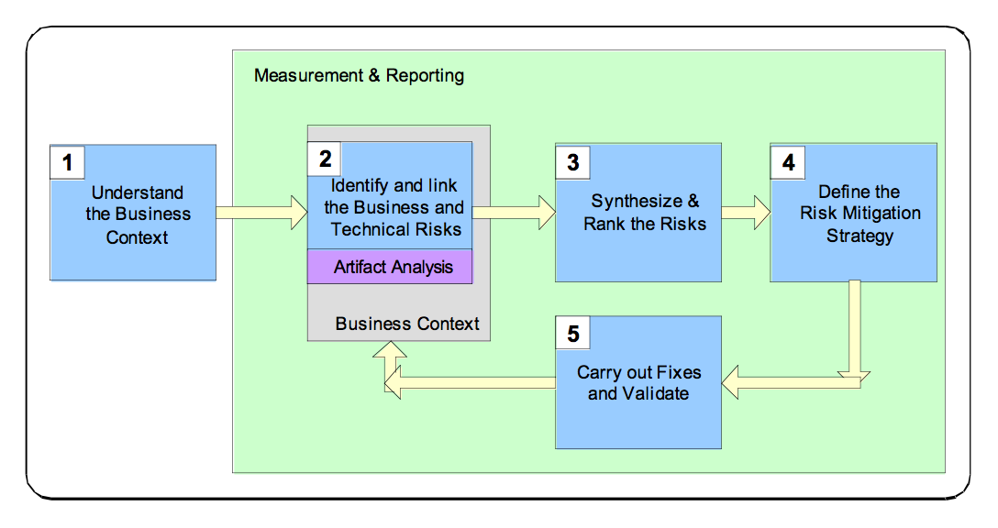
Cigital RMF
https://www.us-cert.gov/bsi/articles/best-practices/risk-management/risk-management-framework-%28rmf%29

Slide 57
Metrics
Identified/Outstanding risks by priority/type/subtype/financial impact
Risk discovery rate by priority/type/...
Risk mitigation status
Risk mitigation by priority/type/...
Risk mitigation rate by priority/type/…
Return on Investment (ROI)

Slide 58
Security Principles
References:
IEEE CSD avoid top-10 design flaws: https://www.computer.org/cms/CYBSI/docs/Top-10-Flaws.pdf
https://www.youtube.com/watch?v=4qN3JBGd1g8
CAE-CD (NSA and DHS)
OWASP security by design principles: https://www.owasp.org/index.php/Security_by_Design_Principles
The Protection of Information in Computer Systems, by Saltzer and Schroeder (in 1975)
http://web.mit.edu/Saltzer/www/publications/protection/Basic.html

