Slide 1
Vulnerability Taxonomy
Yuting Zhang
BU METCS

Slide 2
Vulnerabilities
A vulnerability is a weakness of an asset or group of assets that can be exploited by one or more threats” (ISO 27005)
Can exist in any component of a system:
Hardware vulnerabilities
OS vulnerabilities
Application vulnerabilities
Programming language vulnerabilities
User vulnerabilities
Protocols vulnerabilities
Vulnerability in Software
Implementation Bugs
Design Flaws (manifested in the code)

Slide 3
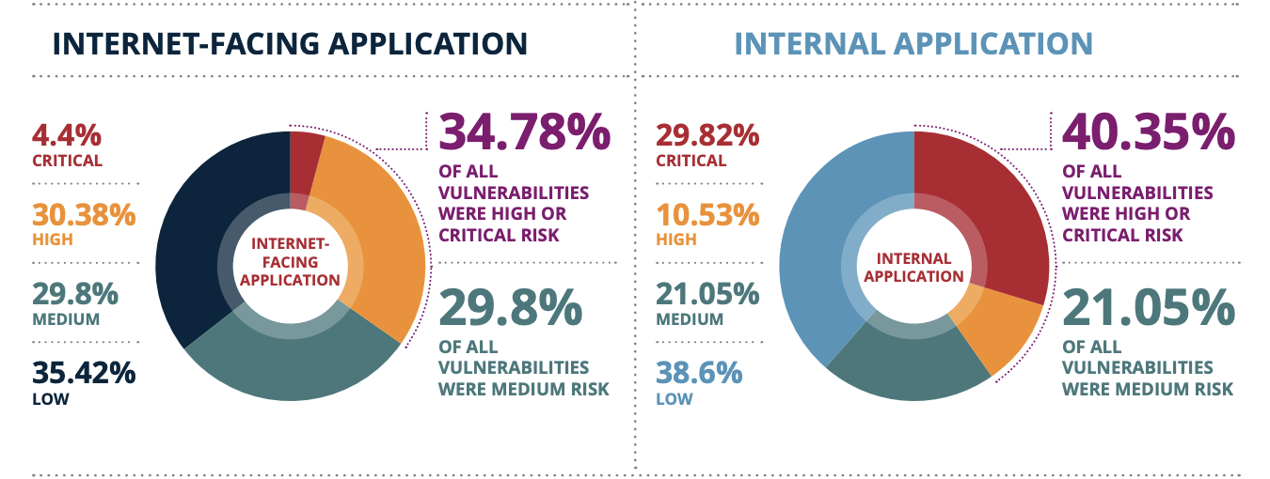
Vulnerability Statistics
https://cdn2.hubspot.net/hubfs/4118561/BCC030%20Vulnerability%20Stats%20Report%20(2020)_WEB.pdf

Slide 4
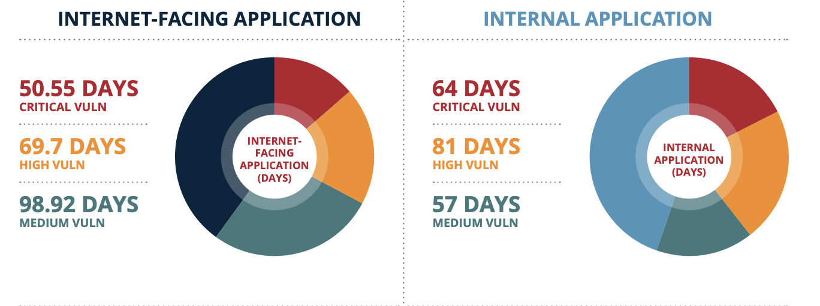
Vulnerability Statistics
https://cdn2.hubspot.net/hubfs/4118561/BCC030%20Vulnerability%20Stats%20Report%20(2020)_WEB.pdf

Slide 5
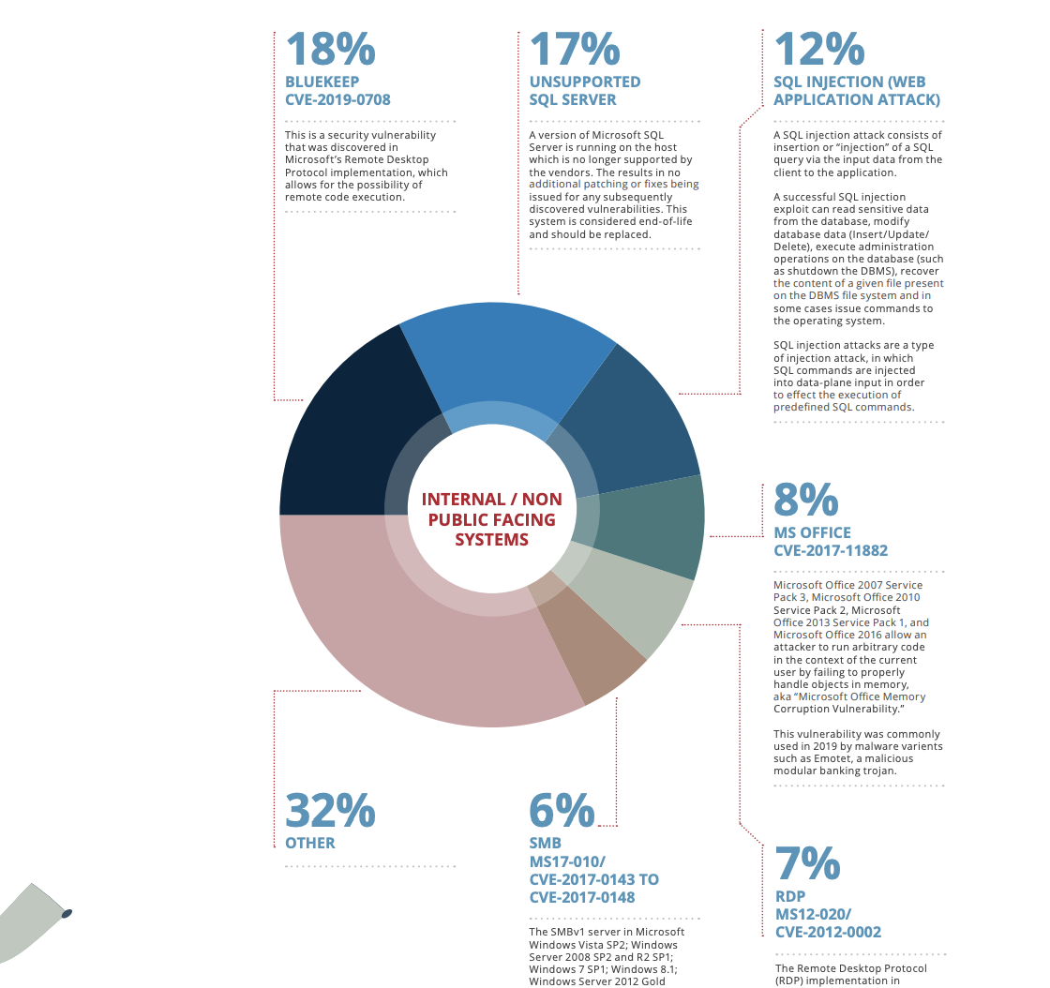
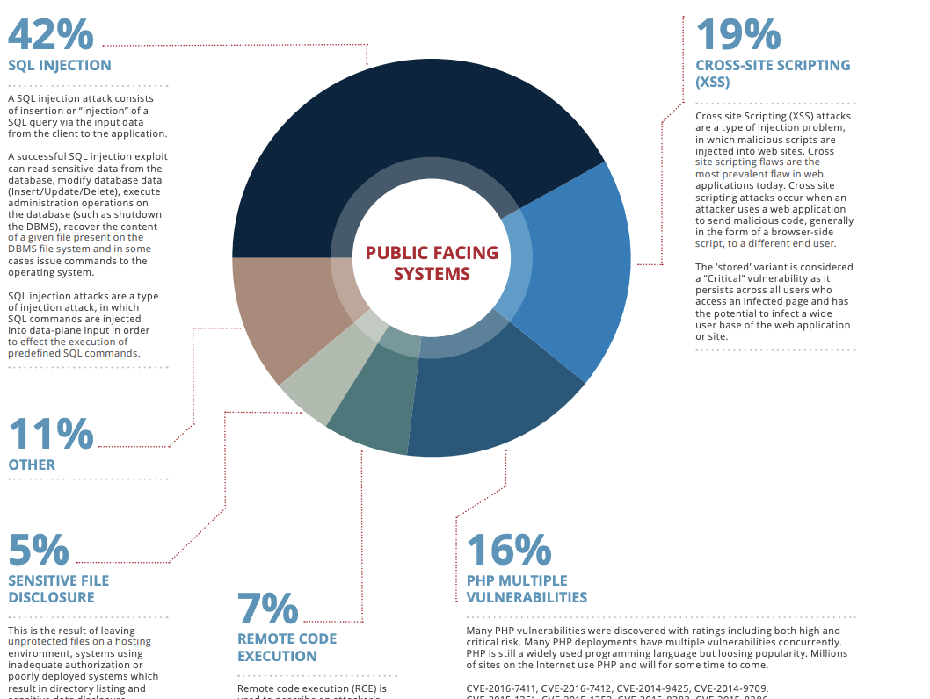
Most Common Critical Vulnerability

Slide 6
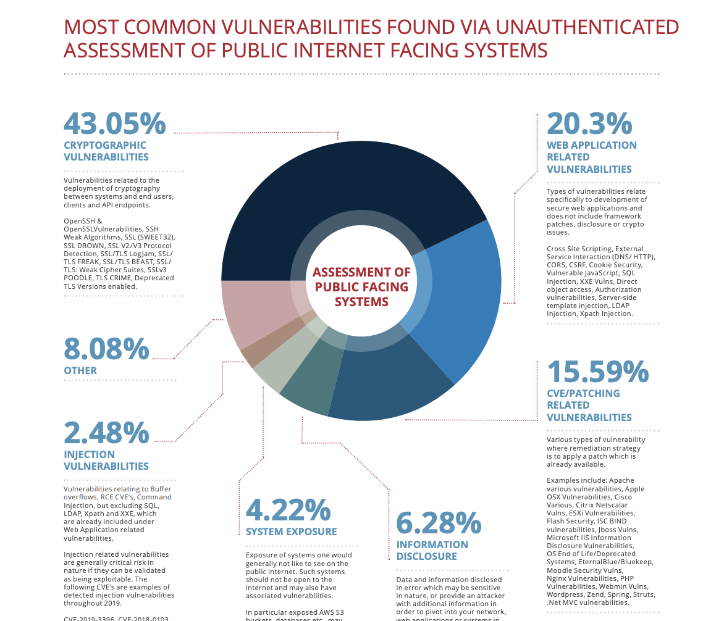
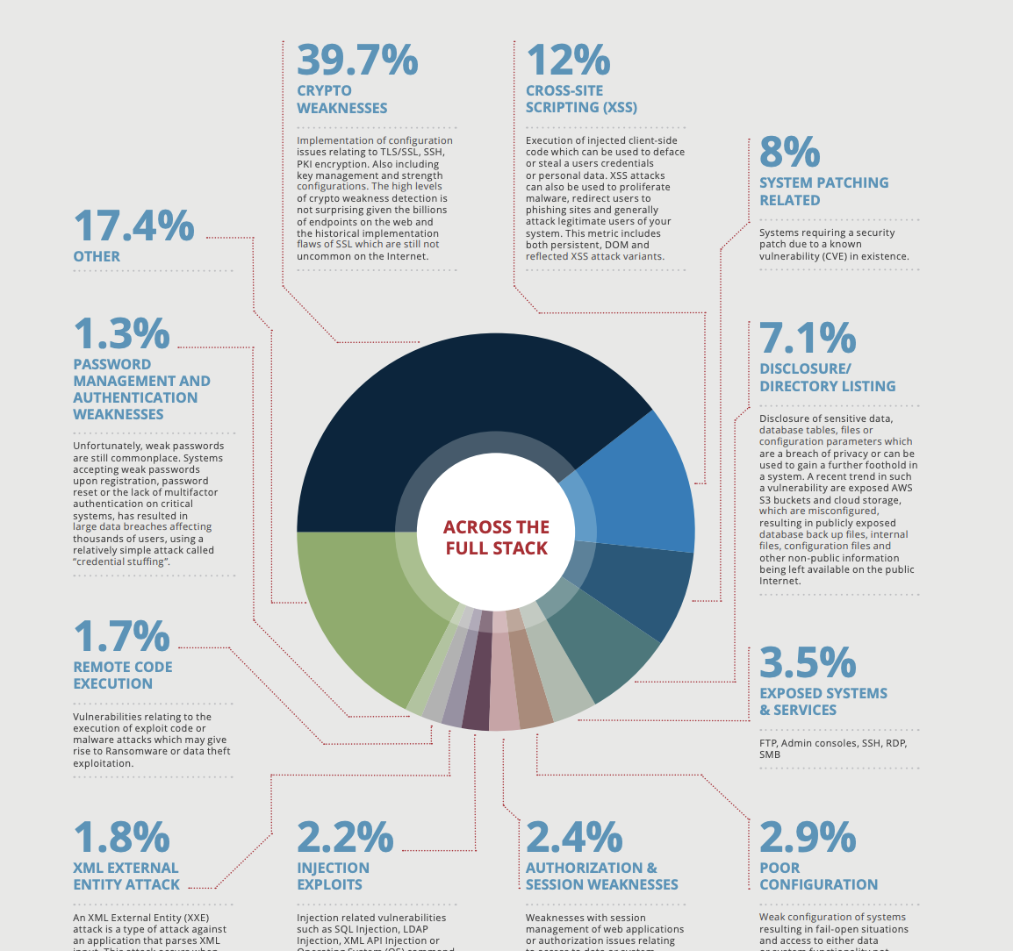
Most Common Vulnerability

Slide 7
OWASP Top 10 (2017) (Web Applications)
Injection (SQL injection, noSQL injection, OS injection, LDAP injection … )
Broken Authentication
Sensitive Data Exposure
XML External Entities (XXE)
Broken Access Control
Security Misconfiguration
Cross Site Scripting (XSS)
Insecure Deserialization
Using Components with Known Vulnerabilities
Insufficient Logging and Monitoring
https://www.owasp.org/index.php/Top_10-2017_Top_10

Slide 8
OWASP Mobile Top 10 (2016)
Improper Platform Usage
Insecure Data Storage
Insecure communication
Insecure Authentication
Insufficient Cryptography
Insecure Authorization
Client Code Quality
Code Tampering
Reverse Engineering
Extraneous Functionality
https://www.owasp.org/index.php/Mobile_Top_10_2016-Top_10

Slide 9
OWASP (Mobile) Top 10 (2016)
Injection (SQL injection, noSQL injection, OS injection, LDAP injection … )
Broken Authentication
Sensitive Data Exposure
XML External Entities (XXE)
Broken Access Control
Security Misconfiguration
Cross Site Scripting (XSS)
Insecure Deserialization
Using Components with Known Vulnerabilities
Insufficient Logging and Monitoring
Improper Platform Usage
Insecure Data Storage
Insecure communication
Insecure Authentication
Insufficient Cryptography
Insecure Authorization
Client Code Quality
Code Tampering
Reverse Engineering
Extraneous Functionality

Slide 10
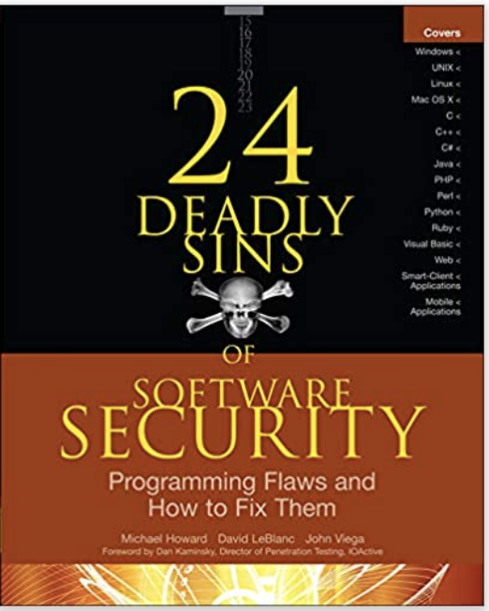
24 Deadly Sins (2010)
By Michael Howard, David LeBlanc, and John Viega
Focus on programming flaws
Classified into 4 categories
Web application sins (4)
Implementation sins (14)
Cryptographic sins (3)
Networking sins (3)
For each sin,
Provide the description, testing techniques and redemption steps
Provide related CWE and CVE references
Provide coding examples in different programming languages.

Slide 11
SQL Injection
Targets: SQL database, e.g. Microsoft SQL, MySQL, Orale, IBM DB2, …
CWE-89 (Top 25 most dangerous programming errors)
CVE-2006-4953 and CVE-2006-4592
Use unvalidated and/or unprocessed input data to construct sql statement (e.g. using string concatenation or string replacement).
Related principle: do not trust user input, separate date and control
Redemption steps:
Validate all input
Use prepared statements or SQL methods

Slide 12
Web Application Sins
SQL injection
Web server related vulnerabilities (XSS, XSRF, and response splitting)
Web client related vulnerabilities(XSS)
Use of magic URLs, predictable cookies, and hidden form field

Slide 13
Implementation Sins
Buffer overruns
Format string problems
Integer overflows
C++ catastrophes
Catching exceptions
Command injection
Failure to handle errors correctly
Information leakage
Race conditions
Poor usability
Not updating easily
Executing code with too much privilege
Failure to protect stored data
The sins of mobile code

Slide 14
Cryptographic Sins
Use of weak password based systems
Weak random numbers
Using cryptography incorrectly

Slide 15
Networking Sins
Failing to protect network traffic
Improper use of PKI, especially SSL
Trusting network name resolution

Slide 16
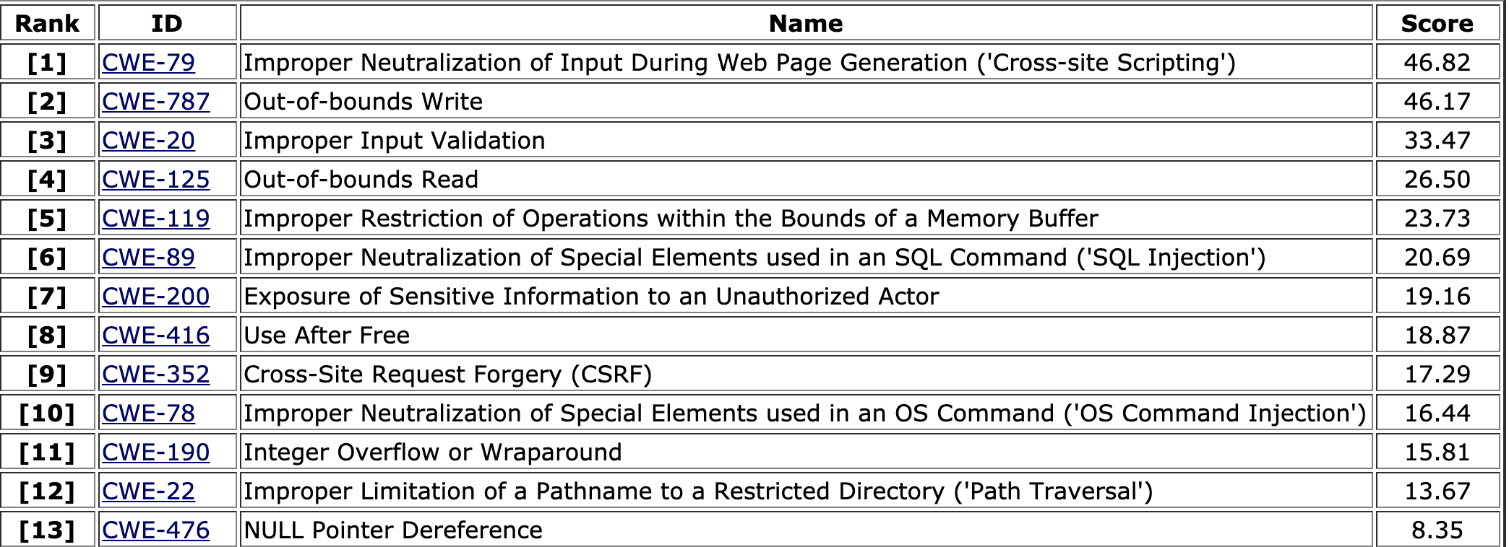
CWE (Common Weakness Enumeration) Top 25 (2020)
https://cwe.mitre.org/top25/index.html

Slide 17
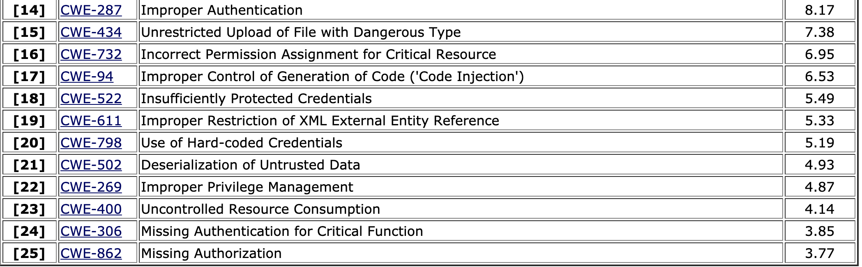
CWE (Common Weakness Enumeration) Top 25 (2020)

Slide 18
CWE vs CVE
CWE (Common weakness Enumeration) (https://cwe.mitre.org/): a list of software and hardware weaknesses that can occur in architecture, design, code, or implementation that can lead to exploitable security vulnerabilities.
CVE (Common vulnerabilities and Exposures) (https://cve.mitre.org/): a list of publicly known cybersecurity vulnerabilities and exposures. It focuses on specific instance within a product or system instead of the underlying flaw.
Both lists are maintained by MITRE Corp.
U.S. National Vulnerability Database (NVD) (by NIST) is a vulnerability database built upon and fully synchronized with the CVE List. It also provides enhanced information for each record such as fix information, severity scores, and impact ratings, as well as advanced searching features such as by OS, vendor name, product name, and/or version number; and by vulnerability type, severity, related exploit range, and impact.

Slide 19
Score Calculation
To determine a CWE’s frequency, the scoring formula calculates the number of times a CWE is mapped to a CVE within the NVD. Only those CVEs that have an associated weakness are used in this calculation, since using the entire set of CVEs within the NVD would result in very low frequency rates and very little difference amongst the different weakness types.
Freq = {count(CWE_X’ ∈ NVD) for each CWE_X’ in NVD}
Fr(CWE_X) = (count(CWE_X ∈ NVD) - min(Freq)) / (max(Freq) - min(Freq))
The other component in the scoring formula is a weakness’ severity, which is represented by the average CVSS score of all CVEs that map to the particular CWE. The equation below is used to calculate this value. Sv(CWE_X) = (average_CVSS_for_CWE_X - min(CVSS)) / (max(CVSS) - min(CVSS))
The level of danger presented by a particular CWE is then determined by multiplying the severity score by the frequency score.
Score(CWE_X) = Fr(CWE_X) * Sv(CWE_X) * 100

Slide 20
CVSS Score
Common Vulnerability Scoring System (CVSS) Calculator:https://nvd.nist.gov/vuln-metrics/cvss/v3-calculator )
Base Score
Temporal Score
Environmental Score.
None | Low | Medium | High | Critical
0.0 | 0.1-3.9 | 4.0-6.9 | 7.0-8.9 | 9.0-10.0

Slide 21
CWE List
Total 1000+ Weaknesses
https://cwe.mitre.org/data/index.html
View by Research Concepts
Mainly organized according to abstractions of software behaviors.
Use class, base, variant, chain and composite to show relationships between weaknesses.
https://cwe.mitre.org/data/definitions/1000.html
View by Development Concepts
Organized around software development concepts
Use category, class, base, variant to show relationships between weaknesses.
https://cwe.mitre.org/data/definitions/699.html
View by Hardware Design
Organized around concepts that are frequently used or encountered in hardware design.
Align closely with the perspectives of designers, manufacturers, educators, and assessment vendors.
Use category, class, base, variant to show relationships between weaknesses.
https://cwe.mitre.org/data/definitions/1008.html

Slide 22
Summary
Common vulnerabilities are included in all lists, with possible different rankings and categories
Most vulnerabilities are described independent of languages and frameworks
Vulnerabilities listed are also aligned with the design flaws.
It is important to understand both high level concepts and detailed manifestation (at the code level) of each vulnerability (and the category), as well as the mitigations.

Slide 23
Questions

