Slide 1
Buffer Overflow
Yuting Zhang
BU METCS

Slide 2
References
Michael Howard, David LeBlanc, John Viega. 24 Deadly Sins of Software Security
SEED Book: Wenliang Du. Computer Security: A Hands-on Approach (Chapter 4).https://www.handsonsecurity.net/
OWASP Buffer Overflow: https://www.owasp.org/index.php/Buffer_Overflow

Slide 3
Introduction
Definition: unvalidated input overflows a buffer
Type: stack overflow, heap overflow, format string, ...
Consequences:
crash, or gain control of app, or gain complete control,
worm, rootkit
Target:
Low level languages (C, C++, Objective-C ...)
High level languages (e.g. Java, .NET, PhP, Python, Perl, ) can be affected indirectly
When you call native code or use external programs/extensions
In the VM itself (usually written in C++)
The interpreter or compiler does not work correctly (e.g. Java bytecode mandated bounds checks)
Security principles violated
Minimum Trust
Separation of duty (separate code from data)

Slide 4
Background
Architecture
C programming language (particularly on pointer)
Memory layout

Slide 5
Some details about architecture
Memory address and value
Binary, hexadecimal, and decimal
35 = 0X23 = 0B 00100011
Bits, Bytes, and address
1 byte = 8 bits (2 hexadecimal digits)
32 bits vs 64 bits architecture
Little endian vs big endian
Little endian: The least significant byte (the "little end") of the data is placed at the byte with the lowest address. The rest of the data is placed in order in the next three bytes in memory.
Big endian: The most significant byte (the "big end") of the data is placed at the byte with the lowest address. The rest of the data is placed in order in the next three bytes in memory.
big endian: 0x 00 40 10 3f
0x 00 40 10 3f
4198463
Low addr
high addr
little endian: 0x 10 3f 00 40

Slide 6
C Programming Basics
a
Pointers and addresses
int a, *b; a = 3; b = &a; a++; b?
Type cast
unsigned int c = (signed int) b
Strings
char *str = “string”; int len = strlen(str);
Printing format
printf(“ %d %x %p %s \n” x, y, z, b);
0x238459e0
04
00
00
00
0x238459e3
b
0x238459e4
0x238459e0

Slide 7
Memory layout
int x = 100;
int main()
{
int a =2;
float b = 2.5;
static int y;
int *ptr = (int *) malloc(20*sizeof(int);
ptr[0] = 5;
ptr[1] = 6;
free(ptr);
return 1;
}
Text: program code
Data: global and static variables initialized
BSS: uninitialized global and static variables
Heap: dynamic allocated data (malloc() or new())
Stack: a collection of stack frame. Keep the history of unreturned functions: parameters, local variables, return address, frame pointer etc.
high addr
stack (a,b,ptr)
Heap segment
uninitialized
BSS segment
Initialized
Data segment
Text segment
Low addr

Slide 8
Stack Frame
high addr
main()
{
A();
}
A()
{
B();
C();
}
B()
{
D();
}
C()
{
D();
}
main()
A()
C()
B()
D()
Low addr

Slide 9
Stack Frame layout
int main() { foo(1,2); }
void foo (int a, int b) {
int x, y
x= a + b ;
y = a - b;
}
high addr
Arguments
Return addr
Previous frame pointer
Current frame pointer
Local variables
Low addr
Current
stack pointer

Slide 10
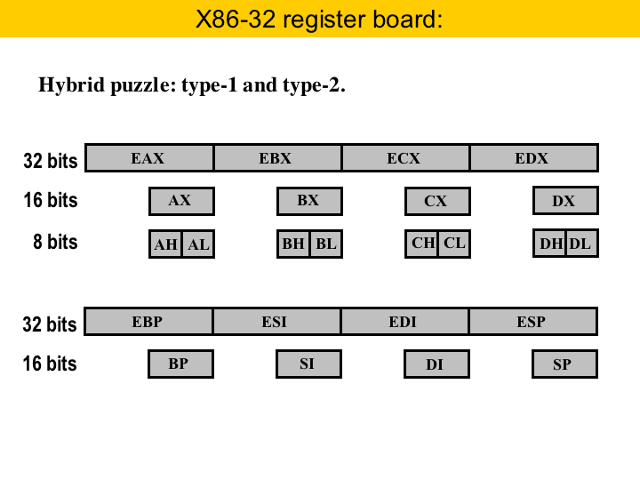
Registers (Intel X86 32 bits)
General purpose data registers
Pointer registers:
EBP: frame (base) pointer
ESI: Source Index
EDI: Destination Index
ESP: stack pointer
Source: A tutorial on Register Allocation by Puzzle Solving (on compilers.cs.ucla.edu)

Slide 11
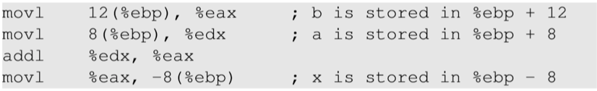
Assembly Code
Int main() { foo(1,2); }
void foo (int a, int b) {
int x, y
x= a + b ;
y = a - b;
}
high addr
Arguments
Return addr
Previous frame pointer
Current frame pointer
Low addr
Local variables
Current
stack pointer

Slide 12
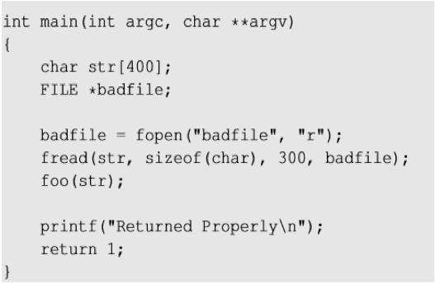
Buffer Overflow Vulnerable Code
stack.c

Slide 13
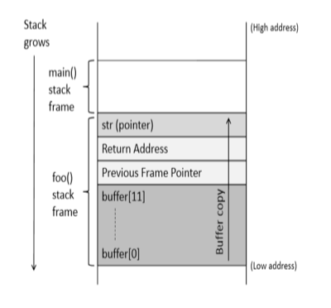
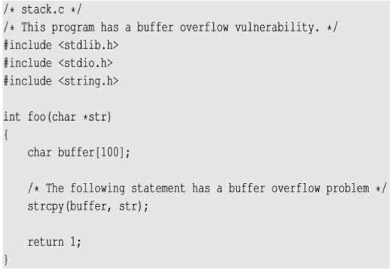
Buffer Overflow Vulnerable Code
99
char str[100] = “hello \0 world”;

Slide 14
Exploits
Malicious code
Malicious code
NOP
high addr
Arguments
overwrite
NOP
NOP
Return addr
Overwrite with new addr
Overwrite with new addr
Previous frame pointer
overwrite
overwrite
Current frame Pointer (ebp)
(ebp)
(ebp)
buff[99]
…
buff[0]
buff[99]
…
buff[0]
buff[99]
…
buff[0]
Low addr

Slide 15
Stack Overflow Consequences
Overwriting return address with some random address can point to :
Invalid instruction
Non-existing address
Access violation
Attacker’s code -> Malicious code to gain access
How to know where the return address is stored in the stack
How to construct malicious code
How to let the return address point to malicious code
Make sure to turn off stack protections:

Slide 16
Address Calculation
Return address location : $ebp + 4 -- don’t know $ebp
Calculate $ebp based on its distance to the buffer base address
Can use gdb to check these addresses: buffer base address, frame pointer (in ebp) (make sure to disable randomize memory)
return address location = buffer base address + distance between $ebp and buffer base address + 4
Return address value >= return address location + 4
Specify the address of malicious code
Malicious code is passed as arguments
Use NOP instructions to increase the chance of jumping to the correct address of malicious code
Construct the bad file. Embed the return address and malicious code into the file.
Malicious code
NOP
NOP
NOP
Overwrite with new addr
overwrite
(ebp)
buff[99]
…
buff[0]

Slide 17
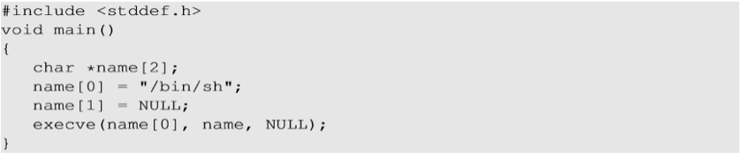
Shell Code
Shell code is commonly used to gain more access of the system
Sd
Challenges : Loader Issue Zeros in the code

Slide 18
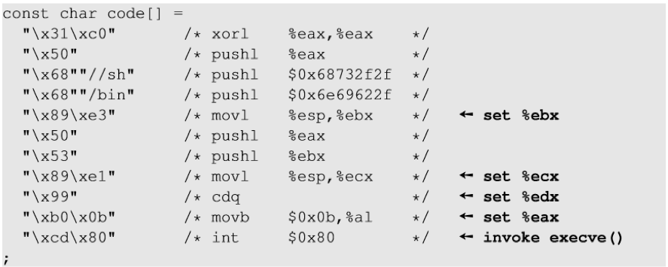
Shell Code

Slide 19
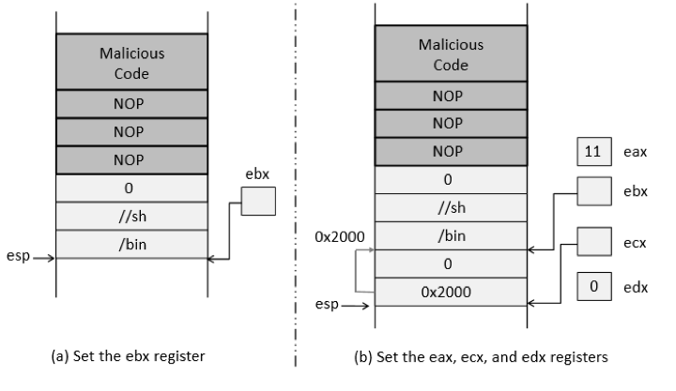
Shell Code

Slide 20
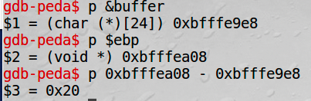
Bad File Construction
char buffer[517];
FILE *badfile;
/* Initialize buffer with 0x90 (NOP instruction) */
memset(&buffer, 0x90, 517);
//specify the return address at the right position
unsigned int offset = 0X24;
unsigned int ret = 0xbfffea98;
*((unsigned int *) (buffer + offset )) = ret ;
// copy the shell code towards the end of the buffer
memcpy(buffer + sizeof(buffer) - sizeof(shellcode), shellcode, sizeof(shellcode));
/* Save the contents to the file "badfile" */
badfile = fopen("./badfile", "w");
fwrite(buffer, 517, 1, badfile);
fclose(badfile);

Slide 21
Python Code to Generate the Bad File
# Fill the content with NOP's
content = bytearray(0x90 for i in range(517))
# Put the shellcode at the end
start = 517 - len(shellcode)
content[start:] = shellcode
ret = ______
offset = _____
content[offset:offset + 4] = (ret).to_bytes(4,byteorder='little')
# Write the content to a file
with open('badfile', 'wb') as f:
f.write(content)

Slide 22
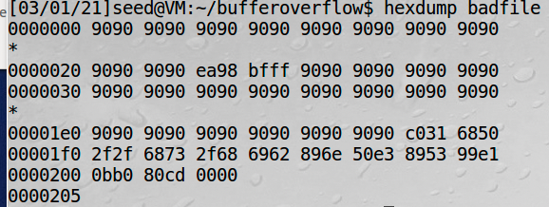
Exploit
Make sure to turn off stack protections:
Create the badfile

Slide 23

Exploit
Exploit it to start a shell
Exploit it to start a root shell

Slide 24
Sin Pattern
Input, whether read from the network, a file or the command line
Transfer of data from said input to internal structures
Use of unsafe string handling calls
Use of arithmetic to calculate an allocation size or remaining buffer size
Off-by-one, wrap-around error, unchecked/incorrect calculation of buffer size, unchecked array indexing, integer overflow

Slide 25
CVE
Find CVE (https://cve.mitre.org/) entries in recent three years that is related to buffer overflow vulnerabilities. How many can you find? What platforms are affected?

Slide 26
Redemption Steps
Application Level:
Replace dangerous string handling functions (strcpy, strcat,sprintf, gets)
Counting, termination, truncation
Audit allocations
Allocation size
Check loops and array accesses
Replace C string buffers with C++ Strings
Replace static arrays with STL (Standard Template Library) container
Use analysis tools
Platform level:
ARLS (Address Space Layout Randomization ) - OS level
Stack protection - Compiler
Non Executable stack and heap - hardware

Slide 27
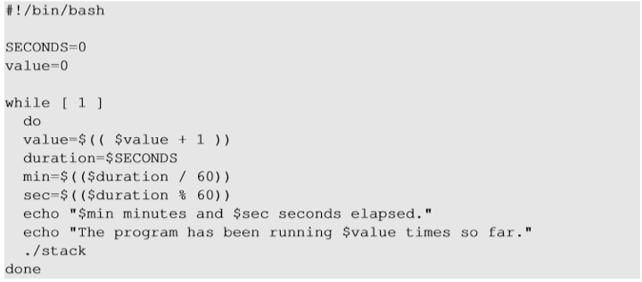
ASLR
Randomize stack location, so it is hard to guess ebp and hard to guess the malicious code address
sudo sysctl -w kernel.randomize_va_space=2
Try brute force to defeat it. Run the vulnerable code many times.

Slide 28
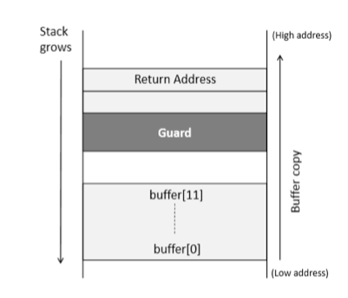
Stack Guard
Compiler inserts a secret value into the stack and if the value is changed due to buffer overflow, the program exists without returning.
Different ways to bypass the guard, e.g. https://www.cs.purdue.edu/homes/xyzhang/spring07/Papers/defeat-stackguard.pdf

Slide 29
Non-executable Stack
NX bit, standing for No-eXecute feature in CPU separates code from data which marks certain areas of the memory as non-executable.
This countermeasure can be defeated using a different technique called Return-to-libc attack

Slide 30
Format String
Format string is used to format data for display or storage
Unvalidated format string from input can cause memory corruption (buffer overflow problem)
Example: the printf() family functions take a variable number of arguments by specifying an ellipsis (...) as the last argument. (printf(“id: %d, namer: %s\n”, id, name);
Sin Patterns: no explicit format string assigned.
printf(user_input);
fprintf(STDOUT, user_input)
fprintf(STDOUT, msg_format, arg1, arg2);
Redemption:
never pass user input directly to a formatting function (e.g. printf, sprintf, fprintf, vprintf, scanf, vfscanf) and handle it at every level.
Never read format strings from untrusted place.
printf(“%s”, user_input);

Slide 31
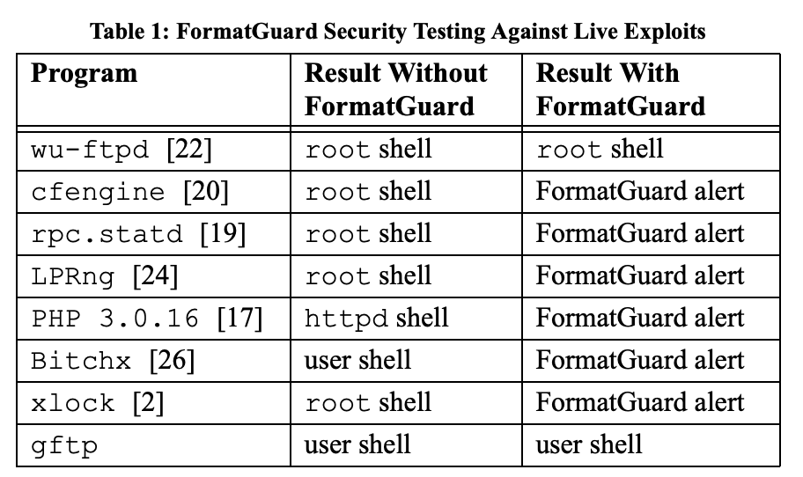
Format String
Exploits example and countering tools:
From “FormatGuard: Automatic Protection From printf Format String Vulnerabilities” by Crispin Cowan, Matt Barringer, Steve Beattie, and Greg Kroah-Hartman, USENIX2001

Slide 32
Format String
Helpful Compiler options
Wall, Wformat, Wno-format-extra-args, Wformat-nonliteral, Wformat-security, Wformat=2
Testing:
Pass formatting specifiers into the application and see if hexadecimal values are returned.
Exercise:
Find format-string vulnerabilities in CVE

Slide 33
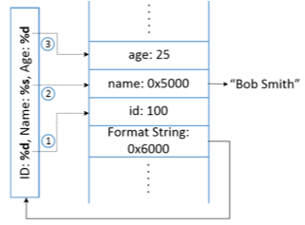
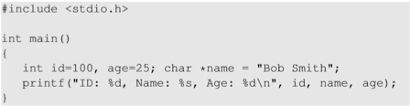
Stack Layout
The va_list pointer points to optional arguments. It starts right after the format string. The format string specifies the number of optional arguments using the number of format specifiers.

Slide 34
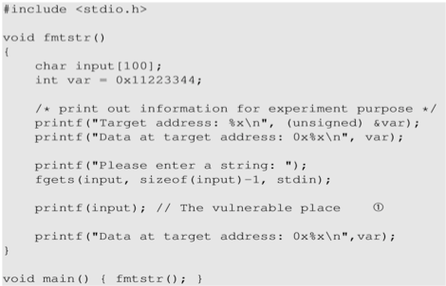
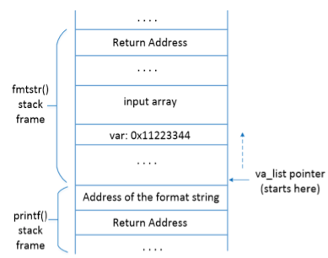
Exploits

Slide 35
Exploits
Use %n to modify memory data
Change to a specific value
And even inject malicious code

Slide 36
Integer Overflow
Integer overflows, underflows, and arithmetic overflows, float pointing errors can be exploited to cause crashes, logic errors, or even escalation of privilege and execution of arbitrary code.
Affect all common languages and can cause more damage on C/C++.
Understand how the numbers are represented in binary and how arithmetic operations cast different types
Byte, short, int, long, long long, unsigned, signed
Upcast or downcast when using operators such as +, - *, /, %, <, >, = |, &, ^, ~ ? In particular, cast between signed and unsigned can be dangerous
32 bits or 64 bits architecture

Slide 37
Exploits
Dangerous cases:
Memory allocation based on your calculation.
Array indexing, array offset,
Pointers calculation
Catch integer exceptions
Redemption Steps:
Do right math
Don’t use tricks
Write out casts
Use safeint

Slide 38
Examples
From the textbook “24 deadly sins”.

Slide 39
Questions?

