Slide 1
CS763
Crypto Basics
Yuting Zhang
BU METCS

Slide 2
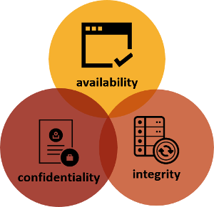
Why Cryptography?
A
B
Msg
C
https://fireoakstrategies.com/infosec/

Slide 3
What is Cryptography?
The art or science that treats of the principles, means, and methods to render information unintelligible to all but the intended receiver. The sender enciphers a message into an unintelligible form, and the receiver deciphers it into intelligible form.
Generically an encryption algorithm E transforms ,encrypts, the original information (plain- or clear-text) P into cipher-text C
The cipher-text can be transformed back, or decrypted, to the original plain-text information through a decryption algorithm D
Encryption depends on the computations specified by the algorithm but also on some constant value e, called the encryption key, that is used in these computations
Decryption also on some constant d, called the decryption key
Copyright © 2015 Stuart Jacobs

Slide 4
What is Cryptography?
Cryptography
Broader meaning: Mathematical techniques used to secure communication in the presence of adversaries. (cipher design)
Cryptanalysis
The study of methods for obtaining the meaning of encrypted information without accessing the secret information (cipher breaking)
Cryptology = cryptography + cryptanalysis

Slide 5
Attacks on Crypto algorithms
Ciphertext only attack: based on collections of the ciphertext
known plaintext attack: based on collections of the plaintext and the ciphertext pairs
chosen plaintext attack: based on collections of the plaintext and the ciphertext pairs where the plaintext are selected by the attacker
chosen ciphertext attack: based on collections of the plaintext and the ciphertext pairs where the ciphertext are selected by the attacker

Slide 6
Cryptanalysis
Goal: Find the clear-text (plaintext) or used encryption key when encryption has been used.
Encryption mechanism is unconditionally secure if the generated ciphertext does not contain enough information to uniquely determine the corresponding plaintext, no matter how much ciphertext is available.
There is only one encryption algorithm, known as the one-time pad scheme, that is unconditionally secure.
Computationally secure means that cost of breaking cipher exceeds the value of encrypted information (namely the time required for breaking encryption exceeds useful lifetime of information)

Slide 7
Kerckhoffs's Principle
Stated by Dutch cryptographer Auguste Kerckhoffs in the 19th century
A cryptosystem should be secure even if everything about the system, except the key, is public knowledge.
This is an very important security design principle - open design.

Slide 8
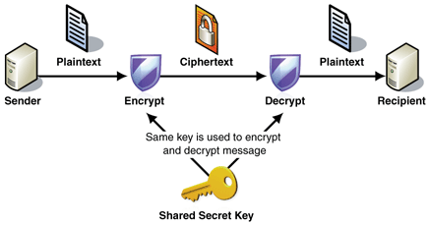
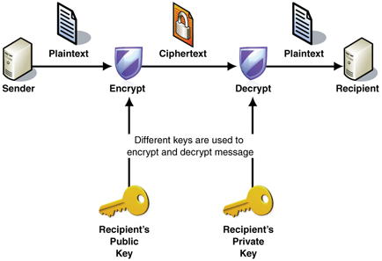
Types of Cryptosystems
Symmetric(use shared secret key)
Asymmetric (use public-private key pairs )
https://msdn.microsoft.com/en-us/library/ff650720.aspx

Slide 9
Symmetric (Secret Key)
C = E_{K}(P) P = D_{K}(C) D_{K}(E_{K}(P)) = P (C: ciphertext, P: plaintext, K: secret key, E: encryption function, D: decryption function)
Both E and D are one-to-one mapping functions
Same key for encryption and decryption
The plaintext length is typically the same as ciphertext length
Need agree on the secret key in advance
Challenge: how to distribute key secretly?

Slide 10
Two Basic Symmetric Encryption Techniques: Substitution
Units of plaintext are replaced with ciphertext.
Types:
Simple substitution: operate on single letters, e.g. shifted or reversed used
Polygraphic substitution: operate on large groups of letters
Monoalphabetic substitution: use fixed substitution over the entire message
Polyalphabetic substitution: use a number of substitutions at different positions in the message, where a unit from the plaintext is mapped to one of several possibilities in the ciphertext and vice versa.
Examples: Caesar’s cipher, Vigenère Cipher, One-time Pad

Slide 11
Two Basic Symmetric Encryption Techniques: Substitution
Caesar’s cipher: simple, monoalphabetic, and easy to break. The distribution of the letters are same.
e.g. K= 3 means right shift 3 positions: ABCD… - DCEF….
Vigenère Cipher: (polyalphabetic, periodic key)
e.g. shift various position depending on the key E (Network) (K= 123): Ogwxqul
One-time Pad: polyalphabetic, use nonperiodic key
Use random key stream. Each key is used only once.
Theoretically unbreakable.
Impractically: need true randomness. The key length need to be the same as the plaintext length due to one time usage.

Slide 12
Two Basic Symmetric Encryption Techniques: Transposition
All characters in the plaintext are still in the ciphertext, but the positions are different.
The ciphertext is a permutation of the plaintext.
Problem: this does not affect the frequency of each individual symbol
Example: CS763 Software Security CofcrS 3Saeri S6tue7tyw

Slide 13
Block Cipher vs. Stream Cipher
Block cipher: the plaintext is divided into blocks (e.g. 64bit, 128 bits) consisting of a fixed length of bits. Each block is encrypted at a time.
Requires padding with extra bits for the last block.
Modes: EBC, CBC, OFB, ...
Stream Cipher: plaintext is broken into a stream of successive bits and each bit (byte) is enciphered at time with the corresponding bit (byte) from a key stream of bits. Usually using XOR operation.
The key stream may be periodic (repeats itself after n character) or nonperiodic.
Types: synchronous stream cipher, Self-synchronous stream cipher

Slide 14
Block Cipher vs. Stream Cipher
Confusion (Confidentiality)
The relationship between the key and ciphertext as complex as possible.
Cannot determine the key based on ciphertext
Diffusion (Integrity)
Redundancy in the statistics of the plaintext is “dissipated” in the statistics of the ciphertext.
Minor change in plaintext should result in major change in ciphertext.
High Speed
Error propagation rate

Slide 15
Block Cipher vs. Stream Cipher
Confusion (Confidentiality)
The relationship between the key and ciphertext as complex as possible.
Cannot determine the key based on ciphertext
Both have. Stream cipher depends on the key stream.
Diffusion (Integrity)
Redundancy in the statistics of the plaintext is “dissipated” in the statistics of the ciphertext.
Minor change in plaintext should result in major change in ciphertext.
Block (high) > Stream (low) ( suspect to change)
High Speed
Stream is faster
Error propagation rate
Stream is better

Slide 16
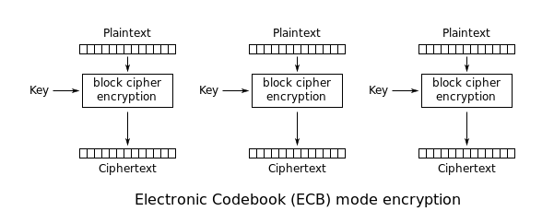
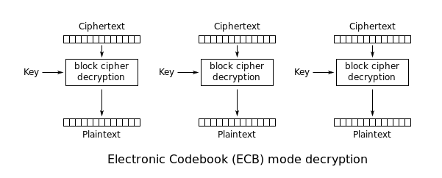
Modes of Operation: ECB
Electronic Code Book
Break the plaintext into blocks, and encrypt each block with the secret key separately.
Decrypt each encrypted blocks and merge together into the original message.
Problems: easy for eavesdropper to get information from repeated blocks, easy to alter. Seldomly used.
https://en.wikipedia.org/wiki/Block_cipher_mode_of_operation

Slide 17
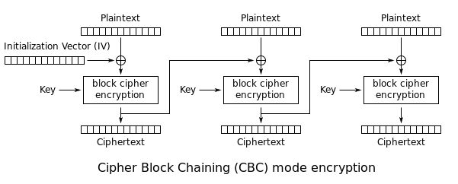
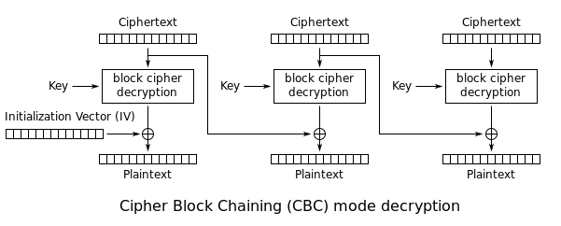
Modes of Operations: CBC
Cipher Block Chaining
Each block of plaintext is XORed with the previous ciphertext block before being encrypted
Each ciphertext block depends on all previously encrypted plaintext blocks.
A random number (known as initialization vector) must be used in the first block to keep each message unique.
https://en.wikipedia.org/wiki/Block_cipher_mode_of_operation

Slide 18
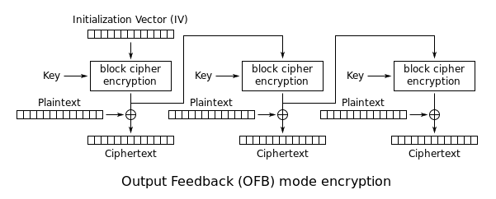
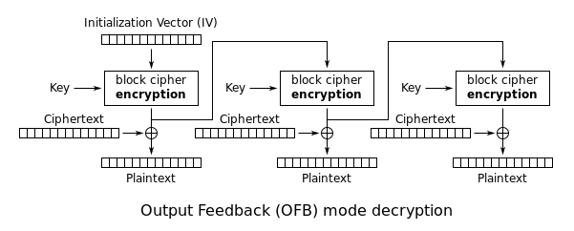
Modes of Operations: OFB
Output Feedback
Generates keystream blocks, then XORed with the plaintext blocks to get the ciphertext.
Initialization vector is needed.
Makes a block cipher into a synchronous stream cipher.
https://en.wikipedia.org/wiki/Block_cipher_mode_of_operation

Slide 19
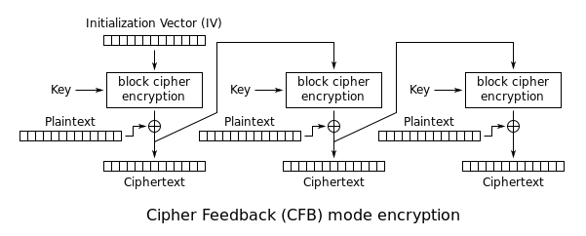
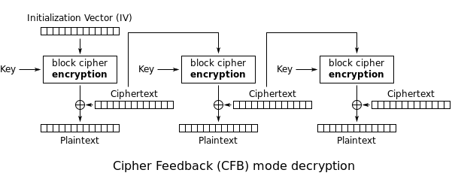
Modes of Operations: CFB
Cipher Feedback
Similar to OFB and CBC
Makes a block cipher into a self-synchronizing stream cipher.
https://en.wikipedia.org/wiki/Block_cipher_mode_of_operation

Slide 20
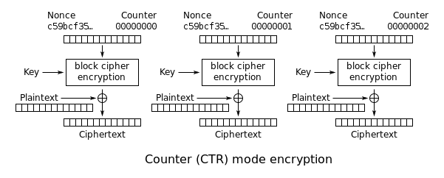
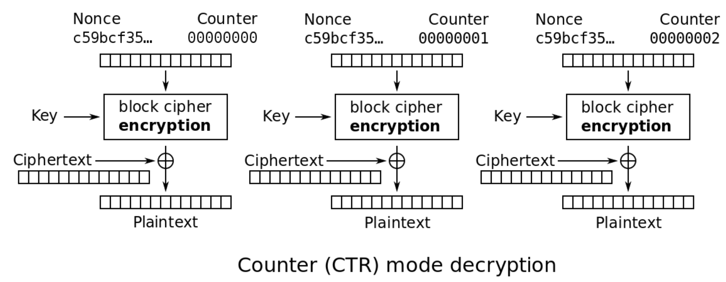
Modes of Operations: CTR
Counter Mode
Turns a block cipher into a stream cipher
https://en.wikipedia.org/wiki/Block_cipher_mode_of_operation

Slide 21
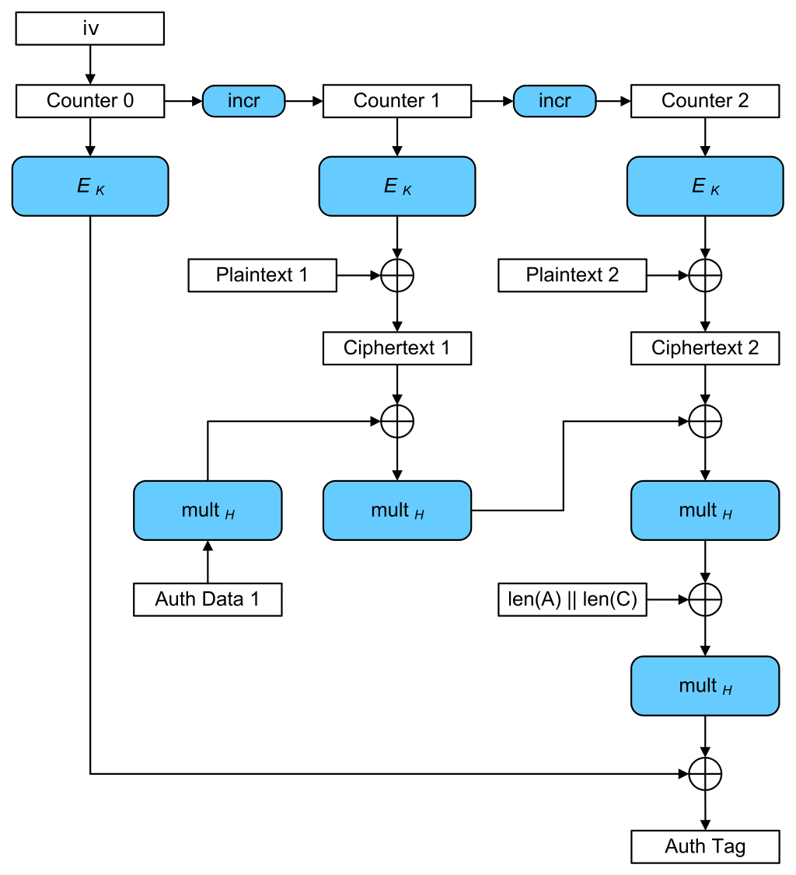
Mode of Operations: GCM
Galois/Counter Mode (GCM)
Similar to CTR in encryption
Also provide integrity, used as GMAC

Slide 22
Comparison of Different Modes
Show pattern
Parallel/Sequential Operations
Loss tolerate

Slide 23
Block Cipher Mode
ECB should not be used if encrypting more than one block of data with the same key.
CBC, OFB and CFB are similar, however OFB/CFB is better because you only need encryption and not decryption, which can save code space.
CTR is used if you want good parallelization (ie. speed), instead of CBC/OFB/CFB.
XTS mode is the most common if you are encoding a random accessible data (like a hard disk or RAM).
OCB is by far the best mode, as it allows encryption and authentication in a single pass. However there are patents on it in USA.

Slide 24
Symmetric Encryption Algorithms
DES (Data Encryption Standard), multiple block modes
64 bit blocks and 56 bit keys. now obsolete
Exhaustive search attack is feasible since late 90s because of small key space.
3DES, multiple block modes
Apply DES three times with three different keys KA, KB and KC: C = E_{KC}(D_{KB}(E_{KA}(P))); P = D_{KA}(E_{KB}(D_{KC}(C)))
Key sizes can be 112 bits (2 different 56 bit keys) or 168 bits (3 different 56 bit keys).
Either 2 or 3 times slower than DES
AES (Advanced Encryption Standard)
Key sizes can be 128 bits, 192 bits or 256, 512 bits
Exhaustive search attack not currently available.
Commonly used now. AES-256 is the choice

Slide 25
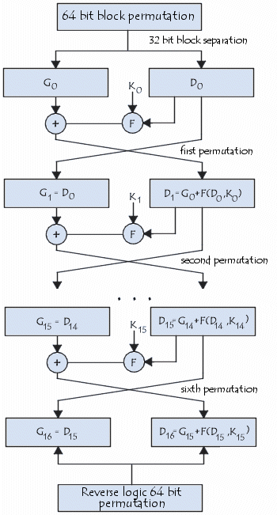
DES
Initial permutation
16 identical rounds of calculation, each using a different 48-bits key generated by 56-bit key.
Final permutation
http://ccm.net/contents/134-introduction-to-encryption-with-des

Slide 26
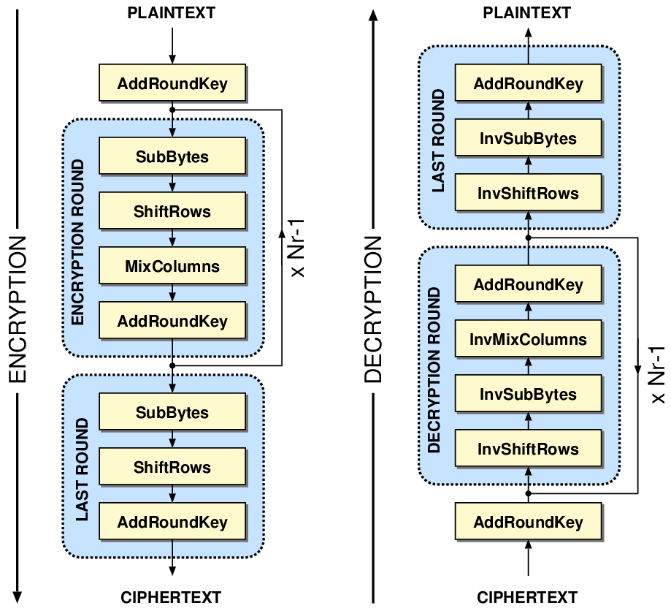
AES
Work on 128-bit blocks
Initially the plaintext P is XORed with the key K.
Then repeats a number of rounds. 10 rounds with 128-bit keys, 12 rounds with 192-bit keys and 14 rounds with 256-bit keys.
It takes the output of the previous round and produce another invertible transformation through 4 steps
The ciphertext C is the output of the final round.
http://crypto.stackexchange.com/questions/8043/aes-addroundkey

Slide 27
Other Symmetric Algorithms
RC4 (Stream cipher)
RC5
Blowfish
Twofish
...

Slide 28
Asymmetric (public key)
Use two different but mathematically related keys.
One is for encryption and the other is for decryption.
One of the keys can be made public and the other one must be private.

Slide 29
Asymmetric Encryption Algorithms: RSA
The first public key encryption algorithm was proposed by Rivest, Shamir and Adelman (RSA) , from MIT, first published in 1978.
Public Key: (n, e), Private Key: (n, d)
n = p * q where p and q are both large primes (e.g. 1024 bits each)
e is relatively prime to (p-1)*(q-1) (that is, their gcd is 1)
d such that e*d mod (p-1)*(q-1) = 1
Encrypt: C = Me mod n Decrypt: M = C^{d} mod n Can also use private key to encrypt and public key to decrypt
Theory: M = (Me mod n)^{d} mod n C = ((Me) mod n ) ^{d} mod n It is computationally infeasible to infer p and q based on any given n.

Slide 30
Other Asymmetric Algorithms
Elliptic curve cryptography (ECC)
An approach based on the algebraic structure of elliptic curves over finite fields
NSA has endorsed ECC as a Suite B recommended algorithm
Further in (Koblitz, 1987; Miller, 1995; Hankerson, Menezes, & Vanstone, 2004; Blake, Seroussi & Smart, 2005).
Digital Signature Algorithm (DSA)
A U.S. Federal standard (FIPS-186-3) for digital signatures in the Digital Signature Standard (DSS)
Covered by a patent given to the U.S. Secretary of Commerce, Washington
NIST has made this patent available worldwide royalty free
Unlike RSA and ECC, DSA does not support encryption using a public key. DSA is faster in decrypting and signing.

Slide 31
Symmetric vs Asymmetric
Speed: Symmetric is much faster. Therefore, asymmetric is usually only used in the key management and digital signature.
Security: Neither has an advantage over the other. In both methods breaking the code depends on length of key and the computational work involved in breaking the cipher.
With the key length n, the number of keys is 2^{n}, the time to exhaust the key space grows exponentially
Key distribution: Some form of protocol is needed to ensure you have the correct public key for a specific subject

Slide 32
Cryptographic Hash Functions
A Hash function takes a plaintext message M and output a fixed length digest or hash value.
The length of digest is fixed regardless of the input length. It is typically smaller than the input length.
It should be computationally efficient regardless of input size.
The hash function is a one way function, which means Given a hash value x, it is hard to find a plaintext P such that h(P) = x

Slide 33
Cryptographic Hash Functions
While the collision is inevitable, it should be computationally infeasible to find collision
weak collision resistance: Given a plaintext P, it is hard to find a plaintext Q such that h(Q) = h(P)
strong collision resistance: It is hard to find a pair of plaintexts P and Q such that h(Q) = h(P)
Hash values of at least 256 bits recommended to defend against brute-force attacks

Slide 34
Commonly Used Cryptographic Hash Functions
Message Digest 5 (MD5)
Developed by Ron Rivest in 1991
Produces a 128 bit digest as output
Still widely used in legacy applications
No longer considered Cryptographically Secure
Subject to a number of attacks such as chosen-prefix collision attacks.

Slide 35
Commonly Used Cryptographic Hash Functions
Secure Hash Algorithm 1 (SHA-1)
Developed by NSA and approved as a federal standard by NIST
Produces a 128 bit digest as output
Still found in legacy applications
No longer considered Cryptographically Secure
Vulnerabilities less severe than those of MD5
Secure Hash Algorithm 2 (SHA-2)
SHA-224, SHA-256, SHA-384, SHA-512
Considered Cryptographically Secure
Also has published attack techniques
Secure Hash Algorithm 3 (SHA-3)
Released in 2015
Internally different from SHA-2, fixed some issues in SHA-2
SHA3-224, SHA3-256, SHA3-384, SHA-3512, SHAKE128, SHAKE256

Slide 36
HMACs (Hash Message Authentication Code)
An HMAC is created by using a selected hash algorithm twice along with a shared secret key and two different hexadecimal constants. (Keyed hash)

Slide 37
MITM in Plaintext Communication
Solution 1: Use the shared secret to encrypt the message.
Solution 2: The sender uses the receiver’s public key to encrypt, so that only the receiver can use its private key to decrypt.
A
B
Plain text
Plain text
M
How to ensure that no one else can intercept the communication?

Slide 38
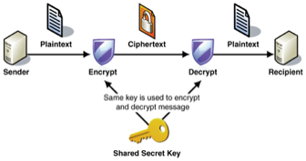
MITM in Encrypted Communication using Secret key
The main problem: how do they get/exchange the secret key secretly?
What if M gets the shared secret key?
M

Slide 39
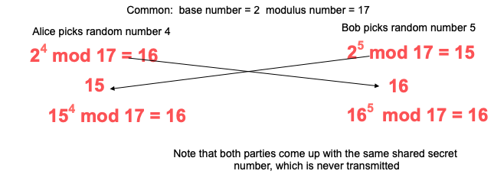
Diffie-Hellman Key Exchange
Calculate QA = b^{PA} mod m, QB = b^{PB} mod m and send to each other
Both generate secret key as (QB^{PA} mod m ) = (QA^{PB} mod m ) mod m
Assumption:
Given QA, or QB , it is computational impossible to compute PA and PB.
The number has to be big enough and has to be carefully chosen.
Discrete logarithm problem over carefully chosen groups has no efficient solution.

Slide 40
DH Protocol
The most common protocol for negotiating session keys is the Diffie-Hellman protocol and used by:
WiFi Wireless Protected Access (WPA) and IEEE 802.11i security
IP Security (IPsec) Internet Key Exchange (IKE) and Internet Security Association Key Management Protocol (ISAKMP)
Transport Security Layer (TLS)
ZRTP to negotiate the keys between two devices in a Voice over Internet Protocol (VoIP) phone telephony call based on the Real-time Transport Protocol

Slide 41
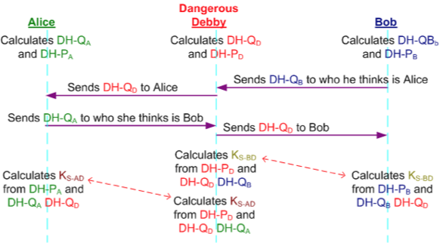
MITM

Slide 42
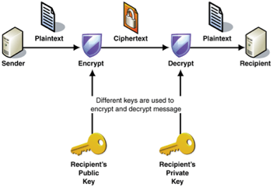
MITM in Encrypted Communication using Public-Private Key Pairs

Slide 43
MITM in Encrypted Communication using Public-Private Key Pairs
M
M’s public key
M’s private key
The main problem: how does the sender know whose public key it uses? How does the receiver know whether the message is from the sender?

Slide 44
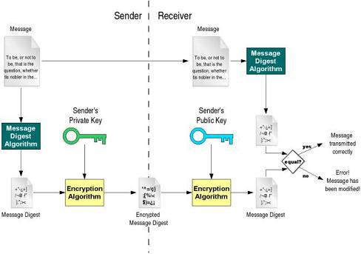
Digital Signature
Again, how the receiver knows that the sender’s public key is authentic?
Solution: need a trusted third party.
http://totalbusinesssolution.in/digital-signature.html

Slide 45
PKI
Certificate Authority (CA): a trusted party, responsible for verifying the identity of users, and then bind the verified identity to a public keys.
Digital Certificates: A document certifying that the public key included inside does belong to the identity described in the document.
In a PKI Certification Authorities (CAs) generate ITU-T X.509 digital certificates that specify a subject identity to which a particular public key is associated with
The only key all nodes need to know in advance is the CA's public key
PKI makes public key distribution secure – nodes need to store only their own private key and get the public key for other node as needed
Digital certificates CANNOT be used directly for proving a subject’s Identity as a digital certificate is used to bind a validated subject’s identity to a specific public key

Slide 46
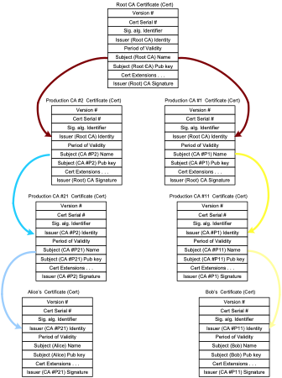
Simple CA Certificate Hierarchy

Slide 47
How to Use Digital Certificate
Need to have some trusted CA’s public key (Root CAs are self signed)
Use the digital signature signed by CA to verify the authenticity of the public key.
Make sure the certificate is in the valid time period. (check the notBefore and notAfter dates)
May need to traverse a Trust Hierarchy Path
Need to check if the certificate is revoked
Certificate Revocation List (CRL) checking
Online Certificate Status Protocol (OCSP)
Must be able to securely store private keys

Slide 48
The following slides are from “Computer Security: A Hands-on Approach” by Dr. Wenliang Du

Slide 49
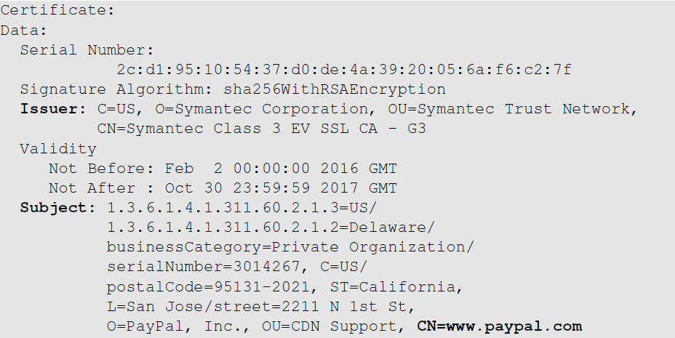
Example of X.509 Certificate (1st Part)
The CA’s identity
(Symantec)
The owner of the certificate
(paypal)

Slide 50
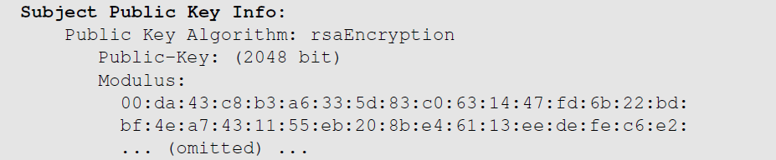
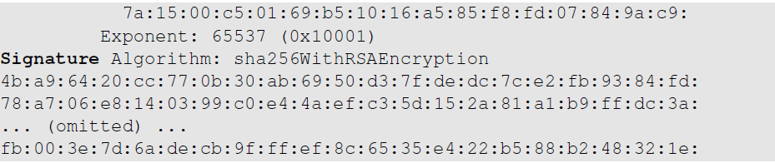
Example of X.509 Certificate (2nd Part)
Public key
CA’s signature

Slide 51
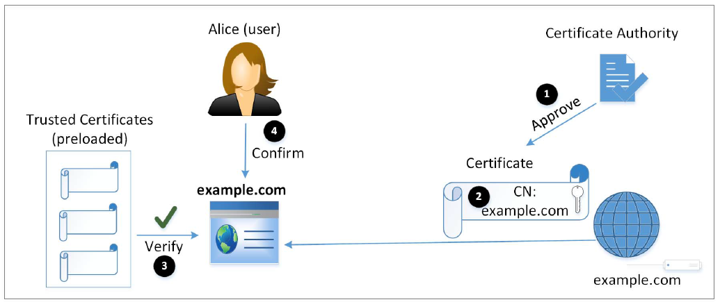
Attacks Surfaces on PKI
Notes:
1- We can not trust what is said by a public key, we have to rely on a third-party CA to conduct necessary checks to ensure the correctness of the owner information.
This is essential to defeat MITM attacks; client can know whether a received public key belongs to the intended server or not.
2- After CA verifies the identity, it will generate a certificate for the owner. Certificate should not be forged or tampered with. This is guaranteed by the one-way hash function and the digital signature algorithm.
3- Integrity of certificate protected by CA’s signature. To verify signature, we need CA’s public key. The public key (trusted certificate) must be preloaded by the client.
4- The client ensures that the subject in the certificate and user’s intention matches.

Slide 52
Attack on CA’s Verification Process
CA’s job has two parts:
Verify the relationship between certificate applicant and the subject information inside the certificate
Put a digital signature on the certificate
Case study: Comodo Breach [March 2011]
Popular root CA.
The approval process in Southern Europe was compromised.
Nine certificates were issued to seven domains and hence the attacker could provide false attestation.
One of the affected domain (a key domain for the Firefox browser): addons.mozilla.org
Notes:
If the CA doesn’t do a good job conducting the subject verification, or the verification process is compromised, an attacker may be able to get a certificate that contains the target subject and the attacker’s public key (now the attacker knows the corresponding pubic key). With this fake certificate, the attacker can launch an MITM attack.
The primary task of a registration authority is to attest to the authenticity of the company/client requesting the certificate.

Slide 53
Attack on CA’s Signing Process
If the CA’s private key is compromised, attackers can sign a certificate with any arbitrary data in the subject field.
Case Study: the DigiNotar Breach [June-July 2011]
A top commercial CA
Attacker got DigiNotar’s private key
531 rogue certificates were issued.
Traffic intended for Google subdomains was intercepted: MITM attack.
How CAs Protect Their Private Key
Hardware Security Model (HSM)
Notes:
Several of DigiNotar’s CA servers including the ones responsible for issuing government certificates were compromised.
Hardware Secrutiy Model:
Capable of generating and storing cryptographic keys.
Device is tamper-proof. Needs to be accessed physically to get the key.
Generally stored in a vault guarded with physical security and video surveillance

Slide 54
Attacks on Algorithms
Digital Certificates depend on two types of algorithms
one-way hash function and digital signature
Case Study: the Collision-Resistant Property of One-Way Hash
At CRYPTO2004, Xiaoyun Wang demonstrated collision attack against MD5.
In February 2017, Google Research announced SHAttered attack
Attack broke the collision-resistant property of SHA-1
Two different PDF files with the same SHA-1 has was created.
Countermeasures: use stronger algorithm, e.g. SHA256.

Slide 55
Attacks on User Confirmation
After verifying the certificate from the server, client software is sure that the certificate is valid and authentic
In addition, the software needs to confirm that the server is what the user intends to interact with.
Confirmation involves two pieces of information
Information provided or approved by user
The common name field inside the server’s certificate
Some software does not compare these two pieces of information: security flaw

Slide 56
Attacks on Confirmation: Case Study
Phishing Attack on Common Name with Unicode
Zheng found out several browsers do not display the domain name correctly if name contains Unicode.
xn—80ak6aa92e.com is encoded using Cyrillic characters. But domain name displayed by browser likes like apple.com
Attack:
Get a certificate for xn—80ak6aa92e.com
Get user to visit xn—80ak6aa92e.com, so the common name is matched
User’s browser shows that the website is apple.com. User can be fooled.
Had the browser told the user that the actual domain is not the real apple.com, the user would stop.
Notes:
Some Unicode characters look like ASCII and they can cause confusion.
Possible to write a string in Cyrillic characters that looks like apple.com in ASCII. When combined in digital certificate these similarities will cause security problems.
Attacker can purchase the domain and get a certificate with www.xn—80ak6aa92e.com as its common name. When user redirected to this URL; browser will verify common name and server name and find that it matches.
Browser then display server name in the URL field and it will look like apple.com which defeats user confirmation step.
If browser told the user that the actual domain is not apple.com, the user would have stopped.

Slide 57
Types of Digital Certificate
Domain Validated Certificates (DV)
Organizational Validated Certificates (OV)
Extended Validated Certificates (EV)

Slide 58
Domain Validated Certificates (DV)
Most popular type of certificate.
The CA verifies the domain records to check if the domain belongs to applicant.
Domain Control Validation (DCV) is performed on domain name in the certificate request.
DCV uses information in the WHOIS database
DCV is conducted via
Email
HTTP
DNS
Notes:
WHOIS database - online repository storing information about domain name registration
Via Email: traditional method. CA fetches the administrator email from domain name supplied in certificate request, then sends email to the email address. If the link in th email is clicked, the domain will be verified. CA now trusts that the applicant owns or manages the domain contained in the certificate request.
Via HTTP: the hash vale of the certificate request is generated and given to the applicant. Applicant creates a file bearing the hash value in its name. The file is placed on a web server inside the domain requested. If CA can get this file, the domain is verified.
Via DNS: the hash value of the certificate request is generated and given to the applicant. Applicant enters a DNS CNAME record for the domain. If the CA can get the hash value back from the corresponding DNS query, the domain is verified.

Slide 59
Organizational Validated Certificates (OV)
Not very popular type of certificate.
CAs verify the following before issuing OV certificates:
Domain control validation.
Applicant’s identity and address.
Applicant’s link to organization.
Organization’s address.
Organization’s WHOIS record.
Callback on organization’s verified telephone number.

Slide 60
Extended Validated Certificates (EV)
CAs issuing EV certificates require documents that are legally signed from registration authorities.
EV CA validate the following information:
Domain control validation.
Verify the identity, authority, signature and link of the individual.
Verify the organization's physical address and telephone number.
Verify the operational existence.
Verify the legal and proper standings of the organization.
EV certificate, hence, costs higher but is trustworthy.
Notes:
DV certificate only verifies that the applicant has the control of the domain but doesn’t say anything about the organization that owns the domain
EV certificates provide a more thorough background checking on the organization.

Slide 61
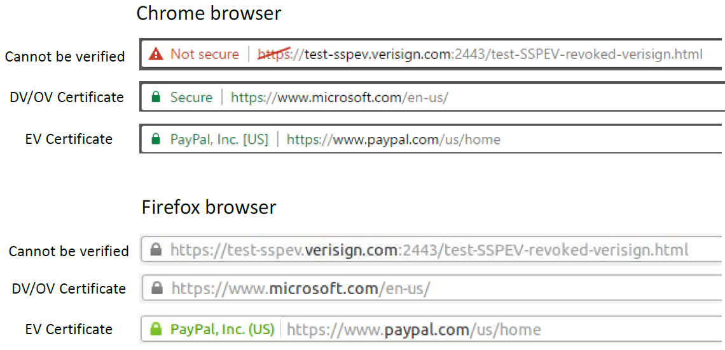
How Browsers Display Certificate Types
Notes:
Browser have separate list for EV-compliant CAs.
CA is EV compliant if it follows all the standards and implement security controls for its infrastructure and can prove its security to browser vendors through third party audits.
EV compliant certificates cannot be added manually for most browsers.
If an EV certificate is verified, browser displays extra information to indicate that the website uses an EV certificate.
The image shows how browsers display the info for three scenarios:
- the website’s certificate can not be verified
- the website is using a DV or OV certificate
- the website is using an EV certificate

Slide 62
Questions?

