Slide 1
Linux Internals & Networking
System programming using Kernel interfaces

Slide 2
Contents

Slide 3

Linux Internals & Networking
Contents
Introduction
Transition to OS programmer
System Calls
Process
IPC
Signals
Networking
Threads
Synchronization
Process Management
Memory Management

Slide 4
Transition to OS programming

Slide 5






Course & modules view
C
0101100
010110
LS
01001
DS
Resource / Service
Provider
Applications
LI
System Call
Interface
EOS
Kernel
Abstracts HW
from users
Device Drivers
LDD
MC
Hardware

Slide 6
Application vs OS
C | Algorithms, Syntax, Logic | Preprocessor Compiler Assembler Linker Executable file (a.out)
OS | Memory segments, process, Threads Signals, IPC, Networking | Executing a program Loader

Slide 7
Application Programming
Compilation Stages
Preprocessor
  Expands header files
  Substitute all macros
  Remove all comments
  Expands and all # directives
Compilation
  Convert to assembly level instructions
Assembly
  Convert to machine level instructions
  Commonly called as object files
  Create logical address
Linking
  Linking with libraries and other object files

Slide 8

Application Programming
Compilation Stages
Preprocessor
.c
Source Code
Compiler
.i
Expanded Source
Code
gcc -E file.c
Assembler
.s
Assembly Source
Code
gcc -S file.c
Linker
.o
Object Code
gcc -c file.c
Loader
.out
Executable
gcc -save-temps file.c would generate all intermediate files

Slide 9
Application Programming
Linking - Static
Static linking is the process of copying all library modules used in the program into the final executable image.
This is performed by the linker and it is done as the last step of the compilation process.
Compiling two .o files also a type of static linking.
To create a static library first create intermediate object files.
  Eg: gcc -c fun1.c fun2.c
Creates two object files fun1.o and fun2.o
Then create a library by archive command
  Eg: ar rcs libfun.a fun1.o fun2.o

Slide 10
Application Programming
Linking - Dynamic
It performs the linking process when programs are executed in the system.
During dynamic linking the name of the shared library is placed in the final executable file.
Actual linking takes place at run time when both executable file and library are placed in the memory.
The main advantage to using dynamically linked libraries is that the size of executable programs is reduced
To create a dynamic library (shared object file)
  Eg: gcc -fPIC -shared fun1.c fun2.c -o libfun.so

Slide 11
Application Programming
Linking - Static vs Dynamic
Parameter
Linking
Static
Dynamic
Executable Size
Loading Time
Memory Usage
No of Sys. Calls

Slide 12
Executing a process
RAM
Memory Layout
Stack Frame
P1
P1
Command Line
Arguments
Local Variables
P2
Stack
Return Address
Hole
Parameter List
P3
Heap
.
.
.
.BSS
(Uninitialized)
Data Segment
Initialized
Pn-1
Code Segment
Pn

Slide 13
Quiz
How a user defined function works?
How a library function works?

Slide 14
Storage Classes
Storage Class | Scope | Lifetime | Memory Allocation
auto | Within the block / Function | Till the end of the block / function | Stack
register | Within the block / Function | Till the end of the block / function | Register
static local | Within the block / Function | Till the end of the program | Data Segment
static global | File | Till the end of the program | Data segment
extern | Program | Till the end of the program | Data segment

Slide 15
Hands-on
Access a static variable from outside file.
Access a global variable from outside file.
Combination of both static and local.

Slide 16
Common Errors
With various memory segments
Stack Overflow / Stack Smashing
Command Line
Arguments
When ever process stack limit is over
Eg: Call a recursive function infinite times.
When you trying to access array beyond limits.
Eg int arr[5]; arr[100];
Stack
Hole
Heap
Memory Leak
When you never free memory after allocating.
Eventually process heap memory will run-out
.BSS
(Uninitialized)
Data Segment
Initialized
Segmentation Fault
Text Segment
When you try to change text segment, which is a
read-only memory or try trying to access a memory
beyond process memory limit (like NULL pointer)

Slide 17


Introduction
What is Linux?
Linux is a free and open source operating system that is causing a revolution in the computer world
Originally created by Linus Torvalds with the assistance of developers called community
This operating system in only a few short years is beginning to dominate markets worldwide

Slide 18
Introduction
What is Linux?
Free & Open Source
  GPL license, no cost
Reliability
  Build systems with 99.999% upstream
Secure
  Monolithic kernel offering high security
Scalability
  From mobile phone to stock market servers

Slide 19
Introduction
Linux Components
Hardware Controllers: This subsystem is comprised of all the possible physical devices in a Linux installation - CPU, memory hardware, hard disks
Linux Kernel: The kernel abstracts and mediates access to the hardware resources, including the CPU. A kernel is the core of the operating system
O/S Services: These are services that are typically considered part of the operating system (e.g. windowing system, command shell)
User Applications: The set of applications in use on a particular Linux system (e.g. web browser)
User
Application
User Space
GNU
C
Library
Linux
System Call Interface
Kernel
Kernel Space
Architecture Dependent
Kernel Code
Hardware Platform

Slide 20
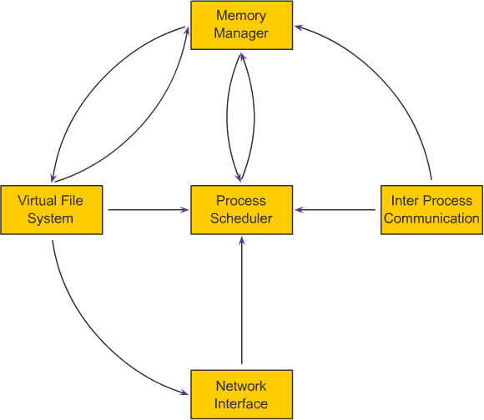
Introduction
Linux Kernel Subsystem
Process Scheduler (SCHED):
  To provide control, fair access of CPU to process, while interacting with HW on time
Memory Manager (MM):
  To access system memory securely and efficiently by multiple processes.
  Supports Virtual Memory in case of huge memory requirement
Virtual File System (VFS):
  Abstracts the details of the variety of hardware devices by presenting a common file interface to all devices

Slide 21
Introduction
Linux Kernel Subsystem
Network Interface (NET):
  provides access to several networking standards and a variety of network hardware
Inter Process Communications (IPC):
  supports several mechanisms for process-to-process communication on a single Linux system

Slide 22
Introduction
Virtual File System
User Processes
User space
System Calls
System Call Interface
Virtual File System – dentry & inode cache
Kernel space
ext2
ext3
/proc
FIFO
Pipes
sockets
Drivers and Buffer Cache

Slide 23
Introduction
Virtual File System
What?
  A kernel software layer that handles all system calls related to file systems.
  Aim is to provide a common interface to several kinds of file systems.
Key Idea
  For each read, write or other function called, the kernel substitutes the actual function that supports a native Linux file system, for example the NTFS.

Slide 24
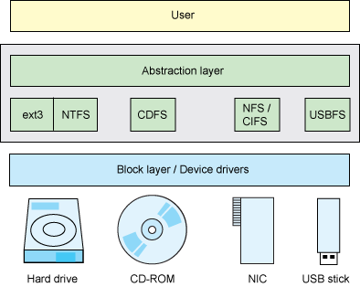
Introduction
Virtual File System

Slide 25
Introduction
Virtual File System
Presents the user with a unified interface, via the file-related system calls.
The VFS interacts with file-systems which interact with the buffer cache, page-cache and block devices.
Finally, the VFS supplies data structures such as the dcache, inodes cache and open files tables.
  Allocate a free file descriptor.
  Try to open the file.
  On success, put the new 'struct file' in the fd table of the process.On error, free the allocated file descriptor.
NOTE: VFS makes “Everythig is file” in Linux

Slide 26
Summary
Linux Device Drivers
Linux Internals
Compilation
Stages
Storage
Classes
Program &
Process

Slide 27



Stay Connected
About us: Emertxe is India’s one of the top IT finishing schools & self learning kits provider. Our primary focus is on Embedded with diversification focus on Java, Oracle and Android areas
Emertxe Information Technologies,
No-1, 9th Cross, 5th Main,
Jayamahal Extension,
Bangalore, Karnataka 560046
T: +91 80 6562 9666
E: training@emertxe.com
https://www.facebook.com/Emertxe
https://twitter.com/EmertxeTweet
https://www.slideshare.net/EmertxeSlides

Slide 28
Thank You

