Slide 1
Linux Internals & Networking
System programming using Kernel interfaces

Slide 2
Contents

Slide 3

Linux Internals & Networking
Contents
Introduction
Transition to OS programmer
System Calls
Process
IPC
Signals
Networking
Threads
Synchronization
Process Management
Memory Management

Slide 4
System Calls

Slide 5
Synchronous & Asynchronous
Communications are two types
Synchronous
Asynchronous
Polling
Interrupts
See in next chapters

Slide 6
Interrupts
Interrupts
Hardware
Software
Generates whenever a
Hardware changes happens
Generates by instruction from code (eg: INT 0x80)
Interrupt controller signals CPU that interrupt has occurred, passes interrupt number
Basic program state saved
Uses interrupt number to determine which handler to start
CPU jumps to interrupt handler
When interrupt done, program state reloaded and program resumes

Slide 7

System calls
What?
  Is a controlled entry point into the kernel, allowing a process to request that the kernel perform some action on the process’s behalf.
  The kernel makes a range of services accessible to programs via the system call application programming interface (API).
  A set of interfaces to interact with hardware devices such as the CPU, disks, and printers.
  Example:
    Creating new process
    Performing I/O
    Creating PIPE for IPC

Slide 8
System calls
General points to be noted
  A system call changes the processor state from user mode to kernel mode, so that the CPU can access protected kernel memory.
  Each system call is identified by a unique number.
  Each system call may have a set of arguments that specify information to be transferred from user space to kernel space and vice versa.

Slide 9
System calls
Advantages:
  Freeing users from studying low-level programming
  It greatly increases system security
  These interfaces make programs more portable
For a OS programmer, calling a system call is no different from a normal function call. But the way system call is executed is way different.

Slide 10

System calls
User
Application
open()
User Mode
System Call Interface
Kernel Mode
open()
Implementation
of open() system
call
return

Slide 11
System Call
Calling Sequence
user task
user mode
(mode bit = 1)
user task executing
calls system call
return from system call
kernel
trap
mode bit = 0
return
mode bit = 1
kernel mode
(mode bit = 0)
execute system call
Logically the system call and regular interrupt follow the same flow of steps. The source (I/O device v/s user program) is very different for both of them. Since system call is generated by user program they are called as ‘Soft interrupts’ or ‘Traps’

Slide 12
System Call vs Library Function
A library function is an ordinary function that resides in a library external to your program. A call to a library function is just like any other function call
A system call is implemented in the Linux kernel and a special procedure is required in to transfer the control to the kernel
Usually, each system call has a corresponding wrapper routine, which defines the API that application programs should employ
Understand the differences between:
  Functions
  Library functions
  System calls
From the programming perspective they all are nothing but simple C functions

Slide 13
System Call
Steps
The application program makes a system call by invoking a wrapper function in the C library.
The wrapper function must make all of the system call arguments available to the system call trap-handling routine.
  These arguments are passed to kernel via specific registers and the stack.
All system calls are identified by the unique numbers by the kernel.
  The wrapper function copies the system call number into a specific CPU register ( %eax).
The wrapper function executes a trap machine instruction ( int 0x80 ).
  This causes the processor to switch from user mode to kernel mode and execute code pointed to by location 0x80 of the system’s trap vector.

Slide 14
System Call
Steps
The kernel invokes system_call() routine to handle the trap. This handler:
  Saves register values onto the kernel stack
  Checks the validity of the system call number.
  Invokes the appropriate system call service routine, from the system call table.
  The service routine returns a result status to the system_call() routine.
Restores register values from the kernel stack and places the system call return value on the stack.
Returns to the wrapper function, simultaneously returning the processor to user mode.
Note:
  If the return value of the system call service routine indicated an error, the wrapper function sets the global variable errno.
  The wrapper function then returns to the caller, providing an integer return value indicating the success or failure of the system call.

Slide 15

System Call
Implementation
User Mode
Kernel Mode
system_call:
…
sys_xyz()
…
ret_from_sys_call:
…
iret
xyz() {
….
int 0x80
….
}
sys_xyz() {
…
}
….
xyz()
….
System Call
Invocation in
application
program
Wrapper routine in libc standard library
System call
handler
System call
service routine
Use strace command, to trace the system calls made by a program, either for debugging purposes or simply to investigate what a program is doing.

Slide 16
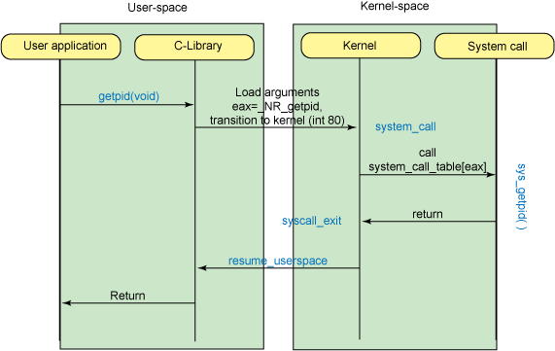
System Call
Simple Flow

Slide 17
System Call
Example: gettimeofday()
Gets the system’s wall-clock time.
It takes a pointer to a struct timeval variable. This structure represents a time, in seconds, split into two fields.
  tv_sec field - integral number of seconds
  tv_usec field - additional number of usecs

Slide 18
System Call
Example: nanosleep()
A high-precision version of the standard UNIX sleep call
Instead of sleeping an integral number of seconds, nanosleep takes as its argument a pointer to a struct timespec object, which can express time to nanosecond precision.
  tv_sec field - integral number of seconds
  tv_nsec field - additional number of nsecs

Slide 19
System Call
Example: Others
open
read
write
exit
close
wait
waitpid
getpid
sync
nice
kill etc..

Slide 20



Stay Connected
About us: Emertxe is India’s one of the top IT finishing schools & self learning kits provider. Our primary focus is on Embedded with diversification focus on Java, Oracle and Android areas
Emertxe Information Technologies,
No-1, 9th Cross, 5th Main,
Jayamahal Extension,
Bangalore, Karnataka 560046
T: +91 80 6562 9666
E: training@emertxe.com
https://www.facebook.com/Emertxe
https://twitter.com/EmertxeTweet
https://www.slideshare.net/EmertxeSlides

Slide 21
Thank You

