Slide 1
Linux Internals & Networking
System programming using Kernel interfaces

Slide 2
Contents

Slide 3

Linux Internals & Networking
Contents
Introduction
Transition to OS programmer
System Calls
Process
IPC
Signals
Networking
Threads
Synchronization
Process Management
Memory Management

Slide 4
Process

Slide 5

Process
Running instance of a program is called a PROCESS
On a single-user system, a user may be able to run several programs at one time:
  a word processor,
  a Web browser,
  gcc compiler etc...
A process includes
  the stack
  a data section
  a heap

Slide 6
Process
Running instance of a program is called a PROCESS
If you have two terminal windows showing on your screen, then you are probably running the same terminal program twice-you have two terminal processes
Each terminal window is probably running a shell; each running shell is another process
When you invoke a command from a shell, the corresponding program is executed in a new process
The shell process resumes when that process complete

Slide 7
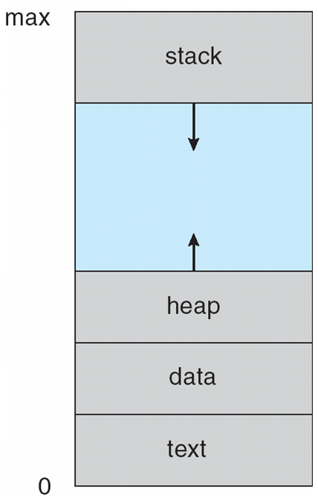

Process
Processes in memory!
Each Process will have its own Code, Data, Heap and Stack

Slide 8
Process vs Program
A program is a passive entity, such as file containing a list of instructions stored on a disk
Process is a active entity, with a program counter specifying the next instruction to execute and a set of associated resources.
A program becomes a process when an executable file is loaded into main memory
One program can be several processes
  Consider multiple users executing the same program
Factor | Process | Program
Storage | Dynamic Memory | Secondary Memory
State | Active | Passive

Slide 9
Process vs Program
Program
Task
int global_1 = 0;
int global_2 = 0;
void do_somthing()
{
int local_2 = 5;
local_2 = local_2 + 1;
}
int main()
{
char *local_1 = malloc(100);
do_somthing();
…..
}
local_1
local_2
stack
5
heap
CPU Registers
global_1
global_2
data
.start main
.call do_somthing
…..
code

Slide 10
Process
More processes in memory!
P0
Free Space
Stack
P1
Heap
P2
Data
Free Space
Code
OS
Each Process will have its own Code, Data, Heap and Stack

Slide 11
Process
State Transition Diagram
new
terminated
admitted
exit
interrupted
ready
running
scheduler dispatch
I/O or event completion
I/O or event wait
waiting

Slide 12
Process
State Transition Diagram
Priority
Round Robin
FCFS
Preemptive
interrupted
ready
running
scheduler dispatch
I/O or event completion
I/O or event wait
waiting
I/O: Keyboard
Even: Signal

Slide 13
Process
States
A process goes through multiple states ever since it is created by the OS
State | Description
New | The process is being created
Running | Instructions are being executed
Waiting | The process is waiting for some event to occur
Ready | The process is waiting to be assigned to processor
Terminated | The process has finished execution

Slide 14
Process
Descriptor
To manage tasks:
  OS kernel must have a clear picture of what each task is doing.
  Task's priority
  Whether it is running on the CPU or blocked on some event
  What address space has been assigned to it
  Which files it is allowed to address, and so on.
Usually the OS maintains a structure whose fields contain all the information related to a single task

Slide 15
Process
Descriptor (PCB / TCB)
Information associated with each process.
  Process state
    running, waiting, etc
  Program counter
    location of instruction to next execute
  CPU registers
    contents of all process centric registers
  CPU scheduling information
    priorities, scheduling queue pointers
  Memory-management information
    memory allocated to the process
  Accounting Information
    CPU used, clock time elapsed since start, time limits
  I/O Status Information
    I/O devices allocated to process, list of open files
Pointer | Process State
Process ID
Program Counter
Registers
Memory Limits
List of Open Files
PCB: Process Control Block / TCB: Task Control Block

Slide 16
Process
Scheduling
Maximize CPU use, quickly switch processes onto CPU for time sharing
Process scheduler selects among available processes for next execution on CPU
Maintains scheduling queues of processes
  Job queue – set of all processes in the system
  Ready queue – set of all processes residing in main memory, ready and waiting to execute
  Device queues – set of processes waiting for an I/O device
Processes migrate among the various queues

Slide 17
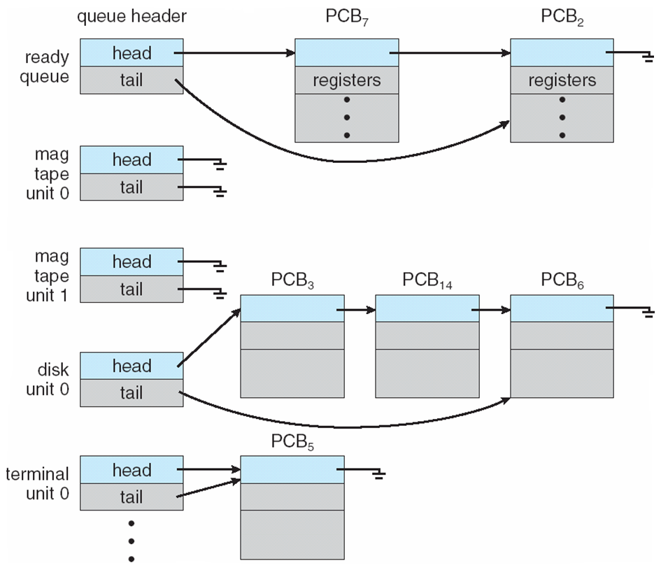
Process
Ready & Various I/O Device Queues

Slide 18
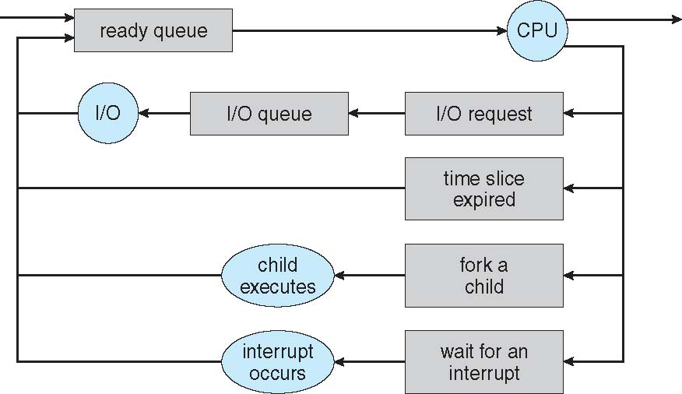
Process
Scheduling – Queueing Diagram
Queueing diagram represents queues, resources, flows

Slide 19
Process
Descriptor – State Field
State field of the process descriptor describes the state of process.
The possible states are:
State | Description
TASK_RUNNING | Task running or runnable
TASK_INTERRUPTIBLE | process can be interrupted while sleeping
TASK_UNINTERRUPTIBLE | process can't be interrupted while sleeping
TASK_STOPPED | process execution stopped
TASK_ZOMBIE | parent is not issuing wait()

Slide 20
Process
Descriptor - ID
Each process in a Linux system is identified by its unique process ID, sometimes referred to as PID
Process IDs are numbers that are assigned sequentially by Linux as new processes are created
Every process also has a parent process except the special init process
Processes in a Linux system can be thought of as arranged in a tree, with the init process at its root
The parent process ID or PPID, is simply the process ID of the process’s parent

Slide 21
Process
Schedule
P1
P2
P3
P4
Stack
Stack
Stack
Stack
User space
Heap
Heap
Heap
Heap
Data
Data
Data
Data
Code
Code
Code
Code
Addr | PS
PID
PC
REG
Memory
Files
Addr | PS
PID
PC
REG
Memory
Files
Addr | PS
PID
PC
REG
Memory
Files
Addr | PS
PID
PC
REG
Memory
Files
Kernel space

Slide 22
Process
Active Processes
The ps command displays the processes that are running on your system
By default, invoking ps displays the processes controlled by the terminal or terminal window in which ps is invoked
For example (Executed as “ps –aef”):
user@user:~] ps -aef
UID PID PPID C STIME TTY TIME CMD
root 1 0 0 12:17 ? 00:00:01 /sbin/init
root 2 0 0 12:17 ? 00:00:00 [kthreadd]
root 3 2 0 12:17 ? 00:00:02 [ksoftirqd/0]
root 4 2 0 12:17 ? 00:00:00 [kworker/0:0]
root 5 2 0 12:17 ? 00:00:00 [kworker/0:0H]
root 7 2 0 12:17 ? 00:00:00 [rcu_sched]
Process
ID
Parent
Process
ID

Slide 23
Process
Context Switching
Switching the CPU to another task requires saving the state of the old task and loading the saved state for the new task
The time wasted to switch from one task to another without any disturbance is called context switch or scheduling jitter
After scheduling the new process gets hold of the processor for its execution

Slide 24
Context Switching
operating system
process P0
process P1
Interrupt or system call
executing
save state into PCB0
idle
reload state from PCB1
idle
Interrupt or system call
executing
save state into PCB1
idle
reload state from PCB0
executing

Slide 25
Process
Creation
Two common methods are used for creating new process
  Using system():
    Relatively simple but should be used sparingly because it is inefficient and has considerably security risks
  Using fork() and exec():
    More complex but provides greater flexibility, speed, and security

Slide 26
Process
Creation - system()
It creates a sub-process running the standard shell
Hands the command to that shell for execution
Because the system function uses a shell to invoke your command, it's subject to the features and limitations of the system shell
The system function in the standard C library is used to execute a command from within a program
Much as if the command has been typed into a shell

Slide 27
Process
Creation - fork()
fork makes a child process that is an exact copy of its parent process
When a program calls fork, a duplicate process, called the child process, is created
The parent process continues executing the program from the point that fork was called
The child process, too, executes the same program from the same place
All the statements after the call to fork will be executed twice, once, by the parent process and once by the child process.
The child obtains copies of the parent’s stack, data, heap, and text segments.

Slide 28
Process
Creation - fork()
The execution context for the child process is a copy of parent's context at the time of the call
int child_pid;
int child_status;
int main()
{
int ret;
ret = fork();
switch (ret)
{
case -1:
perror(“fork”);
exit(1);
case 0:
<code for child process>
exit(0);
default:
<code for parent process>
wait(&child_status);
}
}
Stack
Stack
ret = 0
Heap
Heap
Data
Data
Code
ret = xx
Code

Slide 29
Process fork() - The Flow
PID = 25
Text
Data
Stack
Process Status
Linux
Kernel

Slide 30


Process fork() - The Flow
PID = 25
Files
Text
Data
Stack
Resources
Process Status
ret = fork();
switch (ret)
{
case -1:
perror(“fork”);
exit(1);
case 0:
<code for child>
exit(0);
default:
<code for parent>
wait(&child_status);
}
Linux
Kernel

Slide 31
Process fork() - The Flow
PID = 25
Files
Text
Data
Stack
Resources
Process Status
ret = fork();
switch (ret)
{
case -1:
perror(“fork”);
exit(1);
case 0:
<code for child>
exit(0);
default:
<code for parent>
wait(&child_status);
}
Linux
Kernel

Slide 32
Process fork() - The Flow
PID = 25
PID = 26
Files
Text
Data
Data
Text
Stack
Resources
Stack
Process Status
Process Status
ret = fork(); ret = 26
switch (ret)
{
case -1:
perror(“fork”);
exit(1);
case 0:
<code for child>
exit(0);
default:
<code for parent>
wait(&child_status);
}
Linux
Kernel

Slide 33
Process fork() - The Flow
PID = 25
PID = 26
Files
Text
Data
Data
Text
Stack
Resources
Stack
Process Status
Process Status
ret = fork(); ret = 26
switch (ret)
{
case -1:
perror(“fork”);
exit(1);
case 0:
<code for child>
exit(0);
default:
<code for parent>
wait(&child_status);
}
ret = fork();
switch (ret)
{
case -1:
perror(“fork”);
exit(1);
case 0:
<code for child>
exit(0);
default:
<code for parent>
wait(&child_status);
}
Linux
Kernel

Slide 34
Process fork() - The Flow
PID = 25
PID = 26
Files
Text
Data
Data
Text
Stack
Resources
Stack
Process Status
Process Status
ret = fork(); ret = 26
switch (ret)
{
case -1:
perror(“fork”);
exit(1);
case 0:
<code for child>
exit(0);
default:
<code for parent>
wait(&child_status);
}
ret = fork(); ret = 0
switch (ret)
{
case -1:
perror(“fork”);
exit(1);
case 0:
<code for child>
exit(0);
default:
<code for parent>
wait(&child_status);
}
Linux
Kernel

Slide 35
Process fork() - The Flow
PID = 25
PID = 26
Files
Text
Data
Data
Text
Stack
Resources
Stack
Process Status
Process Status
ret = fork(); ret = 26
switch (ret)
{
case -1:
perror(“fork”);
exit(1);
case 0:
<code for child>
exit(0);
default:
<code for parent>
wait(&child_status);
}
ret = fork(); ret = 0
switch (ret)
{
case -1:
perror(“fork”);
exit(1);
case 0:
<code for child>
exit(0);
default:
<code for parent>
wait(&child_status);
}
Linux
Kernel

Slide 36
Process fork() - The Flow
PID = 25
PID = 26
Files
Text
Data
Data
Text
Stack
Resources
Stack
Process Status
Process Status
ret = fork(); ret = 26
switch (ret)
{
case -1:
perror(“fork”);
exit(1);
case 0:
<code for child>
exit(0);
default:
<code for parent>
wait(&child_status);
}
ret = fork(); ret = 0
switch (ret)
{
case -1:
perror(“fork”);
exit(1);
case 0:
<code for child>
exit(0);
default:
<code for parent>
wait(&child_status);
}
Linux
Kernel

Slide 37
Process fork() - The Flow
PID = 25
Files
Text
Data
Stack
Resources
Process Status
ret = fork(); ret = 26
switch (ret)
{
case -1:
perror(“fork”);
exit(1);
case 0:
<code for child>
exit(0);
default:
<code for parent>
wait(&child_status);
}
Linux
Kernel

Slide 38
Process fork() - How to Distinguish?
First, the child process is a new process and therefore has a new process ID, distinct from its parent’s process ID
One way for a program to distinguish whether it’s in the parent process or the child process is to call getpid
The fork function provides different return values to the parent and child processes
One process “goes in” to the fork call, and two processes “come out,” with different return values
The return value in the parent process is the process ID of the child
The return value in the child process is zero

Slide 39
Process fork() - Example
What would be output of the following program?
int main()
{
fork();
fork();
fork();
printf(“Hello World\n”);
return 0;
}

Slide 40
Process fork() - Example
P
int main()
{
fork();
fork();
fork();
printf(“Hello World\n”);
return 0;
}

Slide 41
Process fork() - Example
P
int main()
{
fork();
fork();
fork();
printf(“Hello World\n”);
return 0;
}
C1

Slide 42
Process fork() - Example
P
int main()
{
fork();
fork();
fork();
printf(“Hello World\n”);
return 0;
}
C1
C2
C3
Note: The actual order of execution based on scheduling

Slide 43
Process fork() - Example
P
int main()
{
fork();
fork();
fork();
printf(“Hello World\n”);
return 0;
}
C1
C2
C4
C3
C5
C6
C7
Note: The actual order of execution based on scheduling

Slide 44
Process
Zombie
Zombie process is a process that has terminated but has not been cleaned up yet
It is the responsibility of the parent process to clean up its zombie children
If the parent does not clean up its children, they stay around in the system, as zombie
When a program exits, its children are inherited by a special process, the init program, which always runs with process ID of 1 (it’s the first process started when Linux boots)
The init process automatically cleans up any zombie child processes that it inherits.

Slide 45
Process
Orphan
An orphan process is a computer process whose parent process has finished or terminated, though it remains running itself.
Orphaned children are immediately "adopted" by init .
An orphan is just a process. It will use whatever resources it uses. It is reasonable to say that it is not an "orphan" at all since it has a parent but "adopted".
Init automatically reaps its children (adopted or otherwise).
So if you exit without cleaning up your children, then they will not become zombies.

Slide 46
Process
Overlay - exec()
The exec functions replace the program running in a process with another program
When a program calls an exec function, that process immediately ceases executing and begins executing a new program from the beginning
Because exec replaces the calling program with another one, it never returns unless an error occurs
This new process has the same PID as the original process, not only the PID but also the parent process ID, current directory, and file descriptor tables (if any are open) also remain the same
Unlike fork, exec results in still having a single process
Notes:
In computing, exec is a functionality of an operating system that runs an executable file in the context of an already existing process, replacing the previous executable. This act is also referred to as an overlay

Slide 47
Process
Overlay - exec()
Let us consider an example of execlp (variant of exec() function) shown below
PID
Program
Counter
/* Program: my_ls.c */
int main()
{
print(“Executing my ls :)\n”);
execlp(“/bin/ls”, “ls”, NULL);
}
Registers
Stack
Heap
Data
Code

Slide 48
Process
Overlay - exec()
After executing the exec function, you will note the following changes
PID
Preserved
Program
Counter
/* Program: my_ls.c */
int main()
{
print(“Executing my ls :)\n”);
execlp(“/bin/ls”, “ls”, NULL);
}
Registers
Reset
Stack
Overwritten by New Code
Heap
Overwritten by New Code
Data
Overwritten by New Code
Code
Overwritten with New Code

Slide 49
Process exec() - Variants
The exec has a family of system calls with variations among them
They are differentiated by small changes in their names
The exec family looks as follows:
System call | Meaning
execl(const char *path, const char *arg, ...); | Full path of executable, variable number of arguments
execlp(const char *file, const char *arg, ...); | Relative path of executable, variable number of arguments
execv(const char *path, char *const argv[]); | Full path of executable, arguments as pointer of strings
execvp(const char *file, char *const argv[]); | Relative path of executable, arguments as pointer of strings

Slide 50
Process
Blending fork() and exec()
Practically calling program never returns after exec()
If we want a calling program to continue execution after exec, then we should first fork() a program and then exec the subprogram in the child process
This allows the calling program to continue execution as a parent, while child program uses exec() and proceeds to completion
This way both fork() and exec() can be used together

Slide 51
Process
COW – Copy on Write
Copy-on-write (called COW) is an optimization strategy
When multiple separate process use same copy of the same information it is not necessary to re-create it
Instead they can all be given pointers to the same resource, thereby effectively using the resources
However, when a local copy has been modified (i.e. write) , the COW has to replicate the copy, has no other option
For example if exec() is called immediately after fork() they never need to be copied the parent memory can be shared with the child, only when a write is performed it can be re-created

Slide 52
Process
Termination
When a parent forks a child, the two process can take any turn to finish themselves and in some cases the parent may die before the child
In some situations, though, it is desirable for the parent process to wait until one or more child processes have completed
This can be done with the wait() family of system calls.
These functions allow you to wait for a process to finish executing, enable parent process to retrieve information about its child’s termination

Slide 53
Process
Termination
Process can be terminated in any one of the following ways,
  Normal program termination, i.e end of the main function.
  By an explicit return statement in the main function.
  By the exit function or _exit system call anywhere in the program.
  On receipt of a signal which may terminate the process.

Slide 54
Process
Child’s exit status
What does the parent do when the child is executing?
  Wait to gather the child’s exit status
    Example:
      Normal shell behavior when any command is run in the command prompt.
  Continue execution without waiting for the child and pick up the exit status of the child later.
    Example:
      Shell exhibiting non-waiting, when any command is run in the background.

Slide 55
Synchronous & Asynchronous
Wait for child to finish
Synchronous
Asynchronous
Polling
Interrupts
sleep
wait

Slide 56
Process
Wait
fork() in combination with wait() can be used for child monitoring
Appropriate clean-up (if any) can be done by the parent for ensuring better resource utilization
Otherwise it will result in a ZOMBIE process
There are four different system calls in the wait family
System call | Meaning
wait(int *status) | Blocks & waits the calling process until one of its child processes exits. Return status via simple integer argument
waitpid (pid_t pid, int* status, int options) | Similar to wait, but only blocks on a child with specific PID
wait3(int *status, int options, struct rusage *rusage) | Returns resource usage information about the exiting child process.
wait4 (pid_t pid, int *status, int options, struct rusage *rusage) | Similar to wait3, but on a specific child

Slide 57
Process
Resource Structure
struct rusage {
struct timeval ru_utime; /* user CPU time used */
struct timeval ru_stime; /* system CPU time used */
long ru_maxrss; /* maximum resident set size */
long ru_ixrss; /* integral shared memory size */
long ru_idrss; /* integral unshared data size */
long ru_isrss; /* integral unshared stack size */
long ru_minflt; /* page reclaims (soft page faults) */
long ru_majflt; /* page faults (hard page faults) */
long ru_nswap; /* swaps */
long ru_inblock; /* block input operations */
long ru_oublock; /* block output operations */
long ru_msgsnd; /* IPC messages sent */
long ru_msgrcv; /* IPC messages received */
long ru_nsignals; /* signals received */
long ru_nvcsw; /* voluntary context switches */
long ru_nivcsw; /* involuntary context switches */
};

Slide 58



Stay Connected
About us: Emertxe is India’s one of the top IT finishing schools & self learning kits provider. Our primary focus is on Embedded with diversification focus on Java, Oracle and Android areas
Emertxe Information Technologies,
No-1, 9th Cross, 5th Main,
Jayamahal Extension,
Bangalore, Karnataka 560046
T: +91 80 6562 9666
E: training@emertxe.com
https://www.facebook.com/Emertxe
https://twitter.com/EmertxeTweet
https://www.slideshare.net/EmertxeSlides

Slide 59
Thank You

