Slide 1
Linux Internals & Networking
System programming using Kernel interfaces

Slide 2
Networking
Fundamentals

Slide 3


Networking
Introduction
How data can be exchanged between two system over the Internet?
If one system is having Windows and other is running with Linux, How these two will communicate with each other?
  In order to solve the above issue, ISO came out with OSI Model

Slide 4
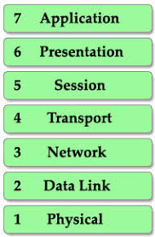
Networking
OSI Layer
Each layer includes a set of protocols
Ex:
  Application Layer, not only contains the applications like Chrome, Firefox it also contains set of protocols such as HTTP/s
  Protocols helps the applications to work seamlessly over the Internet

Slide 5
Networking: OSI Layer
Layer-1: Application
Applications like chrome, firefox uses HTTP/s protocols present in the application layer to surf the stuff.
Protocols present in the application layer, helps in
Service | Protocol
File Transfer | FTP
Web Surfing | HTTP/s
Emails | SMTP
Virtual Terminals | Telnet

Slide 6
Networking: OSI Layer
Layer-2: Presentation
Application
Data Compression
Presentation
Encryption
ABCDEF…
562663…
101010110
10101
001101
Decryption
Translation
JOBS:
1. Translation
2. Data compression + Decompression
3. Encryption + Decryption
Encryption + Decryption happens through SSL(Secure Socket Layer)

Slide 7






Networking: OSI Layer
Layer-3: Session
Deals with
  Connection between two system
  Data exchange(Tx + Rx)
Text
Image
1. Application
2. Presentation
3. Session
JOBS:
1. Authentication
- Who are you?
Username + Password
2. Authorization
- Permission to access the required file
3. Session Management
Separate Session will be established between Text and Image files

Slide 8
Networking: OSI Layer
Layer-4: Transport
Mainly responsible for reliability
JOBS
  Segmentation
  Flow Control
  Error Control
  Connection oriented
  Connection-less Tx

Slide 9

Networking: OSI Layer
Layer-4: Transport: Seg + Flow + Error Control
50 Mbps
5 Mbps
Data
Segments
10 Mbps
Data
Data
Data
100 Mbps
10 Mbps
100 Mbps
Data
Data
Data
Port Number +
Sequence Number
Data Unit
Data
Missing
Data
Data
Data
Data
Port: Helps to direct the packets to right app
Seq: Helps to reorganize the packets at the receiving end
- Automatic Repeat Request
- Checksum for each data unit
TCP | Connection Oriented Protocol - SLOW | Email, tfp etc...
UDP | Connectionless protocol - FAST | Games, Video Streaming, Video conferencing...

Slide 10
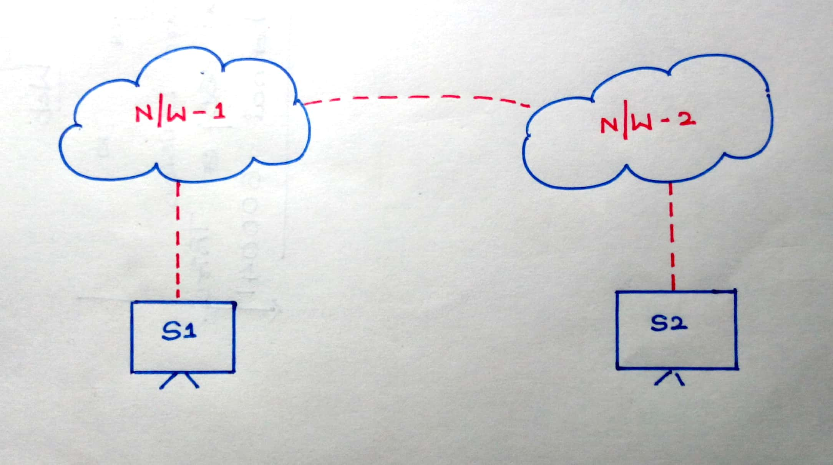
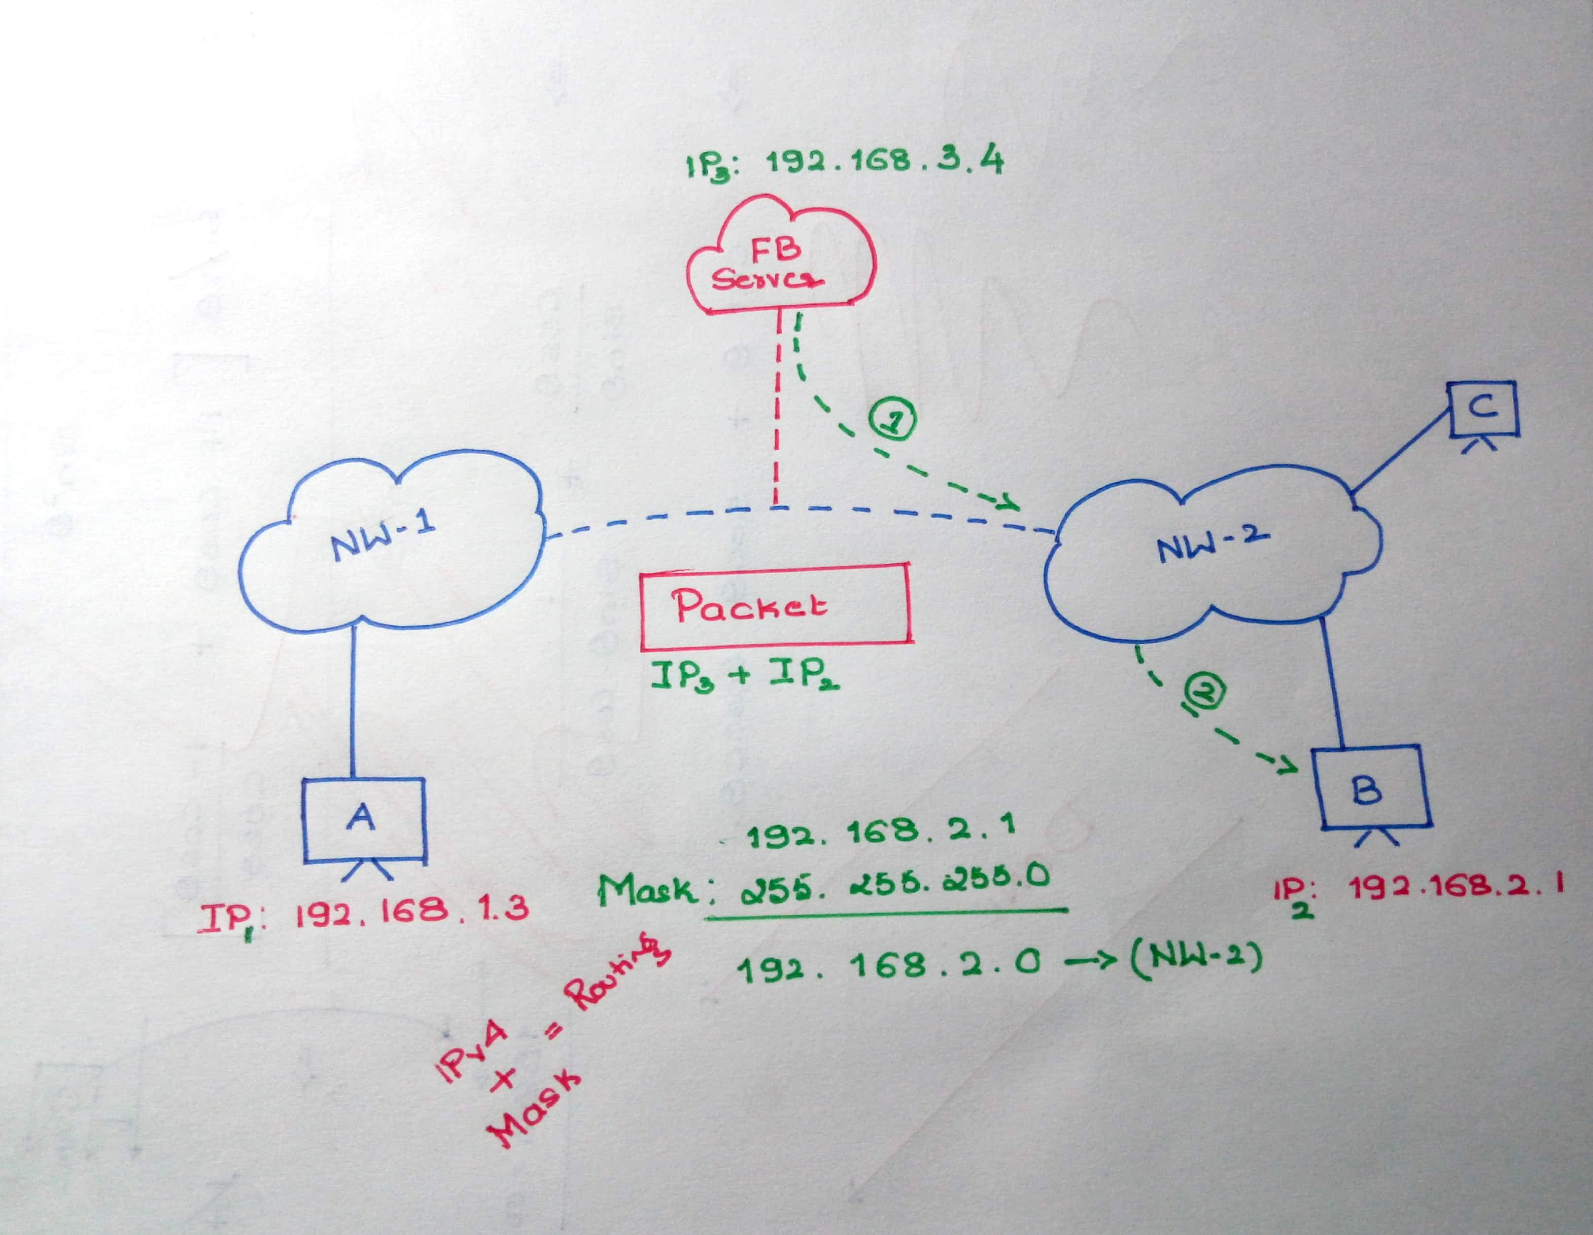
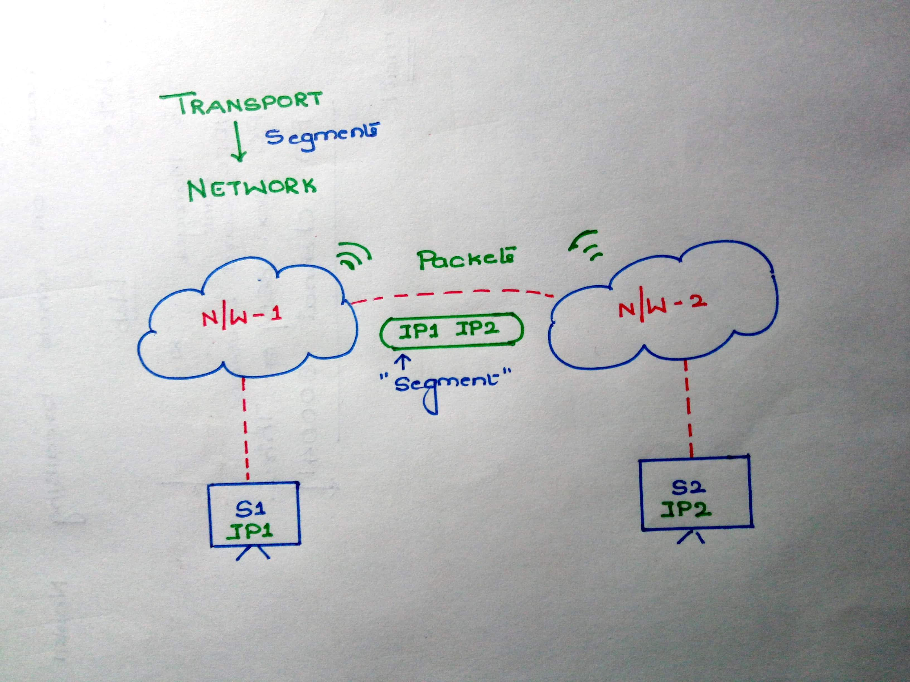
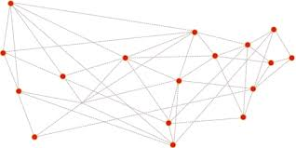
Networking: OSI Layer
Layer-5: Network
2
JOBS:
1. Logical Addressing
2. Routing
3. Path Determination
1
3

Slide 11
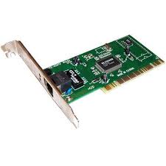
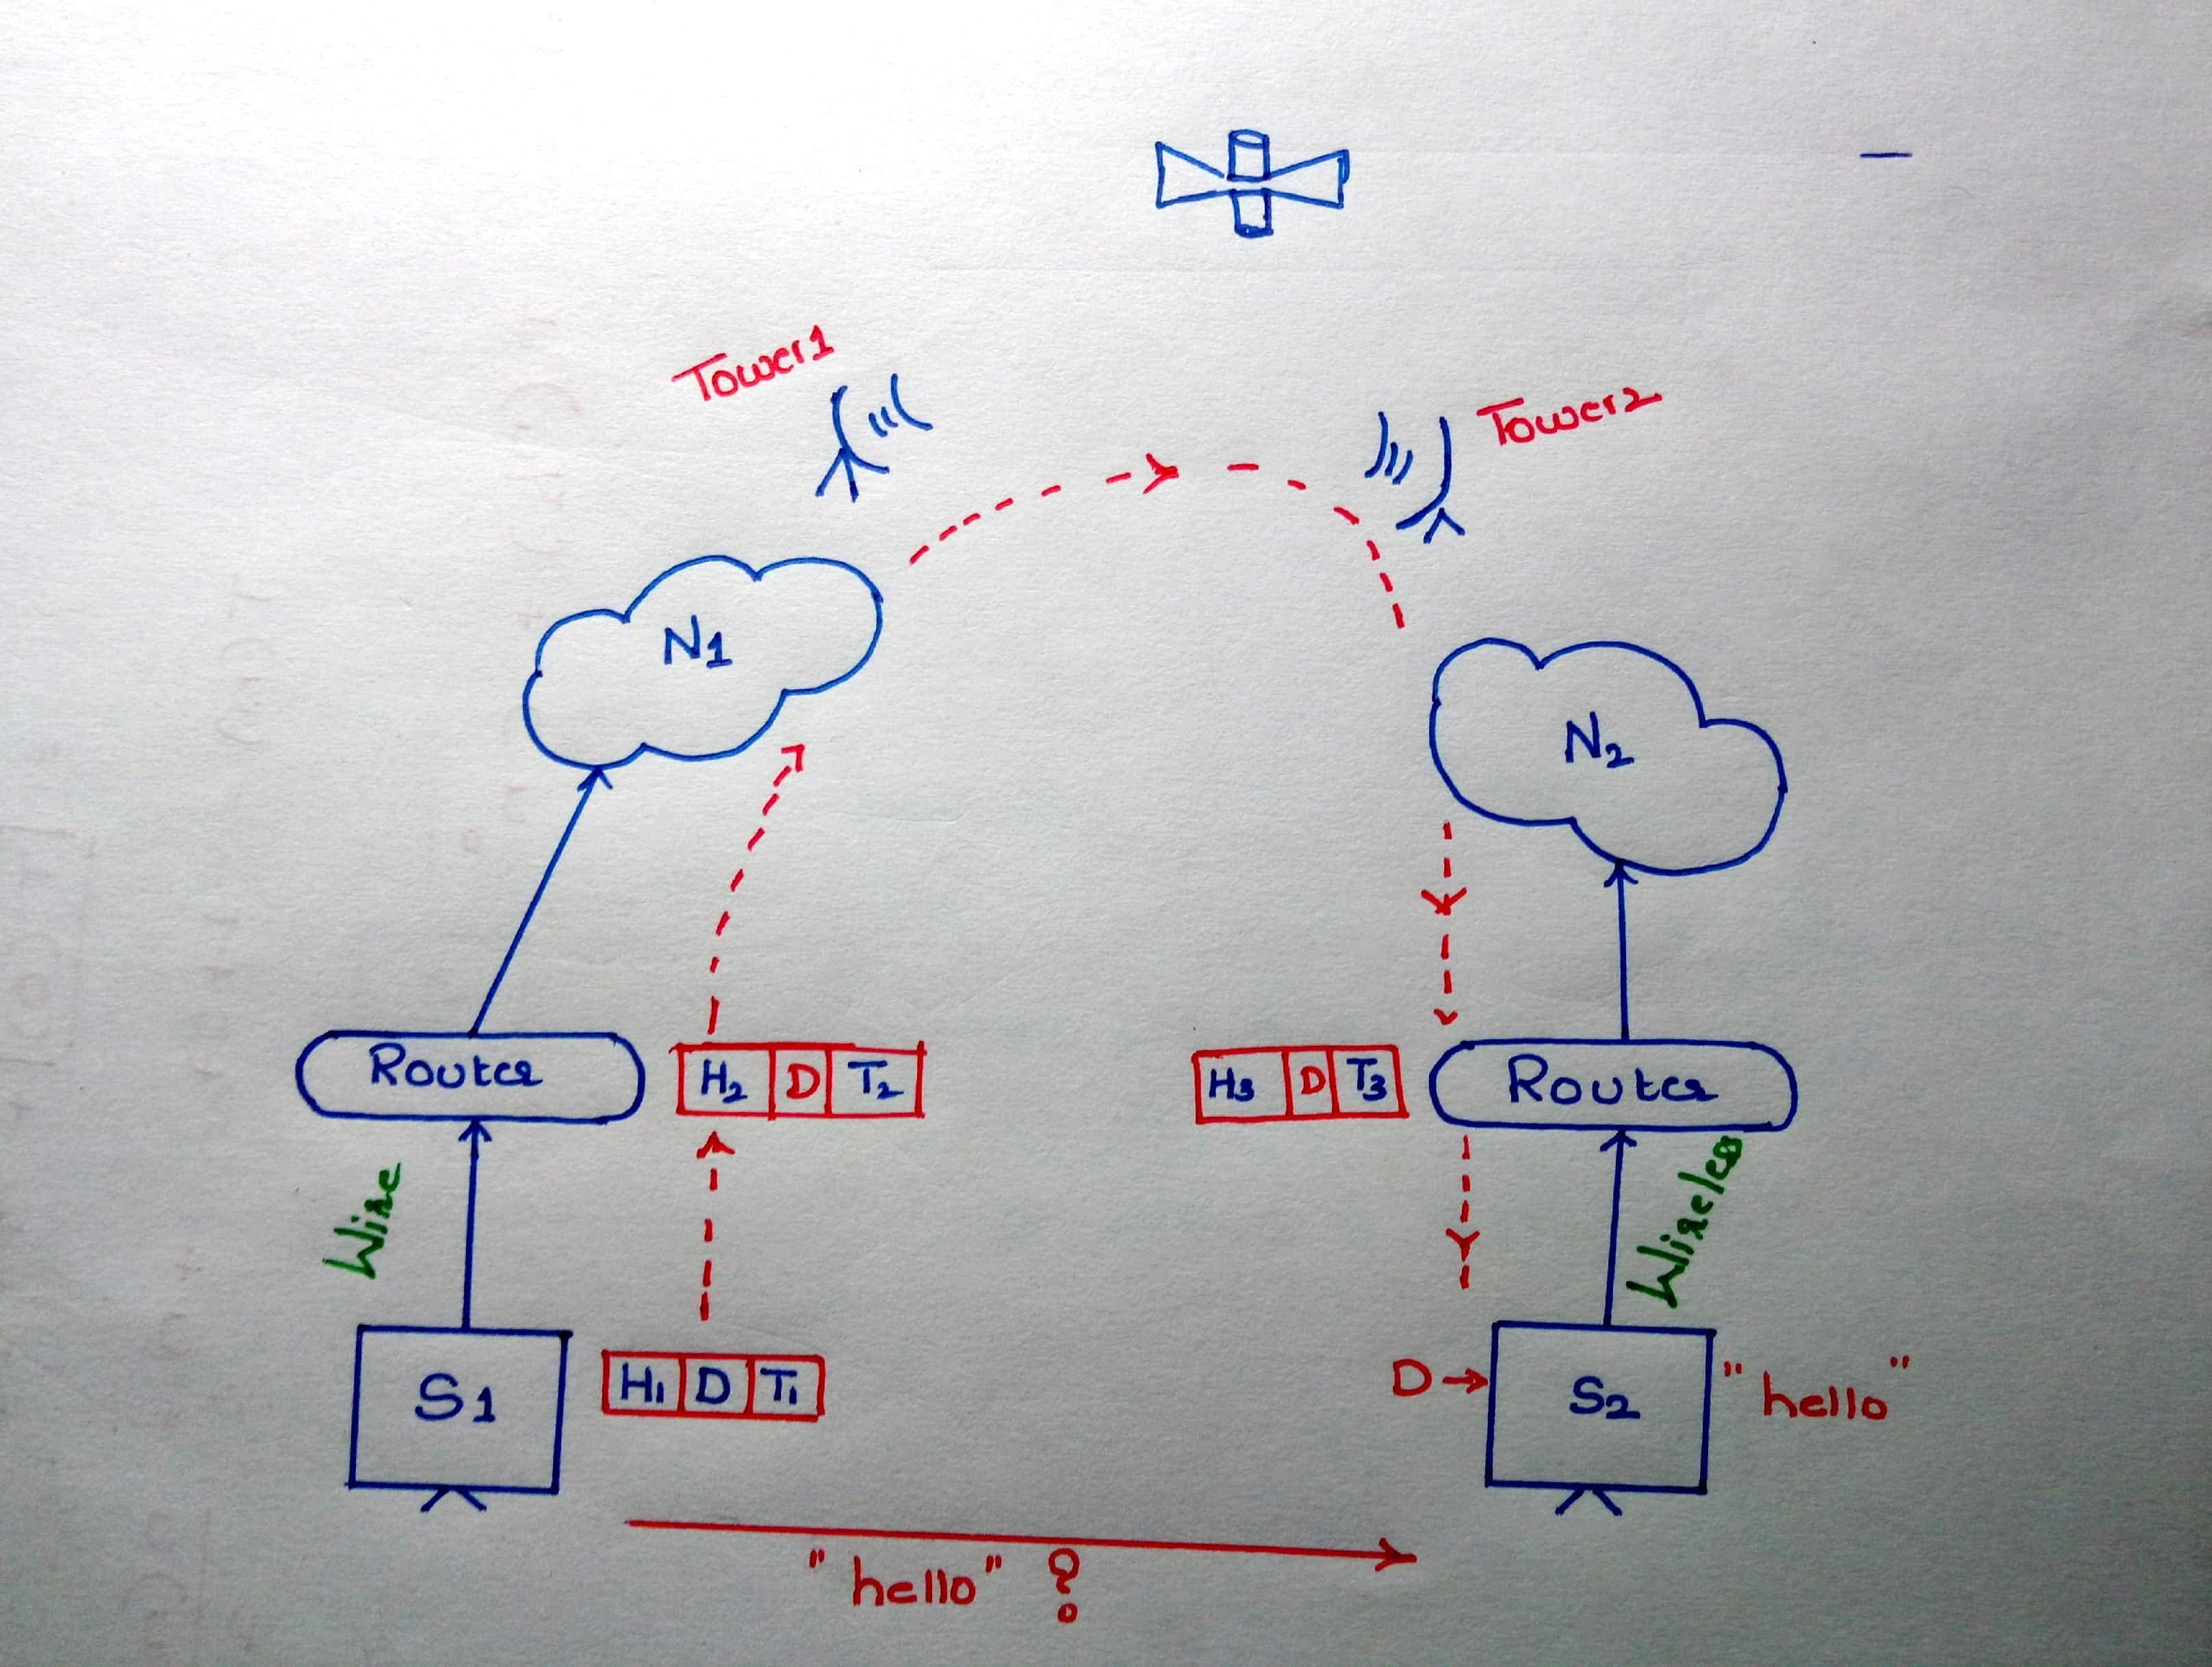
Networking: OSI Layer
Layer-6: Data Link
MAC1 | MAC2 | IP1 | IP2 | Segment
JOBS:
1. Medium access Control
(Framing)
2. Error Detection etc..
Frame
MAC1
MAC2
MAC1

Slide 12
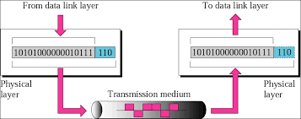

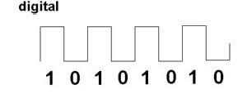

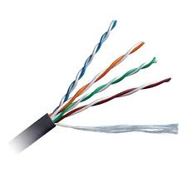
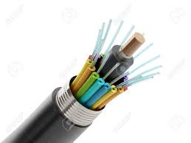
Networking: OSI Layer
Layer-7: Physical
JOBS:
1. Convert Binary data to respective signals
AIR

Slide 13
Networking: OSI Layer
Layers: Brief
Segment
Data
Transport
Packet
Source IP | Destination IP | Segment
Network
Frame
Source MAC | Destination MAC | Packet | Tail
Data
1010101111000110010101010111001010101100010101000001010100101010

Slide 14
Thank You

