Slide 1

BVCOG Contract Management System
Huy Lai: Product Owner
Shreya Gubbi Prakash: Scrum Master1
Thomas Manzini
Neha Manghnani: Scrum Master 2

Slide 2

The problem:
The Brazos Valley Council of Governments (BVCOG) has a Contract Management System.
BVCOG requires additional changes and software modifications within the system to streamline their contract management process.

Slide 3


Fall 2023 Work Summary
We've built upon the contract management system for BVCOG that was started in Spring 2023 semester. The system can manage multiple levels of users, contracts, entities, programs, and vendors.
The modifications requested by BVCOG make the contract management software more intuitive and easier to use by all the stakeholders of the system.
Some of the modifications done:
User Access Levels update
Vendor Dropdown to Text Field
Invitation Email
Rejecting Contract
Contract Value Addition
Contract Duration updates
Contract Renewals added
UI and Text Updates

Slide 4
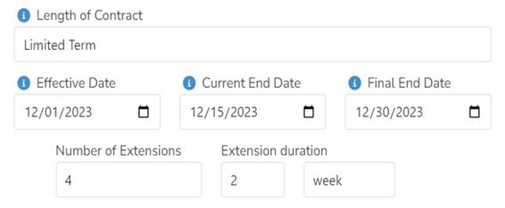
Additional Fields in the Contract – Length of Contract
Length of Contract is a select field with a dynamic view.
Upon selecting 'Limited Term' the fields shown above are made visible in the contract to enter the start and end date for the contract.
There is also an option to extend the contract by specifying the number of extensions and the extension duration for the contract.

Slide 5
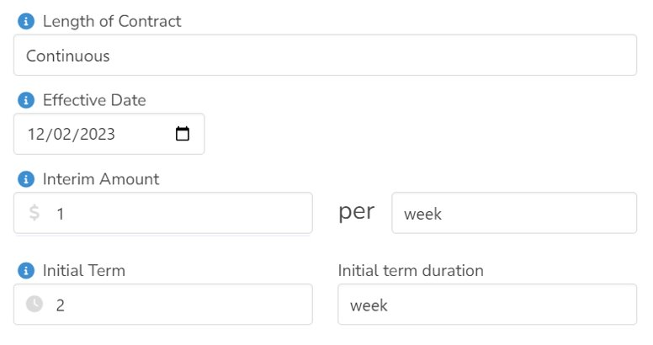
Additional Fields in the Contract – Length of Contract
Selecting 'Continuous' in the contract length, the view changes as depicted in the screenshot.
For a Continuous contract, end date is not specified.

Slide 6
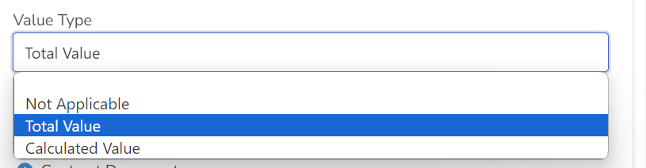
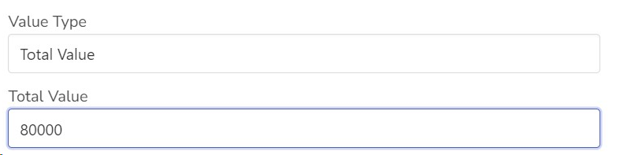
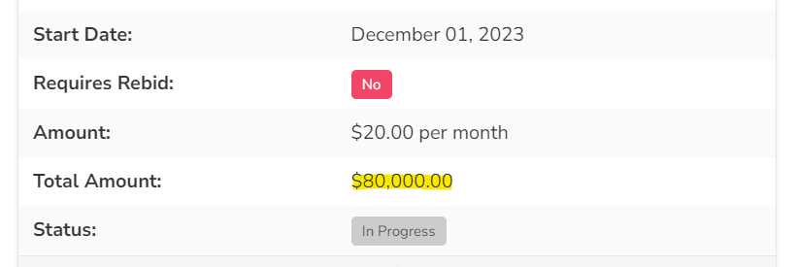
Additional Fields in the Contract – Contract Value
Contract Value can be of three types -
Not Applicable, Total Value, Calculated Value.
On selecting 'Total Value' , a text box is made visible to take the user input for the total value of the contract.
On saving this contract, the total value of the contract is saved as one of the parameters of the contract.

Slide 7
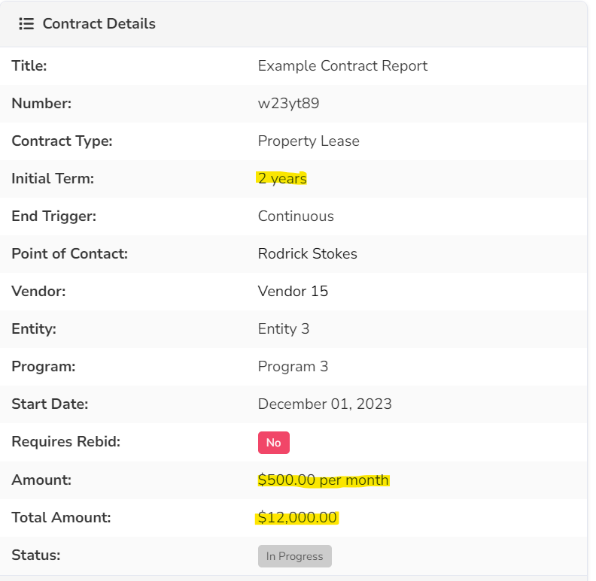
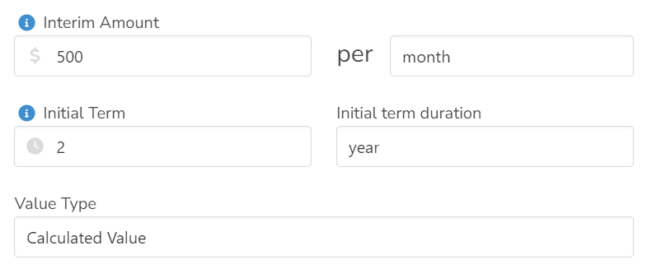
Additional Fields in the Contract – Contract Value
On selecting 'Calculated Value' , the text field for Total Value is hidden to disable user input for Total value of the contract.
The value of the contract is calculated by the initial term of the contract and interim amount of the contract for a particular term

Slide 8
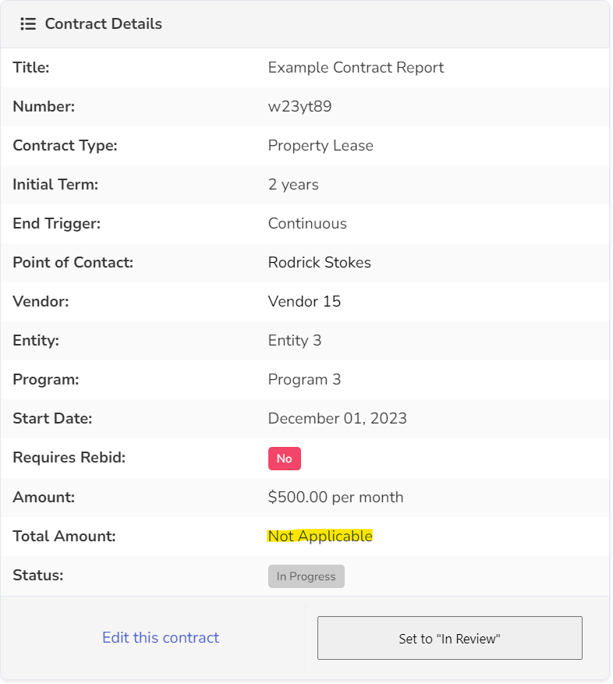
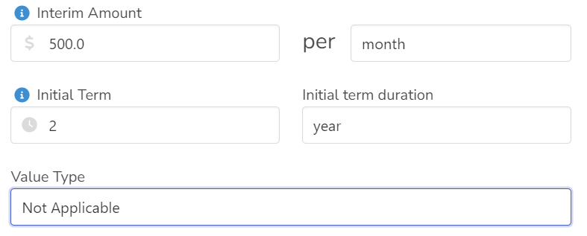
Additional Fields in the Contract – Contract Value
On selecting 'Not Applicable' , the text field for Total Value is hidden to disable user input
The value of the contract is $0 if the Value Type is Not Applicable.
When the Total Value is $0, the contract value is viewed as 'Not Applicable' when reviewing the contract details.

Slide 9
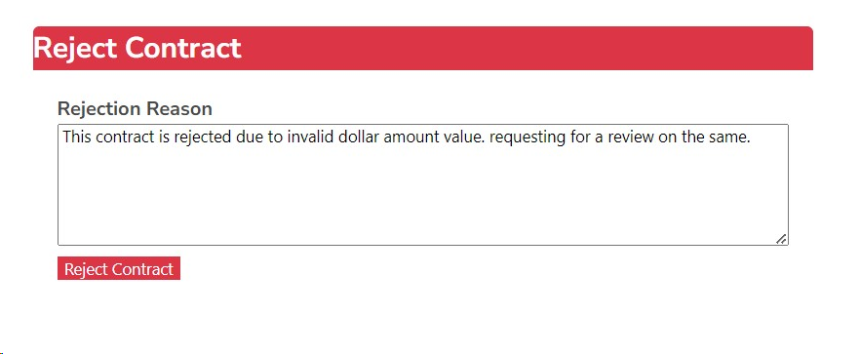
Contract Rejection
Gatekeepers can reject/approve contracts.
The reject button was added to reject contracts if the gatekeeper is not satisfied with the contract contents.
The gatekeeper can add a rejection reason for why the contract is rejected.

Slide 10
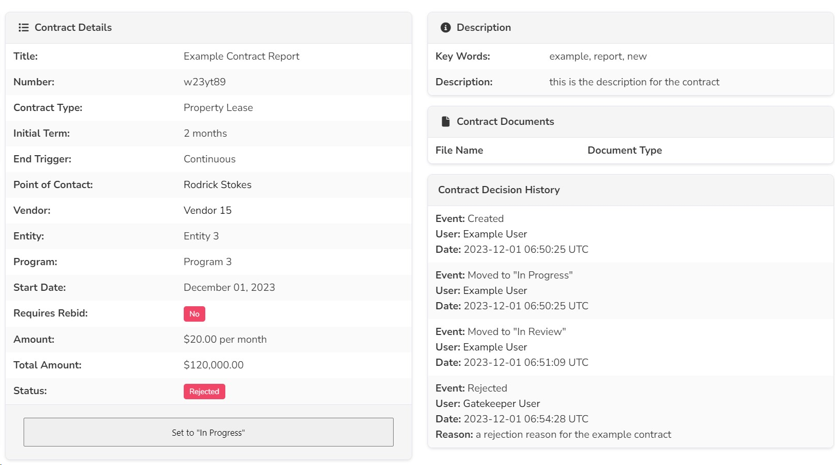
Contract Logs
Contract Logs are maintained for the events of the contract before Approval.
Contract rejected reasons are recorded in the contract decision history.

Slide 11
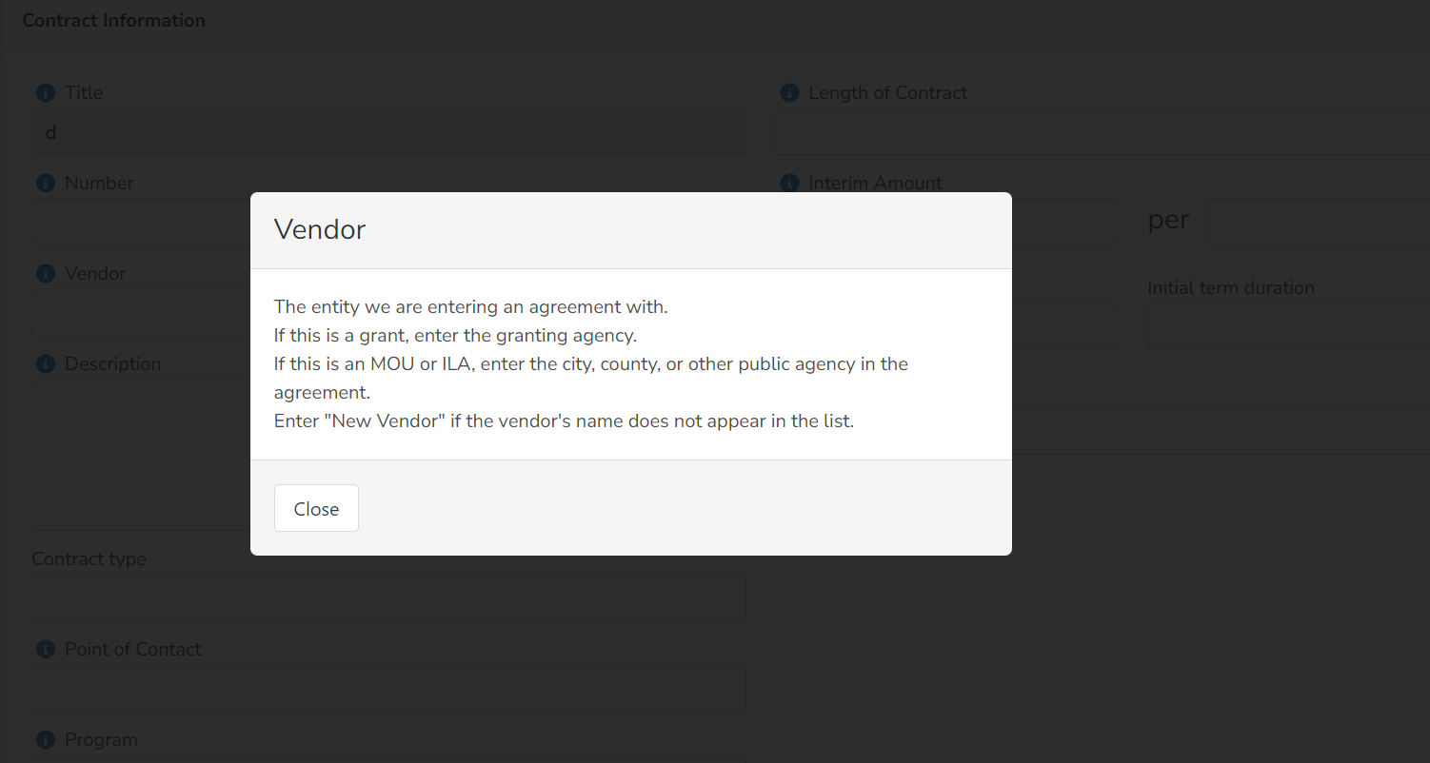
Field Hints
Field Hints added for every text and select field of the contract.
The hint helps the user in understanding what has to be added for the contract.

Slide 12
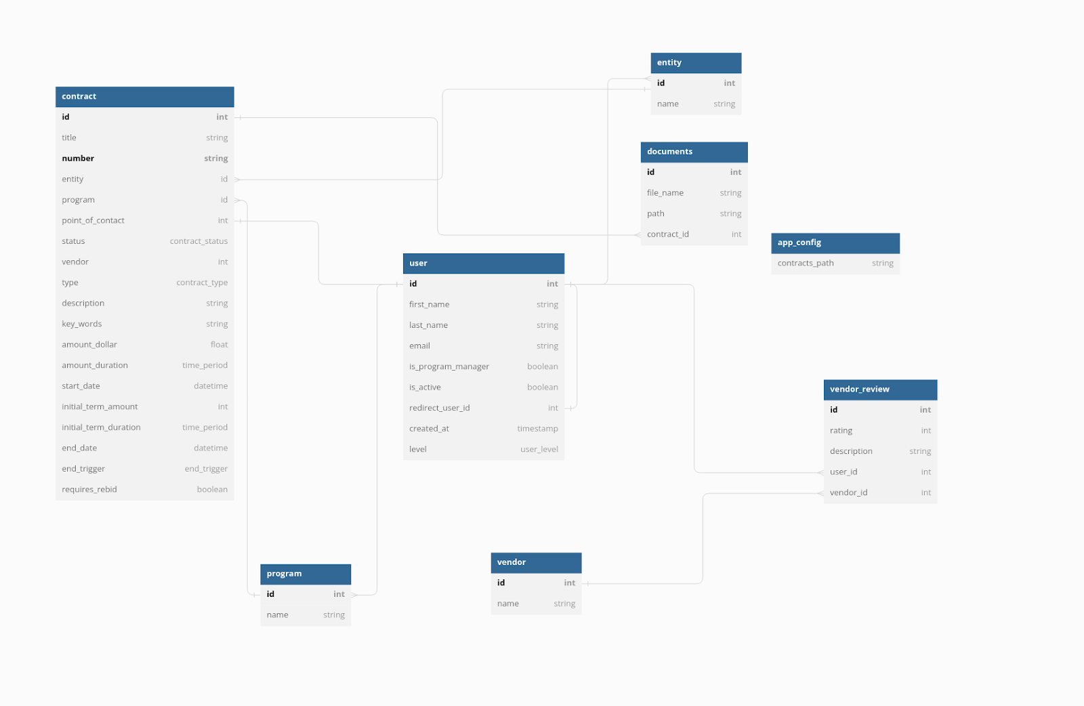
Database Design

Slide 13

Gems/Technologies used
Devise: For user authentication and password resetting
Devise_inviteable: For user invites
Kaminari: Table pagination
Bulma_rails: Styling
Polar OSO: Role based Access Control
Whenever: Automated cron jobs
JQuery : Autocomplete feature for text inputs.

Slide 14

Challenges
Working on the legacy project, understanding the codebase and design choices made by the previous team was time consuming.
Updating previous test cases that were failing due to the implemented change in functionality behavior.
Production Challenges: The rails master key required to deploy the application was not explained well.

Slide 15
Lessons learned
Communicate early with clients; Some major changes needed to be made late into the project because we didn't clarify what our users really wanted
Underestimated the points and the work to do for the functionality, a more thorough analysis had to be done for some of the user stories
Embrace the Rails conventions when working with the framework; deviating from them might lead to challenges and a less straightforward development experience.

