Slide 1

Quakes: A Predictive Analysis on Earthquakes near Mt. Fuji
Julia Cuellar
DSC 630

Slide 2
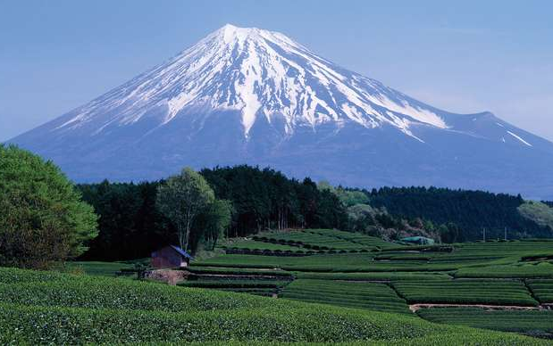
Abstract
Figure 1 Japan: Fuji, Mount
Mt. Fuji is the highest mountain in Japan and an active volcano. There are three clear planes of seismic activity near Mt. Fuji. The triple junction of tectonic activity is the Amurian plate (associated with the Eurasian tectonic plate), the Okhotsk plate (associated with the North American plate), and the Filipino plate along with the Japan Trench. The Hōei eruption of 1707 has an assumption of a correlated relationship between earthquakes and volcanic eruptions. A predictive analysis will be performed to determine what seismic activity could cause a potential catastrophic natural disaster to chance in the country of Japan.

Slide 3
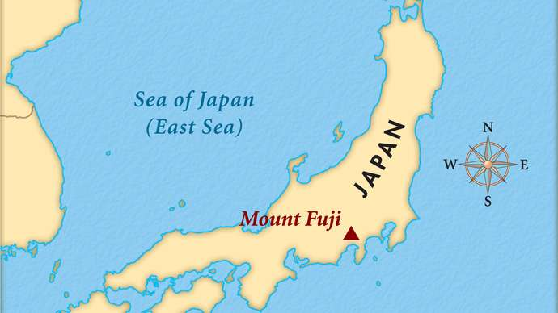
Background
Figure 2 Mount Fuji
“Mount Fuji, Japanese Fuji-san, also spelled Fujisan, also called Fujiyama or Fuji no Yama,…” is the highest mountain in Japan in which it rises to 12,388 feet (or 3,776 meters). Mt. Fuji (for short) is located near the Pacific Ocean coast in the Yamanashi and Shizuoka ken prefectures of central Honshu, approximately 60 miles (or 100 kilometers) west of the Tokyo-Yokohama metropolitan area. Mt. Fuji is not just a mountain but an active volcano. Mt. Fuji has a graceful conical form, and the volcano was formed in 286 BCE from an earthquake.

Slide 4
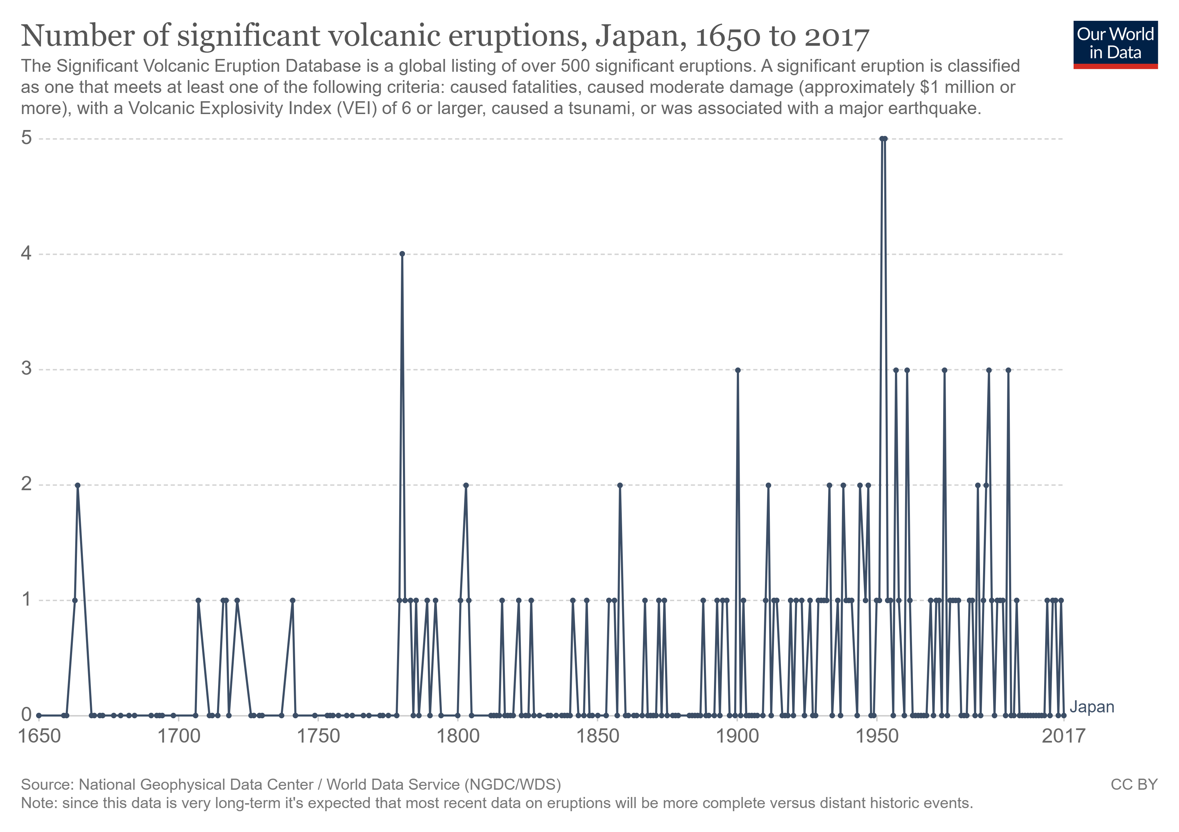
Background cont.
Figure 3 Number of significant volcanic eruptions, Japan, 1650 to 2017
The Hōei eruption of 1707 was proceeded by an 8.6 magnitude (based off the Richter scale) earthquake and a tsunami followed right after the volcanic eruption.

Slide 5
Quakes
A data frame with 1000 observations on 5 variables.
lat (Latitude of event)
long (Longitude)
depth (Depth in km)
mag (Richter Magnitude)
stations (Number of stations reporting)
The data set give the locations of 1000 seismic events of MB (magnitude based) > 4.0.
(Head)
lat long depth mag stations
0 -20.42 181.62 562 4.8 41
1 -20.62 181.03 650 4.2 15
2 -26.00 184.10 42 5.4 43
3 -17.97 181.66 626 4.1 19
4 -20.42 181.96 649 4.0 11

Slide 6
Questions & Hypotheses
How does the depth from an earthquake relate to volcanic activity?
How does the magnitude from an earthquake relate to volcanic activity?
Can the latitude and longitude be used to predict seismic activity which in turn could predict volcanic activity?
Due to Mt. Fuji having two magma chambers, the shallow reaching 8 km while the deeper reaches 20 km, the depth of an earthquake as determined by USGS will fall more into a deeper earthquake which would result in a possible volcanic eruption.
With magnitudes not reaching its highest since 1707, based off the data for seismic activity from the year of 1964 and up, earthquakes in the mid-Richter scale will not contribute to volcanic eruptions.
The latitude and longitude for Mt. Fuji is about 35° N and 138° E, with coordinates exact or close to the proximity to Mt. Fuji as well as near the tectonic activity that is underneath the active volcano, could potentially predict where an earthquake may strike resulting in a possible volcanic eruption.

Slide 7
Methods
To perform this predictive analysis of whether seismic activity relates to volcanic eruptions, clustering models will be built on the depth and magnitude of an earthquake while a multiple, linear regression model will be built on latitude and longitude.

Slide 8
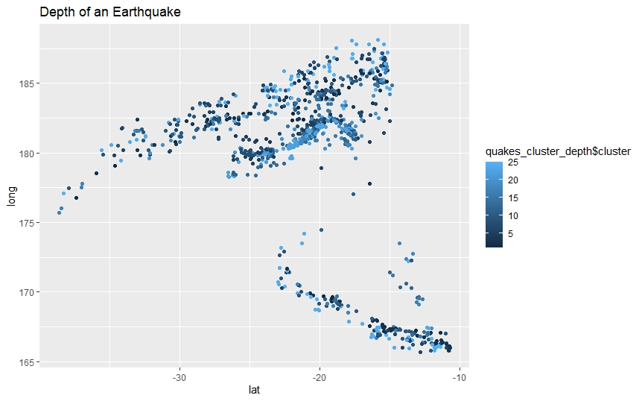
Results
Depth of an Earthquake
In the clustering model built, the depth of an earthquake will tend to flock to about 311 km to where the final resultant based off the question: does the depth from an earthquake relate to volcanic activity, can be drawn to a positive correlation between the two.

Slide 9
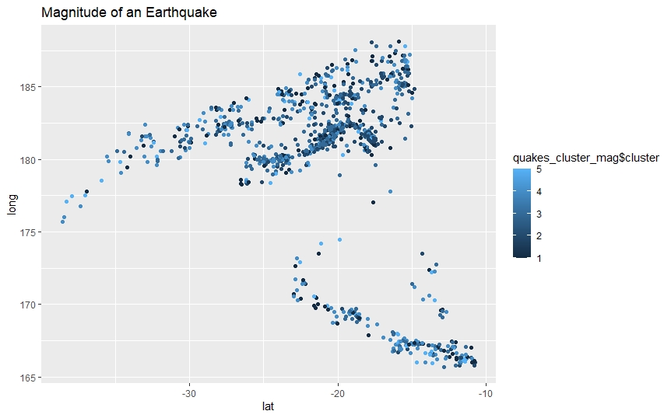
Results cont.
Magnitude of an Earthquake
In the clustering model built, the magnitude of an earthquake will tend to flock to about 4.6 on the Richter scale to where the final resultant based off the question: does the magnitude from an earthquake relate to volcanic activity, can be drawn to no correlation between the two.

Slide 10
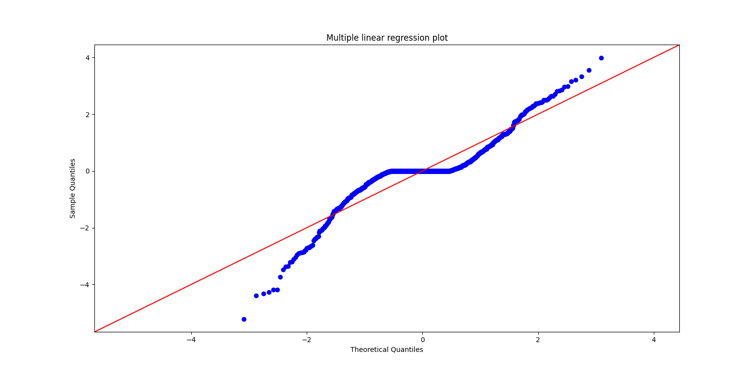
Results cont.
Latitude vs longitude
In the multiple, linear regression model built, the latitude and longitude of an earthquake will tend to flock to about the coordinates of Mt. Fuji to where the final resultant based off the question: can the latitude and longitude be used to predict seismic activity which in turn could predict volcanic activity, can be drawn to a correlation between the two.

Slide 11
Conclusion
After the models have been built, a performance check of whether the models are up to par for answering the business problem needs to be administered. Lastly, conclusions from the results can be drawn but the only drawback to considering that seismic activity has a correlation with volcanic eruptions is because the quakes data has only data from 1964 and up, no data before that year.

Slide 12
References
Determining the Depth of an Earthquake. (n.d.). Retrieved from Determining the Depth of an Earthquake (usgs.gov)
International Registry of Seismograph Stations. (n.d.). Retrieved from International Registry of Seismograph Stations (isc.ac.uk)
Japan. (n.d.). Retrieved from Japan - Our World in Data
Locations of Earthquakes off Fuji. (n.d.). Retrieved from R: Locations of Earthquakes off Fiji (vincentarelbundock.github.io)
Mount Fuji. (2021, February 11). Retrieved from Mount Fuji | Facts, Height, Location, & Eruptions | Britannica
Mount Fuji. (n.d.). Retrieved from Mount Fuji | National Geographic Society
Mt. Fuji: The Earthquake that caused a Volcanic Eruption. (n.d.). Retrieved from Mt Fuji: The Earthquake that caused a Volcanic Eruption | Volcano World | Oregon State University

