Slide 1
Kickstarter Project
Group 28 : Denise Mooren, Seeun Park, Steven Emmink, Sungmin Kim

Slide 2
Derived features
1
Features derived from other columns in the dataset

Slide 3
Derived Features
reached_deadline
Derived from columns ‘created_at’ and ‘deadline’
Value is 1 (true) if the deadline was reached on time
Value is 0 (false) if deadline was not met
cVSl_full_days
Derived from columns ‘created_at’ and ‘launched_at’
Number of days between created and launched date in integers
goal_in_USD
Derived from columns ‘fx_rate’ and ‘goal’
Goal in USD dollars in floats

Slide 4
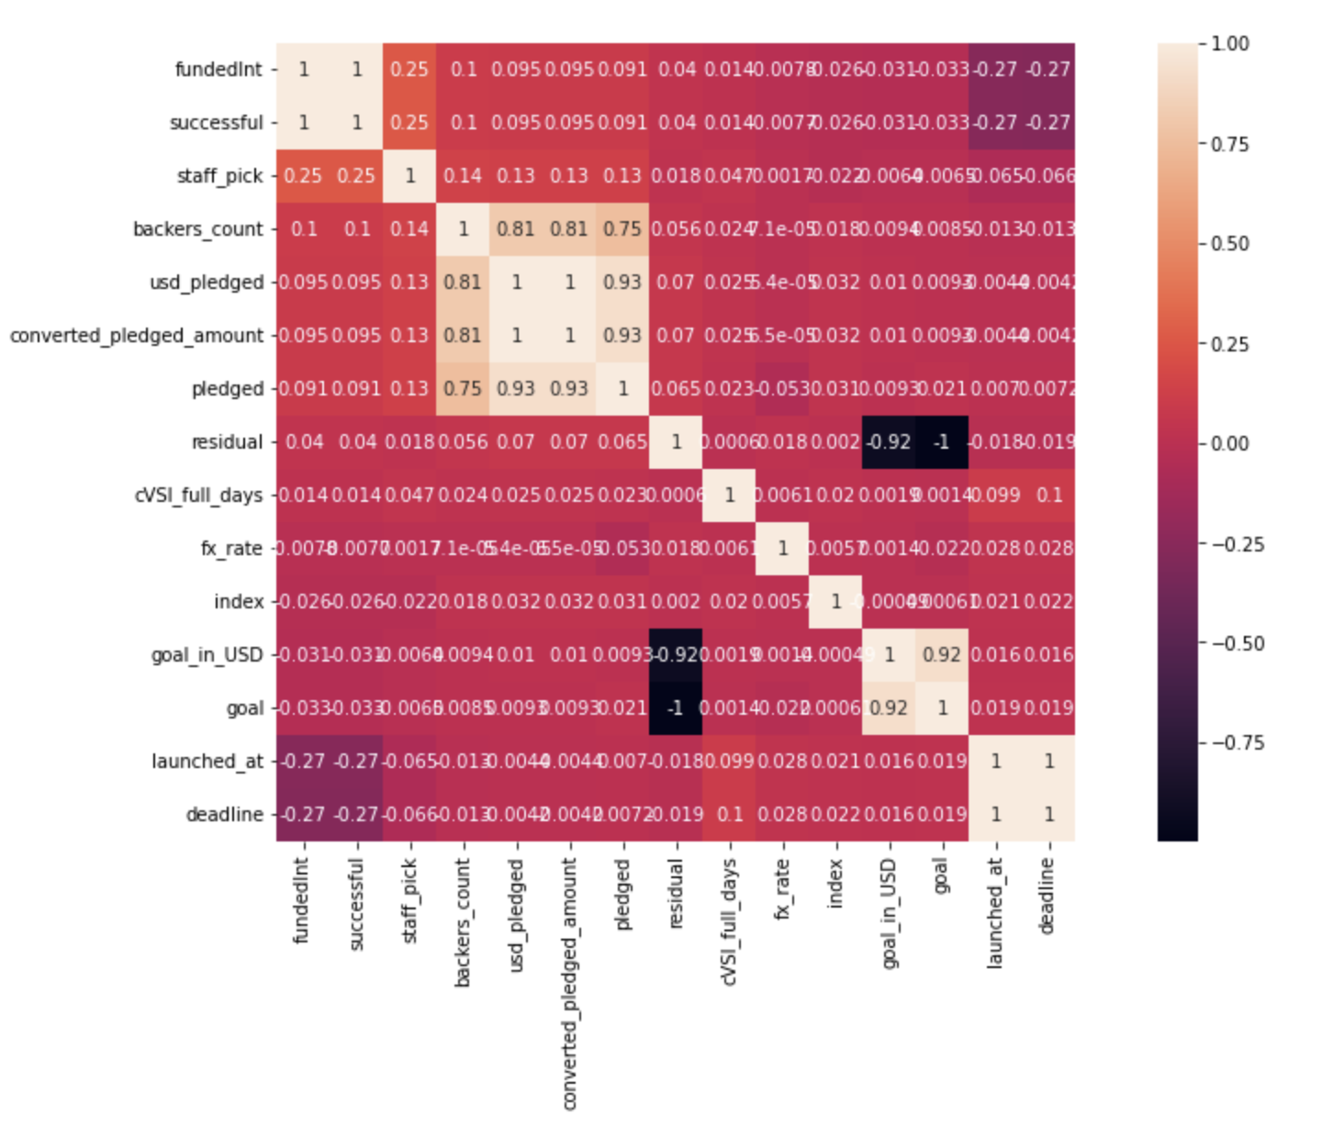
Heatmap of 15 most correlated features on ‘fundedInt’

Slide 5
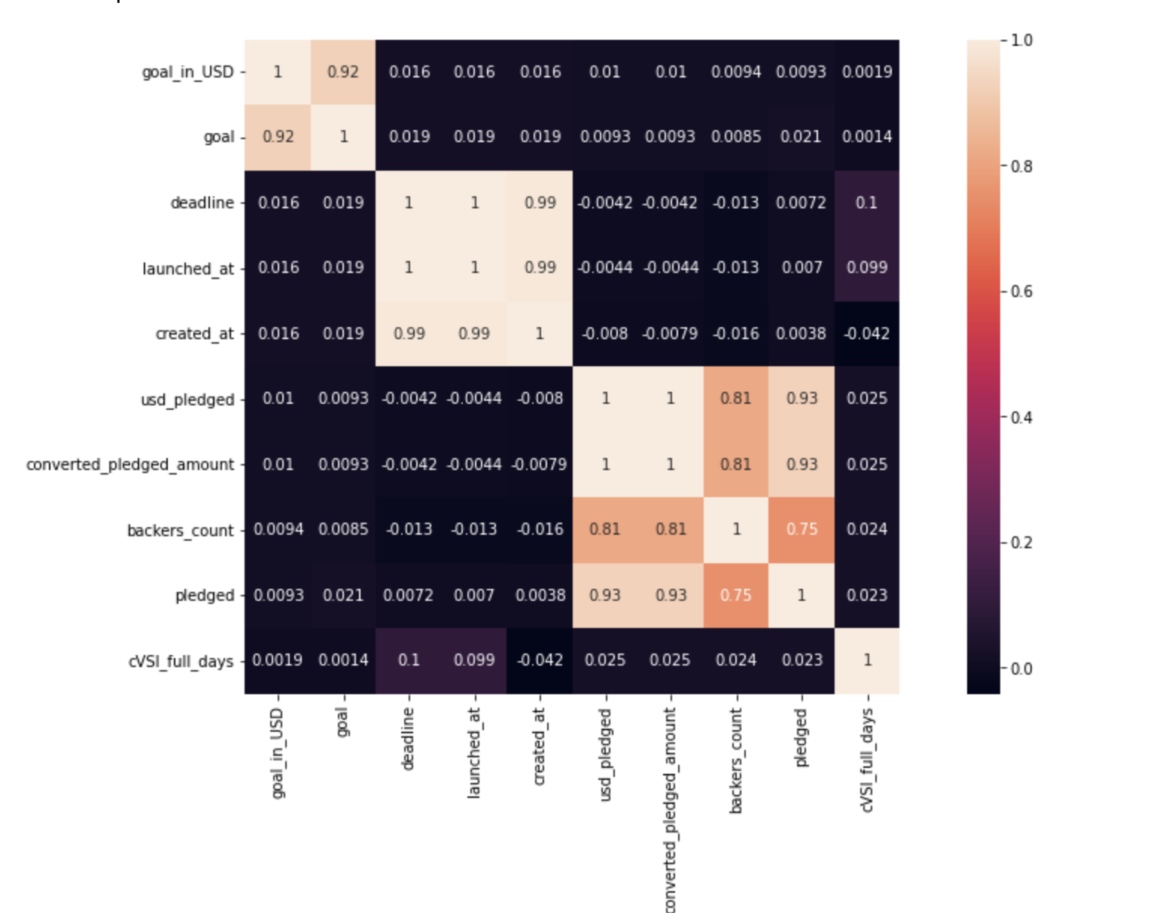
Plots of Derived Features
goal_in_USD

Slide 6
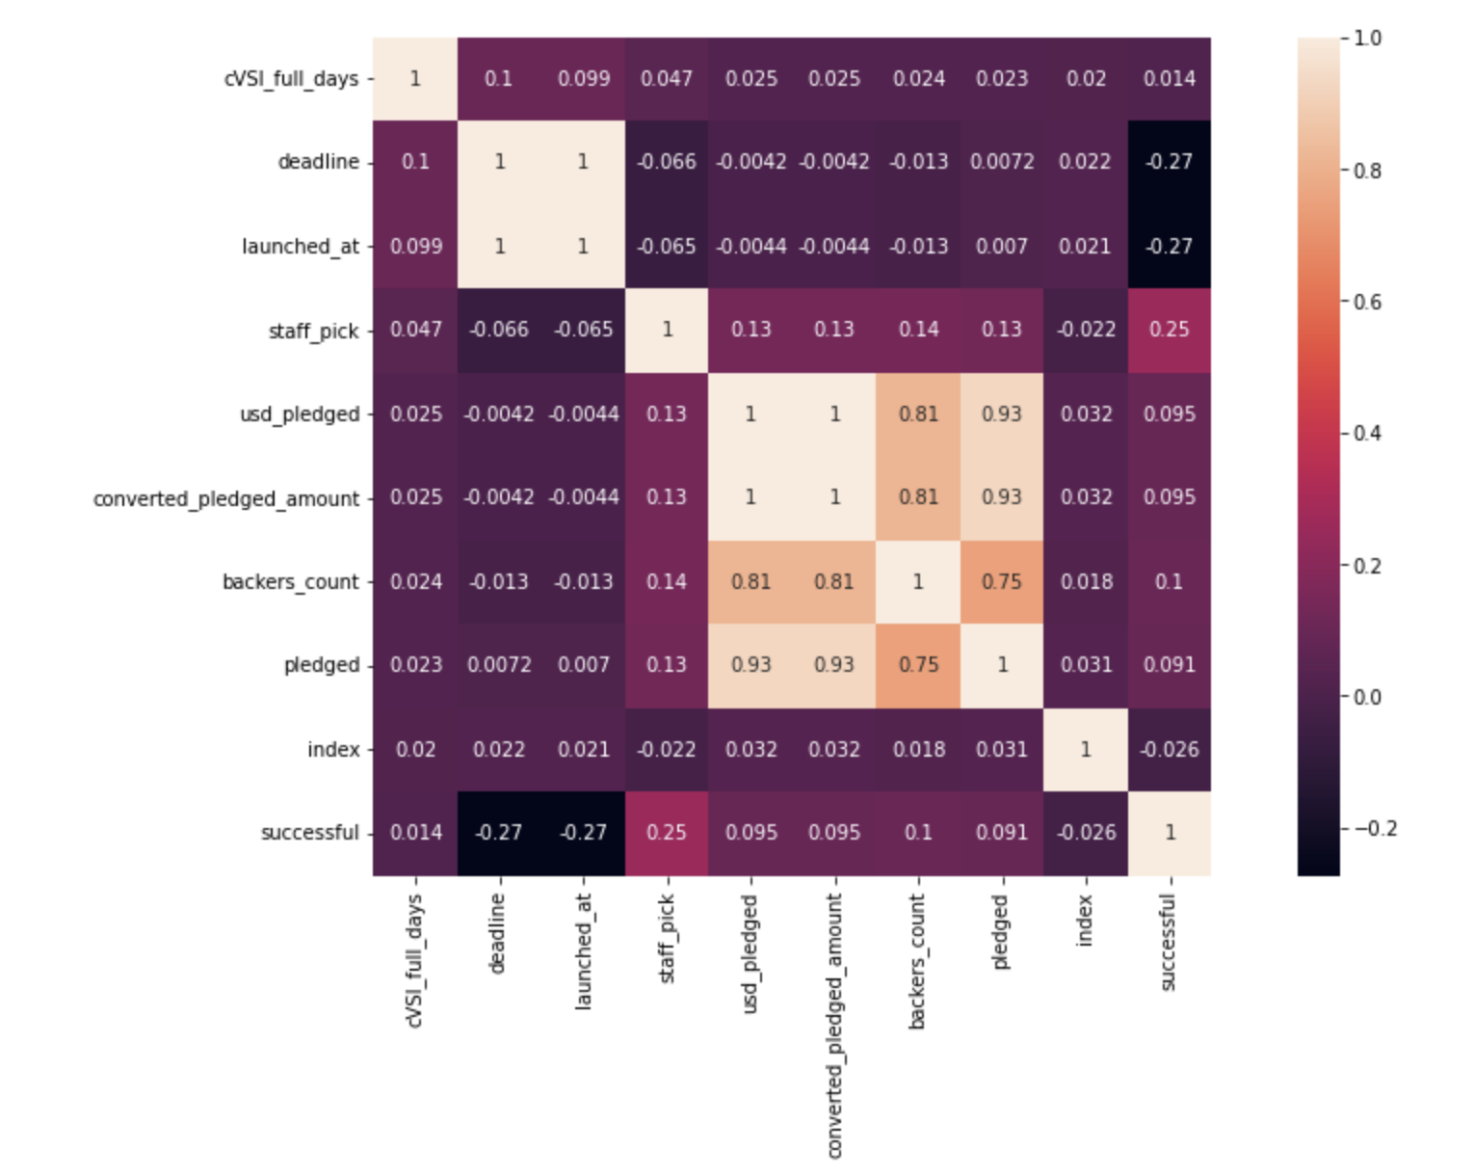
Plots of Derived Features
cVSl_full_days

Slide 7
Model Choice &
Cross Validation
2
Design choices, feature selection, and cross validation scheme

Slide 8
Random Forest
Good at handling categorical and numerical data
Less sensitive to overfitting
Features of importance were one hot encoded
‘name’, ‘blurb’, ‘location’ and URL features excluded
Used SelectFromModel to select most important features for training
20 features selected

Slide 9
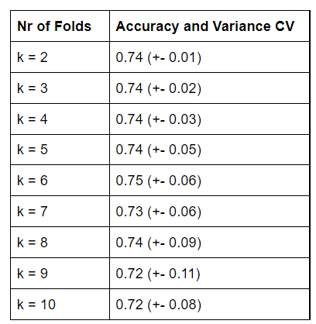
Cross-Validation Scheme
Tried several numbers of folds (2 - 10)
The most optimum number of folds RF: 6

Slide 10
Parameters
3
Hyperparameter tuning for the Random Forest Classifier

Slide 11
Hyperparameter tuning
Hyperparameters used:
{ 'bootstrap': [True],
'max_depth': [10, 20, 30, 40, 50, 60, 70, 80, 90, 100, None],
'max_features': ['auto', 'log2', None],
'min_samples_leaf': [1,2,4],
'min_samples_split': [2, 5, 10],
'n_estimators': [200, 400, 600, 800, 1000, 1200, 1400, 1600, 1800, 2000] }
Initially used RandomizedSearchCV
Performed 6 different random searches with 3 folds CV
With the results from the random searches performed a more directed grid search
Best values: (max_depth=20, min_samples_leaf=4, min_samples_split=3, n_estimators=400)

Slide 12
Interpretation
4
Interpretation of models and feature importances

Slide 13

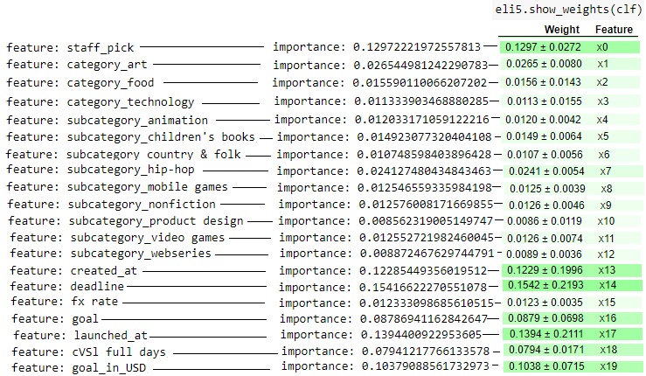
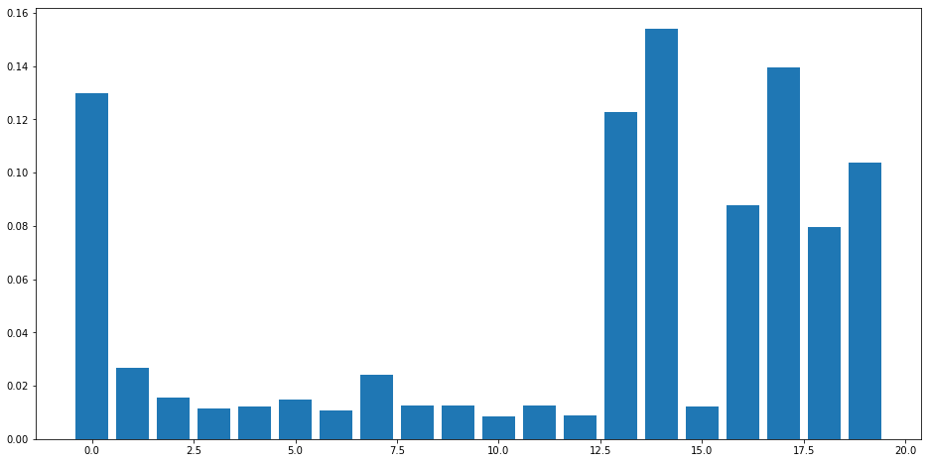
Most important features

Slide 14

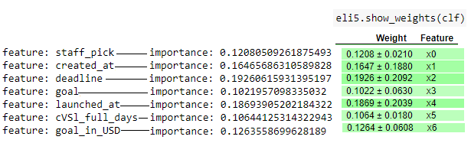
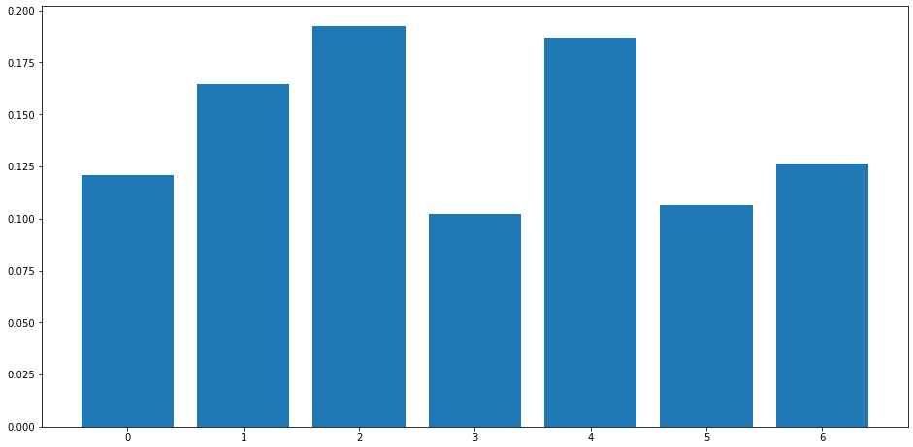
Most important features

Slide 15
Comparison
5
Comparison of assigned Naive Bayes Model with Random Forest

Slide 16
Naive Bayes Pros + Cons
STRENGTHS
WEAKNESSES
Gaussian NB = continuous
Categorical NB = categorical
Performs exceptionally well
with categorical data
Performance for numerical data is not the best
NB is a poor estimator
Don’t have too much faith in
predict_proba
NB
NB

Slide 17


Naive Bayes VS Random Forest

Slide 18
Thanks!
Any questions?

