Slide 1
Comprehensive NLP Analysis of Airbnb Reviews for Improved Decision-Making
Team Members:
Kusum Sai Chowdary Sannapaneni
Vishal Bakshi

Slide 2
Introduction
Airbnb has transformed the hospitality industry with its unique global accommodations. Millions of guest reviews provide a vast source of unstructured data. This project leverages advanced Natural Language Processing (NLP) techniques to analyze these reviews comprehensively. By uncovering insights into guest experiences, preferences, and pain points, the study offers actionable intelligence for hosts, guests, and the Airbnb platform.

Slide 3
Motivation
Our recent trips to Colorado and New York exposed the inefficiency of manually navigating countless Airbnb listings and reviews. The time-consuming process and overwhelming volume of feedback made it difficult to extract essential information. This highlighted a significant gap in user experience, where travelers need a streamlined way to digest review content without sacrificing quality. By leveraging advanced Natural Language Processing (NLP) techniques, this project aims to summarize reviews and highlight key insights, saving time and reducing stress for users when planning accommodations.

Slide 4
Dataset Description
The 2021 NYC Airbnb Reviews dataset contains 17,444 entries, capturing guest feedback across various listings in New York City. Key columns include listing_id (property identifier), url, review_posted_date, and review (guest feedback). The rich textual data in the review column enables advanced NLP tasks such as sentiment analysis, and review summarization.
Source: New York City Airbnb Reviews, Kaggle.

Slide 5
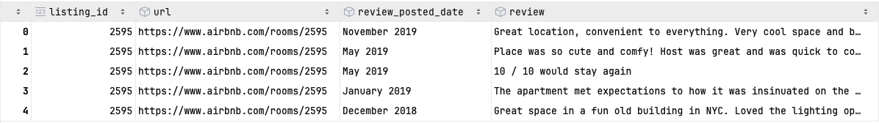
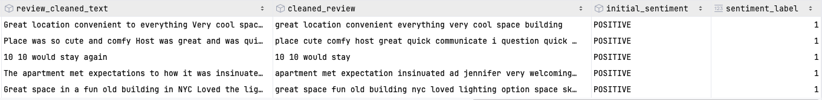
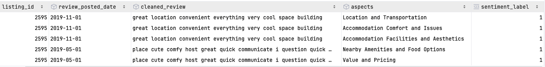
NYC_2021_airbnb_reviews_data.csv
Processed_reviews_SentimentLabels.csv
Processed_reviews_SentimentLabels.csv

Slide 6

SMART Questions

Slide 7
1. How does the distribution of positive and negative sentiments in Airbnb reviews reflect overall guest satisfaction, and what trends can be observed in sentiment changes over the years?

Slide 8
Sentiment Analysis of NYC Airbnb Reviews Using BERT
Steps:
Load Data:
Import NYC_2021_airbnb_reviews_data1.csv into a pandas DataFrame.
Date Parsing:
Convert review_posted_date to datetime format for temporal analysis.
Handle Missing Values:
Ensure completeness; no missing reviews found.
Detect Language:
Use langdetect to filter out non-English reviews.
Text Preprocessing:
Expand contractions, clean text (remove URLs, emojis, mentions, etc.).
Tokenize, lemmatize, and remove stop words to enhance model performance.

Slide 9
Dual Sentiment Analysis Approach
Initial Sentiment Analysis:
Purpose: Generate sentiment labels using a pre-trained model.
Process:
Utilize Hugging Face's distilbert-base-uncased-finetuned-sst-2-english.
Assign ‘POSITIVE’ or ‘NEGATIVE’ labels to each review.
Convert labels to numerical values (1 for positive, 0 for negative).
Training a Custom BERT Model:
Purpose: Fine-tune BERT to adapt to the specific dataset for improved performance.
Process:
Data Splitting: Create training and validation sets with stratified sampling.
Dataset Preparation: Tokenize texts and create Hugging Face Dataset objects.
Model Initialization: Initialize BertForSequenceClassification with binary labels.
Training: Train the model using generated sentiment labels.
Evaluation: Assess performance on the validation set.
Rationale for Dual Analysis:
Label Generation: Annotate data with sentiment labels for supervised learning.
Customization: Adapt the model to specific data nuances, improving accuracy and generalization.

Slide 10
Results & Interpretation
Outcomes:
Epoch 1:
Loss: 0.1149
Accuracy: 96.72%
Precision: 97.11%
Recall: 99.47%
F1 Score: 98.28%
Epoch 2:
Loss: 0.1364
Accuracy: 96.99%
Precision: 97.48%
Recall: 99.37%
F1 Score: 98.42%
Interpretation:
High Performance: Consistently high accuracy and F1 scores indicate effective sentiment classification.
Precision & Recall:
High Recall: Most positive reviews correctly identified.
High Precision: Predicted positive reviews are accurately classified.

Slide 11
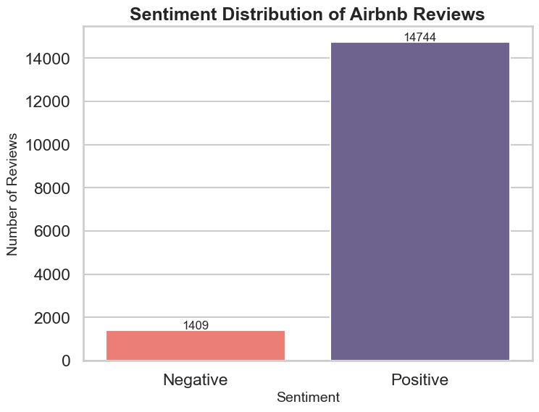
Observation
The bar chart visualizes the distribution of sentiments (positive and negative) in the Airbnb reviews.
Positive reviews dominate, with a significantly higher count compared to negative reviews.
The disparity suggests a general trend of favorable feedback in the dataset.

Slide 12
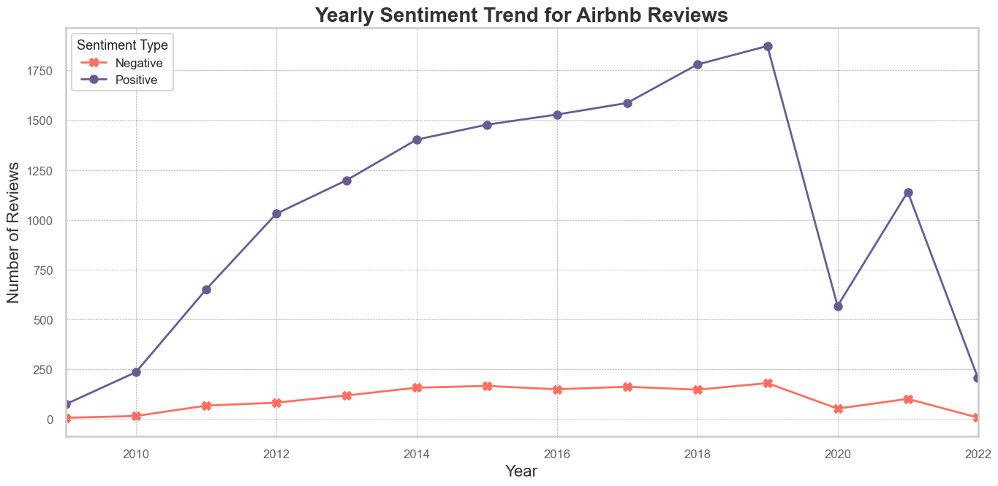
Observation
The line chart illustrates the yearly trend in sentiment distribution for Airbnb reviews
The trend shows a gradual increase in the number of positive reviews, indicating an improvement in customer satisfaction or an increase in Airbnb usage over time.
Negative reviews remain relatively low throughout the years. There is slight fluctuation, but no significant spikes are observed, suggesting consistent service quality.

Slide 13
2. What are the most common bigrams in positive and negative Airbnb reviews, and how can hosts utilize this information to enhance guest experiences and address recurring issues?

Slide 14
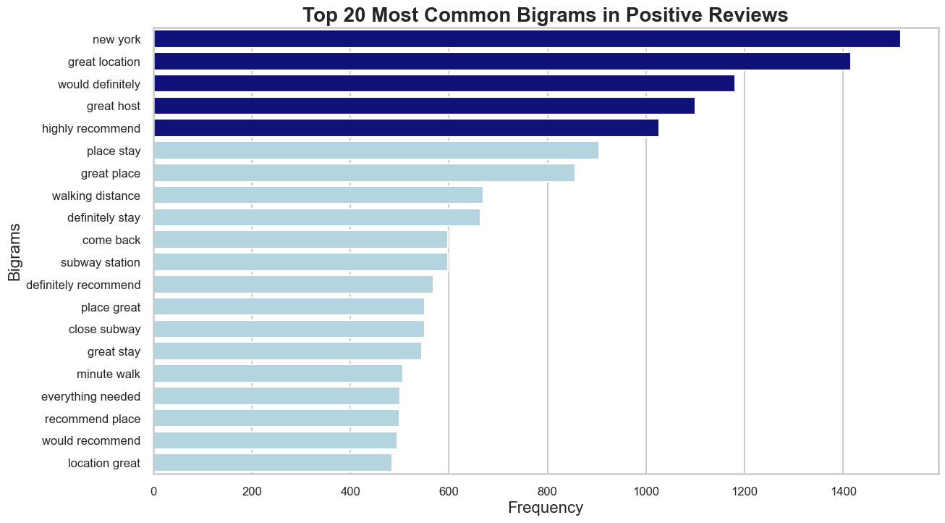
Observation
Common bigrams such as "great location," "would definitely," and "great host" reflect key qualities that resonate positively with customers.
Phrases such as "would definitely" and "highly recommend" indicate strong guest satisfaction and willingness to recommend or revisit.

Slide 15
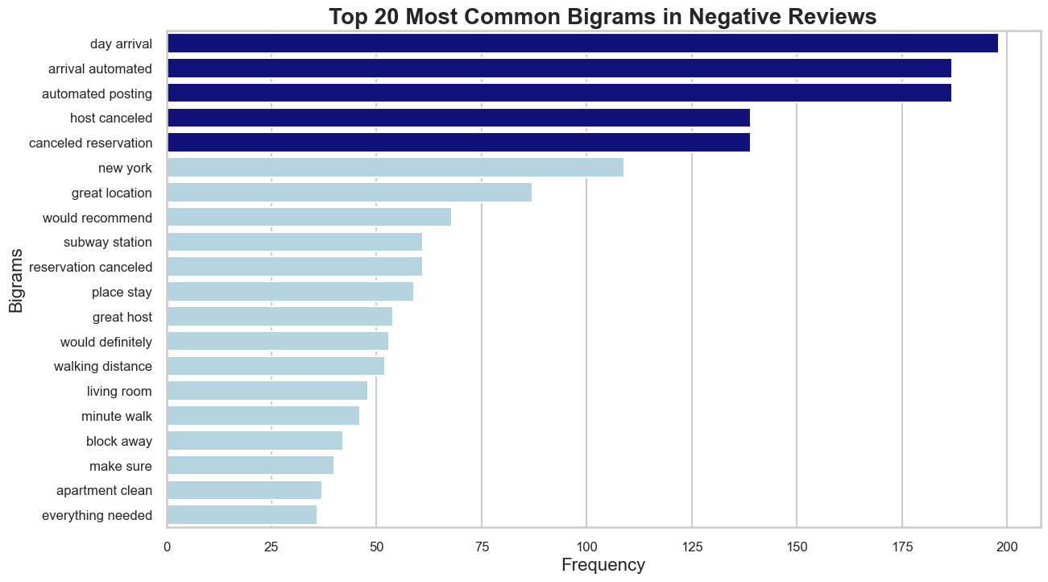
Observation
Common bigrams like "host cancelled," canceled reservation"," and "automated posting" reflect typical areas of dissatisfaction among customers.
Comparing these results with positive bigrams provides a clearer understanding of what distinguishes satisfied customers from dissatisfied ones.

Slide 16
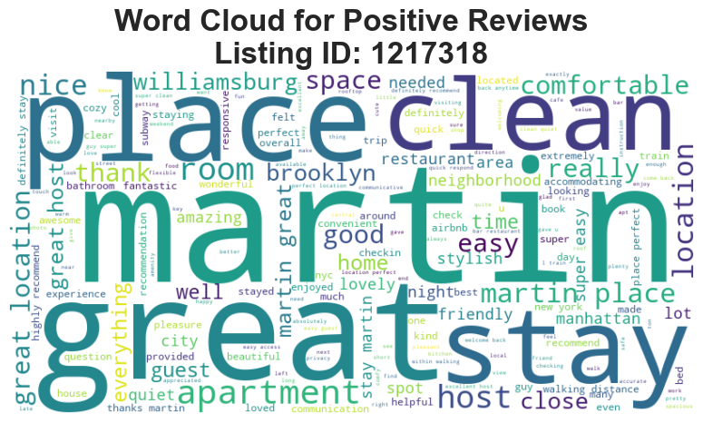
Observation
Words like "great," "stay," "place," "clean," and "martin(host)" are prominent, indicating their significance in shaping positive reviews.
Guests frequently praise the cleanliness, quality of the space, and the hospitality of the host.
The visual emphasizes elements like comfort, cleanliness, and location, which are likely the key drivers of satisfaction.

Slide 17
3. How do sentiments vary across different aspects of Airbnb listings and what specific areas should hosts focus on to enhance guest satisfaction based on the distribution of positive and negative sentiments?

Slide 18
Aspect-Based Sentiment Analysis (ABSA)
Step 1: Loading Data
Import processed_reviews_SentimentLabels.csv into a Pandas DataFrame.
Step 2: Tokenization and Lemmatization
Convert text to lowercase, tokenize, lemmatize, and remove non-alphabetic tokens.
Step 3: Training the Word2Vec Model
Train Word2Vec with parameters (vector_size=100, window=5, min_count=5, epochs=10).
Generate word embeddings capturing semantic relationships.
Step 4: Extracting Nouns from Vocabulary
Perform POS tagging and filter nouns (NN, NNS, NNP, NNPS).
Identify potential aspect terms relevant to reviews.
Step 5: Obtaining Embeddings for Nouns
Retrieve embeddings for extracted nouns from Word2Vec model.
Facilitate semantic similarity measurement for clustering.

Slide 19
Step 6: Clustering Noun Embeddings
Apply KMeans clustering (15 clusters) on noun embeddings.
Group semantically similar nouns into distinct aspects.
Step 7: Assigning Aspect Names to Clusters
Label clusters with meaningful aspect names and save cluster contents.
Step 8: Associating Aspects with Reviews
Map identified aspects to each review based on token matches.
Step 9: Creating a DataFrame for Aspect-Level Sentiments
Transform data to associate each aspect with its sentiment per review.
Step 10: Saving the Aspect-Level Sentiment Data
Export the final DataFrame to AspectbasedSentimentAnalysis.csv.
Preserve processed data for visualization and further insights.
Conclusion:
Successfully links specific aspects with sentiment, enabling deeper understanding of customer feedback.

Slide 20
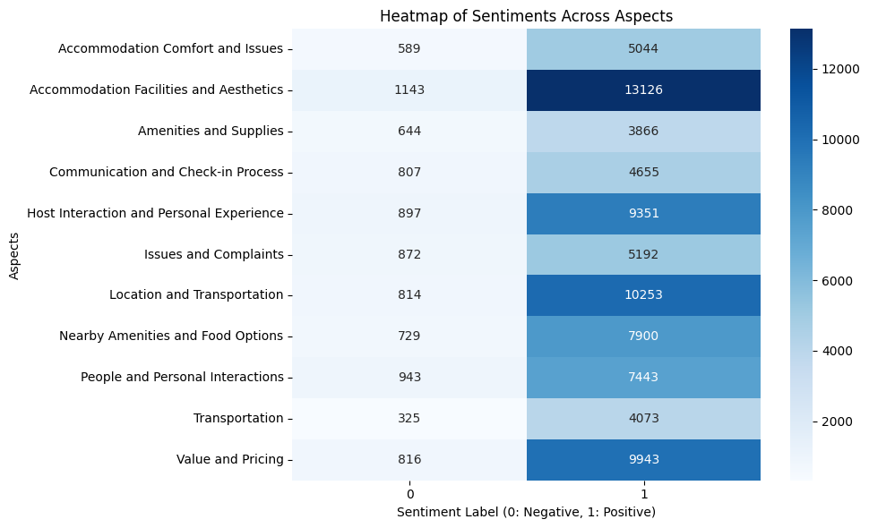
Observations
Certain aspects, such as "Accomodation Facilities and Aesthetics" and "Location and Transportation" have predominantly positive sentiment labels.
The majority of sentiments across most aspects are positive (sentiment label 1), highlighting general customer satisfaction.
Aspects with fewer negative sentiments (label 0) indicate well-performing areas of the service.

Slide 21
4. For the most reviewed listing, what insights can be drawn from the radar chart regarding the distribution of positive and negative sentiments across different aspects, and how does the cumulative evolution of the 'Value and Pricing' aspect over time reflect changes in guest satisfaction?

Slide 22
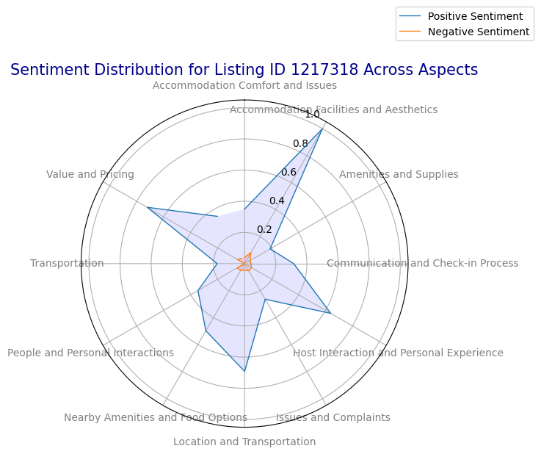
Observations
Some aspects have a strong positive sentiment, indicated by a larger radial extension in the blue area.
Negative sentiments, shown in red, are less dominant across most aspects but may still be significant for specific categories.
The chart reveals aspects where positive sentiment is significantly higher, indicating customer satisfaction in those areas. Similarly, aspects with larger red areas highlight issues or dissatisfaction.

Slide 23
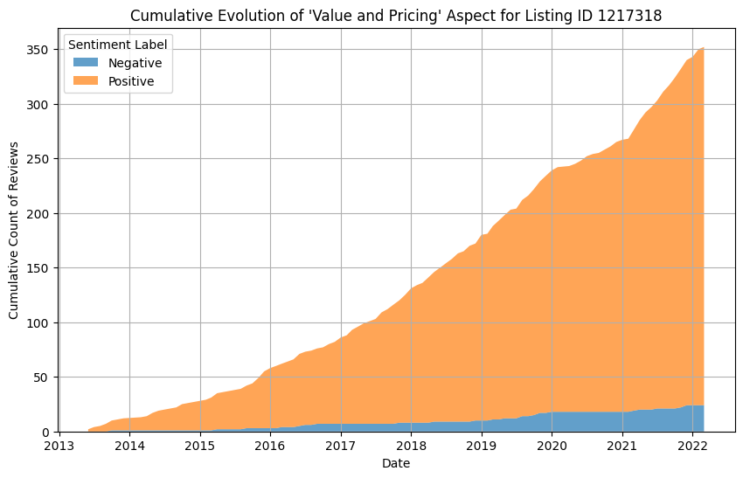
Observations
The cumulative count of positive reviews steadily increases over time, suggesting consistent satisfaction with the "Value and Pricing" aspect for this listing.
Negative reviews also show some growth, but at a slower rate compared to positive reviews. This indicates that while some dissatisfaction exists, it is not as prevalent.
Positive sentiment remains dominant throughout the observed period, with a significantly larger cumulative count than negative sentiment.

Slide 24
5. How can summarization tools, such as the T5 model, be utilized to efficiently generate comprehensive summaries of Airbnb reviews for individual listings, and what benefits do these summaries provide to users in making informed booking decisions?

Slide 25
Review Summarization Using Transformer Models
Objective:
Generate Concise Summaries: Create comprehensive summaries of NYC Airbnb listings' reviews.
Highlight Key Aspects: Focus on host demeanor, accommodation quality, neighborhood, safety, and transportation.
Enhance Decision-Making: Provide quick insights for potential guests and actionable feedback for hosts.

Slide 26
Methodology
Data Retrieval:
Load Data: Import CSV containing reviews and sentiment labels.
User Input: Specify listing_id to summarize.
Filter Reviews: Extract relevant reviews or notify if none found.
Model Initialization:
Select Model: Use t5-large for robust summarization.
Tokenizer Setup: Initialize T5 tokenizer for encoding/decoding.
Text Chunking:
Rationale: Manage input size limitations of Transformer models.
Process: Tokenize and split reviews into 512-token chunks.
Chunk Summarization:
Generate Summaries: Summarize each chunk individually.
Parameters:
Beam Search: 4 beams for quality.
Repetition Penalty: Reduce redundancy.
Final Summarization:
Combine Summaries: Merge chunk summaries into one text.
Refine Summary: Further summarize combined text for conciseness.
Customization: Focus on key aspects like host, location, and amenities.

Slide 27
Review Summary for Listing ID: 10452
Concatenating All Reviews into a single string.
Process:
Splitting text into chunks...
Total Chunks Created: 12
Summarizing Individual Chunks:
Chunk 1/12
Input: Angela was a great host. Great location. Spacious bedroom with comfortable bed. Very good value. Enjoyed my stay! I’ve stayed in a bunch of Airbnbs and Angela was by far one of the best hosts. She kept the place super clean and even offered to take care of the laundry throughout my stay....
Summary: Angela is a lovely host. She keeps the place clean, responds to messages quickly, and goes out of her way to make sure her guests have everything they need. The neighborhood was wonderful, I felt very safe. The subway was a 4-minute walk from the apartment!
Output Example:
Final Summary for Listing ID 10452:
"Angela is a lovely host. She keeps the place clean, responds to messages quickly, and ensures guests have everything they need. For $50/night, it's excellent value. The location is great with plenty of stores, bars, and a nearby train station offering quick access to Manhattan. I spent a month at Angela's and it was a fantastic experience. She is always available and ready to assist with any needs."

Slide 28
Conclusion
This project leverages advanced NLP techniques to transform Airbnb's unstructured reviews into actionable insights. By analyzing sentiments and key aspects, we enhance guest experiences and support informed decision-making for both hosts and guests. Our methodologies extend to other user-generated content platforms, enabling businesses to strategically utilize textual feedback. Utilizing cutting-edge technology, this project promises to significantly impact the hospitality industry and beyond through data-driven strategies.

Slide 29


