Slide 1
INDUSTRIAL KNOWLEDGE INTELLIGENCE
CYPHER
Unified Asset & Operations Brain
An AI-powered platform transforming heterogeneous documents into actionable knowledge.
Overcoming the industrial knowledge cliff with Edge-AI, RAG, and Graph computing.
Document Management · Knowledge Engineering · Quality
1 / 25

Slide 2
01
About The Team
The creators behind the Cypher knowledge intelligence platform.
2 / 25

Slide 3
Team Overview
📷
📷
Team Member 1
Team Member 2
AI & Backend Lead
Graph & Frontend Lead
[ Replace with Photo ] Expertise in Edge-AI deployment, LLMs, and asynchronous API architecture.
[ Replace with Photo ] Expertise in Knowledge Graphs (Neo4j), React UI, and data visualization.
3 / 25

Slide 4
Division of Expertise
Member 1 Focus
Member 2 Focus
• Architected FastAPI asynchronous backend
• Integrated Llama.cpp and Qwen VLM models
• Developed vector retrieval logic (Qdrant)
• Implemented document ingestion pipeline
• Designed Knowledge Graph schema (Neo4j)
• Built the React dashboard and UI
• Developed graph-based entity visualization
• Handled deployment and Docker orchestration
4 / 25

Slide 5
Vision & Mission
Our Mission
To solve the industrial knowledge fragmentation crisis by empowering manufacturing and energy companies with an autonomous AI copilot that democratizes access to technical documentation, reducing downtime, and securing institutional knowledge for the future.
5 / 25

Slide 6
02
Problem Statement
The cost of fragmented industrial knowledge and the incoming knowledge cliff.
6 / 25

Slide 7
The Industrial Knowledge Crisis
Information Fragmentation
Large plants operate across 7 to 12 disconnected document systems. P&IDs in one place, maintenance orders in another, inspection records in a third.
A 2024 McKinsey global survey found that professionals in asset-intensive industries spend a massive portion of their week just looking for data.
35%
of working hours spent searching for info or clarifying instructions
7 / 25

Slide 8
The Knowledge Cliff
An estimated 25% of India's experienced industrial engineers and operators will retire within the next decade.
They will take decades of undocumented operational knowledge, intuition, and failure pattern recognition with them. Once this knowledge leaves the factory floor, it cannot be easily recovered.
The Consequence
New hires rely on outdated or scattered manuals. Troubleshooting that took a veteran 10 minutes takes a new operator hours because the context is lost.
8 / 25

Slide 9
Impact of Fragmentation
Knowledge fragmentation is not just a file management problem.
Safety Risks
Quality Drops
Downtime
Decisions made without full equipment history or hazard warnings.
Inconsistent adherence to evolving regulatory requirements.
18–22% of unplanned downtime events in heavy industry are directly attributed to disconnected data.
9 / 25

Slide 10
The Core Challenge
Challenge Statement:
Build an AI-powered Industrial Knowledge Intelligence platform that ingests heterogeneous documents — engineering drawings, maintenance records, safety procedures, operating instructions — across structured and unstructured formats.
Make their collective intelligence queryable, actionable, and continuously updated at the point of need.
10 / 25

Slide 11
03
System Architecture
The foundations of Cypher: Local LLMs, Vector DB, and Knowledge Graph.
11 / 25

Slide 12
System Architecture — Four Pillars
Neo4j
Qdrant
FastAPI + LLM
React UI
Graph Database
Vector Database
The Brain Backend
Frontend Dashboard
Stores entity relationships, equipment hierarchies, and topological connections.
Stores high-dimensional embeddings for semantic search over unstructured text.
Orchestrates ingestion, querying, local Llama.cpp models, and BGE embeddings.
Provides user search, graph visualization, and chat interfaces.
12 / 25

Slide 13
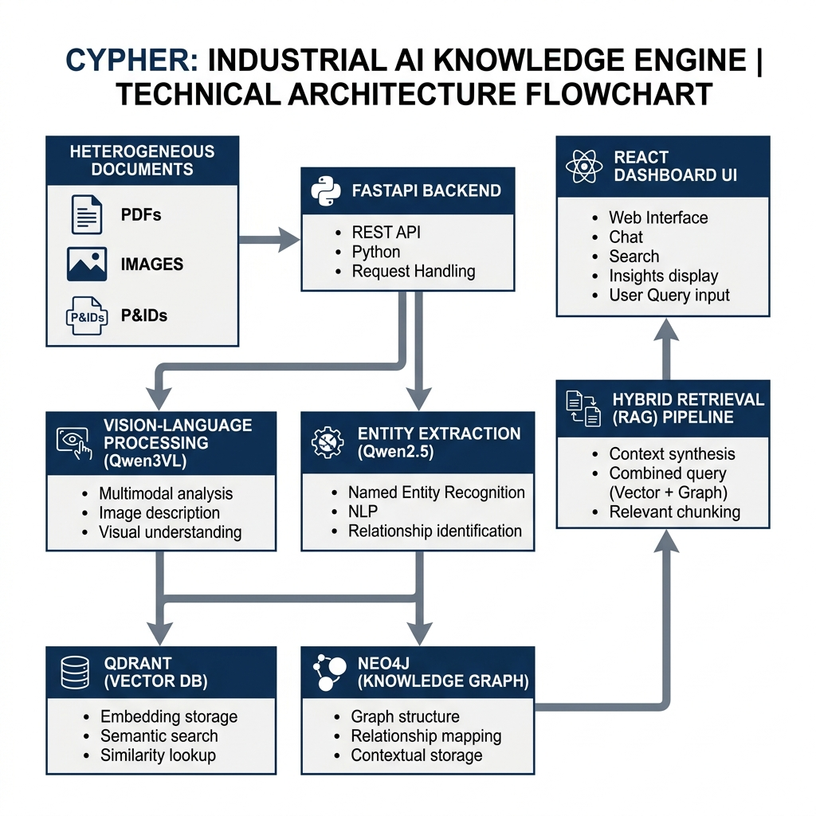
System Architecture Flow
13 / 25

Slide 14
Data Ingestion Pipeline
1. Read & OCR
Raw PDFs, Images, and Text are loaded via `/documents` mount. Visual models (Qwen3VL) parse P&IDs.
2. Entity Extraction
Qwen2.5-3B model extracts key tags, dates, equipment IDs, and specifications from the text chunks.
3. Vectorization
BGE embedding model converts text into semantic vectors for Qdrant storage.
4. Graph Linkage
Extracted entities are mapped as nodes in Neo4j, establishing relationships between documents and assets.
14 / 25

Slide 15
The Hybrid Retrieval Engine
Semantic Search alone is insufficient for engineering data. We fuse Vector and Graph retrieval.
Vector Search (Qdrant)
Graph Search (Neo4j)
Finds conceptually similar text. If a user asks 'How to fix hydraulic leak?', it retrieves manual sections detailing hydraulic repair procedures.
Understands structural links. It knows that 'Pump A' is connected to 'Valve B', and retrieves the last 3 maintenance records explicitly linked to 'Pump A'.
15 / 25

Slide 16
Local Edge-AI & Privacy
Industrial data is highly sensitive. Cypher runs 100% locally.
• Zero Cloud Dependency:
No proprietary documents, P&IDs, or intellectual property ever leave the facility's internal network.
• Llama.cpp Optimization:
Runs massive quantized GGUF models efficiently on local hardware. The Qwen 8B model fits gracefully into VRAM.
• Hardware Acceleration:
Utilizes the NVIDIA Container Toolkit to pass host GPUs into the Dockerized backend for instant LLM inference.
16 / 25

Slide 17
04
Technical Implementation
Deep dive into RAG, AI Pipelines, and asynchronous API design.
17 / 25

Slide 18
Advanced Document Processing
We use specialized models for varying data modalities:
Vision-Language Processing (Qwen3VL-8B-Instruct)
• Translates complex engineering drawings (P&IDs) into textual logic.
• Reads tabular data and maintenance spreadsheets.
• Bridges the gap between scanned, unstructured imagery and the queryable vector database.
• Employs a custom Vision Projector (`mmproj-Qwen3VL`) for highly accurate visual tokenization.
18 / 25

Slide 19
Expert Knowledge Copilot (RAG)
The Retrieval-Augmented Generation (RAG) Flow:
User Query
Engineer asks a natural language question via the React UI.
Search Execution
Backend runs parallel queries against Qdrant (vectors) and Neo4j (graph).
Reranking
A cross-encoder model evaluates the relevance of all retrieved chunks and drops low-confidence data.
LLM Synthesis
The local 8B LLM receives the prompt + top documents and streams the answer back token-by-token.
19 / 25

Slide 20
Backend & API Architecture
FastAPI provides the high-performance, asynchronous bridge connecting the AI to the UI.
• Singleton Resource Management:
Database connections (Qdrant, Neo4j, SQLite) and heavy AI models are loaded once during application startup (lifespan events) to prevent out-of-memory crashes.
• Streaming Responses:
Nginx proxy buffering is disabled. The FastAPI backend streams LLM outputs token-by-token, ensuring a snappy, low-latency chat experience even on slower GPUs.
• Modular Routing:
API is divided logically into `/chat`, `/ingestion`, `/documents`, `/graph`, and `/compliance` endpoints for clean separation of concerns.
20 / 25

Slide 21
Knowledge Graph Construction
Transforming flat documents into an interconnected web of assets.
Cypher utilizes Qwen2.5-3B-Instruct during the ingestion phase for rapid Named Entity Recognition (NER). It identifies equipment tags, operating parameters, and regulatory norms, then dynamically creates nodes and edges in Neo4j.
Example Schema:
(Document: Maintenance Report) -[MENTIONS]-> (Asset: Turbine 04)
(Asset: Turbine 04) -[HAS_PARAMETER]-> (Parameter: 3000 RPM)
This topology allows the LLM to deduce root causes across historically isolated incidents.
21 / 25

Slide 22
05
Business Roadmap
The rollout strategy and value proposition for Cypher.
22 / 25

Slide 23
Implementation Roadmap — Phases 1 & 2
Phase 1: Pilot & Core Integration (Months 1-3)
• Deploy local edge-server in a single pilot plant. • Batch ingest 5 years of historical maintenance logs, OEM manuals, and P&IDs. • Roll out the 'Expert Knowledge Copilot' to the primary engineering team.
Phase 2: Advanced Agentic Capabilities (Months 4-6)
• Activate the Maintenance Intelligence Engine for predictive RCA support. • Introduce Regulatory Compliance intelligence to auto-generate audit evidence. • Connect live telemetry to the knowledge graph.
23 / 25

Slide 24
Roadmap Phase 3 & ROI
Phase 3: Scale & Edge Mobility (Months 7-12)
• Scale horizontally to remaining plants via synchronized distributed servers. • Deploy mobile/tablet interfaces for field technicians to query data on-site. • Potential AR (Augmented Reality) integrations for schematic overlays.
Value Proposition & Return on Investment
35% → 5%
-15%
100%
Reduction in time spent searching for information.
Estimated decrease in unplanned downtime.
Retention of institutional knowledge from retiring experts.
24 / 25

Slide 25
06
Results
Showcasing the Cypher UI and capabilities.
25 / 25

Slide 26
Universal Document Ingestion & Search
[ PLACEHOLDER: Screenshot of Document Ingestion/Search UI ]
26 / 25

Slide 27
Knowledge Graph Integration
[ PLACEHOLDER: Screenshot of Neo4j Graph Network/Visualization ]
27 / 25

Slide 28
Expert Knowledge Copilot
[ PLACEHOLDER: Screenshot of Chat UI answering a complex query with citations ]
28 / 25

Slide 29
Performance & GPU Metrics
[ PLACEHOLDER: Screenshot of terminal logs or dashboard showing inference speed/VRAM ]
29 / 25

