Slide 1
TEAM BRIEFING | 13 AUGUST 2026
Latent
Landscapes
When can ecological process be recovered from imperfect spatial observations?
Synthetic methods -> mink-water vole -> Australian predator impacts
Barry W. Brook
Notes:
Latent Landscapes (0:45)
Open with the ecological destination. This is not a presentation about building a better optimiser for its own sake. The long-term question is whether we can attribute spatial predator spread and prey decline from imperfect observations. The programme is deliberately staged: first a synthetic paper where truth is known, then a constrained mink-water vole application, and finally the harder Australian murid-cat problem that motivated the grant.
[Sources]
- docs/programme.md (programme North Star and synthetic-only Paper 1 boundary).
- Barry Brook, project-history and presentation discussion in this Codex task, 12 August 2026.

Slide 2
LATENT LANDSCAPES | TEAM BRIEFING
We reset because real-data failure was impossible to diagnose
01
03
Discovery concept
Known-truth synth-small
Process, observation and inference sketched at a high level
Synthetic control helped, but the wave was too simple
02
04
Mink-water vole start
Latent Landscapes
Realism arrived before parameter truth or diagnostic control
A richer Python laboratory isolates one failure mode at a time
Progressive diagnosis, not a straight-line success story.
02
Notes:
Why the programme reset (1:50)
Give only the short history. The Discovery proposal contained a plausible conceptual model, but it was not yet a tested inferential system. We then began with mink and water voles. When estimation failed, we could not tell whether the cause was the biological model, the observation process, insufficient data, or the inference machinery. That prompted a known-truth synthetic case. The first one was useful, but too simple. Latent Landscapes is the rebuild: controlled experiments in which each added complication has a diagnostic purpose. Emphasise that the earlier work was not wasted; it identified why a clean synthetic foundation was necessary.
[Sources]
- docs/programme.md (synthetic ladder and method ladder).
- docs/provenance.md (legacy SpatExt as laboratory notebook and parts catalogue).
- Barry Brook, oral project history in this Codex task, 12 August 2026.

Slide 3
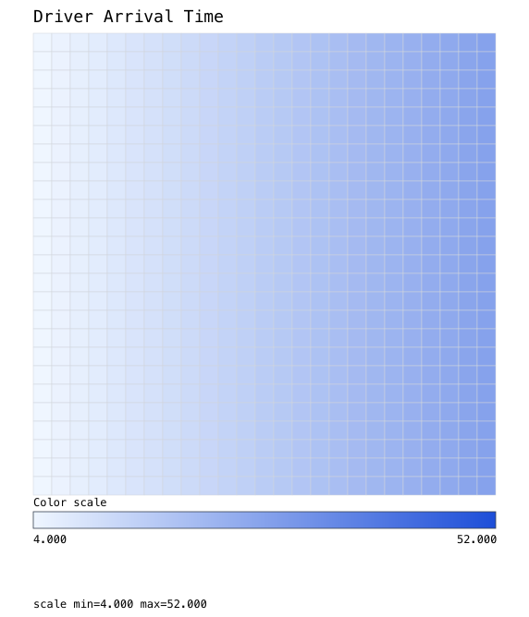
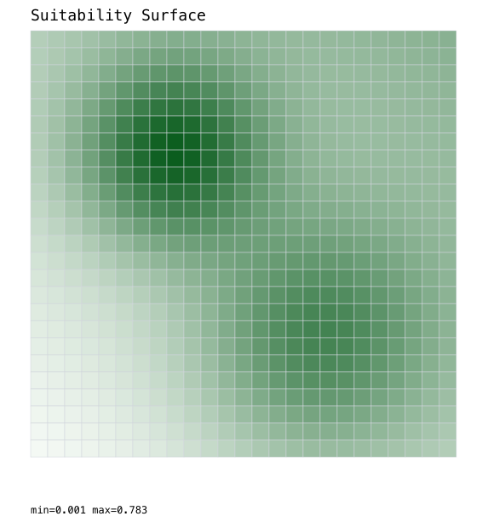
ACT I | WHY KNOWN-TRUTH SYNTHETIC EXPERIMENTS
The first synthetic model was understandable - but not informative enough
What it gave us
Known truth and easy visual checks
A safe place to expose observation failures
What it could not give us
Enough spatial contrast to distinguish mechanisms
A realistic test of resistance, barriers or biased sampling
Smooth habitat
Near-linear arrival wave
03
Notes:
Why synth-small was not enough (1:30)
Use the pictures. The habitat was essentially two smooth patches and the predator wave was close to a simple gradient across a small grid. That made it easy to understand, which was valuable, but different mechanisms could produce very similar observable patterns. We learned about response reconstruction and observation support, but the system was too small and too geometrically regular to teach us enough about spatial identifiability. This is the second and final history slide.
[Sources]
- /Users/bwbrook/papers/spatext/artifacts/synth_small_first_review/suitability.svg (legacy visual, read-only).
- /Users/bwbrook/papers/spatext/artifacts/synth_small_predator_truth/driver_arrival.svg (legacy visual, read-only).
- Legacy source boundary: /Users/bwbrook/papers/spatext at accepted commit 53462d0365babf2c8070714a930f69b4071af276, as recorded in docs/provenance.md.

Slide 4
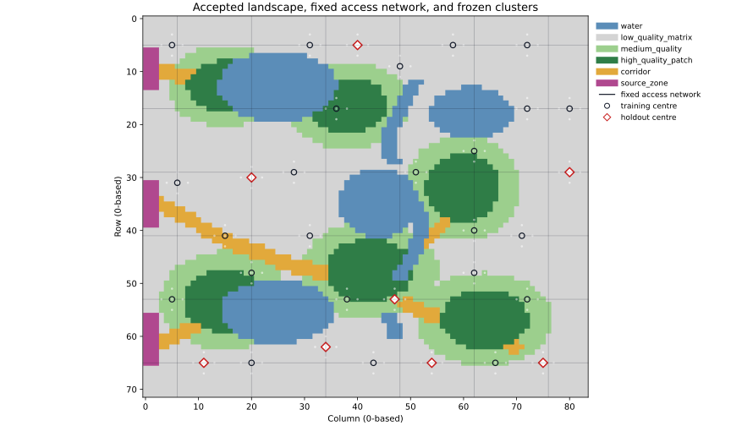
ACT II | THE CURRENT SYNTHETIC LABORATORY
The current laboratory makes resistance and biased sampling explicit
72 x 84 cells
Water barriers; passable low-quality matrix
High-conductance corridors and high-quality patches
Three western predator source zones
Fixed road / transect network
32 clusters; 8 held out
Clusters are balanced by distance from sources - not targeted to good habitat.
04
Notes:
Current landscape and sampling design (2:00)
Orient the group ecologically. Blue is impassable water. The grey matrix is poor but not fatal habitat: it remains passable and imposes higher movement cost. Orange corridors are a separate, deliberately high-conductance movement class; in the spread model their conductance is 1.12, above high-quality patches at 0.90, while low-quality matrix is 0.33. Three western sources launch the wave. The light grid of fixed road columns and transect rows is the access network. Sampling centres are selected from this network, balanced across four distance-from-source strata, then eight clusters are frozen as holdout. They are not habitat-targeted, which explains why many sit in matrix. That choice creates a clear, reproducible access bias, not a claim that it perfectly imitates field practice.
[Sources]
- artifacts/goal001_deterministic_spread/visuals/landscape_design.svg.
- src/latent_landscapes/goal001/design.py (fixed access network, distance strata, cluster split).
- src/latent_landscapes/goal001/spread.py (habitat conductances).

Slide 5
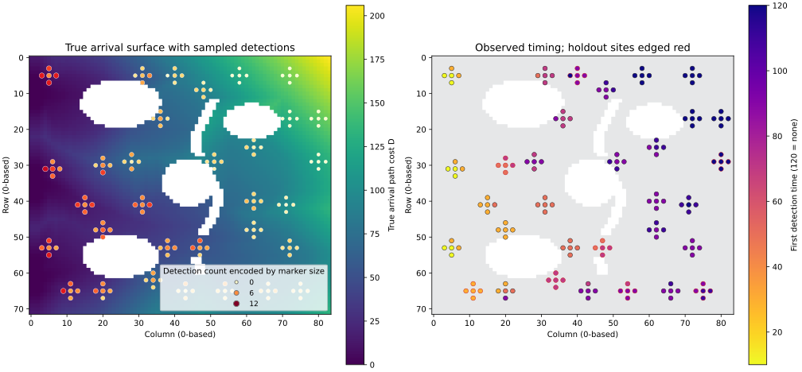
ACT II | PROCESS -> OBSERVATION
Imperfect detection fragments the latent spread history
LEFT colour = true arrival; marker size + hue = total detections
RIGHT colour = first detection; purple = never detected; red edge = holdout
A non-detection is not an absence: detection probability is 0.65 over repeated surveys.
05
Notes:
Truth versus observation (2:00)
Talk through the encoding explicitly. On the left, the surface colour is the known latent arrival time. Both marker size and marker colour encode the number of detections over twelve visits; the original legend title mentioned size only, so say this aloud. On the right, marker colour is first detection time and purple means no detection by the end. Red outlines mark holdout sites. The right-hand background deliberately shows only passable versus water geometry; habitat was shown on the preceding slide. With detection probability 0.65, late or absent detection can occur well after true arrival. That gap is the observation problem the inference must integrate over.
[Sources]
- artifacts/goal001_deterministic_spread/visuals/spread_observations.svg.
- src/latent_landscapes/goal001/artifacts.py (_spread_observations_svg encoding).
- docs/programme.md (Goal 001 observation design).

Slide 6
ACT III | WHAT THE SYNTHETIC SYSTEM HAS TAUGHT US
Ecological signal has thresholds: weak patterns can be real yet unrecoverable
At contrast 0.5, one-third of datasets still admit uniform resistance.
Slower waves estimate spread well, but leave detection probability too broad.
06
Notes:
Resistance and spread-detection thresholds (2:30)
This slide translates the original four-panel diagnostics. On the left, 'closed support' simply means the plausible parameter region does not reach the no-resistance boundary. At true contrast 0.5, only 166 of 250 validation datasets do that; by 0.75, all 250 do. We therefore locate a practical transition between 0.5 and 0.75 for this landscape and design. On the right, spread rate itself is recovered accurately across the tested range, but the detection probability p is too imprecise for slower waves. A slow wave produces fewer informative changes in occupancy within the survey window, so spread and imperfect detection are harder to separate. The uncertainty bars in the original calibrated-coverage plots are Wilson confidence intervals for the estimated coverage proportion across validation simulations; they are not posterior intervals or the distribution of parameter estimates. More validation replicates would narrow those bars.
[Sources]
- artifacts/goal024_resistance_contrast_transition_benchmark/summary.json and transition_summary.csv.
- artifacts/goal025_spread_detection_transition_benchmark/summary.json and transition_summary.csv.
- artifacts/goal024_resistance_contrast_transition_benchmark/resistance_transition.svg (original diagnostic).
- artifacts/goal025_spread_detection_transition_benchmark/spread_detection_transition.svg (original diagnostic).

Slide 7
ACT III | BUILDING THE PREY LAYER SYSTEMATICALLY
The prey signal also has a strength threshold - then survives observation noise
1
Known predator arrival
5x prey effect recovered
2
Imperfect prey detection
Recovery retained at p = 0.65
3
Latent predator arrival
Recovery retained after integrating arrival uncertainty
For this design, effect strength mattered more than perfect observability.
07
Notes:
Prey-effect ladder (2:00)
The known-arrival positive control reveals a second threshold. A two-fold effect is not reliably separated from no effect. Three-fold nearly always excludes no effect, but its intervals remain wider and its coverage is conservative, so it fails the full recovery rule. Five-fold is recovered. We then add observation difficulty in stages. With prey detection at 0.65, the five-fold effect remains recoverable. Finally we hide the realised predator-arrival map and integrate arrival uncertainty from predator detections; the prey effect still has about 96.3% coverage, excludes no effect in all 1,000 validation datasets, and retains a held-out predictive advantage. The claim is conditional on this strong five-fold effect and this design, not that prey responses are universally easy to infer.
[Sources]
- artifacts/goal028_known_arrival_prey_effect_strength_transition/summary.json and effect_transition_summary.csv.
- artifacts/goal029_known_arrival_known_imperfect_prey_detection/summary.json.
- artifacts/goal031_latent_arrival_prey_effect_positive_control/summary.json.

Slide 8
ACT III | A CRUCIAL INFERENCE LESSON
Joint calibration obscured prey information the data retained
ONE SIMULTANEOUS REGION
ONE INTERVAL PER PARAMETER
13%
100%
of validation datasets excluded no prey effect
of validation datasets excluded no prey effect
1x - 10x
typical prey-effect region filled the tested grid
~2-fold
typical prey-effect interval width
Point estimates for spread and prey effect were nevertheless centred on truth.
Separate spread and prey intervals each covered truth in about 95% of datasets.
Same model and data; a different uncertainty question. Simultaneous joint coverage is still unresolved.
08
Notes:
Joint versus parameter-specific uncertainty (2:30)
This is the key recent diagnosis. When spread rate and prey effect were fitted together, their point estimates were already centred: the middle 80% of spread estimates was about 0.946 to 1.057 around truth 1, and prey-effect estimates about 3.9 to 6.3 around truth 5. Their log-MLE correlation was near zero. The failure came from using one simultaneous 95% cutoff. Spread-wave variation has a much broader likelihood-ratio distribution than prey-effect variation, so the shared cutoff was about 53.95. That made the prey interval span the entire 1-to-10 grid and exclude no effect in only 130 of 1,000 validation sets. Calibrating each parameter's profile separately gave cutoffs about 53.02 for spread and 3.57 for prey. Coverage was 94.5% and 94.6%; the typical prey interval spanned a factor of two, and all 1,000 validation intervals excluded no effect. The claim is separate parameter-specific 95% support, not a solution to simultaneous joint coverage.
[Sources]
- artifacts/goal032_joint_spread_rate_prey_effect_positive_control/summary.json.
- artifacts/goal033_parameter_specific_uncertainty_calibration/summary.json.
- artifacts/goal033_parameter_specific_uncertainty_calibration/parameter_specific_calibration.svg (source diagnostic).

Slide 9
ACT III | WORKING SCIENTIFIC POSITION
Identifiability belongs to the whole experiment - not to a parameter alone
OBSERVED
OBSERVED
INFERENCE
Ecological signal
Observation design
Uncertainty calibration
Weak resistance and weak prey effects can be real yet indistinguishable from simpler explanations.
Slow waves and imperfect detections leave less information for separating process from detection.
A joint cutoff can hide parameter-specific information even when the estimates themselves are sound.
Still untested
simultaneous joint coverage | new landscapes | model misspecification | synth-realistic stress test
Rigour at the scientific decision boundary; proportional engineering everywhere else.
09
Notes:
The central scientific take-away (1:45)
This is the sentence to leave in the room: identifiability depends jointly on ecological signal, observation design, and correctly calibrated uncertainty. It is not an intrinsic yes-or-no property of a parameter. Keep observation and inference separate. We have directly observed transitions in recovery as resistance, spread and prey effect change. We infer that the sampling window and detection histories govern how much information is available. We also diagnosed that uncertainty calibration changed the conclusion without changing the model or data. Be explicit about what remains open: simultaneous joint coverage, alternative landscapes, misspecification and the synth-realistic rung.
[Sources]
- Synthesis of accepted evidence in artifacts/goal024 through artifacts/goal033.
- docs/programme.md (North Star and future method ladder).
- Goal 034 narrative approved by Barry Brook, 12 August 2026.

Slide 10
ACT IV | WHERE THE PROGRAMME GOES NEXT
Three papers add ecological realism by design
1
2
3
Synthetic methods
Mink-water vole
Australian murids
Known truth; identifiability thresholds; calibrated uncertainty; more than one landscape/model.
Great Britain as a constrained real-world test; islands retained as potential natural contrasts.
Cats and potentially foxes under sparse, difficult data; the grant-scale ecological endpoint.
Each paper earns the next increase in realism.
10
Notes:
The three-paper sequence (1:45)
Paper 1 is now a substantive synthetic methodology paper, not just a prelude. It should reach the indirect prey-response layer and then test whether the lessons generalise across a small set of additional landscapes or generating models. Paper 2 applies the earned workflow to mink and water voles across Great Britain. Anglesey, the Isle of Wight and perhaps other islands may provide useful contrasts, but do not assert exact factorial species combinations until they are checked. Paper 3 tackles the grant endpoint: Australian murids under cat, and perhaps fox, invasion. Ryo's data collation and complementary POEMS work are part of that broader endpoint. The sequence is intentional: each paper adds uncertainty only after the previous layer is understood.
[Sources]
- docs/programme.md (Paper 1 synthetic-only boundary and synthetic ladder).
- Barry Brook, programme and paper-sequence discussion in this Codex task, 12 August 2026.

Slide 11
DISCUSSION
Three questions
for the team
Which synthetic contrasts would make the identifiability paper most ecologically persuasive?
1
2
What is the minimum extra landscape / model set needed to avoid a one-case story?
3
Which constraints from mink-water vole and Australian data should shape the synthetic work now?
LATENT LANDSCAPES
Notes:
Questions for collaborators (1:30)
Stop presenting and invite reactions. The first question tests the ecological relevance of the synthetic contrast ladder. The second asks for a disciplined generality standard rather than an open-ended landscape sweep. The third deliberately connects today's synthetic decisions to what Natalie, Damien and Ryo know about the real data constraints. If discussion is active, this is where the presentation can run slightly beyond twenty minutes without adding more slides.
[Sources]
- Questions derived from docs/programme.md and the 12 August 2026 supervisor-research fellow discussion.

