Slide 1
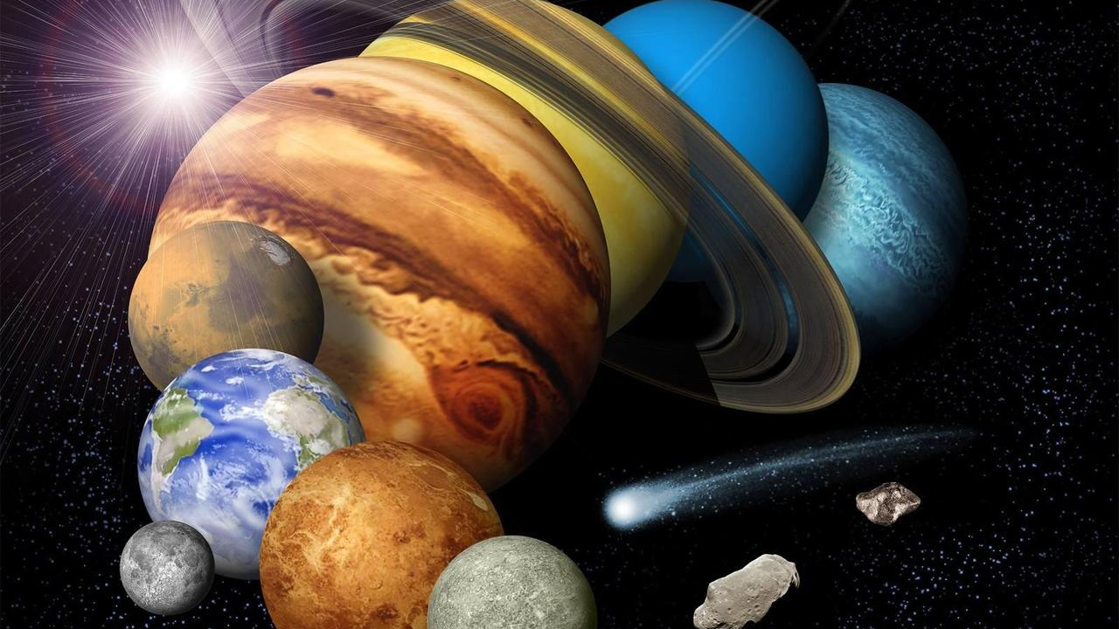
THE
SOLAR
SYSTEM
A guided tour from the star that holds it together to the icy worlds at its edge.
8 planets. 1 star. Billions of small worlds.

Slide 2
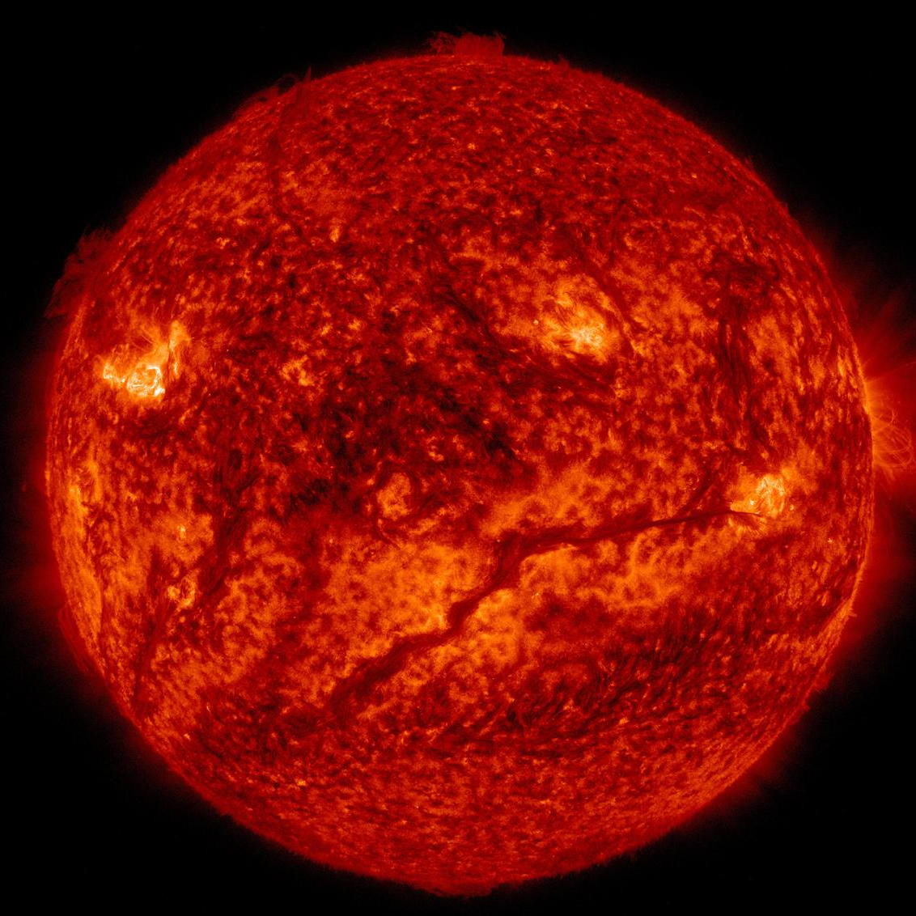
The Sun is the system
Earth
Its gravity, light, and solar wind set the rules for everything else.
one orbit per year
Mass anchor
The Sun holds about 99.8% of the solar system's mass.
Energy source
Sunlight drives climates, seasons, and photosynthesis on Earth.
Space weather
Solar wind shapes magnetic fields, auroras, and radiation environments.
Rounded solar-system facts.

Slide 3
The inner worlds are rocky and close
Mercury, Venus, Earth, and Mars formed in the warmer inner disk, where rock and metal could survive.
Mercury
Venus
Earth
Mars
0.39 AU
0.72 AU
1.00 AU
1.52 AU
Smallest planet; extreme temperature swings
Thick CO2 atmosphere; hottest surface
Liquid water and a protective magnetosphere
Cold desert world with ancient river clues
AU = average Earth-Sun distance
Solar system overview

Slide 4
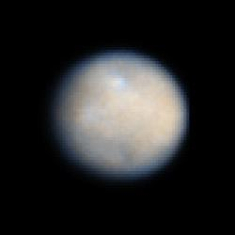
The asteroid belt is not a wall
Between Mars and Jupiter is a wide region of leftover building blocks, with plenty of empty space.
Jupiter
Mars
5.2 AU
1.5 AU
Sun
Ceres is the largest object
Jupiter acts like a sculptor
It is massive enough to be rounded by gravity, so it is classified as a dwarf planet.
Its gravity stirred the region and helped prevent a full planet from forming there.
Solar system overview

Slide 5
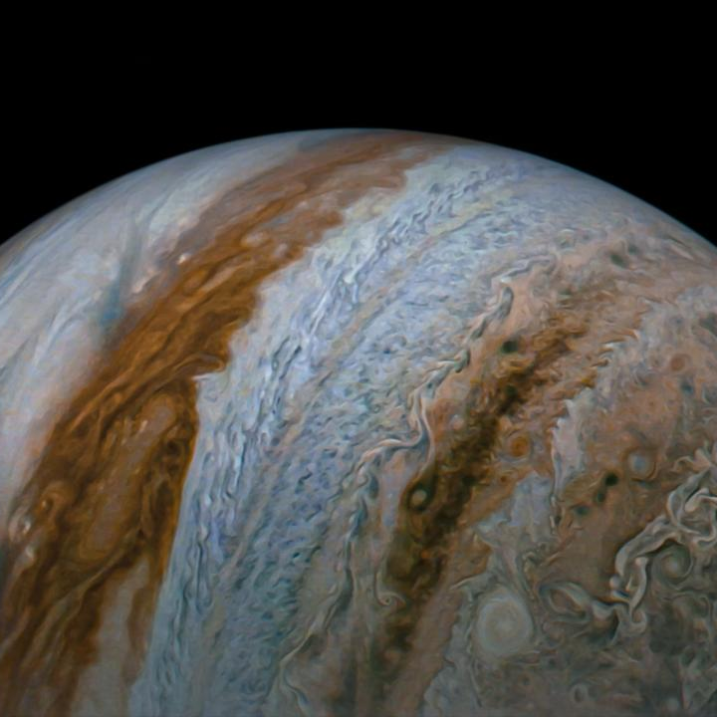
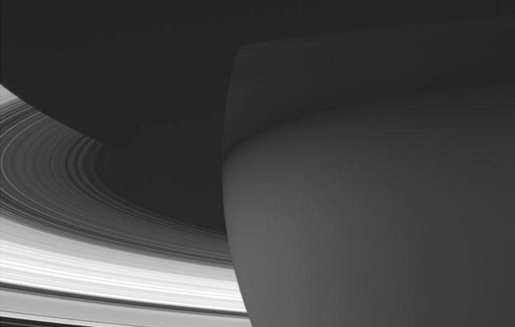
The giant planets are mini systems
Jupiter, Saturn, Uranus, and Neptune are planet-scale environments with moons, rings, storms, and magnetic fields.
Uranus
Neptune
ice giant
fast winds
Saturn
rings make the system visible from across space
Jupiter
largest planet; strong bands and storms
Two families
Jupiter and Saturn are gas giants; Uranus and Neptune are ice giants with more water, methane, and ammonia.
Solar system overview

Slide 6
Scale breaks intuition
Planet order is easy. Planet spacing is the surprise: the outer planets live far beyond the crowded inner system.
Jupiter
Saturn
Uranus
Neptune
5.2 AU
9.58 AU
19.2 AU
30.1 AU
log scale of average distance from the Sun
Mercury
Venus
Earth
Mars
0.39 AU
0.72 AU
1 AU
1.52 AU
If Earth is 1 AU from the Sun, Neptune averages about 30 AU away.
Average orbital distances rounded.
Solar system overview

Slide 7
Small worlds carry old evidence
Dwarf planets, comets, asteroids, and Kuiper Belt objects preserve material from the solar system's formation.
Time capsules
They are less altered by heat and geology than large planets, so they keep chemical clues.
Pluto
Dynamic leftovers
Orbits can be nudged by giant planets, sending comets inward or scattering objects outward.
Eris
Comet
Exploration targets
Missions to asteroids and Kuiper Belt objects test ideas about planet formation.
Arrokoth
Solar system overview

Slide 8
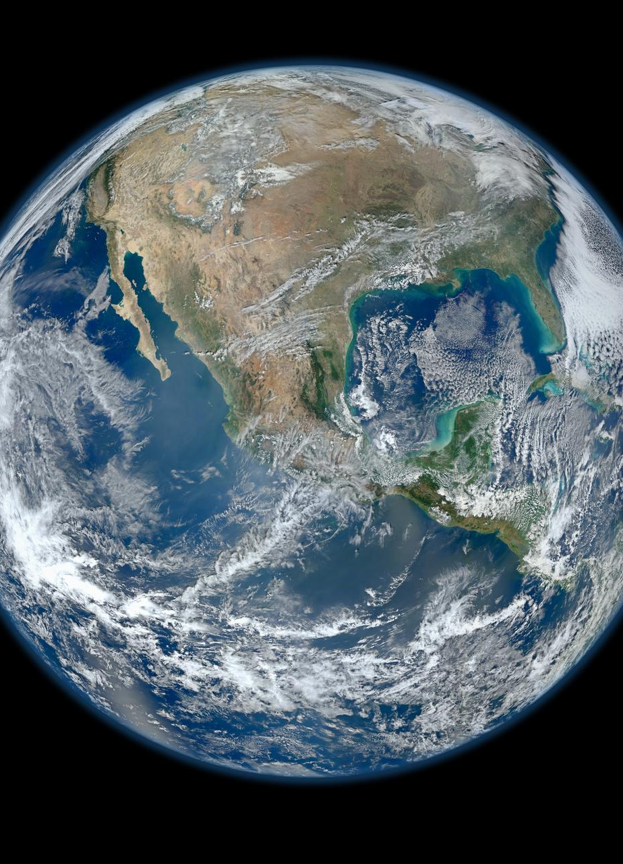
The solar system is our nearest laboratory
It gives us a close-up record of how planets form, how climates change, and where life might persist.
Origins
Planetary leftovers reveal the ingredients that built worlds.
Habitability
Comparing Earth, Venus, Mars, and icy moons sharpens the question of life.
Exploration
Every mission turns distant dots into places with histories.
From one star, a family of worlds.

