Slide 1

Computer Session A/B
Python, R, and GitHub
Z 2021 by Aiden Kenny Š akenny430 ¯ akenny430 J u/akenny430

Slide 2
Agenda
What we are going to cover today:
Installing Python
Installing R (and RStudio)
Installing Git
Setting up and using GitHub
We will be doing this for both Mac OS and Windows
Python is easier to install on Mac OS
R and Git are easier to install on Windows
If you have a Linux machine, you probably don’t need this tutorial
Z 2021 by Aiden Kenny Š akenny430 ¯ akenny430 J u/akenny430

Slide 3
Using the terminal
This whole tutorial will make use of your computer’s terminal/command prompt
Called the terminal on Mac OS/Linux
Called the command prompt on Windows
We can use the terminal to open/run any program on our computer!
Not what we are used to – there is a learning curve
However, very useful and important to know
VERY
To access the terminal:
Mac OS: using spotlight (Command + Space), type in “terminal”
Windows: using the search bar, type in “command prompt”
Z 2021 by Aiden Kenny Š akenny430 ¯ akenny430 J u/akenny430

Slide 4
Installing Python
Easiest way is to go to website: https://www.python.org/downloads/
Latest version is Python 3.9.7
Mac OS: accept all defaults Windows:
Make sure Python is added to your PATH
Choose “customize installation”
Make sure that pip is being downloaded along with Python
Walk through of each now: To check if each are installed:
Mac OS: python3 --version
Windows: py -V
Z 2021 by Aiden Kenny Š akenny430 ¯ akenny430 J u/akenny430

Slide 5
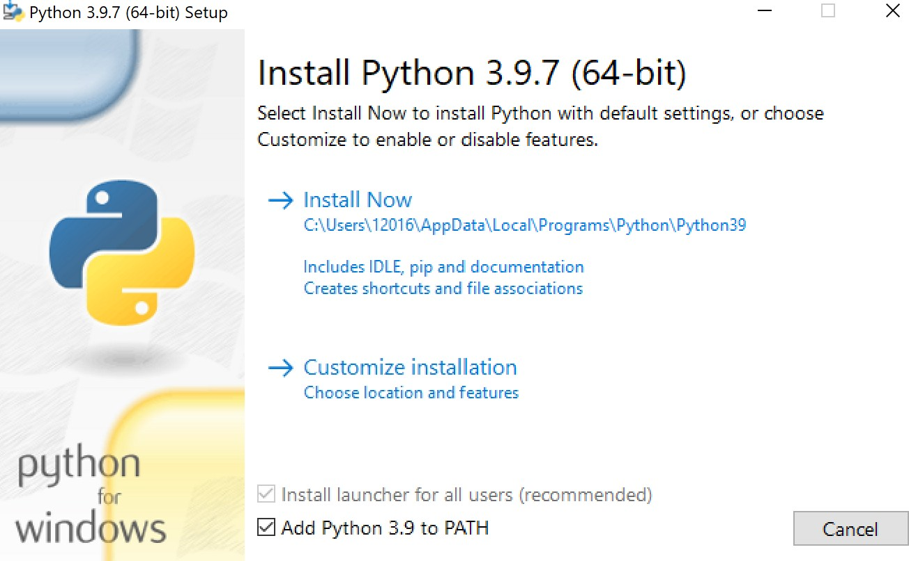
Z 2021 by Aiden Kenny Š akenny430 ¯ akenny430 J u/akenny430

Slide 6
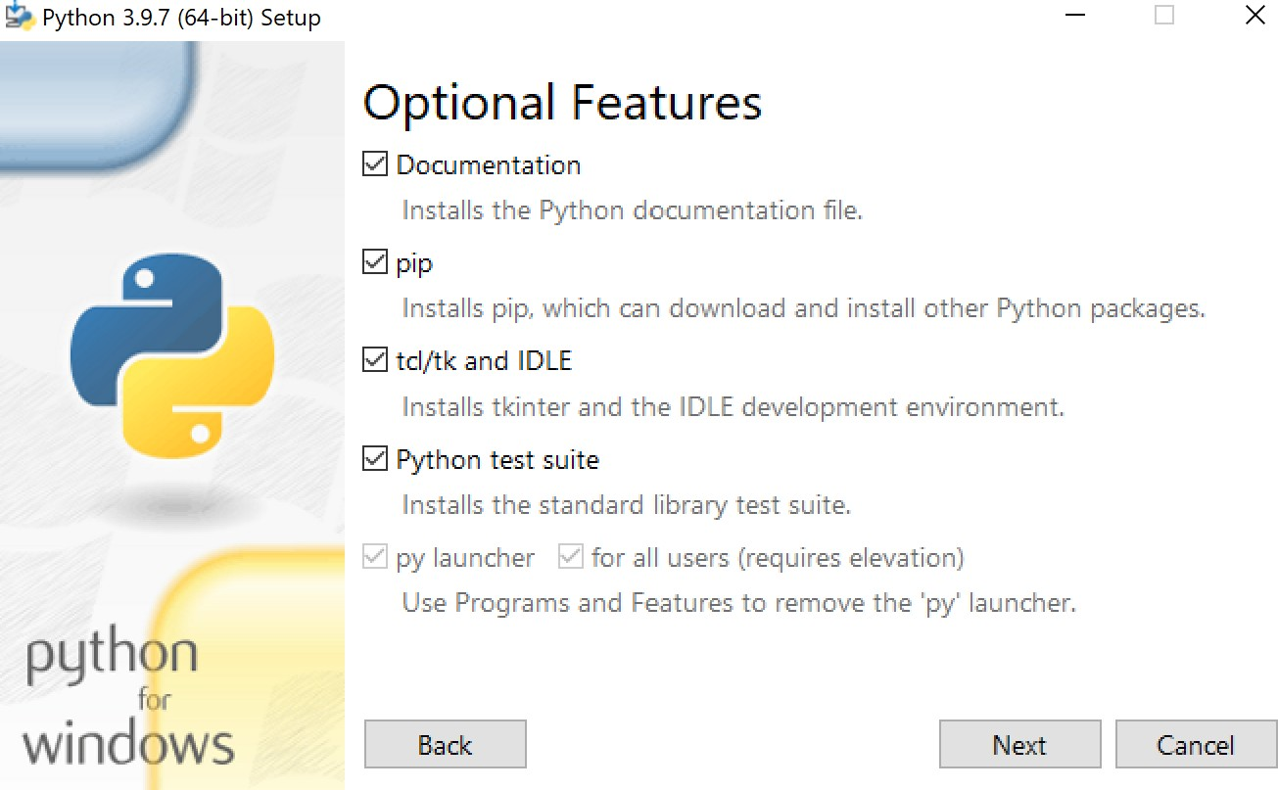
Z 2021 by Aiden Kenny Š akenny430 ¯ akenny430 J u/akenny430

Slide 7
Using Python from terminal
You can use Python by typing this into the terminal:
Mac OS: python3
Windows: py
Type quit() to exit out of Python
Let’s try it out!
Not the most efficient way to use Python
We will look at other, better ways to use Python soon
Z 2021 by Aiden Kenny Š akenny430 ¯ akenny430 J u/akenny430

Slide 8
Installing packages for Python
Python by itself is a very general programming language
We are more interested in statistics/data science/machine learning
There are some things we want that are not included in base Python
However, there are other packages that can be installed to help us
Packages add additional functionality that is not included in base Python
Ways to read in datasets, make plots, do matrix multiplication, etc.
To install packages, we will use pip
pip should have been installed with Python
Mac OS: pip3 --version
Windows: pip -V
Z 2021 by Aiden Kenny Š akenny430 ¯ akenny430 J u/akenny430

Slide 9
Relevant packages that we will want:
numpy (for general scientific computing, extremely powerful)
matplotlib (for making plots)
sklearn (for machine learning)
pandas (for data cleaning)
jupyter (gives us notebooks to use)
To install these, type: pip install numpy matplotlib sklearn pandas jupyter
This might take a while, that is okay
There are other packages one can use as well
Use pip to install those as well
•
Type pip list to see a list of all packages already installed
Z 2021 by Aiden Kenny Š akenny430 ¯ akenny430 J u/akenny430

Slide 10
Using Jupyter notebooks
(One of) the best ways to use Python is through Jupyter notebooks
An integrated development environment (IDE) that is good for Python
Especially true for statistics/data science/machine learning
In terminal: jupyter notebook
Yes, it has to be done through the terminal!
Walk through now:
Technically, Jupyter notebook files and Python files are different
.py extension is single Python file
.ipynb is Jupyter notebook file
Z 2021 by Aiden Kenny Š akenny430 ¯ akenny430 J u/akenny430
10 / 25

Slide 11
Installing R
There are several steps, go to website: https://cran.r-project.org/mirrors.html
Choose a mirror close to you. I am in New York City, so I choose the mirror from Carnegie Mellon University (Pittsburgh, USA)
Top of page: DOWNLOAD R FOR macOS / Windows choose your system
For Windows:
Click “Base”
Click “Download R for the first time”
For Mac OS:
Depends on processor
Click on Apple symbol in top left corner and choose “About This Mac”
Intel Processors: download “Intel 64-bit” version
Apple M1 Chip: download “Apple Silicon” version

Slide 12
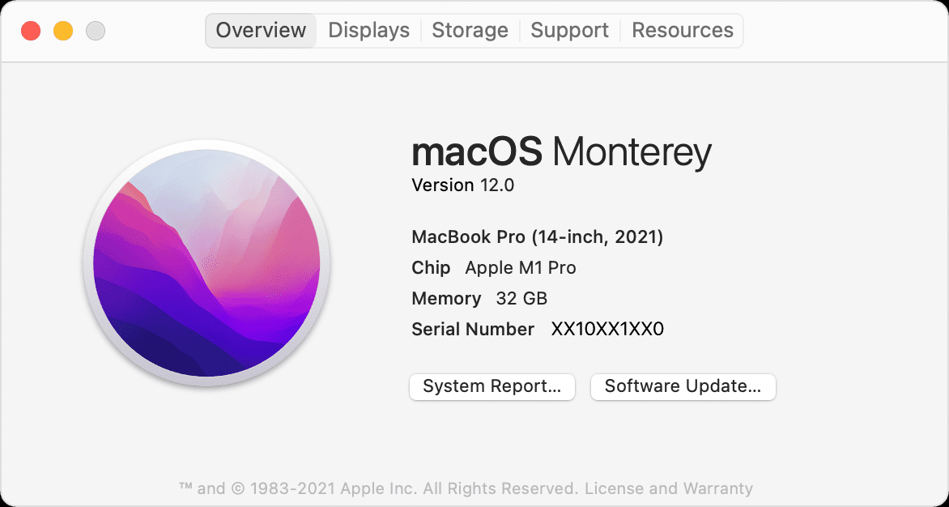
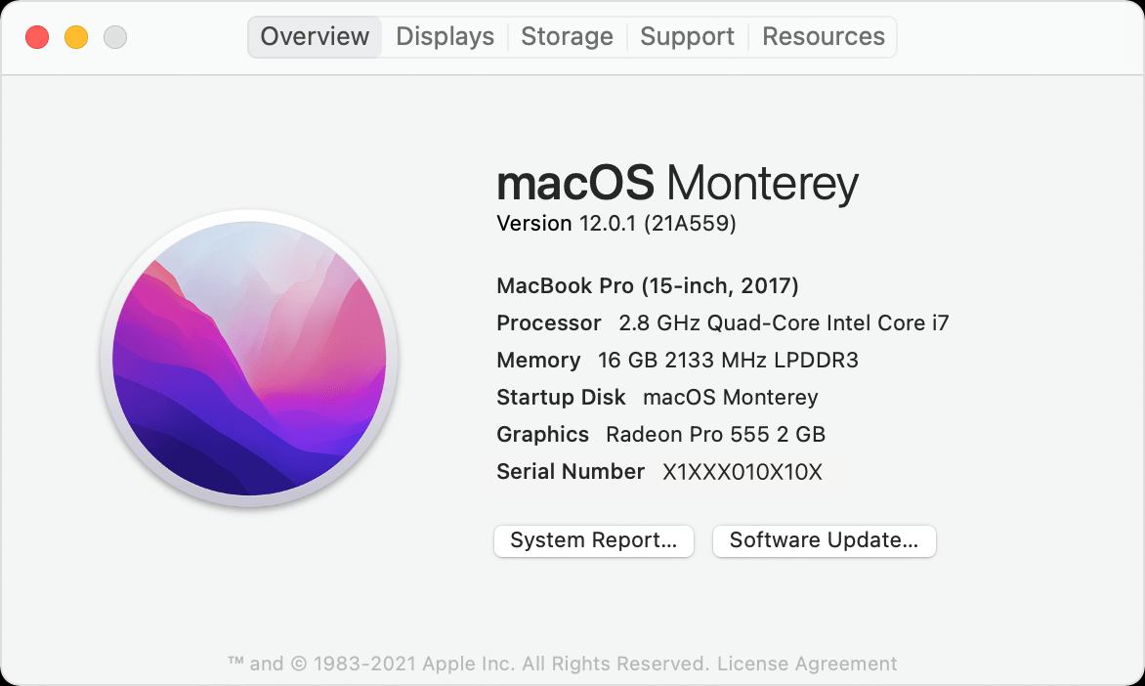
Z 2021 by Aiden Kenny Š akenny430 ¯ akenny430 J u/akenny430

Slide 13
Installing RStudio
Generally, we use RStudio for R
IDE
Pretty much the only IDE
You don’t have a choice
You don’t have freedom
You will use Rstudio and you will like it
To download, go to website: https://www.rstudio.com/products/rstudio/download
Or google “R studio download”
Scroll down to “All Installers”
Download the version for mac or for windows
Z 2021 by Aiden Kenny Š akenny430 ¯ akenny430 J u/akenny430

Slide 14
The console in RStudio
RStudio has a CONSOLE
We can run quick commands
We can install packages
Defaults to bottom left of window, but we can move it
R is designed for statistics, but has packages for other things
We need TIDYVERSE
Has important R packages, like dplyr (data management) and ggplot2 (data visualization)
dplyr is better than plyr
To install packages, we use use the RStudio console:
type install.packages(“package_name")
Z 2021 by Aiden Kenny Š akenny430 ¯ akenny430 J u/akenny430

Slide 15
Install github desktop
https://docs.github.com/en/desktop/installing-and-configuring-github-desktop/overview/getting-started-with-github-desktop
Install git
https://git-scm.com/downloads

Slide 16
Setup github account
Using github:
Github documentation
https://docs.github.com/en/get-started/quickstart

