Slide 1

Dashboards
Auckland, NZ
Notes:
9/29/2016
Hi, my name is Gustavo and I am part of the Galaga Team. I’ve been in the company for about 9ish months.

Slide 2
Agenda
Why?
PO/PD high level architecture
Dashboards history for PO/PD
Cost-wise comparison with DataDog
Grafana
InfluxDB
Live demo
PO = Practice Online
PD = Partner Dashboard
Notes:
9/29/2016
I will have to read some of my notes throughout this presentation. I have 30 min and about 30 slides... so if I miss one word, I might run out of time. :D
PO stands for Practice Online
PD stands for Partner Dashboard

Slide 3
Why?
“Measurement is the first step that leads to control and eventually to improvement. If you can’t measure something, you can’t understand it. If you can’t get it, you can’t control it. If you can’t control it, you can’t improve it.”
"H. James Harrington"
Notes:
9/29/2016
What problem are we trying to save here. The end result would be to know about errors before our customers. However, that is not the only reason.

Slide 4
Practice Online
Partner Dashboard
High level architecture
Notes:
9/29/2016

Slide 5

PracticeOnline Web
(SPA)
ClientPortal Web
Feature License Svc
Partner Dashboard Svc
Public API
ADCommon
(Auth)
Task Svc
Coniguration Svc
Contact Svc
Notification Svc
File Storage Svc
Digital Signature Svc
Notes:
9/29/2016
This slide is just to give you guys a big picture of our architecture. You don't need to know what each box means or does. What I am trying to ilustrate here is that when something goes wrong and with the amount of micro-services/system involved it is very hard to pinpoint the “culprit” or where to start looking for.
From a monitoring and dashboarding point of view this present a big challenge to cope with.

Slide 6
Practice Online
Partner Dashboard
Dashboards history
Notes:
9/29/2016

Slide 7
9 months ago...
Notes:
9/29/2016

Slide 8

Un-centralized
Very limited
Hard to
Customize
Manage
Have a set of dashboards displayed on TV
Notes:
9/29/2016
basically none dashboard at all... just relied on cloudwatch.
uncentralized, very limited, hard to customize, to manage, to have set of dashboards displayed on a TV

Slide 9
6 months ago...
Notes:
9/29/2016

Slide 10
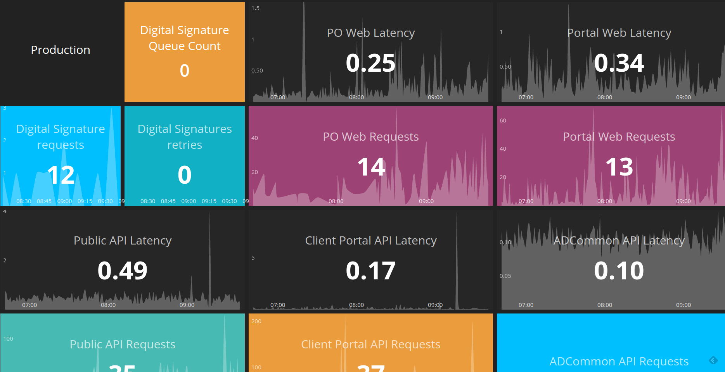
Dashing
NodeJS based
Runs in elastic beanstalk
Need to write code to add/remove tiles and then redeploy
Basically contains just one kind of graph (tiles)
Can't be customizable on the fly
Notes:
9/29/2016
Dashing
uncentralized, very limited, hard to customize, to manage, to have set of dashboards displayed on a TV

Slide 11
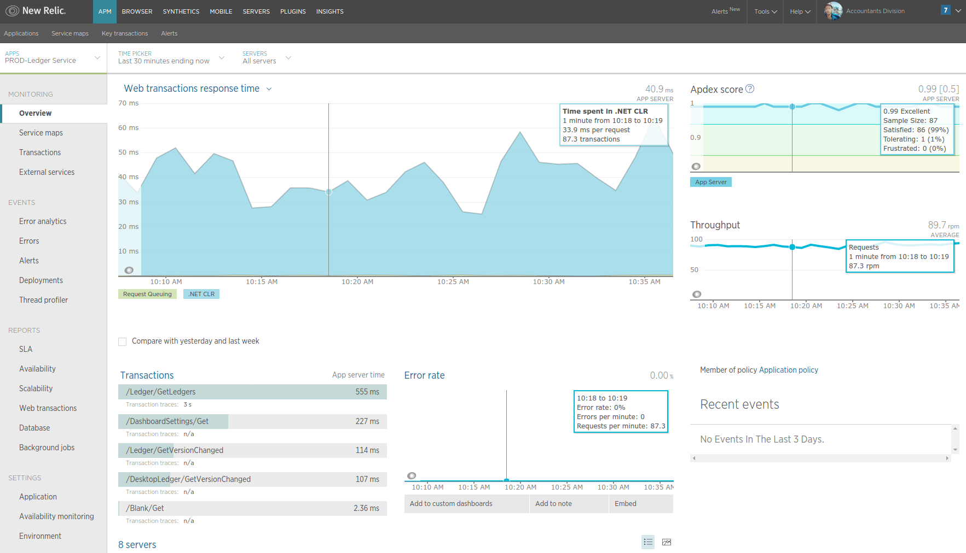
New Relic
Good when you know what service/application is misbehaving
Hard to have multiple dashboards
Can't be customizable (fixed views)
Depends on an agent installed on the machine, if the machine is down so are the metrics sent...
Roughly 5% (+/-) CPU overhead, according to NR
Notes:
9/29/2016
New-Relic
Client-side monitoring. it is also good to provide SLA reports.

Slide 12
3 months ago...
Notes:
9/29/2016

Slide 13
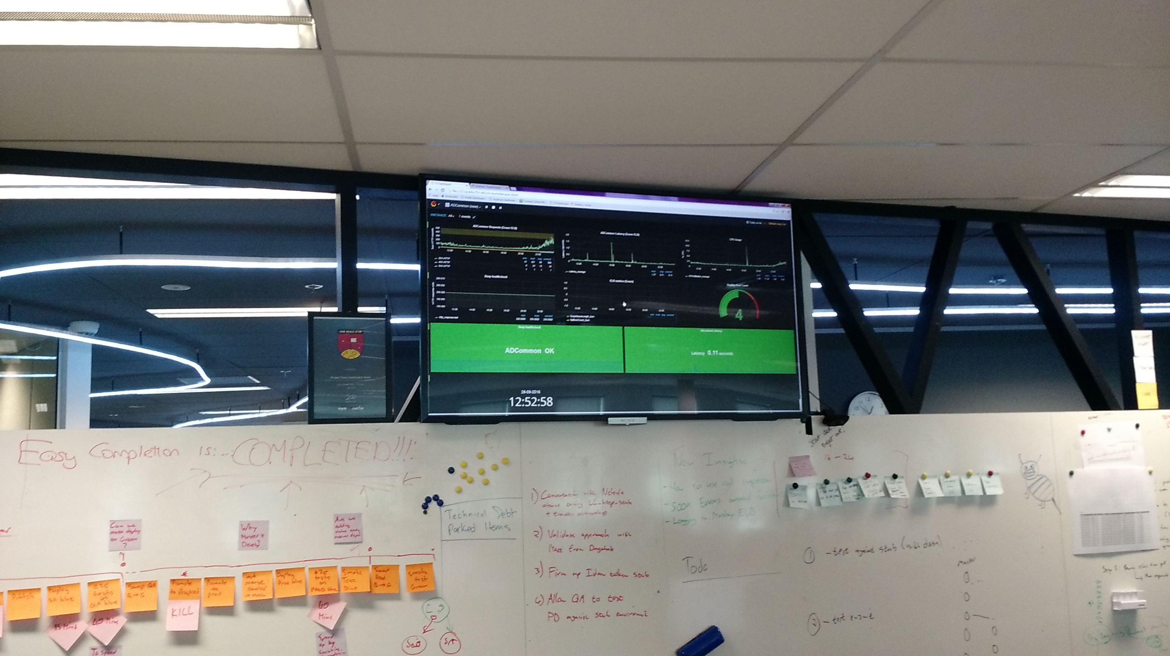
Notes:
9/29/2016
We started using grafana, but we are not the first one. I think Ian has also been using it, but with Graphite as the backend.

Slide 14
Cost wise comparison
with DataDog
Notes:
9/29/2016

Slide 15

Datadog
Free
  $0 per host/month
  Up to 5 hosts
  1 day retention
Pro
  $15 per host/month
  Up to 1000 hosts
  13 months retention
Enterprise
  ????
Notes:
9/29/2016

Slide 16

Notes:
9/29/2016

Slide 17
Grafana
Most commonly used for visualizing time series for Internet infrastructure and application analytics
Open source (strong community around) - *
  11K+ Github stars (https://github.com/grafana/grafana)
Used by
  RackSpace
  Vimeo
  Etsy
  TED
  and a bunch of other IT companies...
Written in Go
Notes:
9/29/2016
* It has also some enterprise plans

Slide 18
High level architecture
Grafana
Datasources
Notes:
9/29/2016
Grafana is basically a visualization application that can pulls data from a bunch of datasources types.

Slide 19
Feature highlights
Rich graphing (fully-interactive, editable graphs and etc)
Generic & Resusable
Many datasources & plugins
Authentication
  Users, roles and organizations through LDAP (SSO)
  Basic Auth & API Key Auth
  Github OAuth
  Google OAuth
HTTP Rest Api
Sharable dashboards
Multi-tenancy
Annotations (can be fetched from Elasticsearch, Graphite and InfluxDB)
Notes:
9/29/2016
HTTP rest api can be used to script basically everything

Slide 20
Feature highlights
CloudWatch Support
  Out of the box
  Rich editor with auto completion for metric names, namespaces and dimensions
  Templating queries for generic dashboards
  One datasource per AWS profile
    We created a IAM user “dashboard” with CloudWatchReadOnlyAccess policy attached
  CloudWatch only holds data for 2 weeks
Notes:
9/29/2016
Cloudwatch support is provide out of the box. Ask Craig if there is any plan for CloudWatch to hold data for longer periods.
Amazon provides 1 million CloudWatch API requests each month at no additional charge. Past this, it costs $0.01 per 1,000 GetMetricStatistics or ListMetrics requests. For each query Grafana will issue a GetMetricStatistics request and every time you pick a dimension in the query editor Grafana will issue a ListMetrics request.

Slide 21

Notes:
9/29/2016

Slide 22
InfluxDB
Open-Source Time series database
  Single node
  Clustering requires commercial product
Written in Go
Useful for recording metrics, events and performing analytics
Built-in HTTP Api
Data can be tagged
SQL-like query language
API SDKs for most languages (python, ruby, java, Node, .NET and list goes on...)
Notes:
9/29/2016
Their websites contains some guidelines about when we should go for single node or cluster. usually low and moderate usages can be handle by the single node architecture. (moderate < 250 thousand field writes per second)

Slide 23
InfluxDB – Comparison to SQL
SQL | InfluxDB
table | measurement
Indexed columns | tags
Unindexed columns | fields
rows | points
Notes:
9/29/2016

Slide 24
InfluxDB – how it correlates with Grafana
Grafana
InfluxDB
Agent/Script 1
Agent/Script 2
Agent/Script n
Notes:
9/29/2016

Slide 25
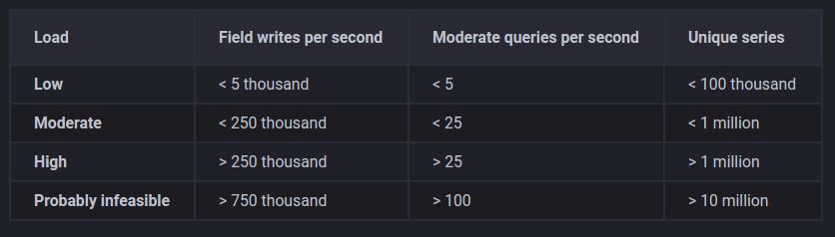
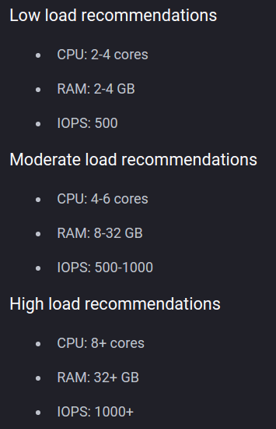
InfluxDB – general hw guidelines
Notes:
9/29/2016

Slide 26
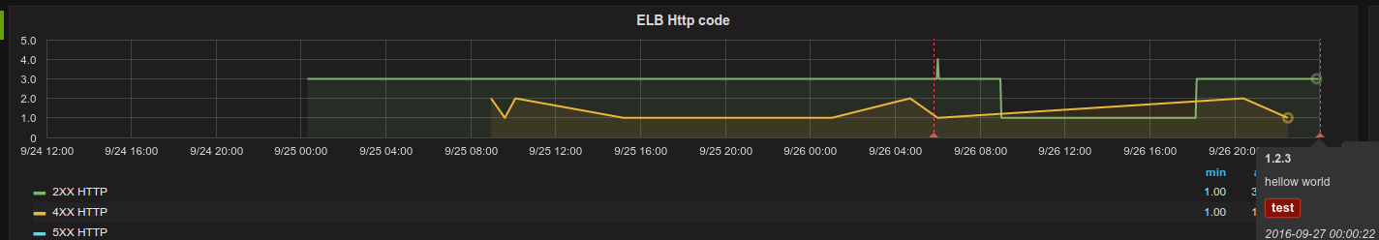
InfluxDB – annotations
CREATE DATABASE "events"
ALTER RETENTION POLICY "default" ON "events" DURATION 365d REPLICATION 1 DEFAULT
curl -i -XPOST 'http://INFLUXDB_HOST: 8086/write?db=events' --data-binary 'alert,application=adcommon,action=test,environment=cop version="1.2.3", text="hello world" '
Notes:
9/29/2016
Influxdb allows you to automatically expire old data, which helps to address storage size concerns
For those that doesn’t know curl, it is a command line tool to transfer data with URLs (it supports http, https, ftp, scp, smtp and etc)
In red is the database name. In dark green is the table name (or measurement) and in blue is the rest of the payload being sent.

Slide 27
All of this looks nice...
but I don't want yet
another system to manage
Notes:
9/29/2016

Slide 28

Notes:
9/29/2016

Slide 29
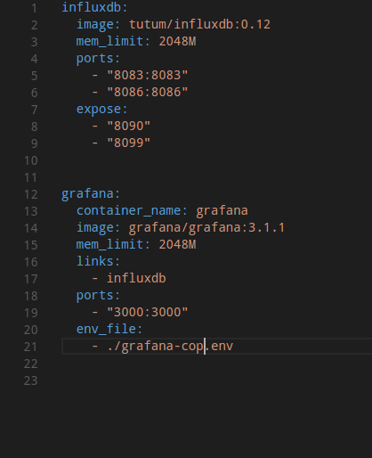
DockerHub contains stock container images for Grafana and InfluxDB
Dramatically reduces the administration cost (assuming a prior basic docker knowledge)
Most of the settings can be customized/overriden via environment variables
Or you can build your own containers on top of the standard container
Makes it easy to move towards a “Dashboard as a Service” model
Notes:
9/29/2016
It took me about 15min to have a local environment up and running to play with.
This docker compose file is very similar to the one we have been using. It is a starting point.

Slide 30

Notes:
9/29/2016

Slide 31
Actually... not yet
Running on premise (virtual machine + docker)
SSO enabled via LDAP
CentOS 7
  8 GB RAM
  15 GB disk size
Dashboards & datasources are backed up daily to S3 with https://github.com/MYOB-Technology/grafana-backup-tool
https://github.com/MYOB-Technology/PS-Grafana-Dashboard/
http://aumelexgrfn01.myob.myobcorp.net/
Notes:
9/29/2016
Initially it was running on aws but since we didn't had direct connect enabled, SSO would not work.
The grafana-dashboard-tool is a python tool that make use of grafana rest API to backup dashboards and datasources settings. It has been forked to MYOB account. I have submitted a PR to the author to accept environment variables

Slide 32
Thank you
MYOBNZ-EXGalaga@myob.com
Notes:
9/29/2016

