Slide 1

AI-DRIVEN PREDICTIVE
ANALYTICS FOR BUSINESS
GROWTH USING R
Use Case: Real Estate Market Intelligence in Nigeria

Slide 2

WHY THIS MATTERS
02
THE AFRICAN BUSINESS REALITY
From fragmented listings to structured business insight.
Many businesses collect data but still make decisions from fragmented signals.
Real estate decisions involve expensive assets, long cycles, and costly pricing mistakes.
Nigeria’s housing demand and pricing complexity create a strong, relatable use case.
Predictive analytics can support pricing, investment screening, and market expansion.
DATA → ACTION
LESS GUESSWORK
DECISION SYSTEMS
RISK REDUCTION

Slide 3
BUSINESS PROBLEM
03
Can we use housing market data to estimate property value and support smarter real estate growth decisions?
PRICING QUESTION
INVESTMENT QUESTION
GROWTH QUESTION
What is a defensible market estimate for a property, given its features and location?
Which listings may be underpriced, overpriced, or unusual enough to deserve closer review?
Which markets, segments, or property types look attractive for expansion or prioritization?
Prediction becomes valuable only when it is translated into business decisions.

Slide 4
STAKEHOLDERS
04
Investors
Developers
Property tech platforms
Screen opportunities, compare locations, and speed up due diligence.
Understand features and locations before allocating capital.
Automate price estimation and market insight.
REIT-style analysts
Banks and lenders
Urban planners
Support property screening and portfolio comparison.
Use valuation signals as additional collateral context.
Understand spatial pricing and infrastructure-linked patterns.
One workflow, many decision-makers.

Slide 5
THE DATASET
05
24,326
25
189
7
ROWS
STATES
TOWNS
PROPERTY TITLES
CORE FIELDS
bedrooms bathrooms toilets parking space
property type town state price

Slide 6
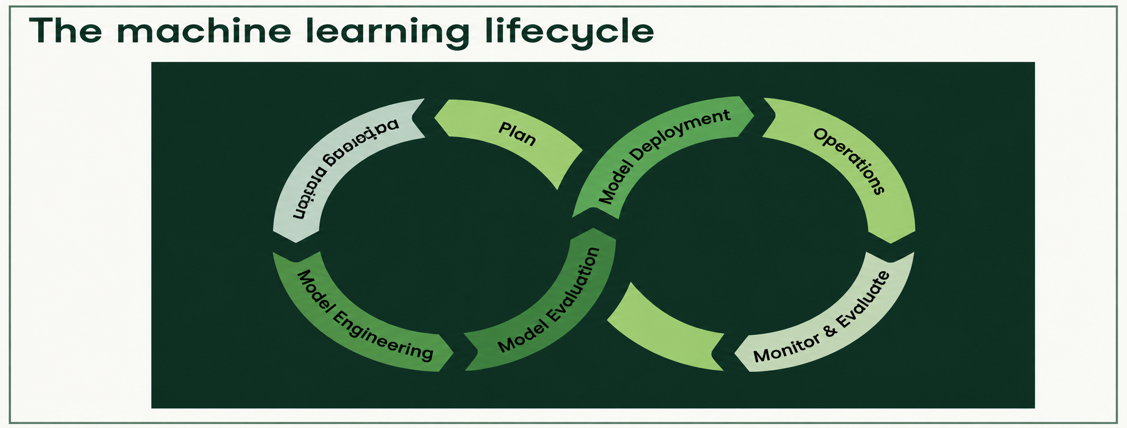
ML LIFECYCLE
06
The session follows the journey from raw data to decision support.

Slide 7
DATA VALIDATION
07
AI is only useful when the data foundation is credible.
VALIDATION CHECKS
21 pointblank checks run before modelling
Positive price and sensible numeric ranges
Required fields are present and non-missing
Categorical values inspected for consistency
Validation report saved for governance and auditability
21/21 OK
TRUST
QUALITY SIGNAL
BUSINESS SIGNAL
Validation reduces the risk of training on unreliable inputs.
Credible data improves confidence in pricing and screening outputs.
Validation report becomes an artifact for stakeholders.

Slide 8
FEATURE ENGINEERING
08
RAW PROPERTY ATTRIBUTES
DERIVED BUSINESS SIGNALS
Bedrooms
Bathrooms
Toilets
Parking space
Property type
Town
State
Price
total_rooms: overall property capacity
bathroom_bedroom_ratio: comfort signal
toilet_bedroom_ratio: convenience signal
parking_per_bedroom: parking adequacy
location and property encodings: model-ready market signals
log_price: stable target for skewed house prices
Feature engineering is where raw records become decision-ready variables.

Slide 9
MODEL TRAINING
09
From baseline model to advanced predictive models.
01
02
03
Linear regression baseline
Random forest
XGBoost
A simple, interpretable benchmark.
Captures non-linear relationships and interactions in tabular data.
A boosted tree model for stronger predictive performance and ranking.

Slide 10
EXPERIMENT TRACKING
10
Logging metrics, parameters, hyperparameters, and artifacts.
WHAT WE LOG
WHY IT MATTERS
Experiment names and run context
Model type and hyperparameters
Evaluation metrics: RMSE, MAE, R²
Predictions and business screening outputs
Figures, reports, and model artifacts
Improves reproducibility and workshop credibility
Makes model comparison auditable
Supports handover to technical teams
Creates evidence for governance and future improvement

Slide 11
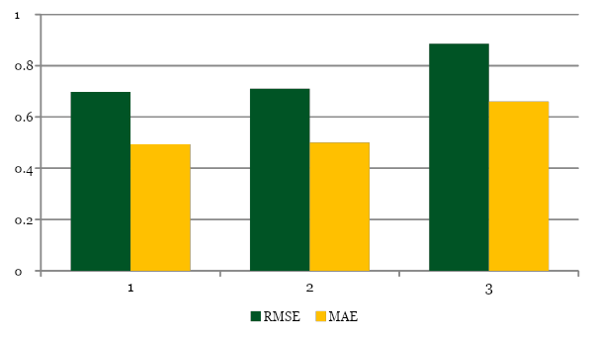
MODEL COMPARISON
11
Which model should the business trust?
Best model: XGBoost
RMSE 0.698 | MAE 0.493 | R² 0.648
XGBoost was the strongest performer.
Random forest was a close second.
Linear regression remains a useful baseline but captured less variation.

Slide 12
BUSINESS INSIGHT LAYER
12
Move from prediction to action.
PRICING GAP
LOCATION RANKING
FEATURE IMPORTANCE
MARKET SIGNALS
Actual price minus predicted price flags unusual listings.
Summarise market patterns by town and state.
Show which variables drive price differences.
Separate opportunities from anomalies.
CANDIDATE TABLE INTERPRETATION
The model does not say “buy this property now.” It says “this listing behaves differently from the market pattern and deserves investigation.”
Potential opportunity: below model estimate
Close to model estimate
Potentially above model estimate
Data quality review: unusually below estimate

Slide 13
WHAT THIS MEANS FOR GROWTH
13
Translate technical outputs into business value.
Better pricing
Investment screening
Market prioritisation
Reduced decision risk
Reusable workflow
Evidence-based pricing decisions
Prioritise candidates for due diligence
Focus on promising towns and segments
Spot anomalies and document assumptions
Repurpose the lifecycle across sectors
Predictive analytics creates growth when it helps organisations allocate capital better, reduce risk, and act with more evidence.

Slide 14

THANK YOU
AI-driven predictive analytics is not about replacing business judgment. It is about improving business judgment with evidence.
The power of AI in African markets is in building decision systems that help businesses grow with more evidence, less guesswork, and better accountability.

