Slide 1
JC

Slide 2
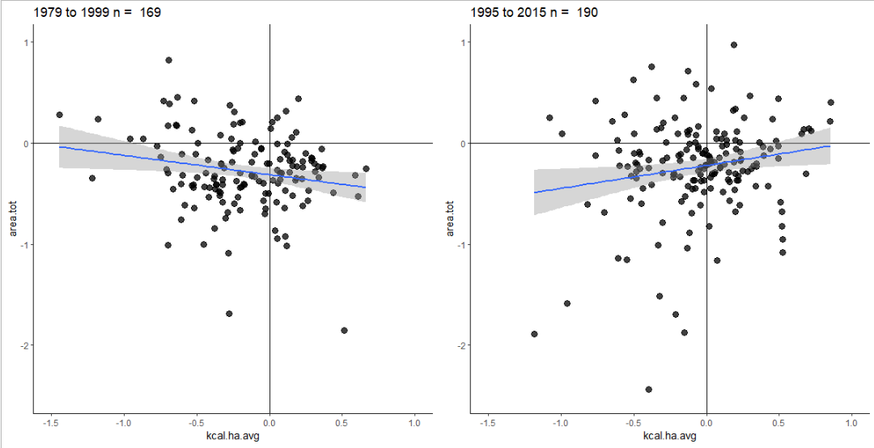


# Old Ewers Model
summary(lm(log.y.dif ~ log.x.dif, data = ewers_79_99_data))
# New Ewers Model
summary(lm(log.y.dif ~ log.x.dif, data = ewers_95_15_data))

Slide 3
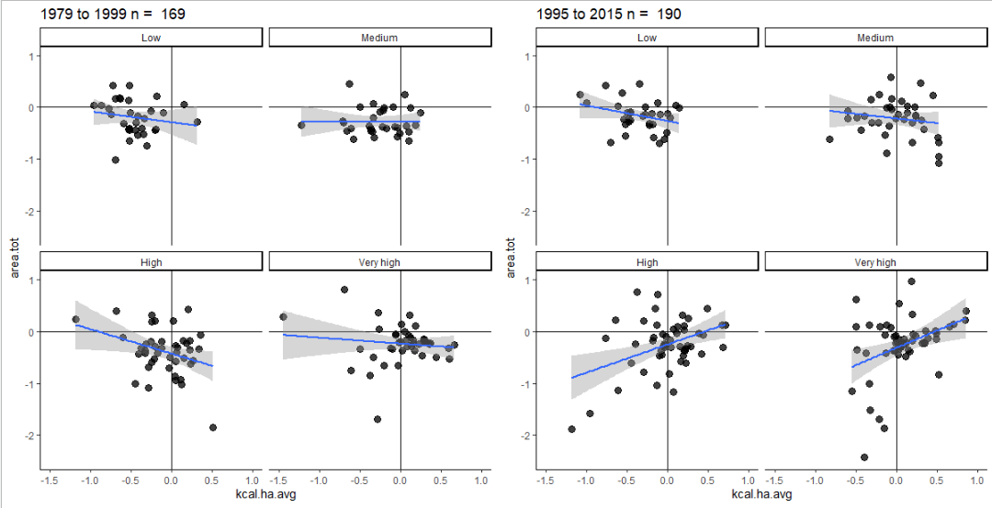
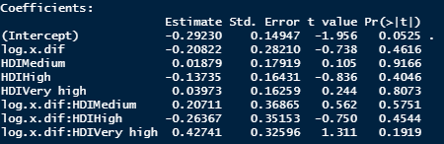
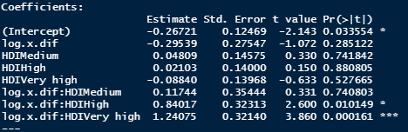

Slide 4
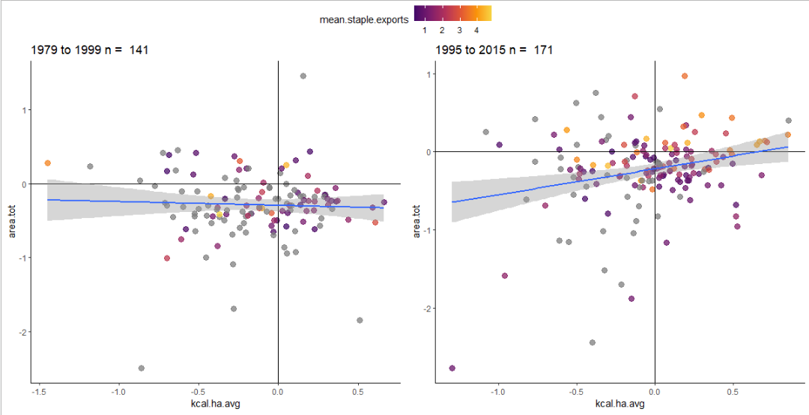



Slide 5
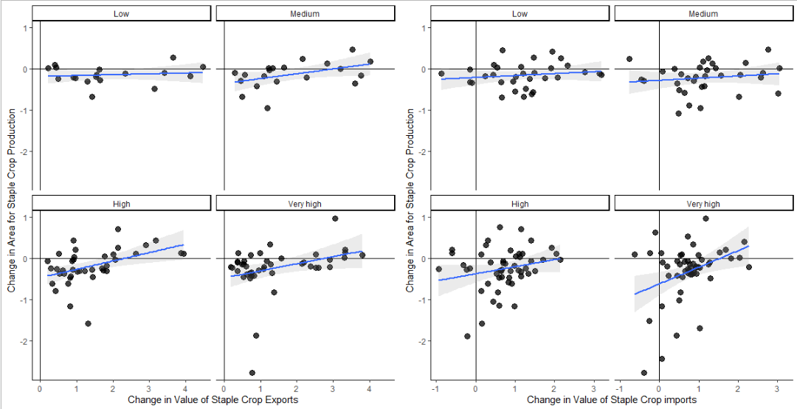
Change from 1995-2015

