Slide 1
JC

Slide 2
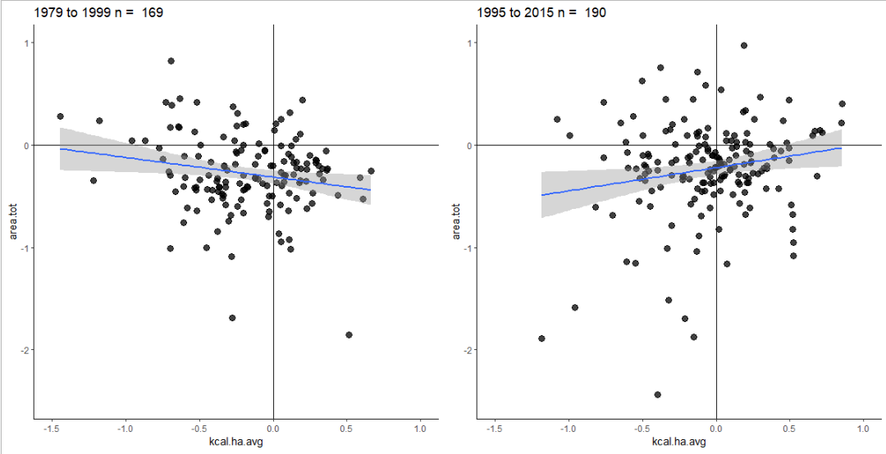


Fig. 1: Ewers Repeat
# Old Ewers Model
summary(lm(log.y.dif ~ log.x.dif, data = ewers_79_99_data))
# New Ewers Model
summary(lm(log.y.dif ~ log.x.dif, data = ewers_95_15_data))

Slide 3
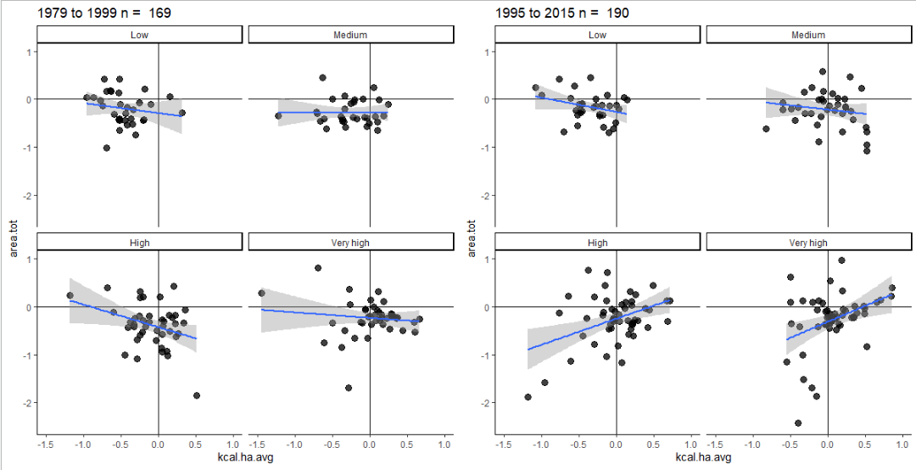
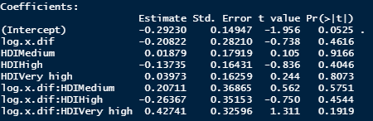
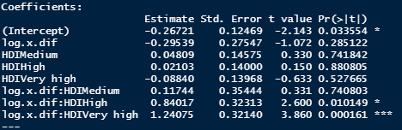
Fig. 1: Ewers Repeat

Slide 4
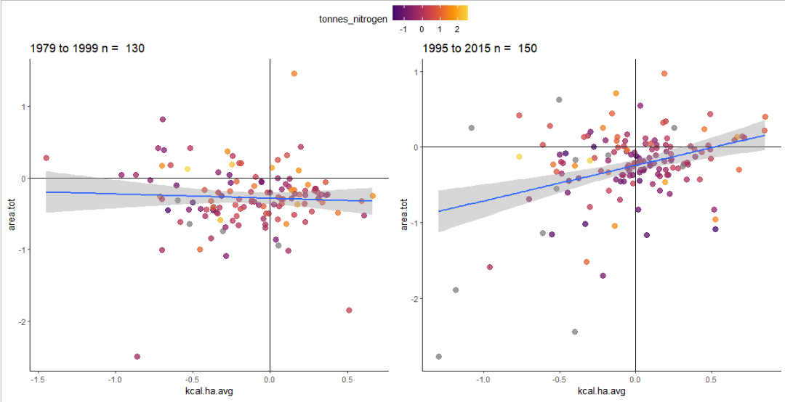

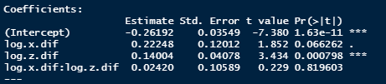
Fig. 3: Effects of Nitrogen

Slide 5
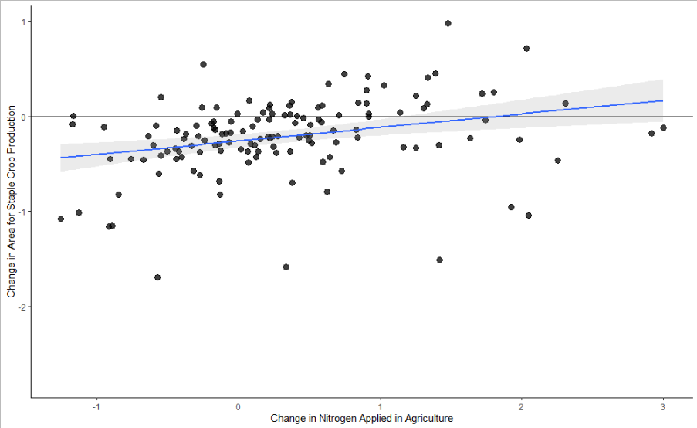

Fig. 3: Effects of Nitrogen
1995-2015 Effects of per-capita changes in nitrogen additions in agriculture on area used to produce 23 staple crops

Slide 6
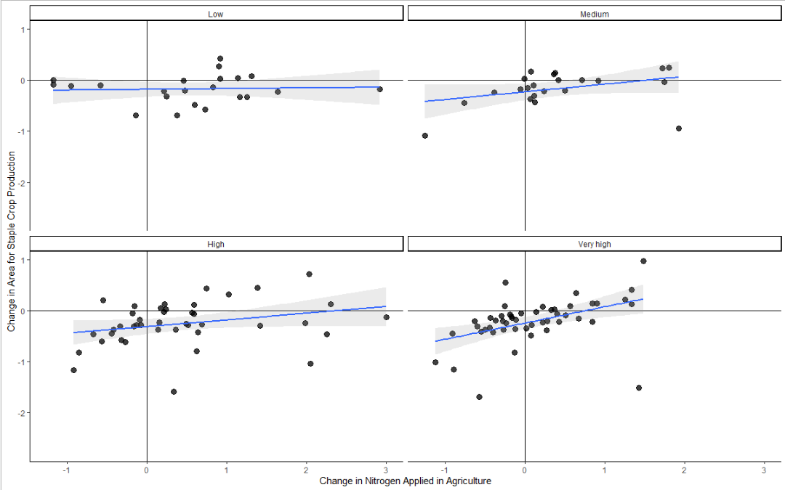
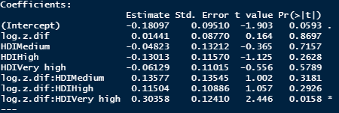
Fig. 3: Effects of Nitrogen

Slide 7
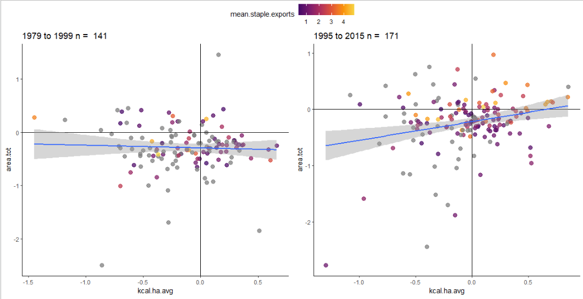


Fig. 4: Effects of Exports/Imports

Slide 8
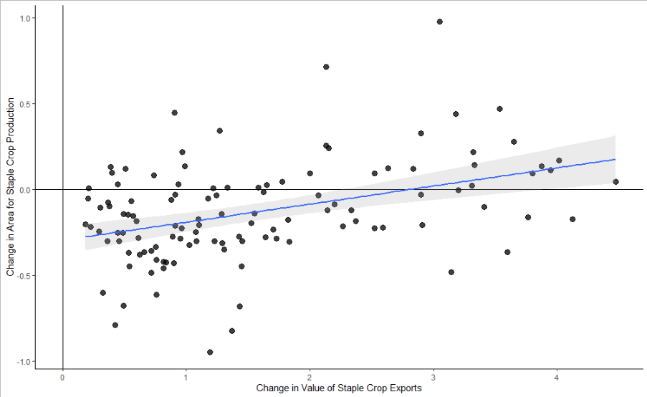

Fig. 4: Effects of Exports/Imports
1995-2015 Effects of per-capita changes in export values on area used to produce 23 staple crops
Some low-Y outliers removed, but same relationship

Slide 9
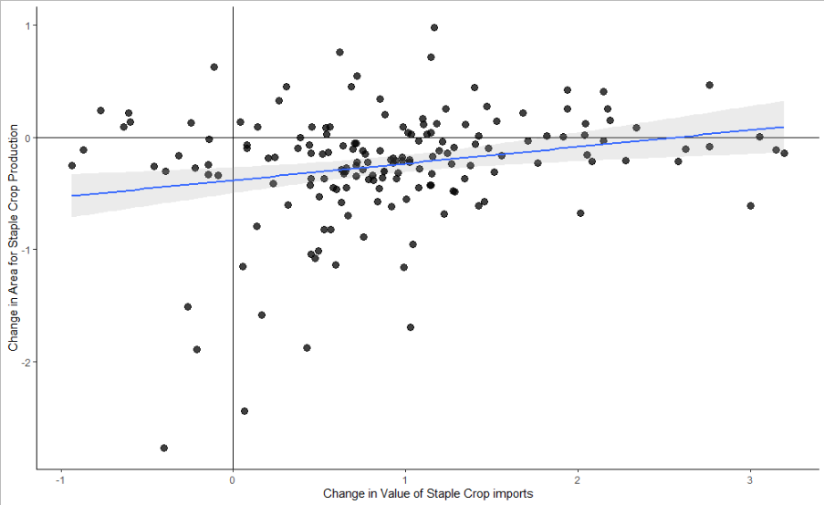

Fig. 4: Effects of Exports/Imports
1995-2015 Effects of per-capita changes in import values on area used to produce 23 staple crops

Slide 10
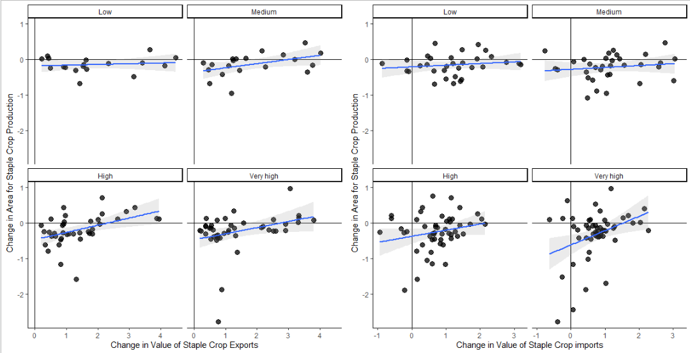
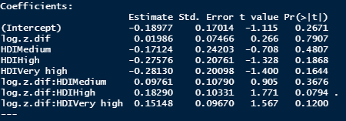
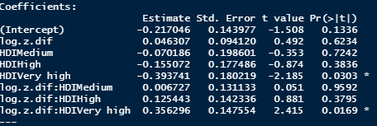
Changes in Land Use and Exports/Imports from 1995-2015 by HDI

