Slide 1

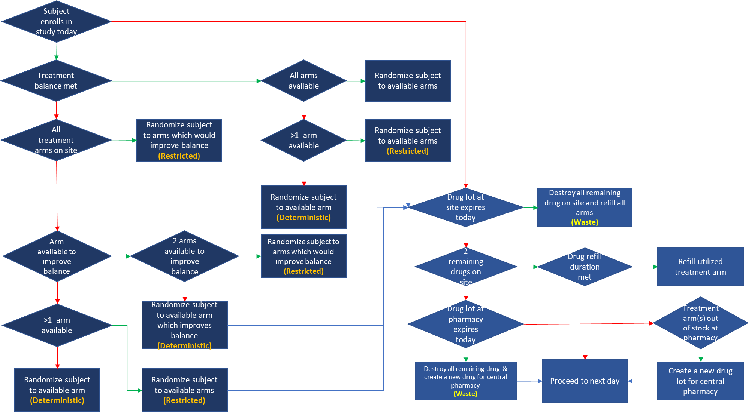
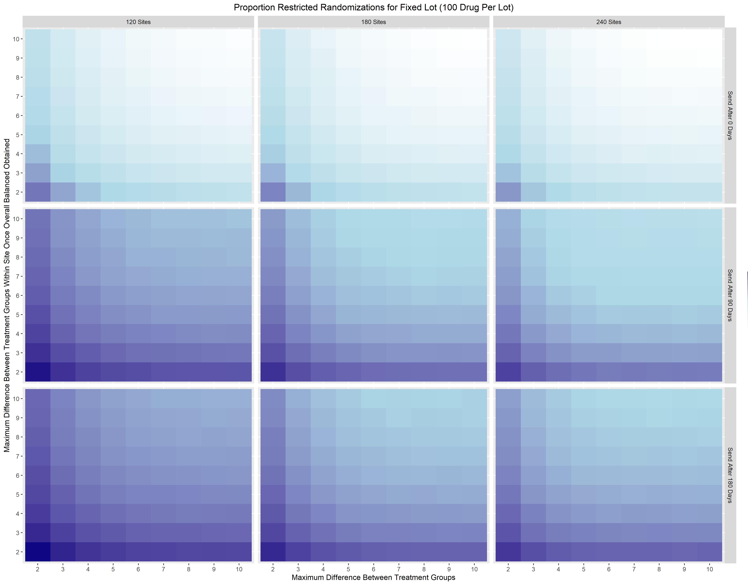
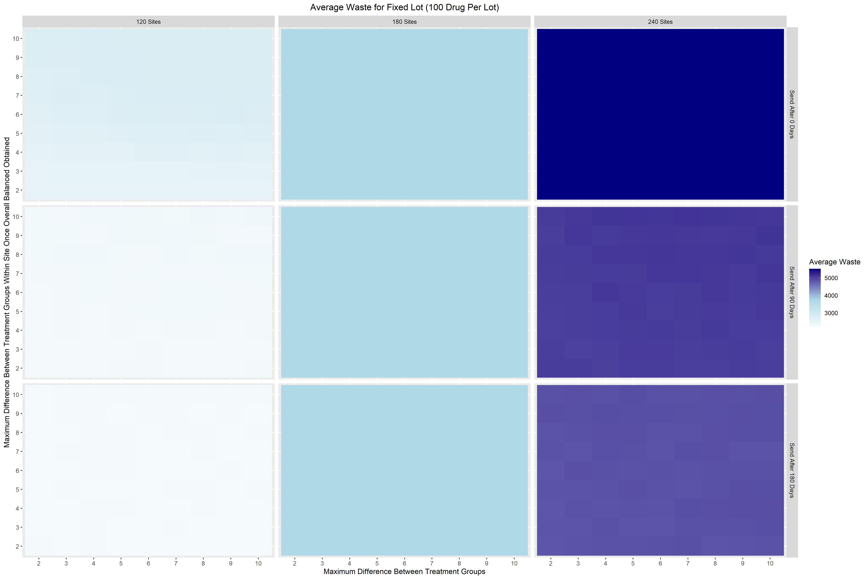
The Impact of the Interactions between Study Drug Shipment Protocols and Randomization Algorithms on Clinical Trial Operations and Costs
Bryce Wiley, MS¹; Jonathan Beall PhD¹; Renee’ Martin, PhD¹; Wenle Zhao, PhD¹;
1 Department of Public Health Sciences, Medical University of South Carolina, Charleston, SC
The authors have nothing to disclose
Introduction
Motivating Example Trial
Randomization and Drug Supply Algorithms
Subject randomization in clinical trials should ensure randomness and prevent serious treatment imbalance.
Random treatment allocation prevents selection bias in clinical trials^{1.}
Consistent imbalance control prevents time related biases in study results^{2.}
Performance of various randomization algorithms is explored sufficiently in literature.
However, there is a lack of literature that considers how the interaction between study drug shipment protocol and randomization algorithm affects randomization performance.
Additionally, the balance between the randomization and drug supply algorithms should be optimized to minimize drug related study costs and maximize randomization performance.
Comparison of Anti-coagulation and Anti-Platelet Therapies for Intracranial Vascular Atherostenosis (CAPTIVA) is a randomized, double-blind, three-arm trial.
All three treatment arms are drug, which incur manufacturing, shipping, labeling and other costs.
A simulation study was performed to evaluate randomization performance and drug related costs.
A simplified version of the CAPTIVA combined randomization and drug supply algorithm was programmed.
Key simulation parameters include number of sites, across/within site maximum treatment imbalances, and resupply characteristics.
The proportion of restricted/deterministic randomizations was chosen as the measure of allocation randomness and amount of drug wasted as a proxy for shipping costs.
Simulations Results
Conclusions
Without accounting for drug supply, restricted randomization rates are artificially decreased.
Prioritizing reductions in drug waste (and shipping costs) increased restricted randomizations and vice versa.
There is a clear trade-off between improving randomization performance and decreasing study drug related costs.
Given that drug supply can decrease randomization performance, it is imperative that drug supply be considered in determining the optimal randomization algorithm parameters.
Acknowledgements
CAPTIVA U01NS117450; RHAPSODY-2 UG3NS119199; StrokeNet U01NS087748
References
Zhao, Wenle, et al. "Quantitative comparison of randomization designs in sequential clinical trials based on treatment balance and allocation randomness." Pharmaceutical Statistics 11.1 (2012): 39-48.
Zhao, Wenle, and Yanqiu Weng. "Block urn design—a new randomization algorithm for sequential trials with two or more treatments and balanced or unbalanced allocation." Contemporary Clinical Trials 32.6 (2011): 953-961.
Across all number of sites as you increase the delay in resending utilized drug, there is an increase in restricted randomizations.
Across all number of sites, as you increase the delay in resending utilized drug, there is a decrease in the amount of drug waste.
Notes:
Photos should be at least 300dpi, but not more than 5-12 mgs each. Your page is set to be enlarged 200% so do not change the page size to fit another poster size. Please call me and I will help you with a new page size if desired. Lisa 792-4724
Please note this is only a template for you to start with. You can change the font size, colors, column widths and the number of columns.

