Slide 1
Inheritance vs. Delegation

Slide 2
REVIEW: The Open-Closed Principle
Software entities (classes and functions) should be open for extension but closed for modification.
  We want to modify/customize a class's behavior without modifying its source code
  Changing a class’s source code is undesirable, because:
    We might introduce bugs into working code
    We might break code that depends on the class that was changed (ripple effects)
  But, how can we modify a class’s behavior without changing its source code?

Slide 3
REVIEW: The Open-Closed Principle
What are different ways I can make a class's functionality customizable and extendable without changing its source code?
  Generic types
  Class inheritance
    Add methods and fields in subclass
    Override superclass methods in subclass (Template Method pattern)
  Flexible Dependencies (uses delegation)
    Abstract Factory pattern
    Dependency Injection
  Strategy pattern (uses delegation)
    Pass-in algorithms
  Wrapping
    Adapter pattern (uses delegation)
    Decorator pattern (uses delegation)
Class Inheritance
Delegation

Slide 4
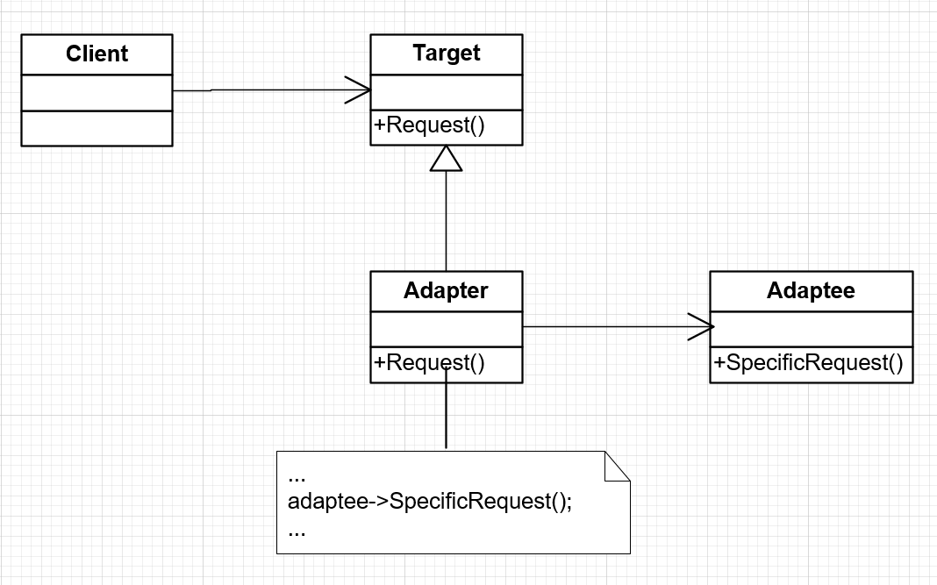
REVIEW: Adapter Pattern

Slide 5
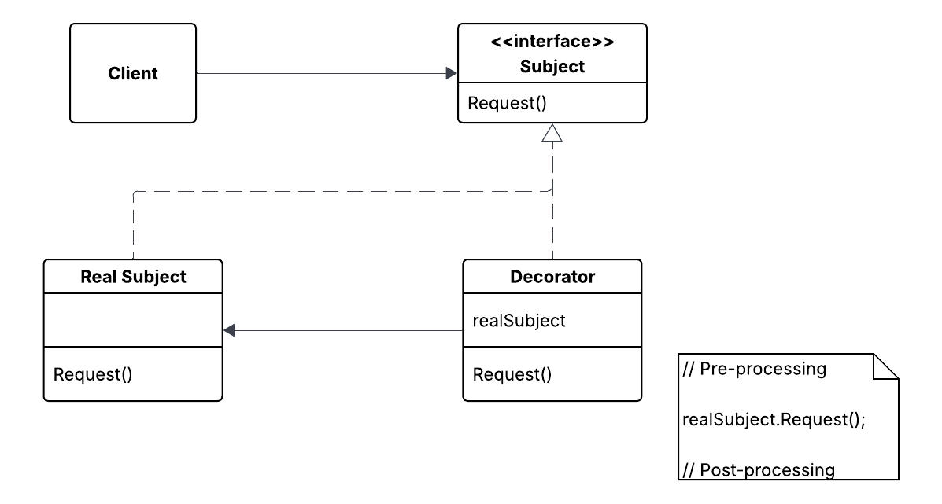
Decorator Pattern (modified)

Slide 6
Choosing Between
Delegation and Inheritance
What type of relationship is being modeled?
  B “has-a” A => delegation
  B “uses” A => delegation
  B “is-a” A => inheritance
    Specialization

Slide 7
Choosing Between
Delegation and Inheritance
“Favor object composition over class inheritance.” [Design Patterns, pg. 20]
  Composition is a synonym of Delegation
Why?

Slide 8
Choosing Between
Delegation and Inheritance
Delegation is more flexible than inheritance
  Pointers can be swapped at runtime, but super-classes cannot
Example:

Slide 9
Choosing Between
Delegation and Inheritance
Inheritance leads to tighter coupling than delegation
Inheritance is sometimes called “white box reuse” and delegation called “black box reuse”
Unwise programmers, when they realize they need to subclass an existing class, make all the “private” features “protected”, make all the methods “virtual”, and say, “There, now it’s a base class!”.
This approach results in extremely high coupling between a base class and its subclasses, and results in a fragile base class (i.e., a base class that is difficult to change without breaking its subclasses)
Information hiding is still a good practice, even between base and sub-classes
Keep base class members private whenever possible

Slide 10
Choosing Between
Delegation and Inheritance
Delegation allows control over which delegate features are exposed, and what the API looks like
Inheritance is easier if you want to expose many of the superclass’ features
  Although, IDEs like Intellij have a handy “Generate Delegate Methods” option for exposing delegate features if you’re using delegation

Slide 11
Choosing Between
Delegation and Inheritance
Inheritance supports polymorphism, delegation does not
If you need polymorphism, you must use some kind of inheritance (class or interface)

