Slide 1
Command Design Pattern
Source: Design Patterns – Elements of Reusable Object-Oriented Software; Gamma, et. al.

Slide 2
Problem
Sometimes a class needs to perform actions without knowing what the actions are
Sometimes actions need to be treated as data objects that can be stored or passed around

Slide 3
Example: Task Scheduling Service
Generic task scheduling service
Allow tasks to be scheduled by
  Interval (e.g., every hour)
  Date/time (e.g., on February 8th at 1:00pm)
  Etc.
Tasks are defined using Command objects
Scheduling service executes Command object at the appropriate time, having no idea what it actually does

Slide 4
Command Objects
<interface>
COMMAND
execute(): void
<implements>
CONCRETE COMMAND
data required to
perform action
execute(): void {
logic to perform action
}

Slide 5
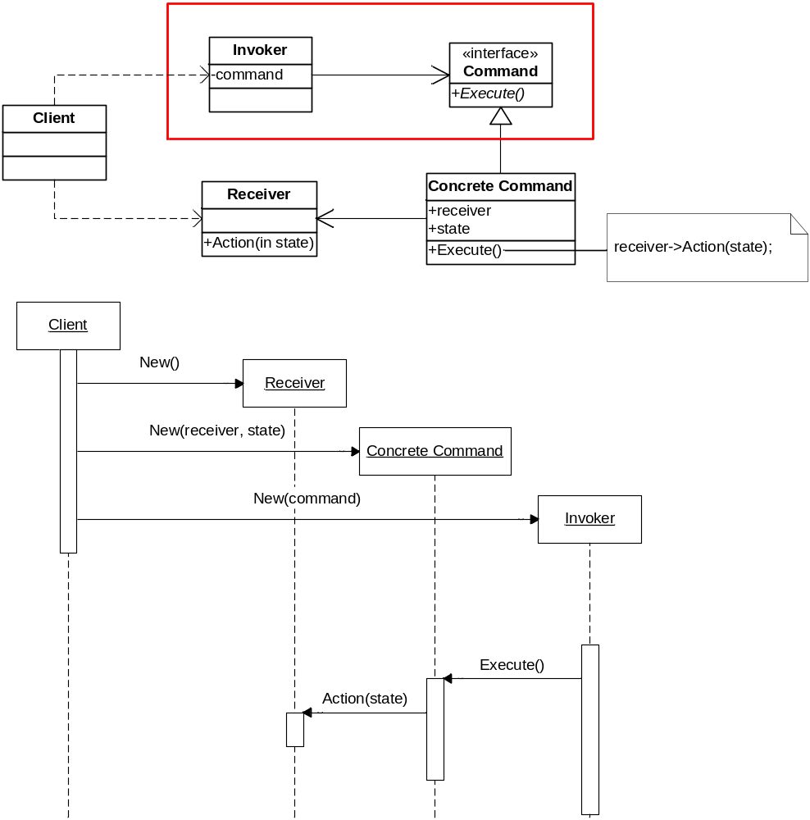
Solution

Slide 6
Consequences
Objects can be parameterized with arbitrary actions
Completely decouples objects from the actions they execute
  Application of “Dependency Inversion”
Adding new kinds of actions is easy
  Just create a new class that implements the Command interface

Slide 7
Known Uses: Undo/Redo
Store a list of actions performed by the user
Each action has
  A “do” method that knows how to perform the action
  An “undo” method that knows how to reverse the action
Store a pointer to the most recent action performed by the user
Undo – “undo” the current action and back up the pointer
Redo – move the pointer forward and “redo” the current action

Slide 8
Known Uses: Recording user actions
Macros
  Record a sequence of user actions so they can be turned into a macro
  Macro can be re-executed on demand by the user

Slide 9
Known Uses: Multi-user network games
Actions performed by a player must be broadcast to all other players and executed on their local machines
How could we use the Command pattern to do this?

Slide 10
class VideoGame {
constructor() {
console.log("Initializing video game");
}
move(player: number, newLoc: Location): void {
console.log(`Player ${player} moved to ${newLoc.toString()}`);
}
jump(player: number): void {
console.log(`Player ${player} jumped`);
}
raiseShield(player: number): void {
console.log(`Player ${player} raised their shield`);
}
swingSword(player: number, angle: number, speed: number): void {
console.log(`Player ${player} swung their sword at angle ${angle} with speed ${speed}`);
}
}
class Location {
constructor(public x: number, public y: number) {
}
toString(): string {
return `(${x}, ${y})`;
}
}

Slide 11
// Command interface
interface Command {
execute(): void;
}

Slide 12
// Specific command classes
class MoveCommand implements Command {
constructor(private game: VideoGame,
private player: number,
private newLoc: Location) {
}
execute(): void {
this.game.move(this.player, this.newLoc);
}
}
class JumpCommand implements Command {
constructor(private game: VideoGame,
private player: number) {
}
execute(): void {
this.game.jump(this.player);
}
}

Slide 13
class RaiseShieldCommand implements Command {
constructor(private game: VideoGame,
private player: number) {
}
execute(): void {
this.game.raiseShield(this.player);
}
}
class SwingSwordCommand implements Command {
constructor(private game: VideoGame,
private player: number,
private angle: number,
private speed: number) {
}
execute(): void {
this.game.swingSword(this.player, this.angle, this.speed);
}
}

Slide 14
class CommandTest {
public run(): void {
let commands: Command[] = [];
commands.push(new MoveCommand(3, new Location(75, 12)));
commands.push(new JumpCommand(3));
commands.push(new RaiseShieldCommand(3));
commands.push(new SwingSwordCommand(3, 45, 100));
commands.forEach((cmd: Command) => cmd.execute());
}
}

