Slide 1
Designing for Testability
*Abstract Factory*

Slide 2
Testing with “fake” dependencies
Test
Test
Report
Cases
Test
Driver
Class
Under
Test
UserDAO
EventDAO
PersonDAO

Slide 3
Testing with “fake” dependencies
Test
Test
Report
Cases
Test
Driver
Class
Under
Test
Fake
UserDAO
Fake
EventDAO
Fake
PersonDAO

Slide 4
Sample Client Code
public class Client {
private RealUserDAO userDAO;
private RealPersonDAO personDAO;
private RealEventDAO eventDAO;
public Client() {
userDAO = new RealUserDAO();
personDAO = new RealPersonDAO();
eventDAO = new RealEventDAO();
}
}

Slide 5
Sample Client Code
public class Client {
private RealUserDAO userDAO;
private RealPersonDAO personDAO;
private RealEventDAO eventDAO;
public Client() {
userDAO = new RealUserDAO();
personDAO = new RealPersonDAO();
eventDAO = new RealEventDAO();
}
}
Programming to concrete types and Calling “new” create inflexible
dependencies

Slide 6
Sample Client Code
public class Client {
private UserDAO userDAO;
private PersonDAO personDAO;
private EventDAO eventDAO;
public Client() {
userDAO = new RealUserDAO();
personDAO = new RealPersonDAO();
eventDAO = new RealEventDAO();
}
}
?
How do we avoid calling new?
1. Abstract Factory
2. Dependency Injection
?
?

Slide 7
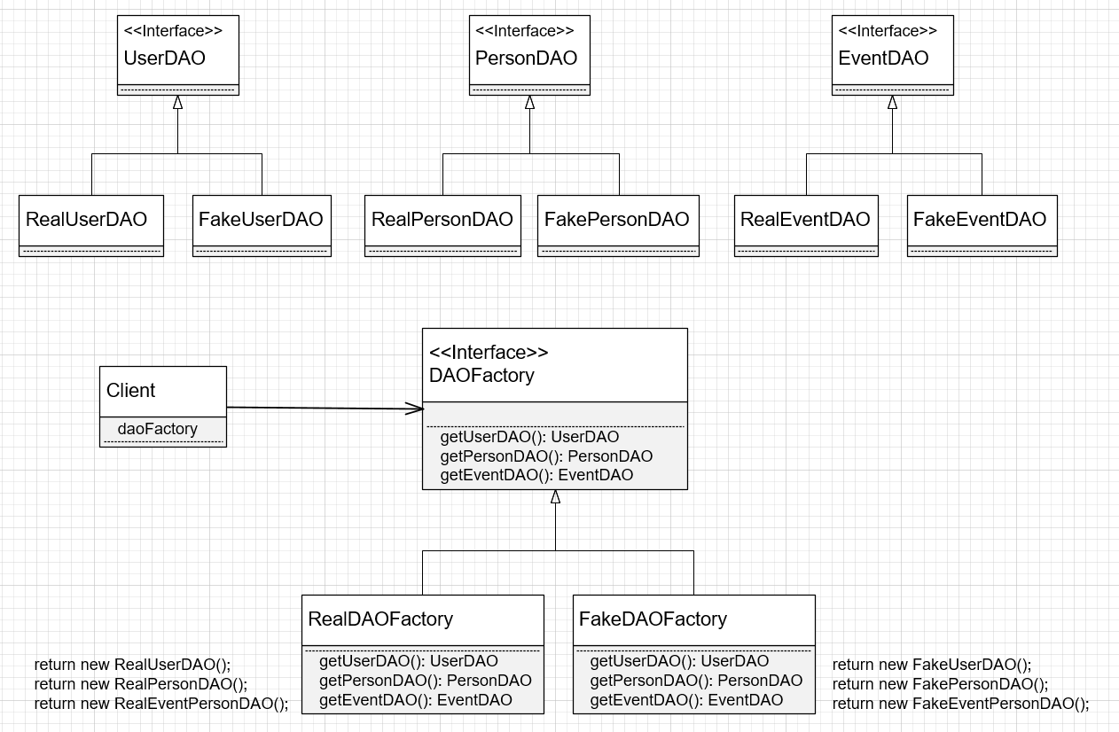

Slide 8
Sample Client Code
public class Client {
private DAOFactory daoFactory;
private UserDAO userDAO;
private PersonDAO personDAO;
private EventDAO eventDAO;
public Client(DAOFactory daoFactory) {
this.daoFactory = daoFactory;
userDAO = daoFactory.getUserDAO();
personDAO = daoFactory.getPersonDAO();
eventDAO = daoFactory.getEventDAO();
}
}

Slide 9
Swappable dependencies
Client
Client
SQL
UserDAO
SQL
EventDAO
FlatFile
UserDAO
FlatFile
EventDAO
SQL
PersonDAO
FlatFile
PersonDAO

Slide 10
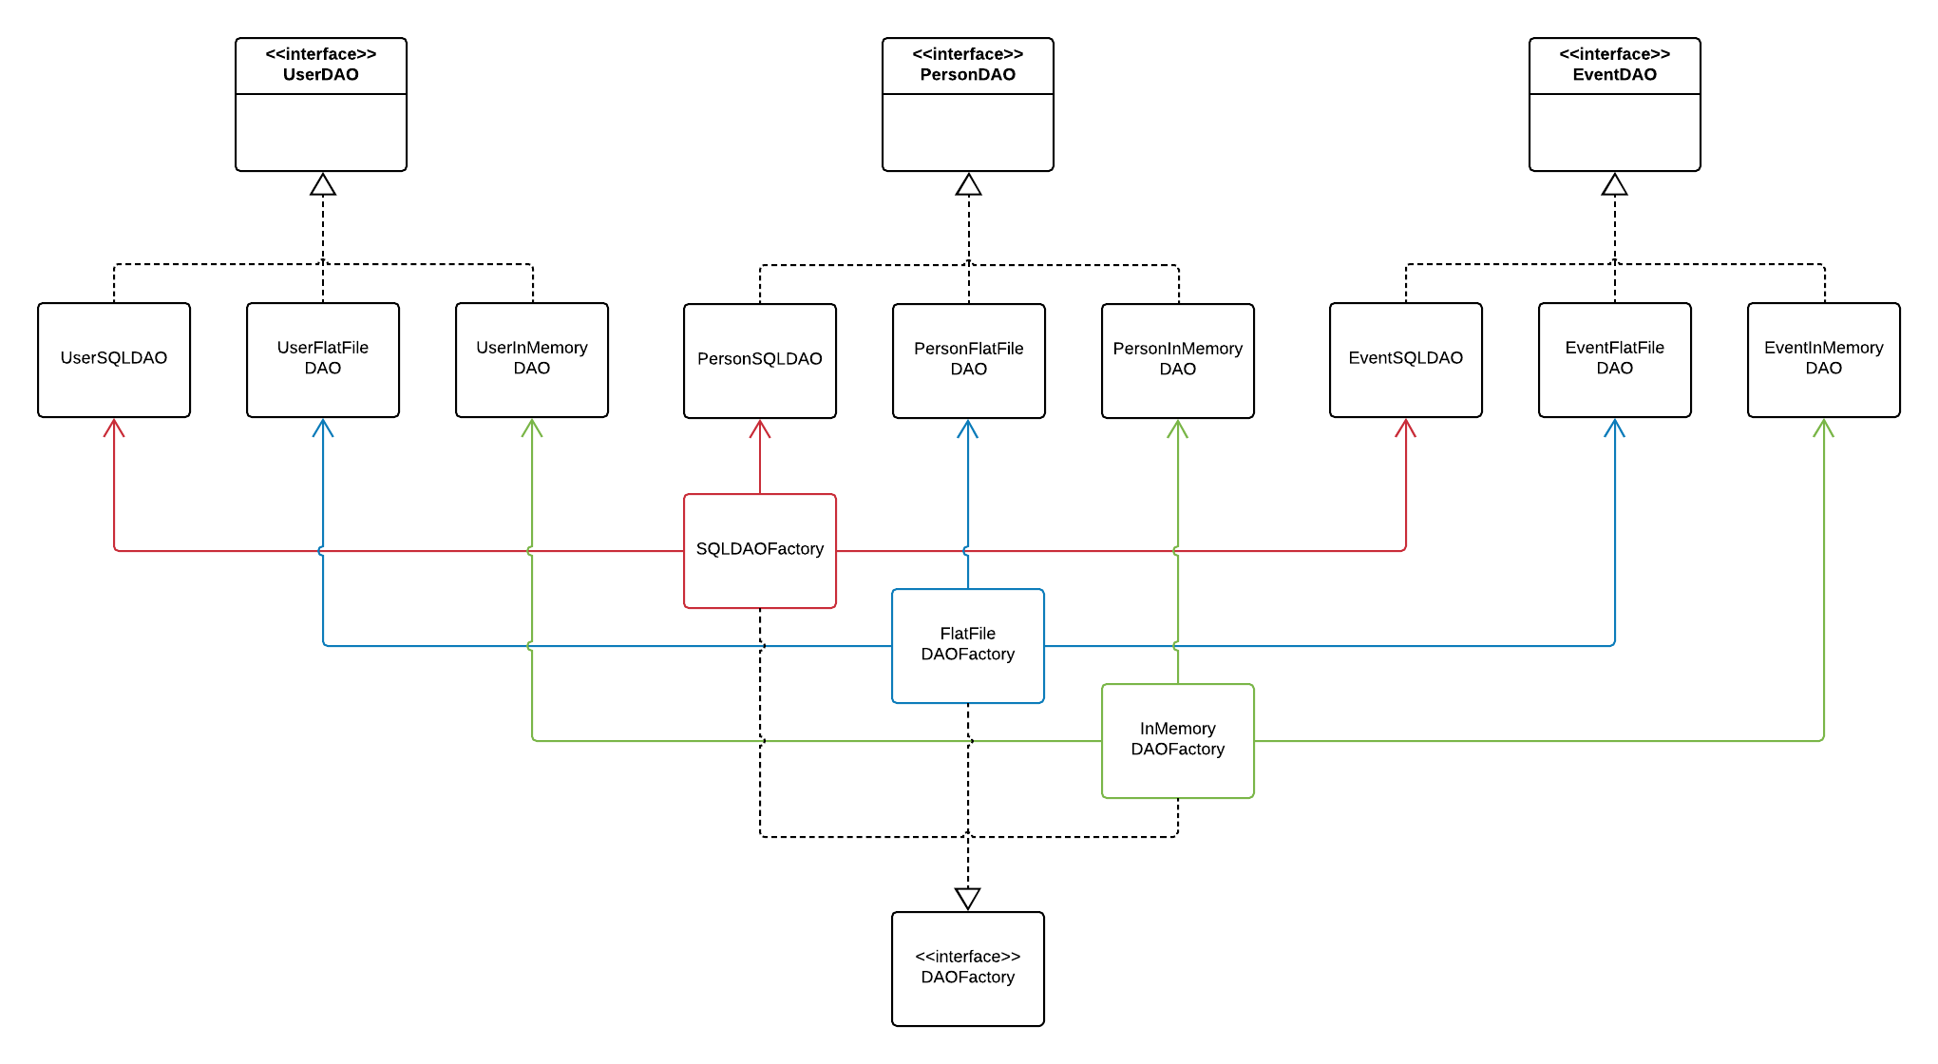
Swappable dependencies

Slide 11
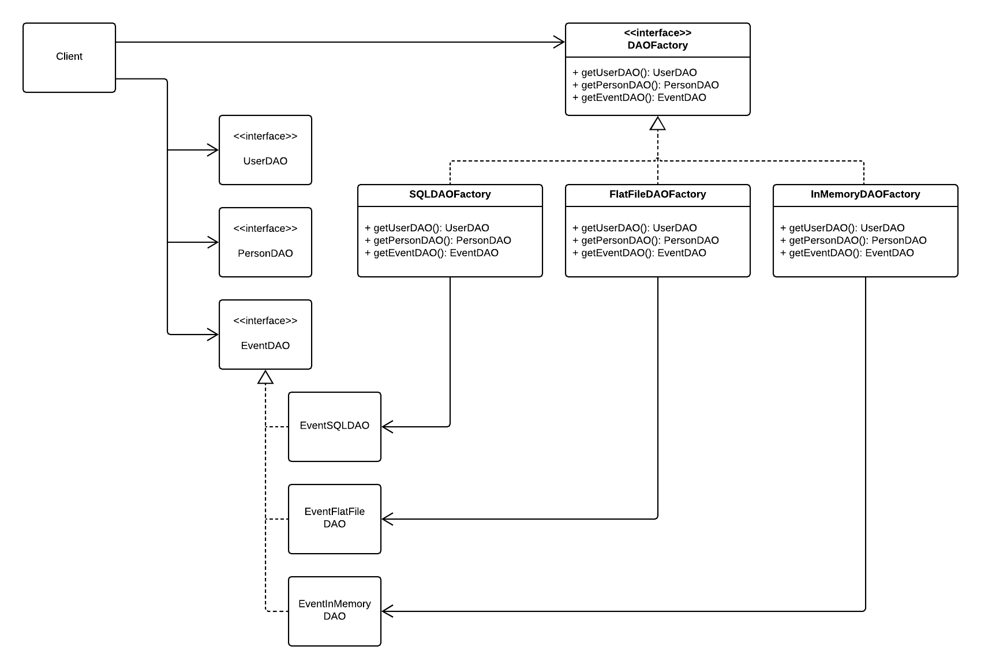
Swappable dependencies

Slide 12
How Does the Client Get Its Factory?
Through constructor
  public Client(DAOFactory daoFactory) {
  this.daoFactory = daoFactory;
  }
From Singleton class
abstract class DAOFactory {
private static DAOFactory instance;
public static void setInstance(DAOFactory value) {
instance = value;
}
public static DAOFactory getInstance() {
return instance;
}
public abstract UserDAO createUserDAO();
public abstract PersonDAO createPersonDAO();
public abstract EventDAO createEventDAO();
}

Slide 13
Singleton Factory
class SQLDAOFactory extends DAOFactory {
@Override
public abstract UserDAO createUserDAO() {
return new SQLUserDAO();
}
@Override
public abstract PersonDAO createPersonDAO() {
return new SQLPersonDAO();
}
@Override
public abstract EventDAO createEventDAO() {
return new SQLEventDAO();
}
}
class Main {
public static void main(String[] args) {
DAOFactory.setInstance(new SQLDAOFactory());
}
}

Slide 14
Sample Client Code
public class Client {
private UserDAO userDAO;
private PersonDAO personDAO;
private EventDAO eventDAO;
public Client() {
userDAO = DaoFactory.getInstance().getUserDAO();
personDAO = DaoFactory.getInstance().getPersonDAO();
eventDAO = DaoFactory.getInstance().getEventDAO();
}
}

Slide 15
