Slide 1

CS 301R · SOFTWARE ENGINEERING STUDIO I
Narrowing to a Defensible Idea
Session 6 — the convergence workshop
Wednesday, September 23, 2026
Notes:
Three weeks of opening up; today we deliberately narrow down. Frame the goal in one breath: leave with one or two ideas you can defend, and a written rationale for them. Convergence done well is a discipline, not a gut call — a shared yardstick, honest feedback, then commit. CP1 Idea Briefs turn in today; the idea you converge on becomes CP2, written over the weekend and due Mon, Sep 28. Keep energy up — most of today is hands-on.

Slide 2


WHERE WE ARE
Three weeks diverging — today you converge
Weeks 1–3 · diverging
Today · converging
You explored the problem space, did discovery, and read feasibility. You arrive with 2–3 candidate ideas.
Score against a shared yardstick, pressure-test with peers, and leave with 1–2 ideas you can defend.
Due today: CP1 Idea Briefs. The idea you converge on becomes CP2 — written this weekend, due Mon, Sep 28.
2
CS 301R · Session 6 · Convergence Workshop
Notes:
Two-minute bridge. The pile of candidate ideas is raw material; today we choose a working direction. Set the destination — 1–2 defensible ideas plus a one-line rationale each. Make the deliverable split explicit and say why the gap is deliberate: CP1 turns in now, but CP2 is written after they've converged and gotten feedback, so it reflects a real decision rather than a rushed guess made the same hour.

Slide 3


CONVERGENCE, DONE WELL
Choose deliberately — don't just grab a favorite
The trap
The discipline — five moves
Premature convergence — grabbing the first or favorite idea and stopping. Scoring exists to make the choice defensible, not just decisive.
Be deliberate — decide on the criteria, not on vibes.
Check your objective — does it serve a real need?
Improve promising ideas — don't only kill weak ones.
Keep the novelty alive — don't default to the safest.
Stay affirmative — narrowing isn't tearing down.
Converging means choosing a working direction you can defend and revise — not marrying an idea.
3
CS 301R · Session 6 · Convergence Workshop
Notes:
Seven minutes. The failure mode is emotional: people converge on the idea they already love and reverse-justify it. The five moves come from the CPS reading — read them as habits, not rules. Emphasize 'improve, don't only kill': a promising-but-flawed idea often beats a safe-but-thin one once narrowed. Land the bottom line hard — a working direction is defensible and revisable; you are not signing a marriage certificate today.

Slide 4

THE SKILL UNDER CONVERGENCE
Evaluating an idea — a portable toolkit
1
Decide what "good" means here
Pick the criteria that fit your goal — the step most people skip.
2
Score candidates against them
Deliberately, not by attachment — a fatal flaw beats a high total.
3
Weigh value against do-ability
Is the payoff worth the effort? Plot it; don't guess.
4
Pressure-test with others
Structured feedback — challenge the idea, not the person.
5
Commit — with a rationale
Choose a working direction you can defend and revise.
Portable: this works on any idea — a feature at work, a startup, a side project. Only step 1 changes — the criteria you choose.
4
CS 301R · Session 6 · Convergence Workshop
Notes:
The reframe that makes the whole session portable. These five moves are how you evaluate ANY idea — a feature proposal at work, a startup concept, a side project. The move people skip is the first: deciding what 'good' means before you score. Say it plainly — today we aim these moves at this course's criteria, but the method is what transfers and outlasts the class. The next slides hand you the tools for moves 1 and 3; moves 2, 4, and 5 are the workshop.

Slide 5
THE CRITERIA WE CHOSE
The selection criteria
Score each candidate 1–3 on each. The two most-missed — real need and richness (highlighted) — carry the most weight.
Criterion | What a strong idea shows
Real need, reachable users | A specific userbase with a felt, evidenced need — not a toy.
Richness / breadth | Exercises multiple engineering dimensions; room for a team to grow.
One-semester MVP | A coherent vertical slice fits ~10 hrs/week over 14 weeks.
Feasibility | Risks named and reducible — the Session-5 read.
Extensible / room to grow | Others can credibly keep building on it as the team grows.
Open-source-worthy | Appropriate to develop and release in the open.
Tractable stack | Tech you can own, explain, and support.
Different goal, different list — same method. These are our criteria because we're founding lasting open-source projects; another context would score on other things.
5
CS 301R · Session 6 · Convergence Workshop
Notes:
Now name what "good" means for THIS course. Walk the seven, dwelling on the two highlighted — real need and richness — the ones students under-weight, chasing what's fun to build. A fatal flaw on real need or feasibility outweighs a high total, so this is a conversation-starter, not an average. The amber bar is the reframe in one line: these criteria are a deliberate choice tied to our goal; another setting lists different criteria and runs the exact same method. Same sheet in their hands.

Slide 6




ONE OF OUR CRITERIA, UP CLOSE
The richness test — feasible isn't enough
The check: does it exercise multiple engineering dimensions (data, interfaces, logic, integration) — and leave room to grow after your slice ships?
Too thin
Too big
The sweet spot
A weekend script. Finish it and there's nothing left to found — nothing for a contributor to do.
Feasible only as a fantasy — no vertical slice you could actually ship this semester.
A rich core with a buildable slice — finishing it leaves obvious, valuable next work for others.
Monday asked "can I build it?" Richness asks "is it worth building?" — both can pass on the feasibility worksheet, which is why this is a separate test.
6
CS 301R · Session 6 · Convergence Workshop
Notes:
Six minutes and the key conceptual move of the day. Feasibility (Monday) and richness (today) are different axes: an idea can be perfectly buildable and still too thin to found a project on. Name both failure modes — the weekend script that's over the moment it's done, and the fantasy with no shippable slice. The target is the middle: a rich core with a vertical slice, deep enough that finishing your slice leaves real work for the people who join.

Slide 7
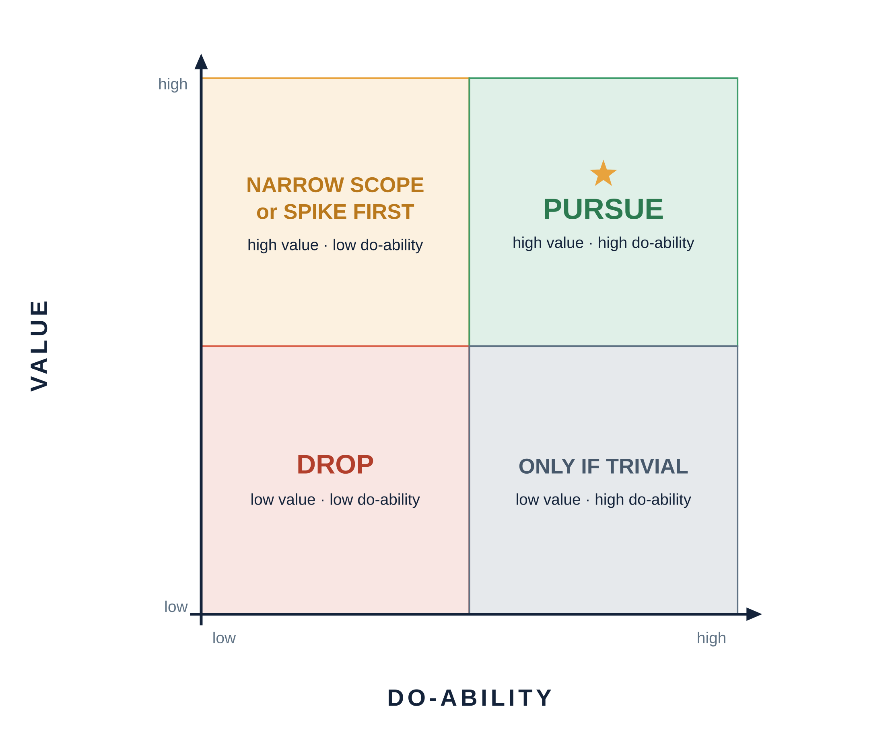
A GENERAL-PURPOSE TOOL
Plot each idea, then act by quadrant
Pursue
High value + high do-ability — your best candidates.
Narrow or spike
High value + low do-ability — shrink the scope or run a spike to raise do-ability.
Drop
Low value — drop it, however easy. Easy-but-pointless is still pointless.
7
CS 301R · Session 6 · Convergence Workshop
Notes:
The CPS convergence tool, and the same value/effort 2x2 the product world uses. Have them physically place each idea. The teaching point is the top-left: a high-value idea with low do-ability is not a reject — it's a 'narrow the scope or run a spike' idea, the exact move we'll demo on the two calibration candidates next. Low value is a drop regardless of how easy it is. This is the picture printed on their scoring sheet.

Slide 8


CALIBRATION · CANDIDATE A
ClassClock — thin, but easy
A browser extension that reads your class schedule and counts down to your next class.
Value
Do-ability
Richness
LOW
HIGH
FAILS
Your phone calendar already does this. No unmet need.
One data source, one screen — a weekend, ~200 lines.
One component. Finish it and there's nothing left to found.
Plots bottom-right — high do-ability, low value. Easy is not a reason. Drop it.
8
CS 301R · Session 6 · Convergence Workshop
Notes:
First calibration candidate — walk the evaluation aloud. It's tempting because it's easy and finishable, which is exactly the trap: high do-ability seduces. Score it live — low value (the need is already met), fails richness (one component, nothing to hand a contributor). It lands bottom-right on the 2x2, and low value means drop regardless of how quick it is. Set up the contrast: the next candidate is the opposite shape.

Slide 9

CALIBRATION · CANDIDATE B
CrowdDefense — rich, but scary
A platform that invites the world to help defend someone facing a serious legal problem — pooling volunteer expertise, research, funding, and documents around their case.
What it would take to build:
Structured case intake & representation
AI-assisted legal research & guidance
Crowd-sourced pro-bono research
Crowd funding & payments
Case document management
Court-system integration (filings, data)
— on top of a data platform, services, UX, and legal / accessibility compliance. Every one is a project on its own.
Value:
HIGH
Do-ability:
LOW
Richness:
VERY HIGH
Plots top-left — high value, low do-ability. Don't drop it. Narrow it.
9
CS 301R · Session 6 · Convergence Workshop
Notes:
Second candidate — the opposite shape, and the one that teaches the lesson. Don't describe it by scope or team size; describe it by the work. Read the six build components: each is a serious subsystem, which is exactly why richness is very high and do-ability, as-is, is low — no single team ships all of that soon. High value plus low do-ability lands top-left: the 2x2 says narrow or spike, not drop. Next slide does the narrowing.

Slide 10


CALIBRATION · THE MOVE
Narrow the rich idea to a slice you can ship
The v1 slice — one semester
Deferred → contributor work
A structured intake + document-assembly tool for one low-stakes case type (small-claims self-filing), with a queue where a volunteer reviews a submission.
AI guidance · crowd funding · more case types · court integration — the obvious, valuable next work you leave for the people who join.
That's the sweet spot: a rich core with a vertical slice you can actually ship — and finishing it leaves real work for others.
10
CS 301R · Session 6 · Convergence Workshop
Notes:
The payoff slide. The better founding bet was the scary one — but only after narrowing. Show the cut: v1 is one low-stakes case type with intake, document assembly, and a human review queue. Everything else — AI, funding, integrations — is deferred, and that's a feature, not a bug: it's the on-ramp for contributors. This is the shape you want them hunting for in their own ideas in the next 12 minutes.

Slide 11



WORKSHOP · PART 1
Now: score your own candidates
You just watched the yardstick run on two candidates. Turn it on your own 2–3 ideas — score them, then plot them.
Score, don't average
Circle a provisional top 1–2
The total is a conversation-starter. A fatal flaw on real need or feasibility outweighs a high score elsewhere.
Commit to a hunch before feedback — so you can tell whether the peer round actually changes your mind.
11
CS 301R · Session 6 · Convergence Workshop
Notes:
Short framing before hands-on. Two reminders that change how they score: first, don't just sum the columns — a fatal flaw on real need or feasibility kills an idea a high total can't rescue. Second, have them circle a provisional favorite before the feedback round, so they can actually observe whether peer input moves them. Then flip to the task slide and start the clock.

Slide 12
WORKSHOP · PART 1 · ~12 MIN
Score your candidates
Solo, on the Idea Scoring Sheet:
Score each of your 2–3 candidates on the seven criteria (1–3).
3 min
1
Plot each one on Value vs. Do-ability.
3 min
2
For each, note the single biggest risk — and if it's high-value / low-do-ability, how you'd shrink it to a slice.
4 min
3
Circle your provisional top 1–2 — before any feedback.
2 min
4
12
CS 301R · Session 6 · Convergence Workshop
Notes:
Leave this up while they work — 12 minutes, solo, on the Idea Scoring Sheet. Circulate: the most common miss is scoring for do-ability and forgetting real need and richness. Nudge anyone whose top pick is the easiest idea to re-check value. Keep the clock visible; call the last two minutes so everyone has a circled top 1–2 before the peer round.

Slide 13




WORKSHOP · PART 2
Peer feedback — how the round works
Groups of 3–4. A round-robin: everyone presents once, ~4 minutes each. Same three challenges for every idea.
Need real, user reachable?
Feasible at one-semester scope?
Rich enough to found on?
Is there a felt need, and can you actually reach the people who have it?
Is there a vertical slice you could ship at ~10 hrs/week?
Does it exercise multiple dimensions and leave room for others?
One protocol for every comment: affirm what's strong → name the sharpest concern → one concrete suggestion.
The presenter captures, doesn't defend — write it down; weigh it after.
13
CS 301R · Session 6 · Convergence Workshop
Notes:
Teach the process before starting the clock — it's printed in Part 3 of their scoring sheet. Three fixed challenges keep feedback substantive instead of vague praise. The protocol — affirm, concern, suggestion — keeps it constructive. The hardest rule to hold is 'capture, don't defend': presenters instinctively argue. Name it explicitly; their job is to collect, not to win. Put solo-track students in a group too so no one skips the round.

Slide 14
WORKSHOP · PART 2 · ~16 MIN
Peer feedback round
Groups of 3–4 · round-robin · ~4 min each:
Present (~90 sec): your top 1–2 — the user, the real need, why it scores well; the slice if it's high-value / low-do-ability.
1
Peers pressure-test on the three axes: need real & reachable? feasible at scope? rich enough?
2
Each comment: affirm what's strong → sharpest concern → one concrete suggestion.
3
Presenter captures, doesn't defend. Then rotate — until everyone has gone.
4
14
CS 301R · Session 6 · Convergence Workshop
Notes:
Leave this up for the full 16 minutes. Enforce the round-robin so quieter students present too. Circulate and add the instructor read where it helps most — especially real need and richness. Watch the clock: ~4 minutes per person; give groups a nudge to rotate so the last presenter isn't rushed. Keep presenters capturing rather than debating.

Slide 15


WORKSHOP · PART 3
Converge — pick 1–2 and commit
Weigh the scores and the feedback together, then commit to one or two ideas to carry forward.
Write a one-line rationale for each: it's for (who), who need (the real need); feasible because (scope / risk); rich because (dimensions it touches).
A working direction, not an irreversible vow. But from here, your discovery and proposal work focus here.
15
CS 301R · Session 6 · Convergence Workshop
Notes:
Bring the room back together for the decision. The rationale sentence is the deliverable — it forces them to name the user, the need, the feasibility read, and the richness in one breath. If they can't fill the blanks, they haven't converged yet. Reassure the anxious: this is a working direction they'll keep refining, not a vow — but from here their effort concentrates, which is the whole point of converging.

Slide 16
WORKSHOP · PART 3 · ~8 MIN
Commit + write your rationale
Weigh it, choose, and write it down:
Weigh the scores and the peer feedback together.
2 min
1
Commit to one or two ideas to carry forward.
2 min
2
Write the one-line rationale for each: who · the real need · why feasible · why rich.
4 min
3
16
CS 301R · Session 6 · Convergence Workshop
Notes:
Leave this up for the final 8 minutes. The rationale is the checkpoint — if the blanks won't fill, they haven't really converged; nudge them to pick anyway and note what they'd verify. Collect one or two rationales aloud, especially one where peer feedback changed the pick. Remind them this exact idea becomes CP2 over the weekend.

Slide 17





THIS WEEKEND
Your idea becomes the Product Definition Brief
The idea you just chose is what CP2 documents — a lightweight PRD (see resources/PRD-Reference.md). Five sections:
Target user
The needs
Prioritized needs
Sharply defined and bounded — who's in, who's out.
What they're trying to do; tagged [E] evidence / [A] assumption.
Must-have vs. nice-to-have, with a one-line rationale.
Success criteria
Open questions
Due Mon, Sep 28
Specific, observable definitions of "this works."
The biggest assumptions you'd still verify.
Written from today's pick + feedback. ~2 pages. Ground it in your Discovery Notes.
17
CS 301R · Session 6 · Convergence Workshop
Notes:
Walk the shape so no one leaves unsure what to write. Emphasize it's a definition of problem and user, not a solution — no architecture yet. The evidence tags [E]/[A] matter: honesty about what came from a real conversation vs. an assumption is graded as heavily as the findings. Point them to the PRD reference handout. The weekend gap is the point — the brief should reflect today's converged pick and the feedback, not a same-hour guess.

Slide 18

HOW CP2 IS GRADED
Product Definition Brief — the rubric
Criterion | Wt | What it measures
Target user clarity | 20 | Userbase sharply defined and bounded — not "everyone."
Needfinding quality & honesty | 30 | Interviews and/or a documented persona; honesty about method graded as heavily as the findings.
Prioritized needs | 20 | Must-have vs. nice-to-have, with a defensible rationale.
Success criteria | 20 | Specific, observable, defensible definitions of "this works."
PRD mapping | 10 | Reads like a lightweight PRD — problem and user, not a solution.
Needfinding carries the most weight (30) — reach at least Developing on every criterion to stay on a passing track.
18
CS 301R · Session 6 · Convergence Workshop
Notes:
Show the rubric so students write toward it, not blind. The highlighted row is where the grade concentrates — needfinding quality and honesty at 30 points. Say plainly that a brief built honestly on thin evidence beats one that dresses guesses as facts: honesty about method is graded as heavily as the findings. PRD mapping means it reads as a problem/user definition, not a design. Every criterion must clear Developing to stay on a passing track.

Slide 19
You converged deliberately — against a shared yardstick, with feedback.
Now you can defend your pick.
BEFORE MONDAY, SEP 28
Turn in CP1 Idea Briefs today
Write CP2 Product Definition Brief from your converged pick + feedback — due Mon, Sep 28
Keep doing discovery on your chosen idea — more real input now makes the proposal stronger
Notes:
Close on the one-liner — the whole session in a sentence: you narrowed on purpose, so you can defend the choice. Make the actions concrete: CP1 in today, CP2 written this weekend from the converged pick, discovery continues. Preview Week 4 briefly — proposal anatomy and arguing feasibility without overpromising; CP3 Written Proposal is due Mon, Oct 5. Send them off to write.

