Slide 1

CS 301R · SOFTWARE ENGINEERING STUDIO I
Draw the System
Session 12 — architecture & data-flow workshop
Wednesday, October 14, 2026

Slide 2


BEFORE WE START
The design document — and what today produces
What it is
What you leave with
Decides how you'll build it — and why this how
Written for a builder: your teammates, and the contributor who joins in January
Three to six pages plus diagrams, on the course template
A system-context diagram and a component diagram
One core flow traced end to end — and traced again when it breaks
A first-cut data model, and two decisions argued against real alternatives
Monday you read a design document and took one apart. Today you build the hard 80% of yours, on a whiteboard, in 57 minutes.
2
CS 301R · Session 12 · Architecture Workshop

Slide 3


WHERE TODAY COMES FROM
You have drawn every one of these before
CS 240 · chess
CS 340 · Tweeter
Seven sequence diagrams, one per endpoint
Server → Handlers → Services → DAOs → Database
ERDs — entities, primary and foreign keys, one-to-many and many-to-many
UML class and sequence diagrams
Clean Architecture — layers, the dependency rule
Patterns, and the trade-offs behind them
Both times, the architecture arrived with the assignment.
What you have never done is decide what goes in the boxes.
3
CS 301R · Session 12 · Architecture Workshop

Slide 4



THE ONE ADJUSTMENT
Everything today is one level up
What you're used to
What today is
Class-level. Objects, methods, lifelines, inheritance. The inside of one program.
System-level. Components, stores, services, boundaries. How whole pieces fit together.
ChessBoard · ChessPiece · UserDAO
the catalog · the photo store · the theater's wifi
Same notation instincts, one level up. If a box on your board has a method list, you dropped a level.
4
CS 301R · Session 12 · Architecture Workshop

Slide 5





THE PLAN
Five rounds — and the draft writes itself tonight
1 · System context
Template §3
10 min
2 · Components & interfaces
Template §4
15 min
3 · Trace one core flow
Template §4
12 min
4 · Data model, first cut
Template §5
10 min
5 · Decisions & alternatives
Template §6
10 min
Each round fills a numbered section of the template, in order. Tonight is transcription, not composition.
5
CS 301R · Session 12 · Architecture Workshop

Slide 6


TWO RULES FOR THE ROOM
They apply to every board, every round
Every box has a job.
Written on the box, in one sentence. If the sentence needs an "and," that's two boxes.
Every arrow carries something nameable.
If you can't label it, you haven't found a drawing problem — you've found a design question.
Marker on a board. Not a diagramming tool, not UML syntax — nothing gets typed until it gets photographed.
6
CS 301R · Session 12 · Architecture Workshop

Slide 7



THE TARGET
Backstage — the costume catalog from the sample proposals
We work from one project all session — the costume catalog whose design document you dissect on Monday. You already know the domain, so none of today goes on learning it.
Same project, start to finish
The same costume catalog you met in the Session 7 sample proposals and take apart again on Monday. Working from a project you already know means no minute of the workshop goes on learning a new domain.
Monday's version, and then the fix
In class you'll see each of its diagrams the way that team actually drew them — and then the version that answers what you found wrong with it.
7
CS 301R · Session 12 · Architecture Workshop

Slide 8
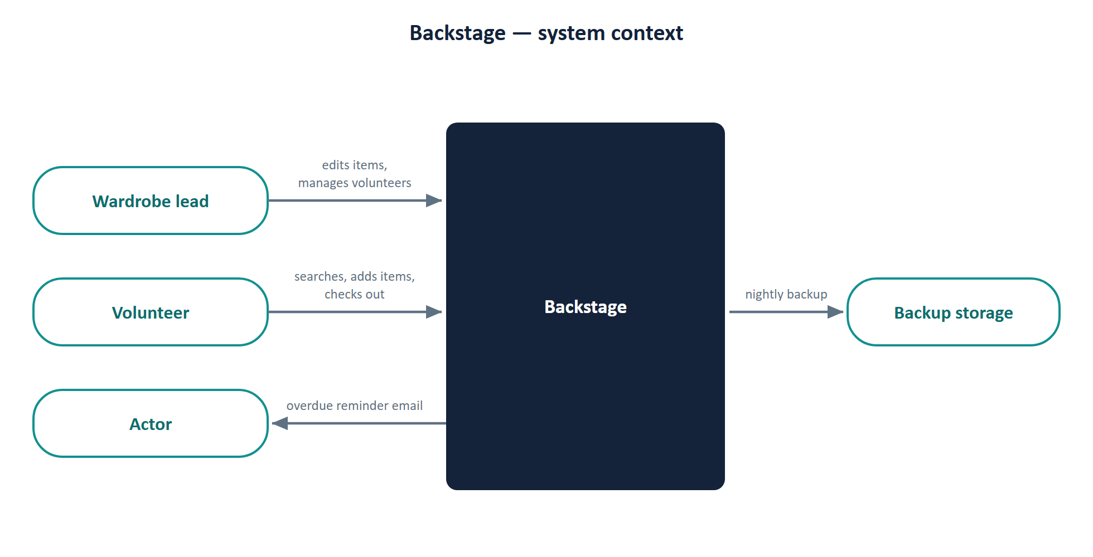
THE TARGET · ROUND 1
System context
Monday's sample, §3 — the diagram as the team drew it
8
CS 301R · Session 12 · Architecture Workshop

Slide 9
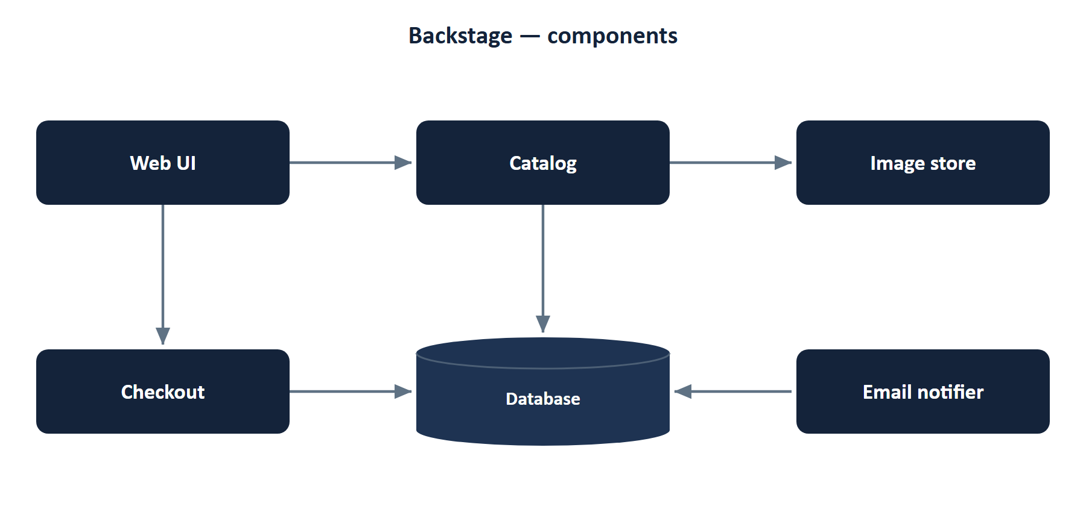
THE TARGET · ROUND 2
Components and interfaces
Monday's sample, §4 — the component diagram as that team drew it
9
CS 301R · Session 12 · Architecture Workshop

Slide 10
THE TARGET · ROUND 3
One core flow, traced — and broken
Monday's sample, §4 — the core-flow section, in full
Core flow, traced end to end: a volunteer checks out a costume
The volunteer searches “bustle” in the Web UI.
Catalog queries the database and returns matching items with photos and bin locations.
The volunteer opens an item and taps Check out, choosing the actor and show from lists and a due date.
Checkout writes a checkout record and marks the item as out.
The Web UI shows the item as out, with the actor's name and due date.
The failure case
“If a request fails, the user sees an error message and can try again.”
10
CS 301R · Session 12 · Architecture Workshop

Slide 11
THE TARGET · ROUND 4
Data model, first cut
Monday's sample, §5 — the data-model section, in full
Entity table: Item · Bin · Show · Person · Checkout · PullList — key fields, relationships, MVP or roadmap.
“The Item table in full:”
id bigint no auto primary key
name varchar(120) no — indexed
category varchar(40) no 'costume' choices in constants.py
size_label varchar(20) yes NULL free text
chest_in numeric(5,2) yes NULL
… and seven more rows
“Search, as implemented:”
def search(request):
q = request.GET.get("q", "").strip()
items = Item.objects.all() # … and eleven more lines
11
CS 301R · Session 12 · Architecture Workshop

Slide 12



ROUND 1 · THE WORDS
System context — four terms
System boundary
Actor / user role
Everything you will build, own, and can change. If fixing it means filing a bug with someone else, it belongs outside the box.
A kind of person, named by their job — not a name. The admin and the setup person count.
External dependency
Boundary arrow
An API, an auth provider, email, hosting, the app store, GitHub itself. Anything you need and don't control.
One direction, labeled with the noun that crosses: "photo upload," "overdue reminder." Never "communicates with."
Nothing in CS 240 or CS 340 ever asked you where your system ends. That's what makes this the hard one.
12
CS 301R · Session 12 · Architecture Workshop

Slide 13
ROUND 1 · 10 MIN · TEAMS
Draw the boundary
Your whole system as ONE box. Every user role and every external service around it. Label every arrow with what crosses.
Who are all your user types? Go back to your Product Definition Brief — then add the ones nobody lists: the admin, the person who does setup, you as maintainer.
1
What do you depend on that you don't control? Include the boring ones: email delivery, hosting, the identity provider.
2
What does each arrow actually carry? Read one out loud as a sentence: "the borrower sends ___ to the system."
3
The test: if it vanished tomorrow, would you have to change code? Then it goes outside the box.
13
CS 301R · Session 12 · Architecture Workshop

Slide 14



ROUND 2 · THE WORDS
Components & interfaces — four terms
Component
Responsibility
One responsibility, one interface, and a name you could put on a contributor's first task. Not a class — it contains classes.
One sentence. One reason to change. Chess had five: server, handlers, services, data access, database.
Interface
State owner
An in-process call, HTTP + JSON, a WebSocket, a queue, a scheduled job, a file drop. Rough is the right amount.
Exactly one box may write each kind of data. Point at it — if your finger lands between two boxes, that's the design question.
Three to six boxes. Fifteen means a class diagram; two called "frontend" and "backend" means you haven't started.
14
CS 301R · Session 12 · Architecture Workshop

Slide 15
ROUND 2 · 15 MIN · TEAMS
Open the box
Three to six components, each with a one-line job written on it. Draw the arrows between them and name what each one carries.
1
Say what your system does in one sentence — then break that sentence at every "and." Those are your components.
2
What's the first self-contained piece of work you'd hand a new contributor? That's a component, and it's a good first issue.
3
For each arrow: is this a function call, an HTTP request, a queue, or a scheduled job? Rough answers are fine; "don't know" is a finding.
4
Point at the box that owns each kind of data. Every piece of state gets exactly one owner.
Three smells to watch for on your own board: the God component · the mystery arrow · data that no box owns.
15
CS 301R · Session 12 · Architecture Workshop

Slide 16

ROUND 3 · THE WORDS
One flow, end to end
Core flow
The trace
The failure case
The one action that, if it didn't work, would make the product pointless. Not the most complex one. Signup is never it.
Start at the user's finger, end at what the user sees. Numbered steps across the boxes you just drew.
The failures that aren't your code: the service is down, the network drops mid-action, two people act in the same second.
You did this seven times in CS 240 — one sequence diagram per chess endpoint. Same move, one flow, no tool.
16
CS 301R · Session 12 · Architecture Workshop

Slide 17
ROUND 3 · 12 MIN · TEAMS
Trace it, then break it
Number the steps of your single most important user action across your boxes. Then trace it again in red, when something breaks.
1
Start at the user's finger. What do they tap, and what do they see one second later?
2
If the trace needs a box you don't have, add it. If it skips half your boxes, ask whether those are MVP or roadmap.
3
Now in red: pick one thing outside your box from Round 1, turn it off, and trace it again.
4
What does the person see, and what can they do next? "Show an error" is not an answer.
This flow is your vertical slice — milestone 1, and what you demo in November. Choose it on purpose.
17
CS 301R · Session 12 · Architecture Workshop

Slide 18



ROUND 4 · THE WORDS
Data model — four reminders
Entity
Key fields
Something the system must remember between visits. Usually a noun your user would recognize. Screens are not entities.
The identifier plus the three to five that matter. Not the column dump — that was Monday's over-specification defect.
Relationships
MVP or roadmap
One-to-one, one-to-many, many-to-many — and draw the join. Same notation as CS 240, less ceremony.
Solid border or dashed. The dashed ones are a scope decision showing up in your data model.
Chose a document store after CS 340? Entities and relationships still come first; access patterns come second.
18
CS 301R · Session 12 · Architecture Workshop

Slide 19
ROUND 4 · 10 MIN · TEAMS
What the system remembers
Entities, key fields, relationships — boxes and labelled lines on a whiteboard. Then walk your Round 3 trace across them and check.
1
What does the user see a list of? That's usually an entity. What has to survive between two visits?
2
Every step in your trace that reads or writes data must land on an entity. Walk it and point.
3
Every entity must be touched by something. If nothing touches it, it's a roadmap feature that snuck in — dash it.
4
Which entities exist only for features you already called roadmap? Dashed border, and out of the MVP schema.
Five to eight boxes is a semester. Fourteen is a scope problem you just found for free.
19
CS 301R · Session 12 · Architecture Workshop

Slide 20


ROUND 5 · THE WORDS
A decision, in five lines
Chosen
The option you're going with.
Alternative considered
One a reasonable team down the hall would actually have picked. A straw man fools nobody.
Why it wins, given our goals
Against YOUR goals and non-goals — not against generic virtues like "it's faster."
Evidence
A spike, a benchmark, prior experience — or honestly "none yet." Unlabeled is the only wrong answer.
What would change our mind
Ten seconds to write. It's what separates a decision from a commitment.
Straight out of template §6. Write the five lines and you've drafted the section.
20
CS 301R · Session 12 · Architecture Workshop

Slide 21
ROUND 5 · 10 MIN · TEAMS
Argue two decisions
Your two biggest decisions, five lines each. Three sentences of thinking per decision — this is §6 of the template, drafting itself.
1
Stuck on which? Name the choice you'd be most annoyed to have to redo in November. That's decision one.
2
Finish this sentence: "A reasonable team might have picked ___ instead, and here's why we didn't."
3
Is your reason about your users, your team, or the five weeks? If it's none of the three, it isn't a reason yet.
4
What would have to be true for you to switch? Write it down — that's the last line.
Real criteria here: what your team knows · what five weeks can absorb · what your user's setting requires · what a contributor can install.
21
CS 301R · Session 12 · Architecture Workshop

Slide 22

Photograph every board before anyone erases anything.
Everything, not just the neat parts.
Red failure arrows and parked ideas too — those become your risks section.
Name a person per section, out loud.
§3 context · §4 components + flow · §5 data · §6 decisions. Four sections, four names.
A photo of a whiteboard is a legitimate diagram for the draft. The boards are the work — tonight is transcription.
22
CS 301R · Session 12 · Architecture Workshop

Slide 23



BEFORE NEXT CLASS
What's due, and what's coming
Design Document draft — end of day tomorrow, Thu, Oct 15
Photographed diagrams + skeleton prose + your two argued decisions. That's a complete draft.
Monday, Oct 19
Git for maintainers — the branching and PR discipline you'll run to December.
Wednesday, Oct 21
CP5 — Design Document (revised), due end of day, alongside CP6 — Git Workflow Lab.
Draft, review, revise — the same loop as the proposal. The revision is what's graded.
23
CS 301R · Session 12 · Architecture Workshop

