Slide 1
WEEK 7
Patch Management and Change Enablement
Prioritize · deploy · verify · recover · review
CYBER 444 · Systems & Network Administration
Fall 2026

Slide 2
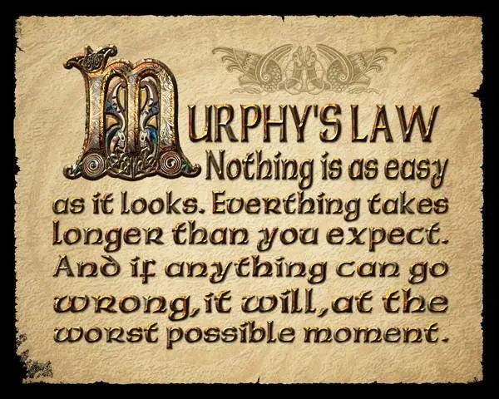

Slide 3
BEFORE THE CHANGE
Capture a baseline before touching packages
You need a way to explain what changed and what to restore.
VERSION
HEALTH
SECURITY
RECOVERY
packages + running kernel
service checks + error rate
scan + baseline
backup and rollback decision
Preflight question
What observation would tell you the change made the service worse?

Slide 4
INVENTORY
You cannot patch what you cannot locate
Know the asset, owner, software version, exposure, and dependency.
ASSET
OWNER
EXPOSURE
DEPENDENCY
What runs?
Which version?
Who accepts risk?
Who deploys?
Internet?
CDE?
Privilege?
What breaks if it restarts?
Discussion
Which missing inventory field most often makes a patch window fail?

Slide 5
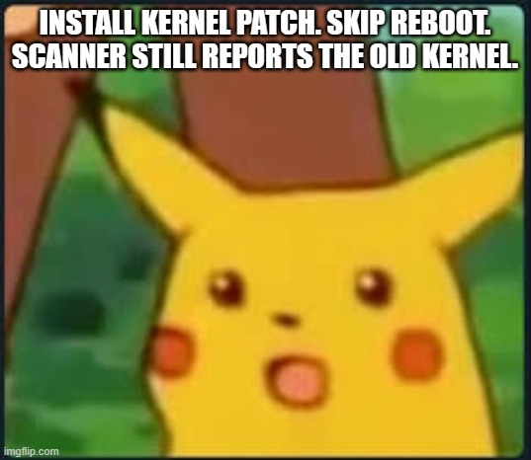
LIFECYCLE
A patch is a lifecycle, not a command
Every stage produces evidence needed by the next decision.
Discover
Rank
Test
Deploy
Verify
asset + advisory
risk + SLA
staging + plan
change + rollout
health + rescan
Evidence trail
A successful installer exit code is only one piece of the final decision.
Notes:
Walk around the lifecycle twice: first for a routine security fix, then for an actively exploited issue. NIST describes identifying, prioritizing, acquiring, installing, and verifying. This teaching sequence also includes change authorization and recovery. Ask where an unpatched exception enters and how it expires.

Slide 6
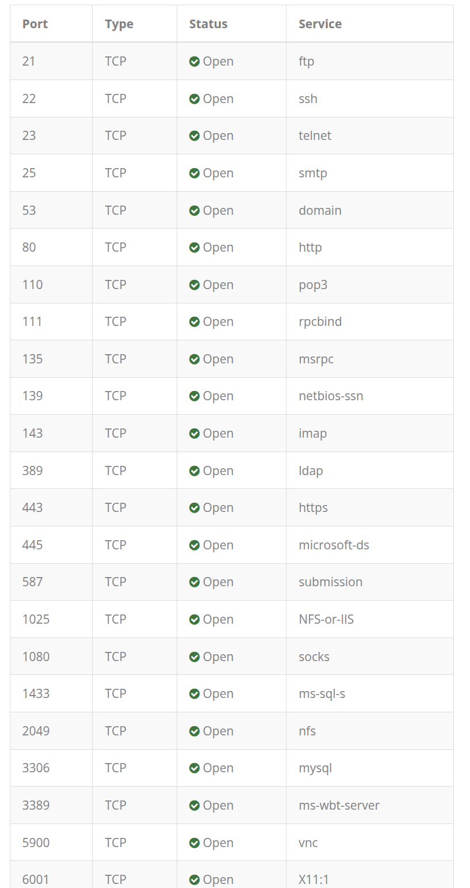
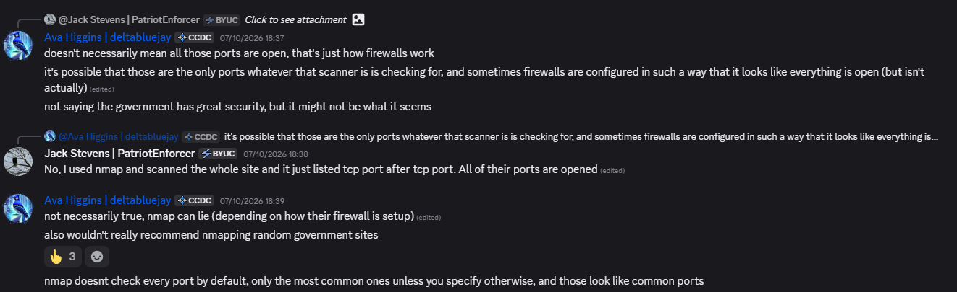
Credentialed and uncredentialed scans answer different questions

Slide 7
Credentialed and uncredentialed scans answer different questions
External visibility and package inventory complement each other.
UNAUTHENTICATED
CREDENTIALED
EXTERNAL Approved Scanning Vendor
What can a network observer see?
What versions and settings are installed?
Who performs the required external scan?

Slide 8
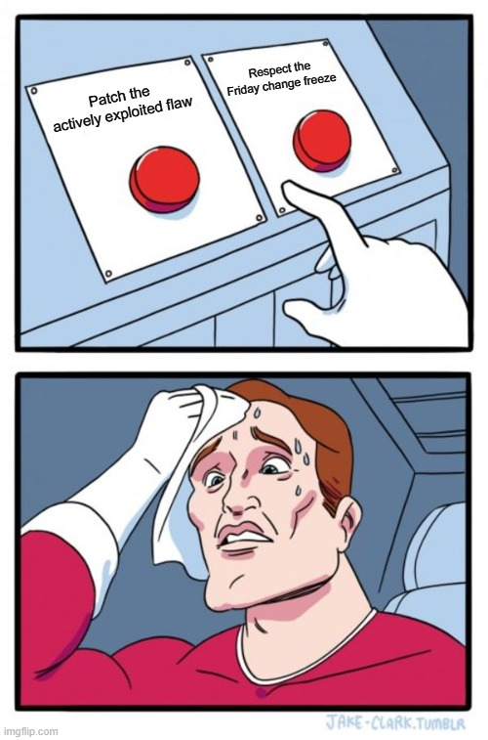
Friday at 4:00 PM: patch or wait?
A service has a newly disclosed vulnerability. A change freeze begins at 5:00 PM.
SECURITY
OPERATIONS
MEDIA SLOT
Known exploitation
Payment-facing asset
Friday deployment
Limited staff coverage
Next Window is in two weeks
Quick vote
Patch now, mitigate until morning, or wait for the next window? What fact would change your vote?

Slide 9
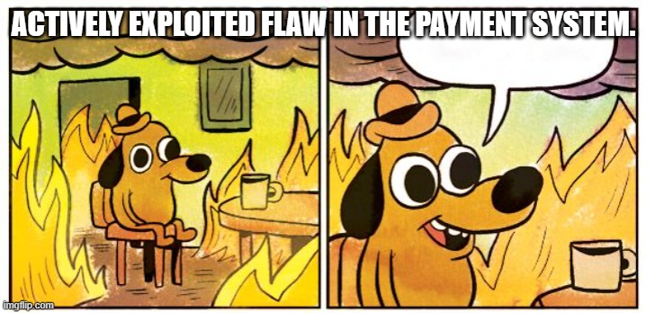
Known exploitation changes the queue
KEV
Vendor
Asset
Owner
exploitation observed
fix or mitigation
affected + exposed?
emergency decision
Decision
A calendar does not turn an actively exploited exposure into routine work.

Slide 10
TRIAGE
A practical patch priority framework
Use one written rule so two analysts reach a similar decision.
Applicability
Affected product, vulnerable build, vendor advisory
Threat
KEV, active exploitation, exploit availability
Exposure
Internet path, reachable service, privilege level
Impact
CDE, critical service, safety or availability
Action
Patch, mitigate, exception, owner, deadline

Slide 11
FINDING TRIAGE
A finding must be confirmed before closure is claimed
Keep false positives and accepted risk distinct.
Finding
Confirm
Act
Verify
scanner assertion
version + context
patch or mitigate
rescan + service test
Evidence rule
A passing scan without a healthy service is not a successful change.

Slide 12
LINUX: AUTOMATION
Ubuntu unattended-upgrades needs an operating policy
Automated install is useful only when exceptions and reboot behavior are explicit.
Scope
Which repositories and update classes are allowed?
Timing
When may installation and reboot occur?
Exceptions
Which packages need manual testing?
Evidence
Where are logs and failure alerts sent?
Recovery
Who owns a failed unattended update?

Slide 13
WINDOWS: WSUS
WSUS uses groups and approvals to stage Windows updates
The rollout still needs tests, restart coordination, and closure evidence.
Sync
Pilot
Broad
Verify
update catalog
test group approval
staged approval
install + reboot
Current product note
WSUS is supported for existing production use but is no longer receiving new features.

Slide 14
STAGING
Patch rings reduce the size of a bad surprise
Move from representative systems to critical production deliberately.
Lab
Staging
Pilot
Fleet
basic install test
realistic dependencies
small production ring
wider deployment
Gate
Advance only after health, security, and rollback checks pass for the current ring.

Slide 15
TEST GATES
Test the service outcome, not only the install
A change has both security and availability acceptance criteria.
Security
Affected version or advisory is remediated
Service
Synthetic transaction passes
Dependency
Database, auth, and upstream calls work
Telemetry
Error rate and latency stay within gate
Recovery
Rollback path remains available
Notes:
Build a test checklist with the class: package installed, process restarted or host rebooted, application endpoint healthy, authentication path working, logs acceptable, dependencies connected, monitoring quiet, and vulnerability absent in a post-change check. Discuss failure thresholds and who can stop the rollout. Use a small synthetic transaction rather than a vague “looks good.”
Citations:
- NIST SP 800-40 Rev. 4, https://csrc.nist.gov/pubs/sp/800/40/r4/final

Slide 16
KUBERNETES
Roll an application update one Pod at a time
A Deployment can add one new Pod, wait for readiness, then retire an old one.
BEFORE
DURING
AFTER
A A A
3 ready replicas
A A A B
B must become ready
B B B
3 ready replicas
strategy: RollingUpdate maxSurge: 1 maxUnavailable: 0
Notes:
Use a three-replica Deployment as the example. Explain `maxSurge: 1` permits one extra Pod above the desired replica count and `maxUnavailable: 0` aims to keep the desired number available during the update. A readiness probe and Service routing are essential to meaningful availability. Demonstrate `kubectl rollout status deployment/payments` and `kubectl rollout undo deployment/payments`. A Deployment rollout replaces application Pods; it does not patch Kubernetes node operating systems. Avoid promising zero downtime without considering startup, shutdown, capacity, and app compatibility.

Slide 17
CLOSURE
Rescan with comparable settings
Report what closed, what remains, and what broke.
Closed
Finding no longer detected and service healthy
Still open
Confirm version, restart, and detection logic
New finding
Investigate package or configuration change
Exception
Owner, mitigation, approval, and expiry
Evidence
Record scan IDs and change outcome
Notes:
Use the same target scope and similar scan configuration before and after patching. Compare CVEs and severity, then confirm application health and running versions. A scan finding may persist because of a false positive, a backport detection gap, a failed restart, or an incomplete patch. Require evidence before closing the ticket. In the course lab the scanner itself retains the pre- and post-patch reports.
Citations:
- NIST SP 800-40 Rev. 4, https://csrc.nist.gov/pubs/sp/800/40/r4/final
- /opt/byu-cyber-444.github.io/labs/copies/lab-07.md

Slide 18
ROLLBACK
Choose the recovery layer before the change
Package, application, image, traffic, and backup rollback are different.
FAST
PACKAGE
IMAGE
RESTORE
Stop rollout
Shift traffic
Downgrade or undo transaction
Revert application revision
Recover system or data state
Plan quality
The rollback procedure must say who decides, what triggers it, and how recovery is verified.
Notes:
Compare rollback options: package downgrade or transaction undo; previous container image; traffic shift; known-good system image; restore of data or configuration. Each has a different recovery time and data risk. A database schema change may make application rollback nontrivial. In the current lab, snapshot restore is forbidden by grading rules, so present it only as a production design concept and not an action for students to take there.
Citations:
- NIST SP 800-40 Rev. 4, https://csrc.nist.gov/pubs/sp/800/40/r4/final
- /opt/byu-cyber-444.github.io/labs/copies/lab-07.md
- Kubernetes rolling update tutorial, https://kubernetes.io/docs/tutorials/kubernetes-basics/update/update-intro/

Slide 19
GROUP ACTIVITY
The security fix broke the payment API
Pick the next action and defend the threshold.
Pilot API: vulnerability closed; 8% of test payments fail. What do you do?
Pause at the pilot while checking the failure threshold
Roll back the pilot and apply a temporary mitigation
Continue briefly under a tightly monitored canary gate
GROUP DISCUSSION

