Slide 1
WEEK 8 · PROJECTS + DESIGN
Final Projects & Data Center Design
Choose a capstone · analyze one small facility together
CYBER 444 · Systems & Network Administration
October 20 & 22, 2026
Notes:
Launch the final projects first, retaining the published end-of-Week-9 proposal deadline. Then introduce the fictional two-rack facility for board calculations and cover the 18 chapters of the Keentel Engineering guide. Instructor-led activities are done on the board rather than on separate slides.
Citations:
- /opt/byu-cyber-444.github.io/final-project-cyber/index.md
- /opt/byu-cyber-444.github.io/final-project-it/index.md
- Keentel Engineering, Data Center Design Guide, https://keentelengineering.com/data-center-design-guide
- /opt/byu-cyber-444.github.io/schedule/week-08.md

Slide 2
CYBER OPTIONS
Six Cyber projects: choose a system to secure
Each option requires meaningful Linux and Windows Server roles.
C1
Hardened infrastructure — CIS Level 2 or DISA STIG
C2
Zero-trust identity and PKI platform
C3
Detection engineering / SOC-in-a-Box
C4
Compliance-as-Code pipeline
C5
Secure container platform
C6
Patch and vulnerability management program
Notes:
Ask students to identify which option best uses the skills and infrastructure they already have. The Cyber overview lists all six options. Every Cyber project includes at least one Linux system and one Windows Server system doing real work; both appear in automation, diagram, documentation, and demo.
Citations:
- /opt/byu-cyber-444.github.io/final-project-cyber/index.md

Slide 3
IT OPTIONS
Five IT projects: choose an operations problem
All IT options run in the student’s own Proxmox environment.
I1
HA platform with backup and disaster recovery
I2
Monitoring and service desk
I3
On-prem AI inference service
I4
Identity and endpoint lifecycle
I5
Self-service provisioning and golden images
Selection lens
Which option fits your available RAM, time, and evidence you can capture?
Notes:
Invite students to compare operational value, resource load, and evidence burden. The IT overview says these projects can run in the student’s own Proxmox lab; no cloud account is required. Most options use Valley Medical Group as the scenario organization.
Citations:
- /opt/byu-cyber-444.github.io/final-project-it/index.md

Slide 4
PROPOSAL
A passing proposal makes the build concrete
Submit one PDF in Learning Suite by October 29th
Option + team
Name the option; pairs identify each person’s ownership
Scope
Answer every checklist item on the chosen option page
Infrastructure
Hostnames, OS, roles, addresses, RAM, disk, and heaviest service
Tools
Name and justify automation, test/scan, and evidence tools
Milestones
Specific outputs for Weeks 10, 11, 12, and 14
Notes:
Both proposal pages require all five sections and specific answers. Week 13 is Thanksgiving break with no deliverable. The Cyber proposal additionally requires at least one Linux and one Windows Server system and the Windows role. A failed proposal must be revised and passed before project credit can be received. Do not imply the Week 8 launch changes the deadline.
Citations:
- /opt/byu-cyber-444.github.io/final-project-cyber/proposal.md
- /opt/byu-cyber-444.github.io/final-project-it/proposal.md

Slide 5
CLASS SCENARIO
The small data center: starting loads
Use this fictional facility for board calculations and outage tests.
STARTING TOPOLOGY · use for board calculations
EQUIPMENT + LOADS
UTILITY
GENERATOR
DUAL PSU IT
4 compute 4.0 kW; storage 1.5 kW
25 kW usable
15 kW
A ONLY
ATS + PANEL
switch 0.5 kW; backup NAS 0.8 kW
B ONLY
switch 0.5 kW
A PATH
B PATH
COOLING
2 CRACs; each draws 4 kW, removes 8 kW
UPS 9 kW · PDU 8 kW
UPS 9 kW · PDU 8 kW
OTHER
lights / facility 0.7 kW
Dual-powered core + single-cord devices

Slide 6
CHAPTER 1
The data center converts power into heat
Follow energy from the service entrance to IT and then back outdoors.
POWER IN
CONVERT
HEAT OUT
Utility and generator
Servers do work
Cooling ejects heat

Slide 7
CHAPTER 2
Three imperatives: power, cooling, operation
A working data center keeps all three available through planned and unplanned events.
CONTINUOUS POWER
CONTINUOUS COOLING
CONTINUOUS OPERATION
Condition supply and bridge outages
Remove heat while IT operates
Maintain and repair without avoidable downtime

Slide 8
CHAPTER 3
A data center is not an office building
Its load and heat persist around the clock, so operating practices are part of design.
LOAD
FAILURE
OPERATIONS
IT and cooling run continuously
Power or cooling loss threatens services quickly
Access, maintenance, and response need plans

Slide 9
CHAPTER 4
From grid to fence: utility supply
A service connection has a capacity, route, protection, and approval process.
UTILITY
SERVICE
SITE
Available capacity
Meter + switchgear
Protected distribution

Slide 10
CHAPTER 5
On-site chain: switchgear to rack
Every stage needs a capacity and a way to isolate faults.
PANEL
UPS
PDU
IT
Protection and branching
Condition and bridge
Distribute to racks
Dual or single supply

Slide 11
CHAPTER 6
UPS: condition power and bridge outages
A double-conversion UPS keeps the inverter feeding the critical load.
RECTIFIER
BATTERY
INVERTER
AC to DC
Short-duration stored energy
DC to regulated AC

Slide 12
CHAPTER 7
Generator: the long outage handoff
UPS bridges the start and transfer; generator capacity must include the chosen cooling load.
UTILITY LOSS
START
TRANSFER
RESTORE
UPS holds IT
Generator stabilizes
ATS feeds panel
UPS returns to input power

Slide 13
CHAPTER 8
Power studies prove the paths will work
Capacity, fault current, breaker selectivity, and maintenance safety need engineering.
LOAD FLOW
FAULT + COORDINATION
ARC FLASH
Check normal and contingency loading
Interrupt and isolate the right branch
Understand maintenance hazards

Slide 14
CHAPTER 9
Every IT watt becomes a cooling problem
Airflow must carry rack heat to the cooling equipment without hot-air recirculation.
IT HEAT
AIR PATH
LEAKS
Measured IT kW sets sensible heat load
Cold intake → hot exhaust
Blanking and sealing protect the path

Slide 15
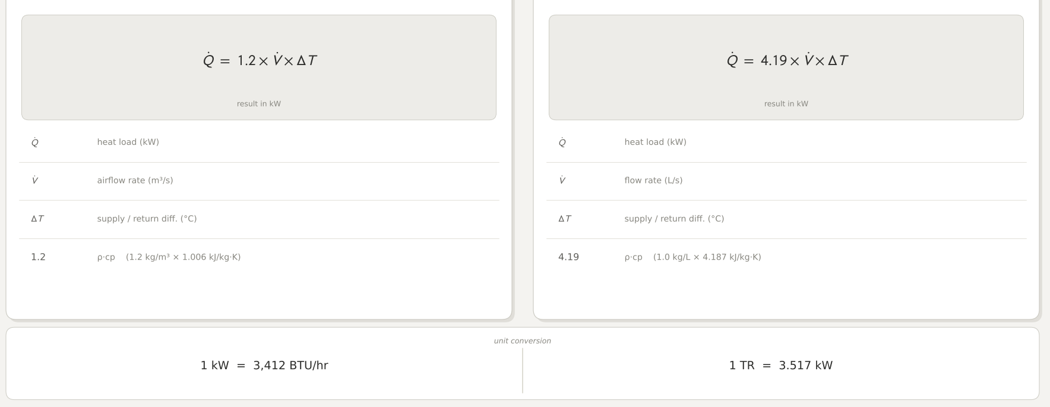

Slide 16
CHAPTER 10
Containment keeps supply and return apart
Cold-aisle and hot-aisle schemes close the mixing path.
COLD AISLE
HOT AISLE
SEALING
Enclose rack fronts and supply air
Enclose rack backs and exhaust
Doors, panels, and blanks close gaps

Slide 17
CHAPTER 11
Cooling units can serve room, row, or rack
CRAC creates refrigeration locally; CRAH transfers cooling from chilled water.
CRAC
CRAH
IN-ROW / RACK
Self-contained refrigeration circuit
Air handler supplied by chilled-water plant
Cooling close to concentrated heat

Slide 18
CHAPTER 12
Chilled water moves heat across the facility
A chiller, pumps, and CRAH coils create a shared cooling loop.
CHILLER
PUMP
CRAH
RETURN
Cool the water
Deliver to coils
Take room heat
Warm water back

Slide 19
CHAPTER 13
Heat must leave the building
Air-cooled, water-cooled, and economizer modes trade electricity, water, and complexity.
AIR-COOLED
WATER-COOLED
ECONOMIZER
Eject outdoors with fans and coils
Evaporation and water treatment
Use favorable outdoor conditions

Slide 20
CHAPTER 14
Liquid cooling addresses concentrated heat
Direct-to-chip and immersion serve densities where air delivery becomes difficult.
DIRECT-TO-CHIP
IMMERSION
HYBRID
Cold plates take heat from processors
Dielectric fluid surrounds hardware
Residual components still need air

Slide 21
CHAPTER 15
Redundancy is a whole-system claim
Uptime Institute Tiers describe whole-facility topology and behavior.
TIER I
Basic capacity
TIER II
Redundant capacity components
TIER III
Concurrently maintainable
TIER IV
Fault tolerant
Design language
N+1 and 2N are component patterns; a Tier has no fixed availability “nines” value.

Slide 22
CHAPTER 16
Controls make power and cooling act together
Monitoring, alarms, and automation turn components into an operating system.
BMS
EPMS
DCIM
Stage cooling and track environment
Watch breakers, UPS, generator, and power
Relate facility status to IT/rack load

Slide 23
CHAPTER 17
Site viability precedes equipment choice
Grid capacity and an achievable energization path limit the design envelope.
CAPACITY
TIMING
GROWTH
Usable utility service and margin
Upgrade or connection lead time
Phased load plan

Slide 24
CHAPTER 18
Integrate the power and cooling design
One load figure must agree across UPS, distribution, generator, cooling, and site service.
IT LOAD
POWER
COOLING
CONTROL
SITE
Rack schedule
A/B + generator
One-unit-down heat path
Alarm and transfer rules
Capacity and residual risk

