Slide 1
WEEK 6
PAM, MFA, and Enterprise Policy
Identity · privileged access · policy as an enforcement mechanism
CYBER 444 · Systems & Network Administration
Fall 2026
Notes:
Opening intent: Week 6 moves from identity proof into MFA, privileged access, and organizational policy.
Ask: What has to be true before a privileged session should begin?
Expected themes: authenticated identity, trusted device, authorized action, monitored session, and policy-backed accountability.
Citations:
- NIST SP 800-207, https://csrc.nist.gov/pubs/sp/800/207/final
- NIST SP 800-53 Rev. 5, https://csrc.nist.gov/pubs/sp/800/53/rev-5/final

Slide 2
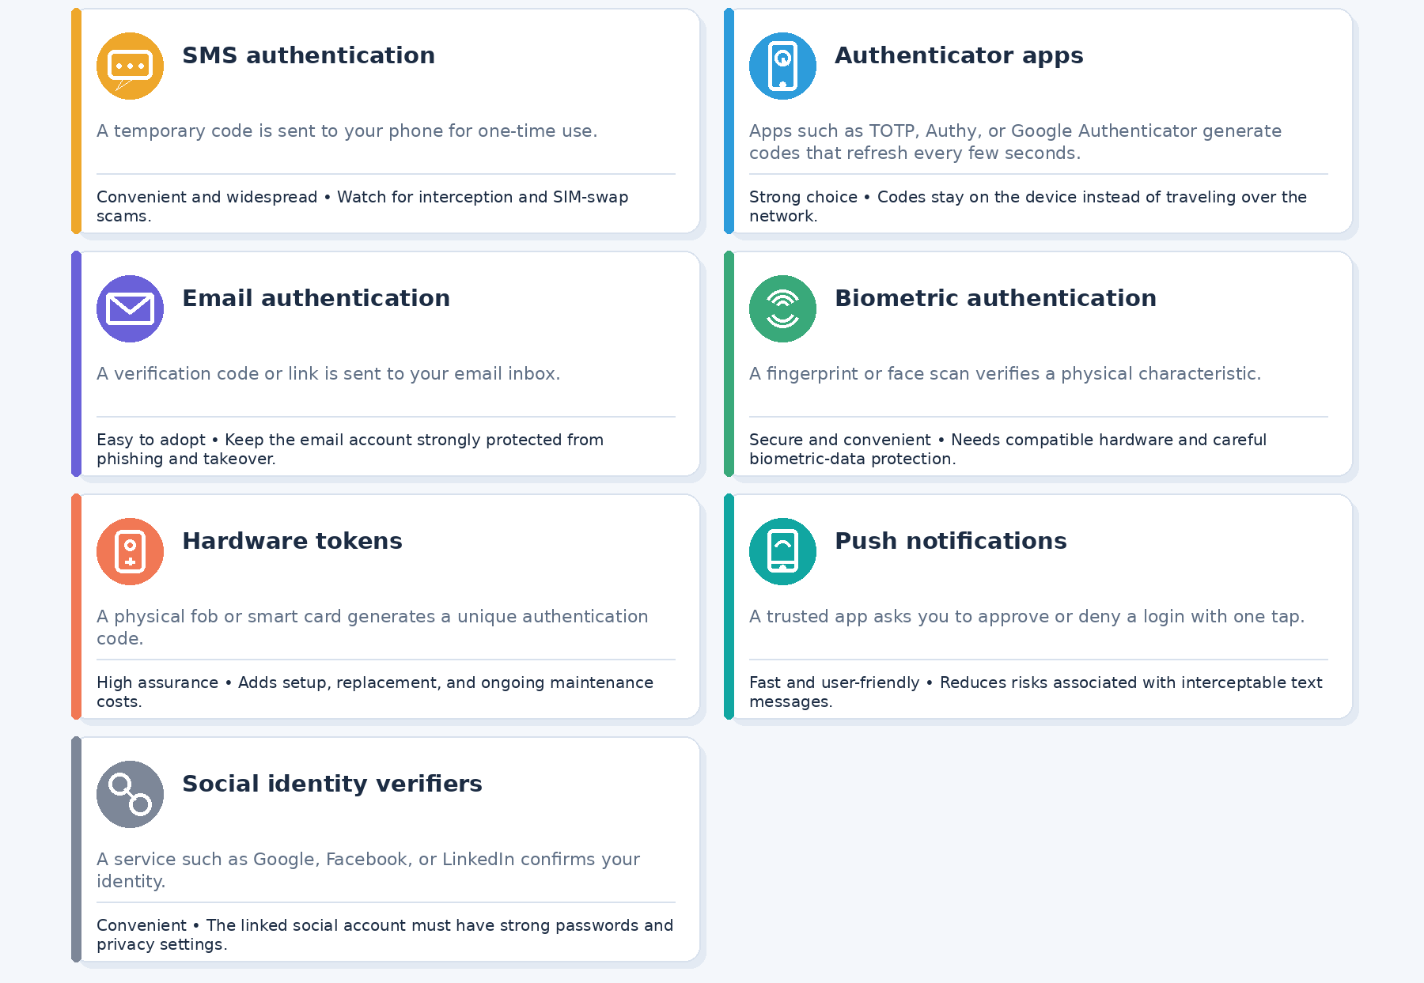
MFA
Multi-Factor Authentication (MFA) Methods

Slide 3
MFA FAILURE
Availability and security fail in different ways
A good design anticipates both lockout and bypass.
Lockout
Bypass
legitimate user cannot authenticate
attacker gets an exception
Outage
Recovery
provider or network unavailable
new factor must be bound
DISCUSS · WHICH FAILURE IS MOST DANGEROUS?

Slide 4
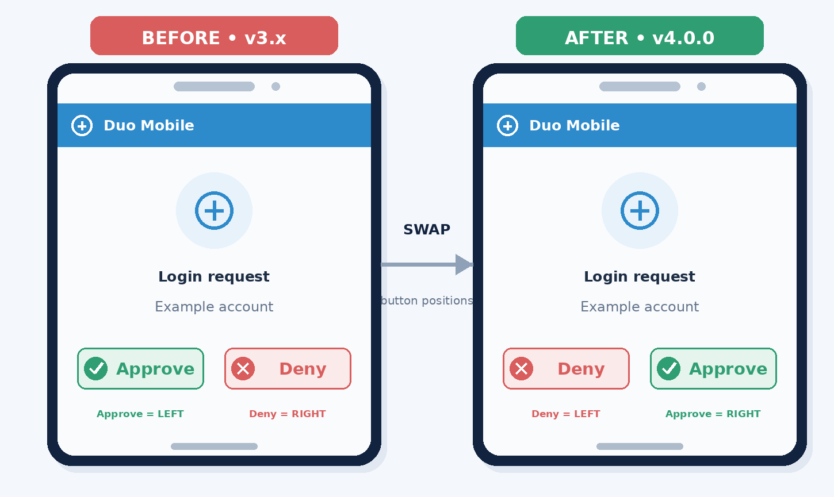
Duo layout change

Slide 5
POLICY DESIGN
Policy length: concise enough to use, complete enough to control
There is no universal page limit. The goal is decision density, not word count.
Too short
Useful
Too long
values only
no test or owner
scope + duty + evidence
linked standards and procedures
buried requirements
contradictions and policy debt
Editing test
If a reader cannot find the required action, evidence, owner, and exception path quickly, the policy needs restructuring.

Slide 6
Acceptable Use Policy
Our organization is committed to maintaining a secure, reliable, and productive digital environment that supports the work of our employees, partners, and broader community. To help preserve this environment, all users are expected to exercise sound judgment and use company technology resources responsibly, ethically, and in accordance with applicable laws and organizational requirements.
Company systems, networks, applications, devices, and information should be used primarily for authorized business purposes. Users must take appropriate steps to safeguard their passwords, multi-factor authentication devices, company equipment, and any confidential or sensitive information entrusted to them.
Respect for information boundaries is essential. Users must not access, copy, modify, distribute, or disclose information unless they have the appropriate authorization to do so. Similarly, users must not introduce malicious software, attempt to circumvent established security controls, or engage in activities that could impair, interrupt, or otherwise compromise the availability and reliability of company services.
The organization recognizes that occasional personal use may be reasonable in the course of everyday work. Such use is permitted only when it is lawful, secure, limited in nature, and does not interfere with productivity, system performance, workplace responsibilities, or the rights of other users.
Everyone plays an important role in maintaining organizational security. Any suspected security incident, unauthorized access, loss of equipment, or potential exposure of company information should be reported promptly through the appropriate reporting channel so that it can be reviewed and addressed without unnecessary delay.
Failure to follow this policy may lead to the removal or restriction of system access and may also result in disciplinary action, up to and including termination of employment or other applicable consequences.

Slide 7
Acceptable Use Policy
Use company systems only for authorized, lawful business purposes.
Protect passwords, MFA devices, company equipment, and confidential data.
Do not access, copy, modify, or share information without permission.
Do not introduce malware, bypass security controls, or disrupt services.
Limited personal use is allowed if it is lawful, secure, and does not interfere with work.
Report suspected security incidents promptly.
Violations may result in loss of access or disciplinary action.

Slide 8
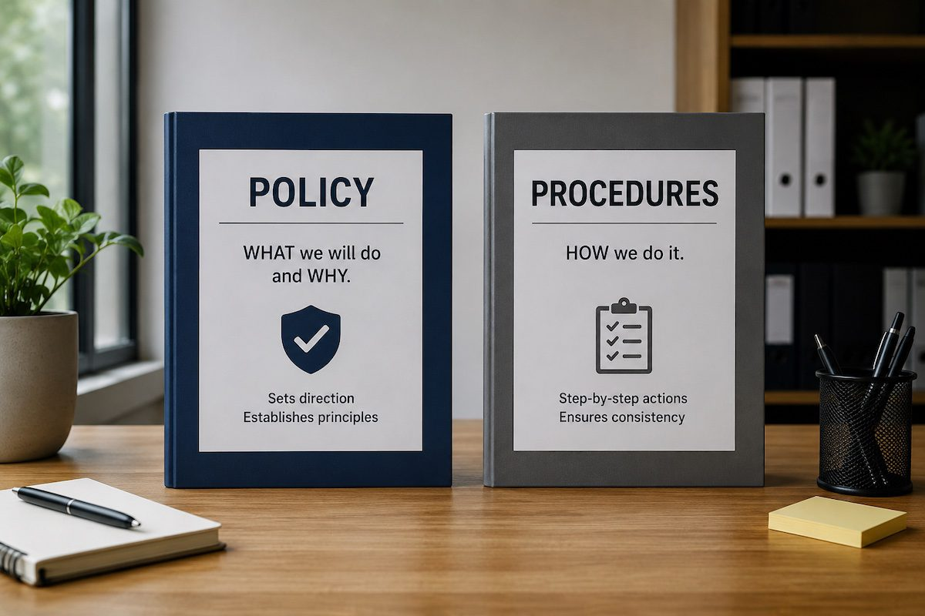
POLICY CONTROL
Policy versus procedures
A principle guides judgment. An enforceable policy creates a checkable obligation.

Slide 9
POLICY QUALITY
Good policy language names owners, scope, evidence, and exceptions
Vague language creates unreviewable risk.
Owner
Scope
Control
Evidence
Exception
who is accountable?
what is covered?
what must happen?
how is it proven?
who may approve?
Remote administrator access shall require
strong authentication plus MFA, use the approved
access path, and be retained in logs
for the defined review period.

Slide 10
POLICY
Policy is the management decision. Standards make it testable.
A policy package needs layers with different levels of specificity.
Policy
Standard
Guideline
Procedure
why and who
what must be true
what is preferred
how to perform it
Quality test
Can an auditor or operator tell whether the requirement is satisfied?

Slide 11
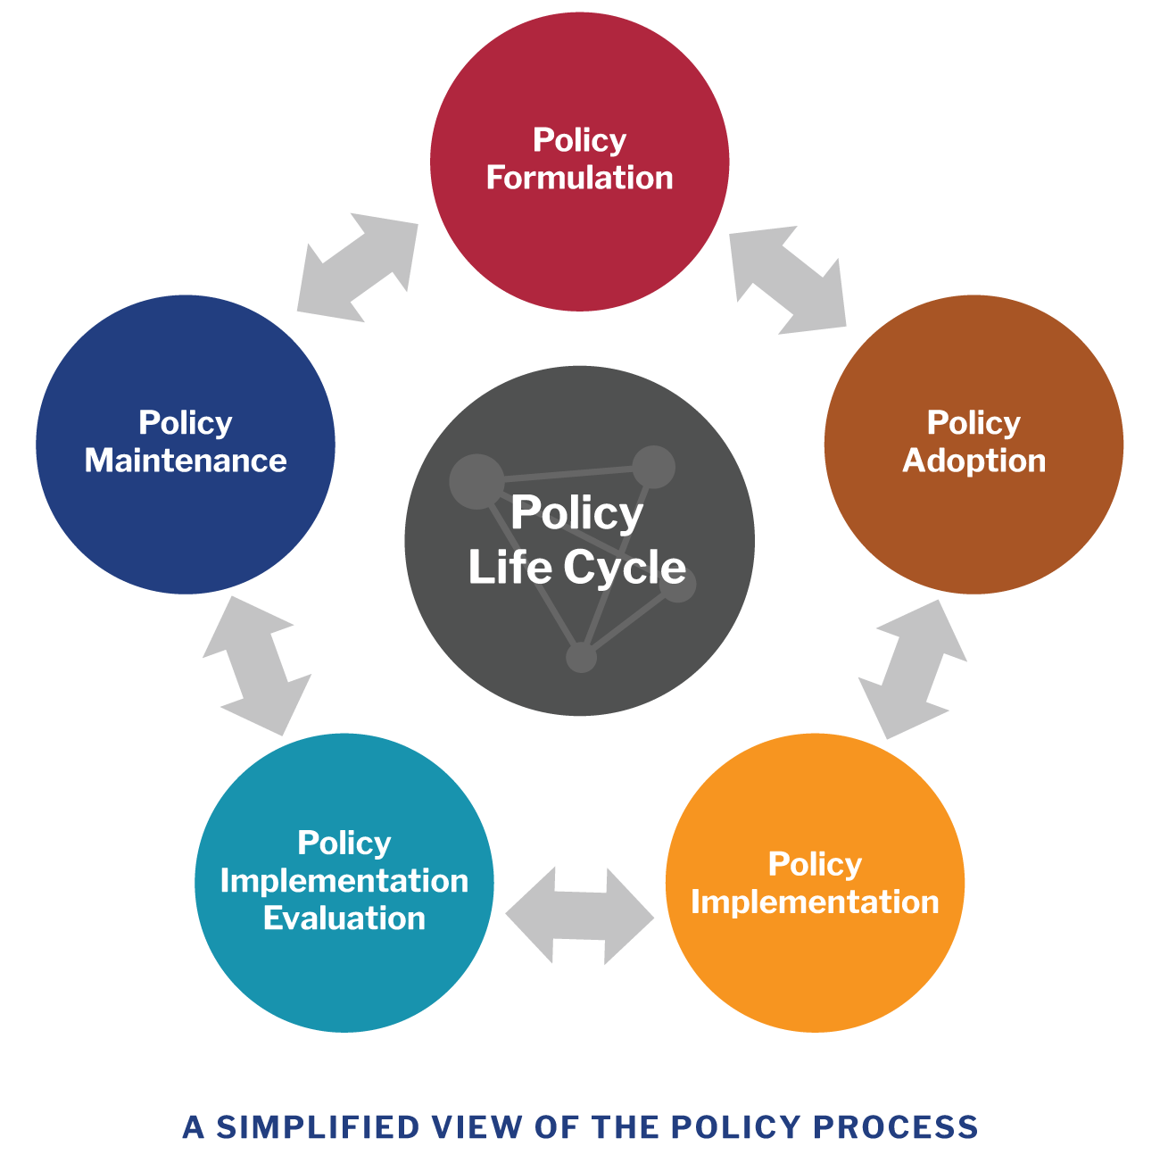
POLICY LIFECYCLE
Policy maintenance is an operational control
A policy that is never reviewed becomes a historical document.
REVIEW

Slide 12

Data Classification Policy
Ensure information receives the right level of protection.
Core components:
Classification levels: Public, Internal, Confidential, Restricted
Data ownership and classification responsibility
Labeling and handling requirements
Access based on business need and least privilege
Approved storage, sharing, and transmission methods
Retention and secure disposal requirements
Periodic review and incident reporting

Slide 13
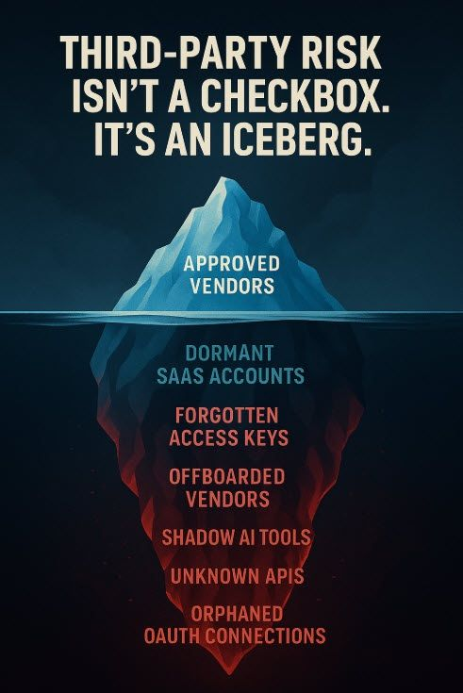
Vendor & Third-Party Access Policy
Manage the risks created by external organizations and service providers.
Core components:
Vendor security due diligence and risk assessment
Contractual security and privacy requirements
Least-privilege, time-limited access
MFA, SSO, and approved access methods
Data handling, storage, and subprocessors
Monitoring, logging, and periodic access reviews
Incident notification and vendor offboarding

Slide 14

Acceptable Use Policy
Define responsible and secure use of organizational technology.
Core components:
Use systems only for authorized and lawful purposes
Protect passwords, MFA devices, equipment, and data
Prohibit unauthorized access, copying, or disclosure
Prohibit malware, security bypasses, and service disruption
Define limits for personal use
Require prompt reporting of suspected incidents
Explain consequences for policy violations

Slide 15

Multi-Factor Authentication (MFA)
Add additional verification beyond a password.
Core components:
Multiple factor types: knowledge, possession, and inherence
Approved MFA methods and enrollment requirements
Strong preference for phishing-resistant methods where available
Conditional or risk-based access policies
Secure account recovery and backup methods
Device registration and user verification
Monitoring of MFA activity and suspicious prompts
User training against phishing and MFA fatigue attacks

Slide 16
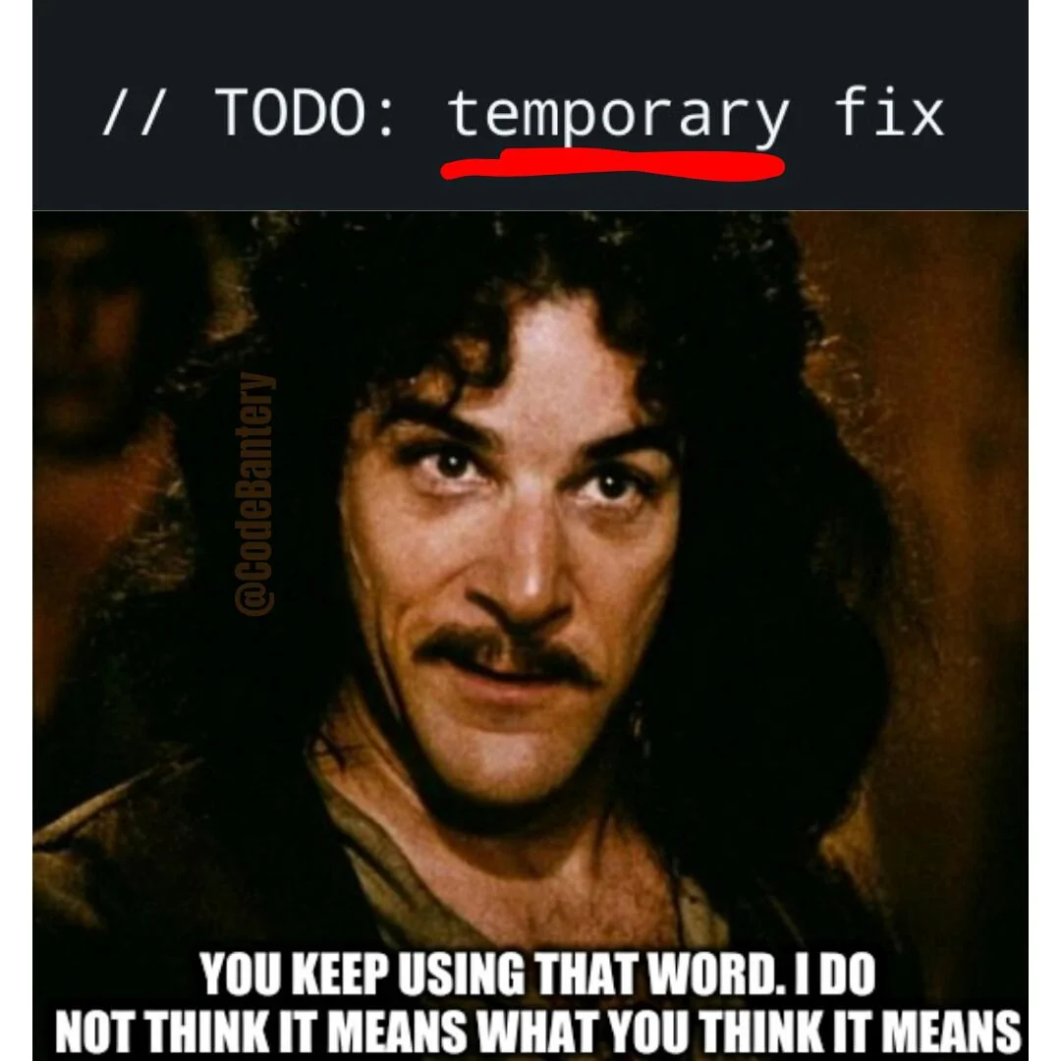
When the exception becomes the architecture
MEDIA SLOT

