Slide 1
Tools: Git, Markdown, WSL, and Docker
IT&C 210A – S02

Slide 2

Git – Distributed Version Control
Manages source code
Tracks all changes, who made them, and when
Coordinates multiple people working on the same project
Saves you from mistakes
Protects you from hardware or software failures

Slide 3
Other Version Control Systems
CVS (Concurrent Versions System)
Mercurial
Microsoft SourceSafe (Discontinued)

Slide 4
Philosophy
Most Multiuser Systems
Git
Fine-grained access control to limit contributor’s ability to change things.
Grant all team members full access.
Make it easy to detect and reverse errors.

Slide 5
Git Vocabulary
Repo – A repository of source code that is managed by Git
Commit – A set of source code changes that are committed to the repo.
Remote – A shared copy of a repository on a managed service such as GitHub
Push – Copy your commits to a remote
Pull – Retrieve and merge commits from a remote
Sync – Pull then push
Branch – A set of commits that are isolated from the main trunk with the intention of merging them later.
Fork – A copy of a repo on which new commits are made that diverge from the original.
Pull request – A request for a repo manager to merge in a set of commits from a branch or fork.

Slide 6




Git Remote Hosts
GitHub – The most well-known
Atlassian BitBucket – Quite popular
SourceForge
GitLab – Open Source Git host that you can deploy yourself
Shared Directory – You can push and pull from a shared file system directory

Slide 7

Git Commit and Revert Demo

Slide 8
Markdown: Shorthand for HTML
# Heading 1
This is a paragraph with a [link](https://byu.edu) embedded in it.
## Heading 2
This paragraph is followed by an image.
![UML Diagram](UmlDiagram.jpg)
* Lists
* Are
* Easy

Slide 9

MarkDown Applications
GitHub:
README.md
Issues Tracker
GitHub Pages (optional)
Discord
Jekyll static website generator
Blogging software
Your own documents

Slide 10
MarkDown Demo (VS Code)

Slide 11
Windows Subsystem for Linux (WSL2)
Lets you run a Linux Kernel on Windows
Shares resources between the Linux Kernel and the Windows host such as file system, memory allocation, CPU allocation, etc.
By default, loads Ubuntu but other distributions are available in the Windows Store.
No longer restricted to CLI apps though you must install a virtual GPU to run GUI apps.

Slide 12
WSL2 File System Mappings
WSL2 and Windows each has its own file system.
The WSL2 file system is stored in a large file within the Windows File System.
You can access the Windows file system from WSL2 at the /mnt path (e.g. ‘/mnt/c/users/My Documents’
You can access the WSL2 file system from Windows at \\wsl$\Ubuntu (e.g. ‘\\wsl$\Ubuntu\

Slide 13
Containers (Docker)
A container is like a lightweight virtual machine in which libraries and applications can be installed.
Unlike a virtual machine, a container may share resources with the host machine like file system access, memory management, CPU allocation, etc.
Containers are less demanding of the host than virtual machines.

Slide 14
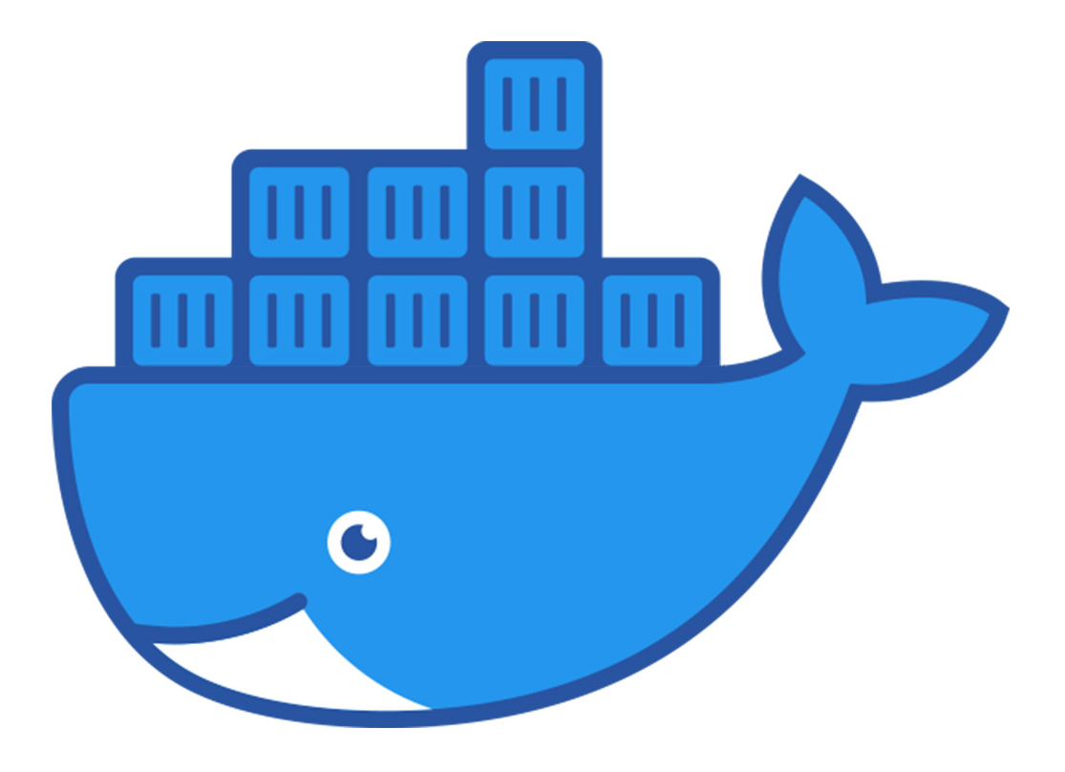
Docker
Docker is the most popular container host.
Docker Desktop is a container host for Windows, macOS, Linux, and others.
On Windows, Docker relies on WSL2 for Linux services.

Slide 15
docker-compose.yml and DOCKERFILE
Docker-Compose loads one or more containers and connects them on virtual networks and/or shared file mappings.
References a huge library of pre-built docker containers on https://hub.docker.com
DOCKERFILE is a set of instructions to create a new container, often by adding features to an existing container.

Slide 16
Commands (That we use in this class)
docker compose up
docker compose up –d
Detaches the console of the container
docker compose down
docker compose down –v
Erases any “volume” data that was saved in the container.

Slide 17
Study Questions
What do the following Git terms mean: “repo”, “commit”, “branch”.
How does using Git save you or your team from mistakes?
Why use MarkDown instead of plain HTML?
Where do the containers come from that are referenced by docker-compose?

