Slide 1
JSON (JavaScript Object Notation) and Browser localStorage
IT&C 210A S06

Slide 2
JavaScript Object Notation (JSON)
“syntax for storing and exchanging text information”
Similar, in purpose, to XML, but faster and easier to parse
Language and platform independent
JSON Example
{
"employees": [
{"firstName": "John", "lastName": "Doe"},
{"firstName": "Anna", "lastName": "Smith"},
{"firstName": "Peter", "lastName": "Jones"}
]
}
Notes:
See http://www.hunlock.com/blogs/Mastering_JSON_(_JavaScript_Object_Notation_) for an excellent overview.

Slide 3
JSON Language
Language Type | Declarative (Data Representation)
Runtime Model | Interpreted
Property Names | Case Sensitive Dynamically Typed
Syntax | Braces { } represent objects Brackets [ ] represent arrays Property names and values must both be in quotes. { "Name": "Sarah" }
Comments | Pure JSON doesn’t allow comments. However, many JSON parsers will accept JavaScript comments
Object-Oriented | Defines objects and arrays for manipulation by imperative programming languages
Other Features | A subset of JavaScript Most popular data representation language Relatively new. First defined in 2001, standardized in 2006, gained popularity over XML starting in roughly 2011.

Slide 4
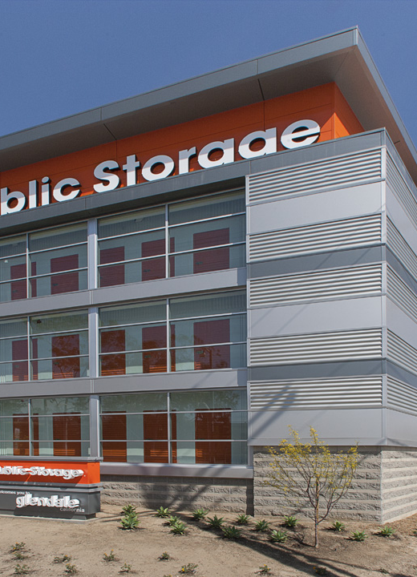
Browser localStorage
window.localStorage is a built-in global object on the browser.
It stores name-value pairs where the name and the value are both strings.
Use JSON to put structured data into localStorage.
Each Origin (scheme://domainName:port) has its own storage collection
http://example.com has a different collection from https://example.com which is different from https://www.example.com.
Officially the behavior for file: is undefined but in practice each file has its own storage.

Slide 5

Browser sessionStorage
window.sessonStorage works just like localStorage except…
The data go away when you close the browser.
Each tab has its own sessionStorage – even if it’s on the same web site.

Slide 6

JSON and Local Storage Walkthrough
https://byu-itc-210.github.io/walkthrough/JSON-localStorage

Slide 7
Review Questions
What is JSON?
Can you embed JSON in JavaScript?
How do you use JSON from JavaScript?
What kind of data does localStorage store?
How would you get other kinds of data into localStorage?

