Slide 1
The World-Wide Web URLs, Protocols, and Certificates
IT&C 210A - S8

Slide 2
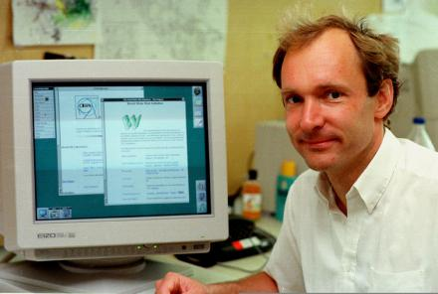
What is the World Wide Web?
It is a set of documents and other resources (e.g., images, HTML pages) linked together by hyperlinks, made available by web servers, and “read” by client web browsers
WWW documents are requested and sent using the HTTP protocol.
It is not the Internet.
It is not a computer network
Tim Berners-Lee invented the World Wide Web at CERN.
Notes:
Who invented the World Wide Web? Tim Berners-Lee who was working at CERN at the time

Slide 3
URLs (Uniform Resource Locators)
IT&C 210A

Slide 4
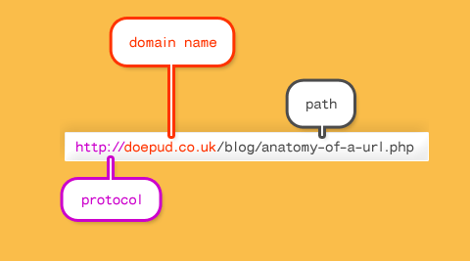
Simple Universal Resource Locator (URL) Example
Notes:
See http://doepud.co.uk/blog/anatomy-of-a-url.php for a full description of the parts. Image from there.
Note that uk is the “top level domain”, co is the “first level domain” doepud is the “host name” or the name of the machine on the .co.uk domain.

Slide 5
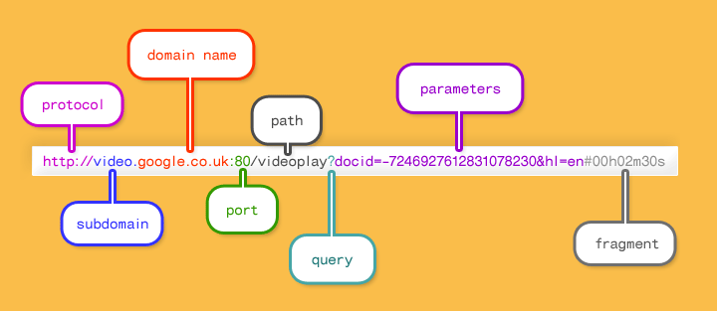
Detailed URL Example
Notes:
See http://doepud.co.uk/blog/anatomy-of-a-url.php for a full description of the parts. Image from there.
Understanding these parts of a URL has important security implications: see http://www.20thingsilearned.com/en-US/url/1

Slide 6

URL Demo (Wikipedia, YouTube)

Slide 7
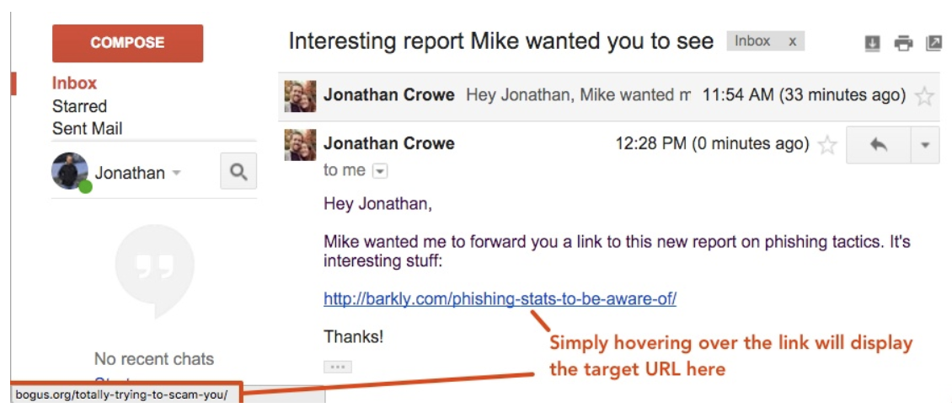
Look before You Leap
Notes:
https://blog.barkly.com/how-to-avoid-getting-phished-spot-fake-url

Slide 8
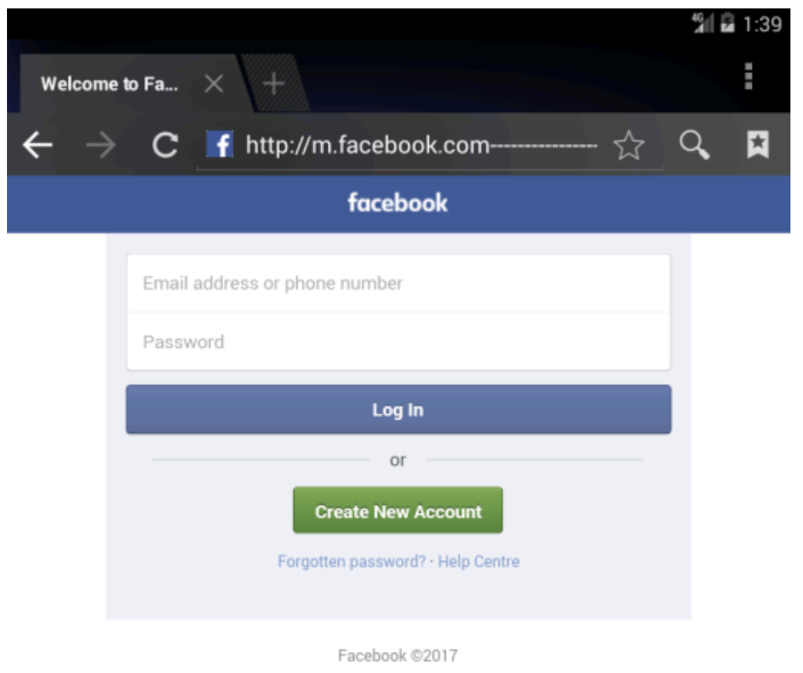
Beware: URL Padding
hxxp://m.facebook.com----------------validate----step1.rickytaylk[dot]com/sign_in.html
Notes:
https://info.phishlabs.com/blog/the-mobile-phishing-threat-youll-see-very-soon-url-padding

Slide 9
More on URLs
Other Protocols (aka Schemes):
HTTPS: secure HTTP
FTP: File Transfer Protocol
Also: file:, mailto:, telnet:, news: etc.
Notes:
See https://www.icann.org/resources/pages/what-2012-02-25-en for a nice description of how the “Internet” addressing (IP addresses and domain names) are facilitated by ICANN

Slide 10
HTTP (HyperText Transfer Protocol)
The protocol of the World Wide Web

Slide 11
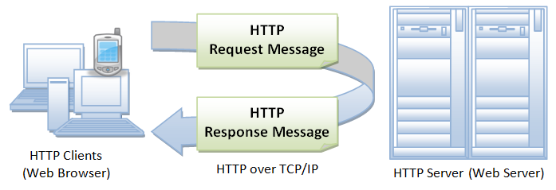
HTTP Protocol
Pull protocol (i.e., client initiated)
Stateless protocol (i.e., forgetful, connectionless)
Uses TCP
Notes:
See http://www3.ntu.edu.sg/home/ehchua/programming/webprogramming/HTTP_Basics.html
for a very detailed and excellently illustrated walk-through of everything HTTP. Images taken from that link.
At it’s core, a web server is simply software that knows how to respond to HTTP requests. You’ll make a very simple one in networking! (show them?)

Slide 12
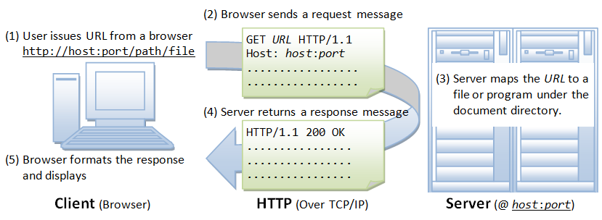
A Closer Look
Notes:
Remember, the first part of a URL is the “protocol”, which for the WWW is HTTP, or it’s cousin HTTPS which is a secure version of HTTP that uses encryption as we’ll learn about later in the class.

Slide 13
Demo
Reviewing an HTTP request in browser tools.

Slide 14
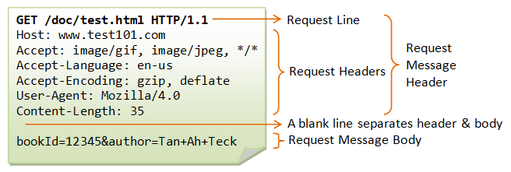
HTTP Request Example

Slide 15
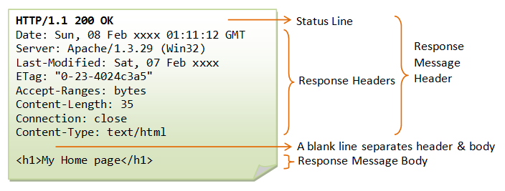
HTTP Response Example

Slide 16
HTTP Status Messages
200 – OK: The request is fulfilled
3xx – Redirect
400 – Bad request (probably syntax error)
401 – Authentication Required
404 – Not found
408 – Request timeout
500 – Internal server error (likely an error in your server-side code – e.g., PHP code)
503 – Service unavailable (e.g., server is overloaded or down)

Slide 17
HTTP Verbs
GET – Retrieve a resource
PUT – Store or update a resource
POST – Send form data or create a new resource.
GET can only send textual data in the query string.
PUT and POST have a payload that may be text or binary.

Slide 18
Web Frontiers
HTTP/2
Next-generation HTTP protocol successor to HTTP/1.1
Proposed in 2014, standardized in 2015 as IETF RFC 7540
More compact, binary headers
Can push data to the browser before it is requested
QUIC Protocol
Alternative to TCP that builds on UDP
Developed by Google
Improved performance for web communication
Standardized in 2021 as IETF RFC 9000
Supported by Chrome, Edge, and Firefox among others
HTTP/2 plus QUIC is sometimes called HTTP/3

Slide 19
Certificates and HTTPS

Slide 20
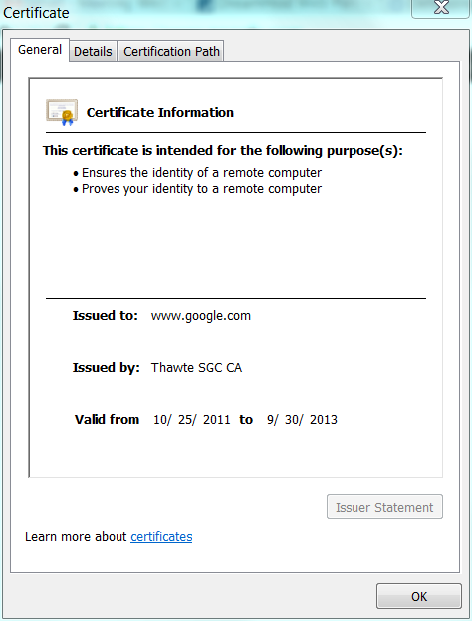
Public Key Certificates and Certificate Authorities
Trusted 3rd Party
Certificate Authority
A certificate is required for TLS
TLS is used by HTTPS and other secure protocols
TLS authenticates the server (they are who they claim to be)
TLS encrypts the connection

Slide 21
Obtaining a TLS Certificate
Generate a public key – private key pair
Send the public key to a certificate authority along with identifying information.
Certificate authority adds a digital signature thereby creating a digital certificate
The public key
The owner of the public key
Authorized use of this certificate
Expiration date
Digital signature
Contemporary tools like Certbot automate the process for you.

Slide 22

Demo: Digital Certificates

Slide 23
Study Questions
What are the parts of a URL and what does each do?
How do malefactors trick you into thinking a malicious URL is OK?
Does HTTP 1.1 use TCP or UDP for its transport?
What are the most common HTTP verbs and what are they used for?
Can PUT or POST send binary data?
Can GET send binary data?
What are the two functions provided by TLS?

