Slide 1
UML and Debugging
IT&C 210A – S09
Brandt Redd

Slide 2
UML
Unified Modeling Language

Slide 3
Software modeling
Model process (sequence of activities)
Changes of state
Data structures
Data structure types and with methods
Need languages of abstraction …

Slide 4
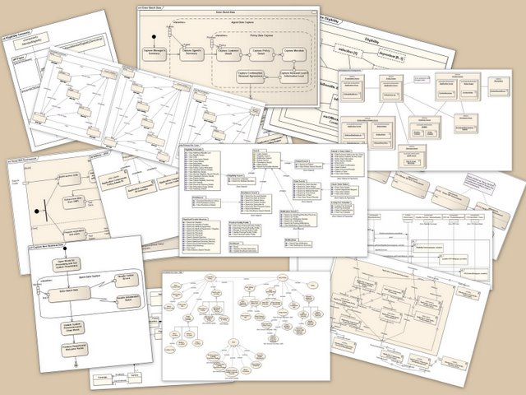
UML – Diagrams

Slide 5
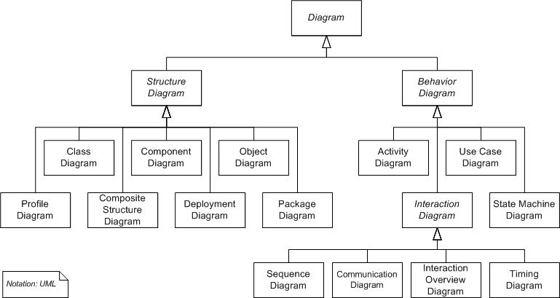
UML Diagram Types
Notes:
14 diagram types in several sub-trees
No, you don’t need to memorize them. Look them up and use them as needed.
We’ll focus on the ones circled: Class Diagrams, Activity Diagrams, and Sequence Diagrams, in this class.

Slide 6
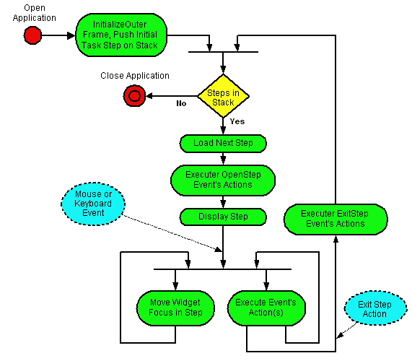
UML Diagrams – Activity (Analogous to Flow Charts)
Notes:
You should know and use the following correctly:
Open and close circles (in red)
Decision nodes and branches (like the yellow triangle) – which should include the values on the lines (e.g., “No” and “Yes” in the above examples).
Outside events (in yellow dotted circles)
We’ll be a bit more flexible about: Forks and Merges (black line going across like the one above the yellow triangle) to split and combine activities (not just 2-ways, could be more). Merges wait until all its feeding activities are complete (i.e., synchronize).
Make sure you use appropriate labels (e.g., label decisions and actions well – put them in boxes/circles and on lines when needed)
Image from: http://www.classle.net/faq/what-activity-diagram

Slide 7
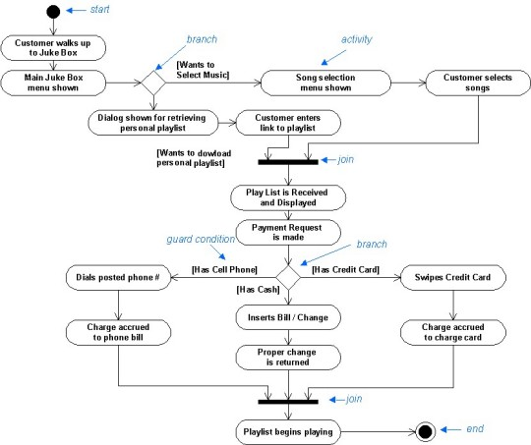
Example Juke Box

Slide 8
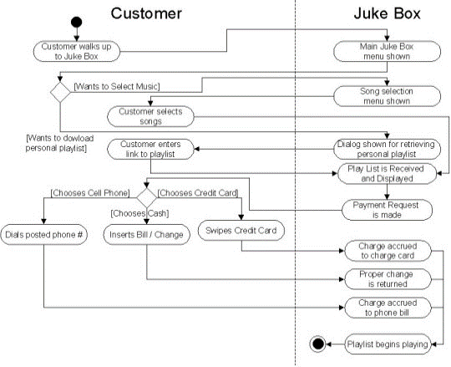
Juke Box with Partitions
Also called swim-lanes
Notes:
Partitions = Swim Lanes
These will be required for many of our labs, since they are helpful in characterizing what different things do (e.g., server, database, client)

Slide 9
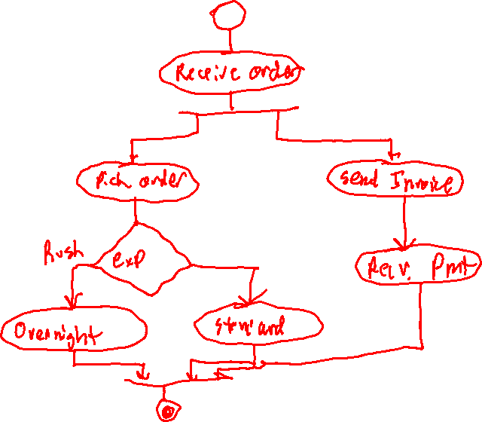
Activity Diagram – Fulfill Order

Slide 10
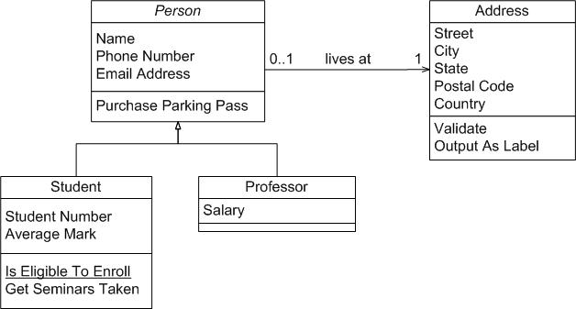
UML Diagrams – Class (Analogous to Entity-Relationship Model)
*

Slide 11
UML Diagrams – Class
Relationship
Entity
*
Property
Cardinality
Subclass / Subentity
Methods

Slide 12
Entity
object, noun-verb, “thingy”
Something that has a name
Something that has Identity
Person, place, thing
Something you can point at.
Something that does stuff or has stuff done to it
Can you think of another way to say it?

Slide 13
Attribute or Property
Characteristic of an object
E.g. color, weight, height, dimensions, class, style, etc.
Subtle Distinction
Height is an attribute of Person
Location is an attribute that may change frequently, sometimes called a property.
Systems often “create” objects with attributes and “attach” properties.
UML makes no distinction between attributes and properties.

Slide 14
Relationship
Objects are related to each other in the real world.
John husband of Mary
Julio’s Ferrari
Carburator part of engine
Mary is a Girl
Cardinality
1:1
1:Many
Many:Many

Slide 15
Cardinality
left | right |  | example
1 | 1 | one-to-one | person <-> birth record
0..1 | 1 | optional on one side one-to-one | death record <-> person
0..* or * | 0..* or * | optional on both sides many-to-many | person <-> book
1 | 1..* | one-to-many | person <-> language

Slide 16
Inheritance
A relationship between classes such that all of the attributes and methods of the super-class are projected into the sub-class.
Two kinds Structure and Interface: difference beyond scope of lecture

Slide 17
Relationships with Attributes
Sometimes a relationship between two objects can have attributes.
John was married to Mary on January 3, 2999
Marriage date is not an attribute of either John or Mary. It is an attribute of their relationship.

Slide 18
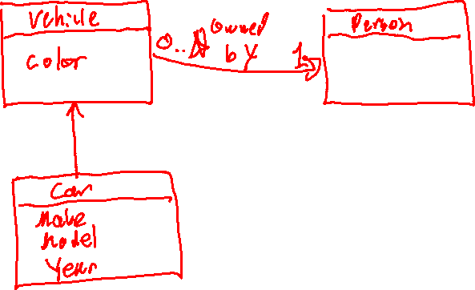
Class Diagram: Vehicles

Slide 19
We will cover UML Sequence Diagrams in IT&C 210B

Slide 20
UML Tools
Lucidchart.com
Diagrams.net (formerly Draw.io)
Microsoft PowerPoint
Microsoft Visio
Your favorite drawing app.
Hand draw and photograph / scan.
Microsoft office and many other apps are free or discounted to BYU students. See http://software.byu.edu

Slide 21
Debugging Web Applications

Slide 22
Web Debugging Tools
console.log
Browser “Developer Tools”
Elements, Console, Sources, Network, Performance, Memory, Application, Security, CSS Overview, Others
Breakpoints and examining variables
Build and test one feature at a time

Slide 23

Demo: Debugging an App

Slide 24
Review Questions
In class we talked about two types of UML diagrams, Activity and Class. What does each represent?
How are UML Activity diagrams similar to and different from traditional flow charts?
How are UML Class diagrams similar to and different from traditional Entity-Relationship diagrams?
What tools are available for creating UML diagrams?
What debugging tools are built into your browser?
What are some good strategies for preventing and finding bugs?

