Slide 1
Databases and Structured Query Language (SQL)
IT&C 210A S10

Slide 2

What’s a database?
Data stored in a structured format that lends itself to easy manipulation and recall
Notes:
See http://www.w3schools.com/sql/sql_quickref.asp for a nice introduction. Many tables and examples in this presentation come from there.

Slide 3
Types of Databases
Hierarchical Database
Mostly Obsolete
Relational Database
RDBMS = Relational Database Management System
Examples: MySQL, MariaDB, PostgreSQL, Oracle, Microsoft SQL Server, Microsoft Access, Etc.
Specialty and Custom Databases
Directory Systems: Microsoft Active Directory, LDAP Databases
Full-Text Indexes: Google Search, Apache Lucene, Amazon Elastic Search, Etc.
“NoSQL” Databases
MongoDb, CouchBase, Dynamo, Apache River, Microsoft Cosmos DB
Optimized for high performance on extremely large databases.

Slide 4


Career Option: Database Administrator (DBA)
Bachelor Degree in Computer Science, IT, Cybersecurity or Related
3-5 Professional Certificates
Oracle Certified
Microsoft Certified Database Administrator (MCDBA)
Etc.
Starting salary well in excess of $75,000
Huge Demand

Slide 5
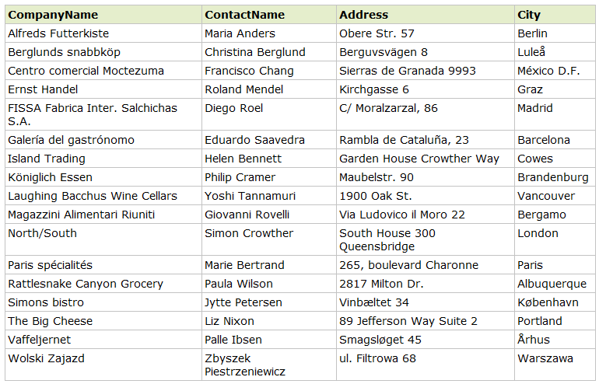
Rows and Columns

Slide 6
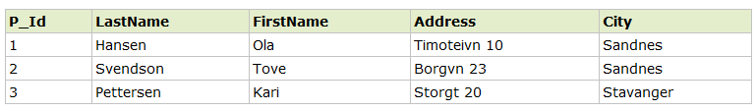
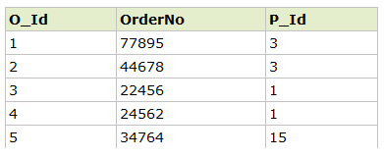
Where it gets interesting…
In a relational database, tables can be linked:
Tables, columns, rows, “keys”, joins
Notes:
Google – good example of organizing data in useful ways via databases.

Slide 7
What is SQL?
A standard language for accessing databases
SELECT P_id, FirstName, LastName, Age
FROM tbl_people
WHERE Age > 18
ORDER BY LastName
An underlying language used by Relational Database Management System’s (RDBMS) such as MySQL, MS SQL Server, Oracle, Microsoft Access
Note: SQL is NOT case senSiTive
SQL Statement

Slide 8
SQL Language
Language Type | Declarative Query
Runtime Model | Interpreted
Variables | Must start with a letter May contain letters, digits, _ and $ Case-insensitive
Syntax | Clauses introduced by keywords: SELECT, FROM, WHERE, ORDER BY, etc.
Comments | /* this is a comment */ -- this is another comment

Slide 9
Strong Data types
Describe type of data (text, numeric, date/time, binary)
Available types depends on RDBMS
Size matters! (for performance)
See http://www.w3schools.com/sql/sql_datatypes.asp

Slide 10
Demo Database
Actor
Movie
actorid
name
birthdate birth_city
birth_country
0..*
0..*
movieid
title
rating gross_revenue

Slide 11
Demo Database
Actor
Role
Movie
1
0..*
actorid
name
birthdate birth_city
birth_country
actorid
movieid
character screen_time
1
0..*
movieid
title
rating gross_revenue

Slide 12
Practice and Reference
Walkthrough: https://byu-itc-210.github.io/walkthrough/SQL
Quick Reference: https://www.w3schools.com/sql/sql_quickref.asp

Slide 13
Study Questions
How do you distinguish between a database, a database management system (DBMS), and the SQL query language?
What are the four most common clauses in a SQL query?
What is a SQL aggregate function and how does it relate to the GROUP BY clause?
What are the four types of JOIN and what distinguishes them?

