Slide 1
PHP & Server-Side Programming
IT210A S11

Slide 2

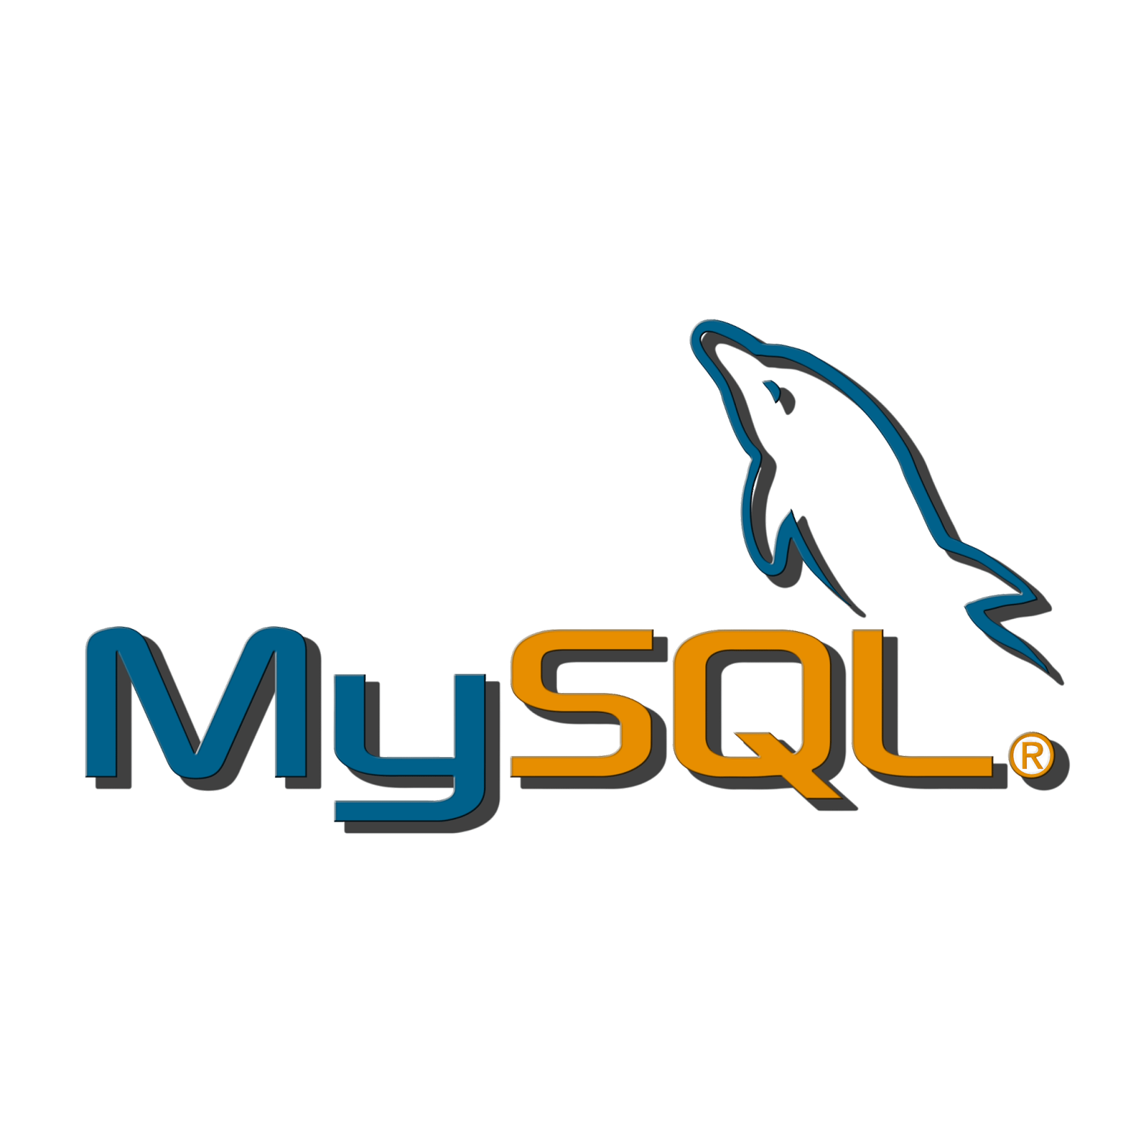


The LAMP Stack
PHP
MySQL
Apache
Linux

Slide 3
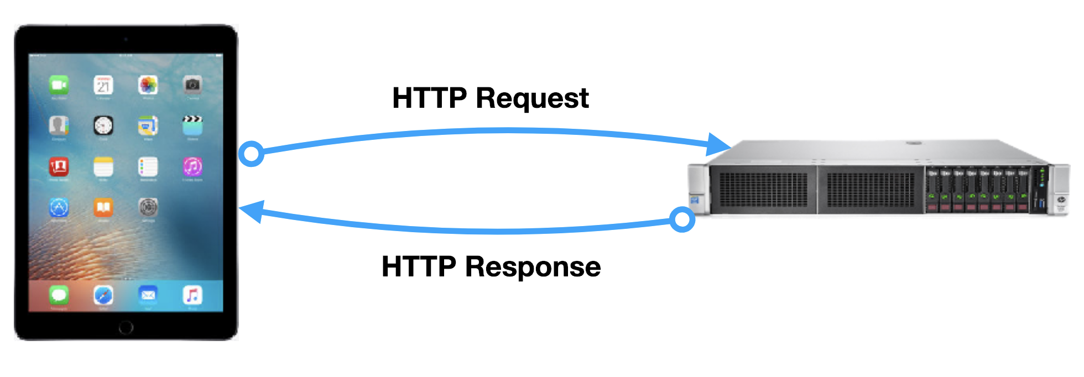
Client and Server Architecture
Where is “code” executed?
Notes:
Reminder: When we’re working with the web (i.e., HTTP), we assume a Client (i.e., browser) - Server (i.e., HTTP server or web server) architecture. The server is where the code is stored. It “serves up” the pages that are requested.

Slide 4
Client and Server Architecture
Browser
executes HTML, CSS,
and Javascript
“LAMP” Server:
Linux, Apache, MySQL, PHP
Where is “code” executed?
Notes:
The server can send static files with HTML, CSS, and Javascript to the client, which executes them. AND/OR it can execute some server-side code (e.g., PHP code) on the server BEFORE sending it to the browser.
Answer: It depends.
Client-side “code” like HTML, CSS, and Javascript are executed by the browser.
Server-side “code” like PHP, ASP.NET, Python (or Javascript on the server, like when we use NodeJS) is executed on the server BEFORE the file is sent to the browser.

Slide 5
Why Use a Server-Side Language?
Security (no access to source code)
Performance
Let people update content that everyone can see
Libraries that work well for things like email
Keeping track of session
Notes:
Some answers include:
You can reuse code: Don’t Repeat Yourself (e.g., create one menu bar PHP page and insert it into all your other pages)
You want to allow people to make a change that will affect what other people see (e.g., post an Instagram image)
Store data in a database that isn’t available to everyone (for security reasons) and use a server-side language to look up info.
You don’t want anyone to see or copy your “fancy”/proprietary code.
Browsers aren’t capable of performing the task (e.g., you need a super powerful machine to do it).
You want to personalize information for people using “feature phones” that don’t execute javascript.
You can have the server connect to other computers and services that a client can’t connect to (e.g., for security reasons).

Slide 6
PHP: Hypertext Preprocessor
Open source language for web server-side scripting
Can be embedded into HTML
Works well with databases
Runs on all major platforms and servers, often as part of default installation
Used to develop MediaWiki, Drupal, Wordpress, Moodle, and many other content management systems
Notes:
PHP (recursive acronym for PHP: Hypertext Preprocessor) is a widely-used open source general-purpose scripting language that is especially suited for web development and can be embedded into HTML.

Slide 7
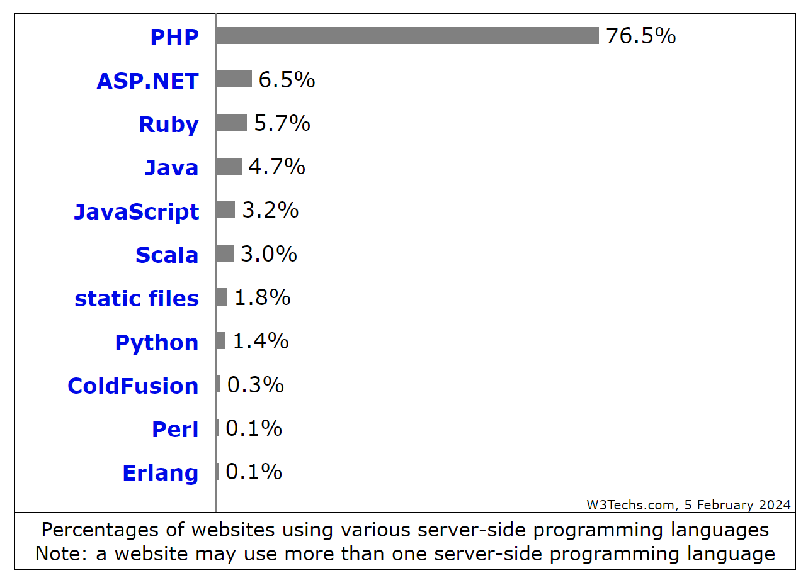
Notes:
See https://w3techs.com/technologies/overview/programming_language/all for live stats.

Slide 8
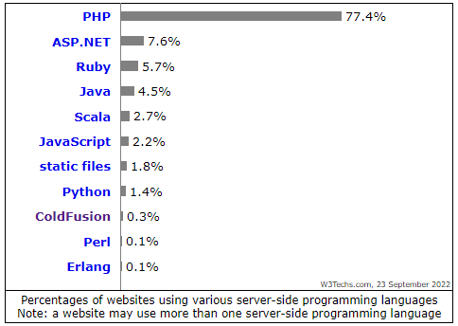
Notes:
See https://w3techs.com/technologies/overview/programming_language/all for live stats.

Slide 9
PHP Language
Language Type | Imperative
Runtime Model | Interpreted
Variables | Start with a $ followed by a letter or underscore Case Sensitive Dynamically Typed Examples: $a $text $for4 $this_variable Constants do not have a $
Syntax | Curly-braces (like C, C++, C#, Java, etc.)
Comments | /* this is a comment */ // Another comment # One more comment
Object-Oriented | class { public $property; } Arrow notation (e.g. object->property)
Variable Scoping | Global Local Static
Other Features | Superglobal Arrays Session Variables

Slide 10
PHP Walkthrough
https://byu-itc-210.github.io/walkthrough/PHP

Slide 11
Study Questions
Is PHP code executed on the browser, the server, or somewhere else?
In contrast to PHP, where is JavaScript code typically executed?
What are some advantages to running code on the server side? (Yes, this kind of gives away the previous answers. But study them anyway.)
What are some limitations to what server-side code can accomplish (as compared to browser-side code)?
Are PHP variables strongly-typed or loosely-typed? What does that mean?
Must every entry in a PHP array be of the same type?
What does the $ (dollar sign) prefix mean with a PHP symbol?
How does PHP manage sessions?
If you “view source” on a web page, will you see the PHP code? Will you see JavaScript code?

