Slide 1
SQL Injection MySQL in PHP
IT&C 210a S12

Slide 2
SQL Injection Attacks

Slide 3
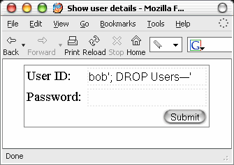
SQL Injection = Huge Security Problem
submit
query = "SELECT Username, UserID, Password
FROM Users WHERE
Username = 'bob'; DROP Users--
'AND Password = ''"

Slide 4
Most Common Web App Vulnerabilities
OWASP Top 10 Vulnerabilities 2021
A01:2021-Broken Access Control
A02:2021-Cryptographic Failures
A03:2021-Injection (XSS and SQL Injection)
A04:2021-Insecure Design
A05:2021-Security Misconfiguration
A06:2021-Vulnerable and Outdated Components
A07:2021-Identification and Authentication Failures
A08:2021-Software and Data Integrity Failures
A09:2021-Security Logging and Monitoring Failures
A10:2021-Server-Side Request Forgery (SSRF)
https://owasp.org/Top10
Notes:
See https://www.owasp.org/index.php/Category:OWASP_Top_Ten_Project for descriptions. We’ll talk about some of these more in future weeks. Notice that “injection”, of which SQL injection is the canonical example, is the top problem in 2010 and still in 2013.

Slide 5
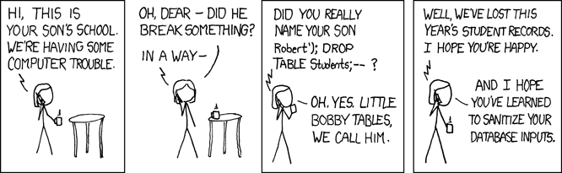
https://xkcd.com/327/

Slide 6
SQL Injection Attack
Name:
Robert
Name:
Robert'); Drop Table St
Birthdate:
2003-11-17
Birthdate:
2003-11-17
SELECT * FROM users
WHERE name = 'Robert'
AND birthdate = '2003-11-17'
SELECT * FROM users
WHERE name = 'Robert');
DROP TABLE Students;--' AND birthdate = '2003-11-17

Slide 7
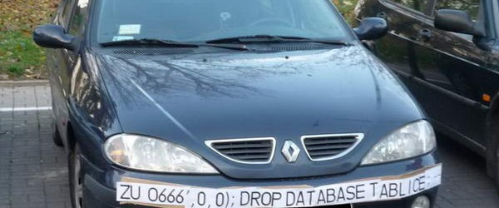

Notes:
“tablice” in Polish means “number plates” – and ZUO666 means “Evil666”

Slide 8
Protecting Against SQL Injection Attacks
Good: Escape the string before inserting it into a SQL Query
$mysqli -> real_escape_string($myvar)
Better: Use Prepared Statements and pass parameters separately
$stmt = $conn -> prepare("INSERT INTO MyGuests(firstname,lastname,email)VALUES(?,?,?)"); $stmt->bind_param("sss",$firstname, $lastname, $email); $firstname = "Bill" $lastname = "Preston" $email = "bill@wyldstallyns.music"
See the excellent resources in the Articles column of LearningSuite

Slide 9
Near-Synonyms
Database | Spreadsheet | Object | HTML DOM | E-R Diagram
Database | Table | Namespace | Document | Model
Record | Row | Object | Element | Entity
Field | Column | Property | Property | Attribute

Slide 10

SQL and PHP Walkthrough
https://byu-itc-210.github.io/walkthrough/PHP-SQL
Includes SQL Injection and Cross-Site Scripting (XSS) vulnerabilities.

Slide 11
Study Questions
What is a SQL Injection Attack and how to you protect against it?
How does PHP make use of SQL?
How do you specify the port number in a URL and why does that make a difference when accessing PHP-MyAdmin for MySql?
Why is it useful to store configuration information in the environment (.env) file?
Which kind of UML diagram will be used in this week’s homework?

