Slide 1
Applied Cryptography (With a Web Orientation)
IT210a S18

Slide 2
Cryptography
Cryptography: science of communicating via secret code
Important in Internet context (e.g. exchange credit card information, facilitate secure login…)
Deals with 4 of 5 core security services:
Confidentiality
Integrity
Authentication
Non-repudiation
(but not Availability, though it may indirectly be involved)
Notes:
See 210A information assurance slides for more detials. This is covered in much more depth in IT466.
Confidentiality: only authorized parties can access the information.
Integrity: Data cannot be modified undetectably
Authentication: Documents are genuine. Parties are who they say they are.
Non Repudiation: Like a traditional signature. The agreement is assured and the agreeing parties cannot (reliably) deny that they agreed to the arrangement.
There is one more security service that cryptography isn’t directly related to:
Availability: Data must be available when desired. The security system must not prevent access by authorized parties.

Slide 3
Encryption & Decryption
Plaintext
Cyphertext
Encryption Algorithm
Hello, how are you?
SX$H@BBA*#_A;L
Cyphertext
Plaintext
Decryption Algorithm
SX$H@BBA*#_A;L
Hello, how are you?
Notes:
Plaintext refers to the original message, while cyphertext refers to a modified version that is harder to “decode”.
In our day, the actual algorithms are known (i.e., they are not kept secret), but they require a “key” that may be kept secret (or public – see late) to encrypt and decrypt messages.
A simple example is the Book Cypher, which uses a book (e.g., KJV modern-day LDS edition bible) as the key. Plaintext messages are converted to numbers (e.g., page number, line number, and character number) of matching letters in the book. Then the numbers (i.e., cyphertext) can be converted back into plaintext by looking the appropriate letters up using the numbers and the book. Even when the method is known, if the specific book (i.e., key) is not known it is very difficult to break.

Slide 4




3 Core Cryptographic Algorithm Types
A) Secret key (symmetric) cryptography. SKC uses the same key for encryption and decryption.
plaintext
ciphertext
plaintext
B) Public key (asymmetric) cryptography. PKC uses two keys, one for encryption and the other for decryption.
plaintext
ciphertext
plaintext
C) Hash function (one-way) cryptography. Hash functions do not require a key, though they may use one. The plaintext cannot be recovered from the digest.
plaintext
digest
Notes:
Image from http://www.garykessler.net/library/crypto.html (a great resource for much of this content)
Secret Key (symmetric) cryptography
Public key (asymmetric) cryptography
Hash functions
These act as “ingredients” to various security schemes.

Slide 5
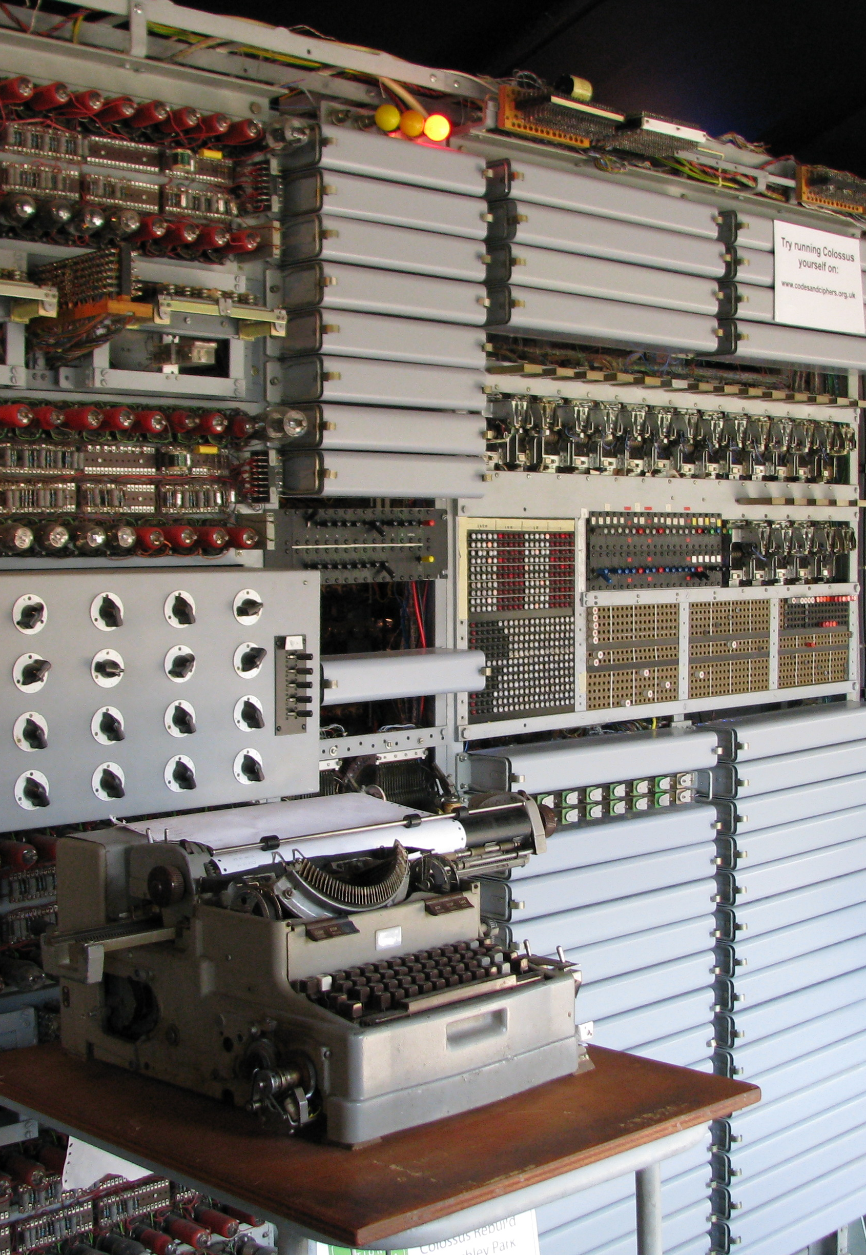
Any cryptographic algorithm can be broken through a brute-force attack given infinite time.
DES: The U.S. encryption standard as of 1977.
56-bit key. 2⁵⁶ = approx. 72 quadrillion combinations.
Broken in 1999 in 22 hours and 15 minutes.
Triple-DES remains in use today
168-bit key (56 * 3)
Three times as much work to encrypt or decrypt.
Third-power more computing time to break (n ^ 3).
Assuming the same technology as 1999, would require 9.4 × 10⁴⁷ years to break.
The universe is approximately 1.3 × 10¹⁰ years old.
Image: Functional replica of Colossus, the world’s first programmable digital computer. Used to break the German Lorenz cipher in World-War II.
Notes:
The film, The Imitation Game simplifies the story by merging the Alan Turing’s work on the Bombe, which broke the Enigma cipher with his work on Colossus, which broke the more complicated Lorenz cipher.
Many computer histories describe the American ENIAC as the first programmable digital computer, but Colossus predated it by approximately two years. Colossus remained classified for three decades following WW II and has been omitted from many histories of computing. Whereas ENIAC was publicly known from the beginning.
Between 1993 and 2008 a functional replica of Colossus was built. To celebrate its completion, the National Museum of Computing created a competition, pitting the newly rebuilt Colossus against amateur radio operators. Three messages were enciphered using a Lorenz machine and transmitted from Paderborn, Germany. The victor’s 1.4 Ghz laptop broke the code in less than a minute whereas Colossus took approximately four hours. Still impressive for a 60-year-old design.

Slide 6
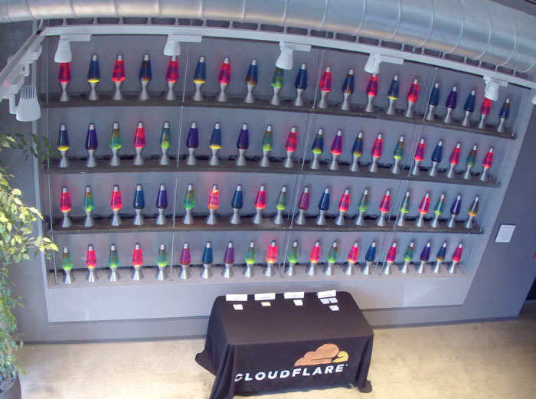
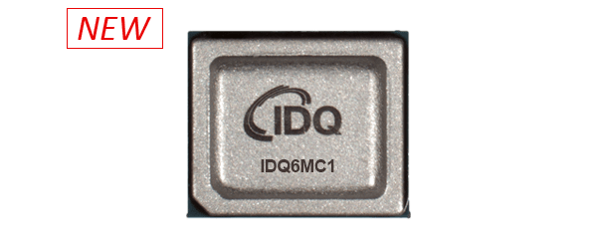
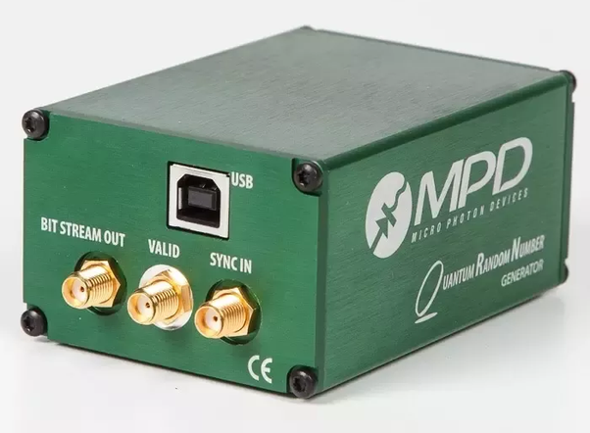
Random Numbers
A good cryptographic implementation also requires a supply of truly random numbers.
Lava Lamp random number generator at CloudFlare.
Device
(radioactive decay)
Chip
(quantum thermal noise)
RDRAND
Intel processor instruction for on-CPU random number generation.
Notes:
Cryptographic exchanges often require generation of encryption keys. If there is a pattern to the numbers generated, then a brute-force attack becomes much easier than the number of bits in the key would suggest. Therefore, a source of truly random numbers becomes important.
Here are some devices used to generate random numbers. CloudFlare uses a digital camera pointed at a wall of lava lamps to generate a supply of random numbers. More common are devices based on radioactive decay or quantum effects. A low rate of random numbers can be generated by sampling a high-speed counter each time the user presses a key or moves a mouse.
Modern CPU chips have embedded random number generators based on quantum thermal noise.

Slide 7
Secret Key (symmetric) cryptography
The “secret” is the key, not the algorithm
Encryption & Decryption computationally cheap (relative to public key encryption)
Examples:
Advanced Encryption Standard (AES)
128-bit key
Current standard, NIST standardization, NSA approved
Data Encryption Standard (DES)
56-bit key
Previous standard (as of late 1970s)
Triple-DES (168-bit key) is still considered to be reliable
Problem: distributing the key to both parties and nobody else!

Slide 8
Public Key (asymmetric) Encryption
The secret is one of the pair or keys (i.e., the “secret key”), not the algorithm
One key encrypts, its pair key decrypts
Based on “one-way” functions. For example:
7 x 19 = fast to compute
Factor 133 to find 7 & 19 = harder to compute
Do this with really big prime numbers and it forms the basis of RSA Public Key Encryption
Encryption & decryption is computationally expensive
Example: RSA [2048-bit recommended, 512-bit is weak]
Problem: Knowing if this really is someone’s public key. Maybe it’s from an attacker posing as the organization.
Notes:
“Public-key cryptography has been said to be the most significant new development in cryptography in the last 300-400 years. Modern PKC was first described publicly by Stanford University professor Martin Hellman and graduate student Whitfield Diffie in 1976.” - http://www.garykessler.net/library/crypto.html
Note: It doesn’t matter which of the 2 keys are applied to encrypt and decrypt a message. If one encrypts then the other decrypts, and visa versa. Also, knowing one key does not help in discovering what the other key is, although they are mathematically related.

Slide 9
Hash Functions
One-way encryption that doesn’t need a key
A “hash” is a short message digest that cannot be used to recreate the original message
Used to create a “digital fingerprint” of a file to ensure integrity (no modification of the file)
Examples:
SHA-2: The Current Standard
Produces hash values of 224, 256, 384, or 512 bits. (SHA-224, SHA-256, SHA-384, etc.)
SHA-3: Standardized Alternative
Also has values of 224, 256, 384, and 512 bits in length.
SHA-1: The Previous Standard – produces 160-bit hash values.
“Not considered secure against well-funded opponents.”
Message Digest [MD2, MD4, MD5: not recommended]
Problem: two different messages create same hash (i.e., a hash function is “broken”) – but this is difficult to do deliberately or even accidently and becomes increasingly unlike as hashes get bigger.
Notes:
When two different files create the same hash, there is a “hash collision”. This is the main security risk associated with how hashes are used in practice. If I can create a substitute message and get the hash to match what you think it should be for the original message, then you wouldn’t know there was a problem with it.

Slide 10
Symmetric Encryption
Asymmetric Encryption
Cryptographic Hash
On these fundamental algorithms we can build most of the important cryptographic applications.
However, it is critical that they are applied correctly. Strong cryptography can be broken by a weak implementation.

Slide 11
Applied Cryptography: Verifying Sender Identity (Authentication and Nonrepudiation)

Slide 12
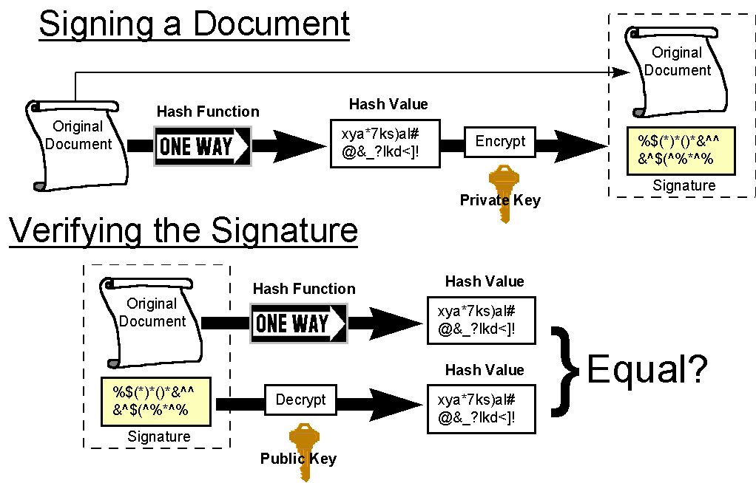
Verifying Integrity and the Sender
Notes:
Digital signatures use hashes and public key encryption together.

Slide 13
Trust Models
Answer the question: How can public keys be distributed in a trustworthy manner?
Methods:
Public Key Certificates and Certificate Authorities
PGP Web of Trust – public key. Used for email. Trust essentially left up to users.
Kerberos – private key. Used to distribute keys between devices.
Notes:
PGP stands for Pretty Good Privacy.

Slide 14
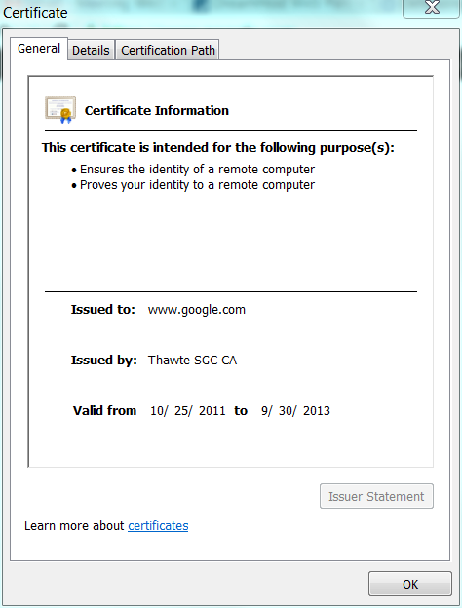

Public Key Certificates and Certificate Authorities
Trusted 3rd Party
Certificate Authority
Notes:
Demo: go to https://www.verisign.com
See green URL → SSL established
Click on “Verify” under logo
→ see some certificate info
Click on the green bar too
Encryption models don’t account for how to distribute the keys to various parties. There are many unanswered questions: “How, for example, does one site obtain another party's public key? How does a recipient determine if a public key really belongs to the sender? How does the recipient know that the sender is using their public key for a legitimate purpose for which they are authorized? When does a public key expire? How can a key be revoked in case of compromise or loss?” – see http://www.garykessler.net/library/crypto.html
“The basic concept of a certificate is one that is familiar to all of us. A driver's license, credit card, or SCUBA certification, for example, identify us to others, indicate something that we are authorized to do, have an expiration date, and identify the authority that granted the certificate.”

Slide 15


Demo: Digital Certificates

Slide 16
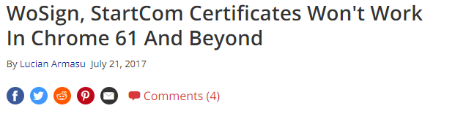
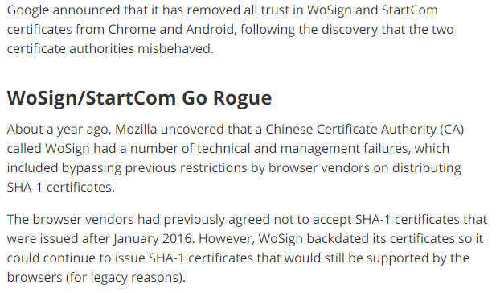
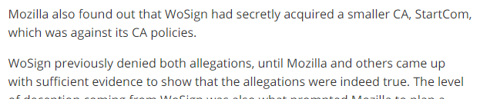
https://www.tomshardware.com/news/google-wosign-startcom-certificates-banned,35055.html
Notes:
https://www.tomshardware.com/news/google-wosign-startcom-certificates-banned,35055.html

Slide 17
Applied Cryptography: HTTPS – based on TLS

Slide 18
Transport Layer Security (TLS)
TLS Provides both Encryption (keep people from seeing my data) and Authentication (this server is the one it claims to be) on Web
HTTPS is HTTP over TLS
Formerly Secure Sockets Layer (SSL) and frequently still called that

Slide 19
How it works
Depends on trust
Website gets a certificate from trusted authority
The authority verifies, at a minimum, that the applicant has control over the website.
For LetsEncrypt, the Certbot does that automatically.
TLS checks the authenticity of the certificate and then encodes data

Slide 20
TLS handshake (see link)
Client contacts server, requests TLS
Server sends Cert and public key and selected protocol
Client checks Cert against trusted database
Client authentication possible here
Client and server compute symmetric keys
Client and server exchange symmetric keys using the public key in the certificate.
Communication is encrypted from here on
(See details in this video)

Slide 21


HTTPS: Concluding Observations
TLS is computationally expensive
Initially only adopted for sensitive information such as passwords, credit cards, etc.
Dedicated hardware can speed it up.
Computing power has increased in recent years leading to…
Encrypting the Web
Campaign launched in 2016 by the Electronic Frontier Foundation (EFF) and endorsed by many others.
Major browsers (FireFox, Chrome, Safari, Edge) warn about unencrypted content.
Leading to…
EFF, Mozilla and a host of other sponsors launched the “Let’s Encrypt” program offering free SSL certificates.

Slide 22
Applied Cryptography: Securing Passwords

Slide 23
Securing Passwords
Suppose someone steals your password database – can they break into your site?
Security for Data at Rest (in the database)
Symmetric-Key cryptography: Limited additional security, the key has to be available to the host program, so it is as easy to steal as the database.
Public-Key cryptography: Not helpful in this context.
Cryptographic Hash: Much better, passwords cannot be recovered. But vulnerable to a rainbow table attack. (Table of pre-computed hashes.)
Salted Cryptographic Hash: Much, much better.
A random number (salt) is generated. The password plus salt are hashed and both are stored in the database.
Vulnerable to brute-force. The hash is a large number but there is a much smaller set of useful passwords.
Slow Salted Cryptographic Hash: State of the art.
Uses a computationally expensive hash algorithm like bcrypt.
bcrypt is simply a cryptographic hash repeated thousands of times.
PHP password_hash() from Lab 3 uses the bcrypt algorithm.

Slide 24
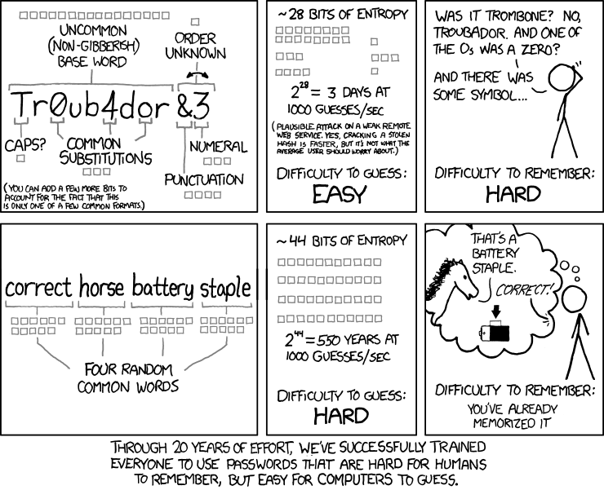
https://xkcd.com/936/

Slide 25
Study Questions
What are the 3 core types of cryptographic algorithms discussed in this lesson?
How do each of them work, and which security services do they help provide?
What is the security mechanism added to HTTP to make HTTPS?
What are the two functions provided by TLS?
Explain the use of symmetric and Public Key (a.k.a asymmetric) encryption (e.g., in TLS)
Which type of encryption is computationally fastest?
What might you observe when working with a website that would make you question their password security?

