Slide 1
Information Assurance and Security: Overview IT210A - S16

Slide 2
Cybersecurity Threats

Slide 3
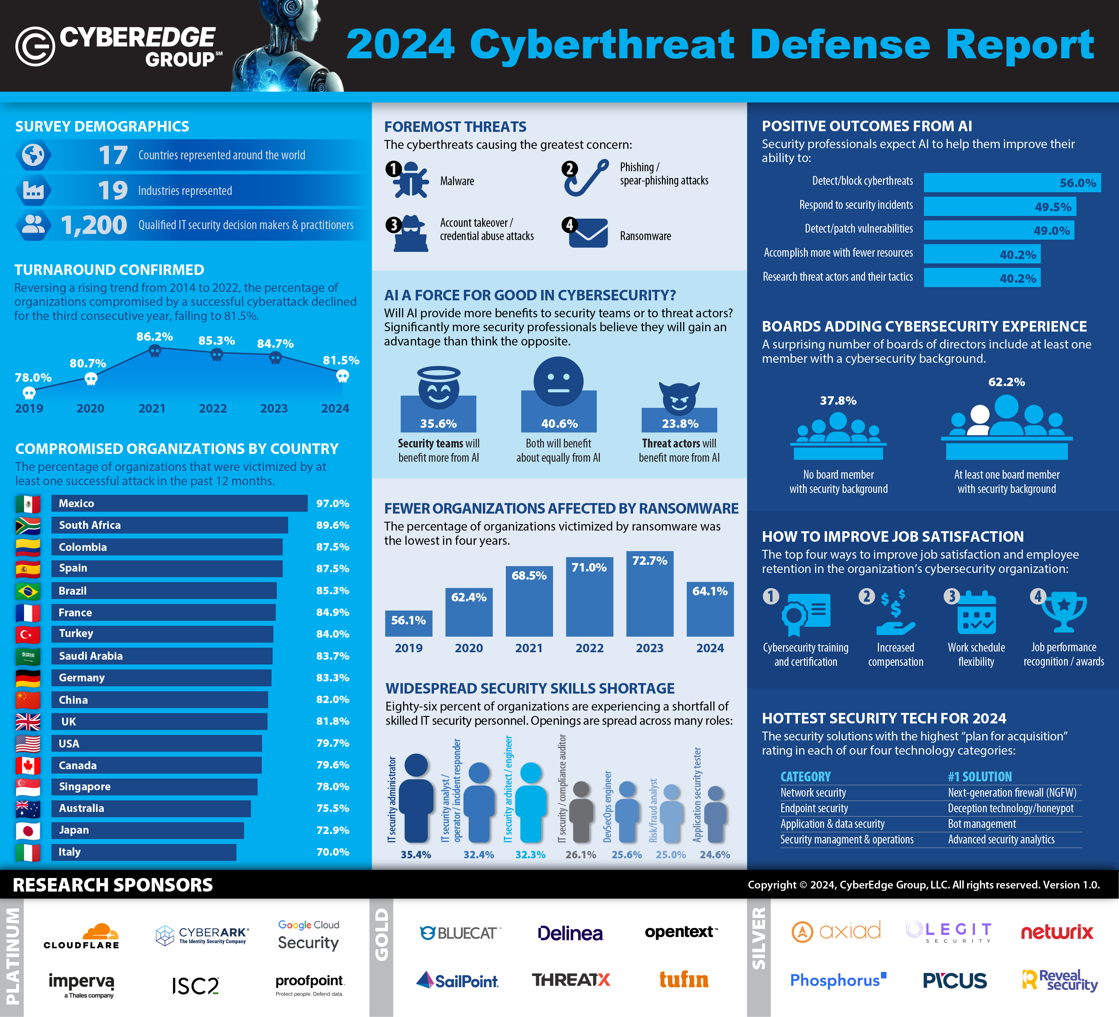
2024 Cyberthreat Defense Report CyberEdge Group https://cyber-edge.com/cdr/
Notes:
What’s it like on the frontier?

Slide 4
From the 2024 report:
64% of organizations were victimized by a successful ransomware attack.
49% of victimized organizations paid the ransom.
The average ransom paid was $568,705
This is down from 73% of organizations victimized and 60% paying the ransom in 2023.

Slide 5
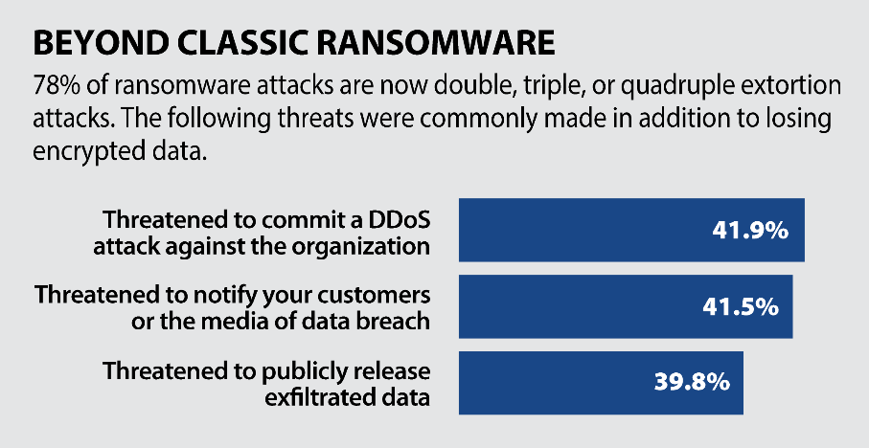

Elsewhere, the report says that 73% of organizations experienced a successful ransomware attack and 60% of them paid a ransom.

Slide 6
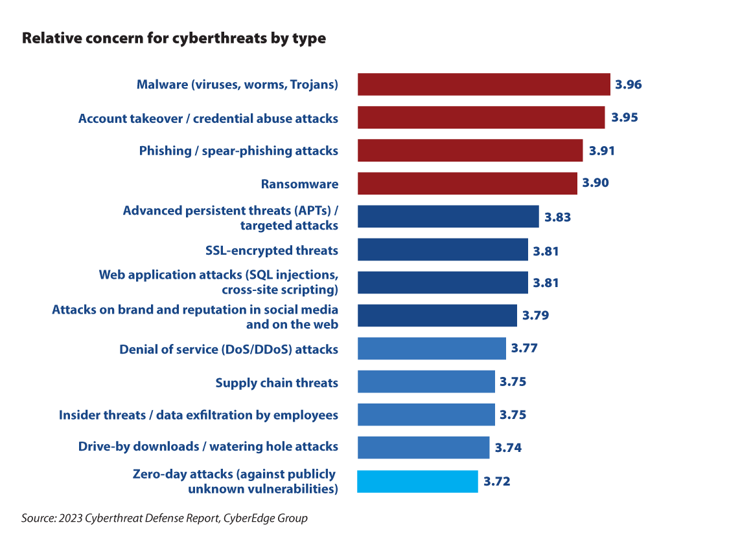

Slide 7
Goal: Manage Risk
Probability of successful attack (i.e., exploit)
Risk = threat x vulnerability x consequence
”threat actor”
Skill
Motive
Opportunity
Resources
”weaknesses”
Ease of discovery
Ease of exploitation
Awareness (known?)
Ease of detection
Human & Technical
”impact”
Technical impact
Business impact
Societal impact
Notes:
The best we can do is “manage” risk, we can’t get rid of it all. “You can accept, ignore, mitigate or transfer risk, but you can't prevent it.” - https://searchsecurity.techtarget.com/feature/The-security-risk-management-lifecycle-framework
See https://securityintelligence.com/simplifying-risk-management/ for an explanation of terms and slide
What are some examples of “threats or threat actors”? What are some examples of “vulnerabilities” (human and technical)? What are some examples of consequences?

Slide 8
Most Common Web App Vulnerabilities
OWASP Top 10 Vulnerabilities 2021
A01:2021-Broken Access Control
A02:2021-Cryptographic Failures
A03:2021-Injection (XSS and SQL Injection)
A04:2021-Insecure Design
A05:2021-Security Misconfiguration
A06:2021-Vulnerable and Outdated Components
A07:2021-Identification and Authentication Failures
A08:2021-Software and Data Integrity Failures
A09:2021-Security Logging and Monitoring Failures
A10:2021-Server-Side Request Forgery (SSRF)
https://owasp.org/Top10
(OWASP Reports top 10 every four years. Next due in 2025.)

Slide 9
Security is hard to “tack on” after the fact
Examples:
SMTP – Email
DNS
But it can be done
Examples:
HTTP ➔ HTTPS
Telnet ➔ SSH
DNSSec: DNS Security Extensions

Slide 10
Information Assurance

Slide 11
Information Assurance
“Measures that protect and defend information and information systems by ensuring their availability, integrity, authentication, confidentiality, and non-repudiation. These measures include providing for restoration of information systems by incorporating protection, detection, and reaction capabilities.”
National Information Assurance (IA) Glossary

Slide 12
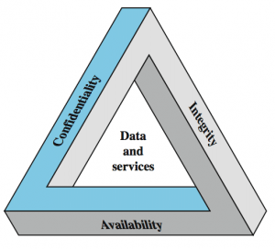
CIA Triad
Notes:
Has nothing to do with the U.S. Central Intelligence Agency

Slide 13
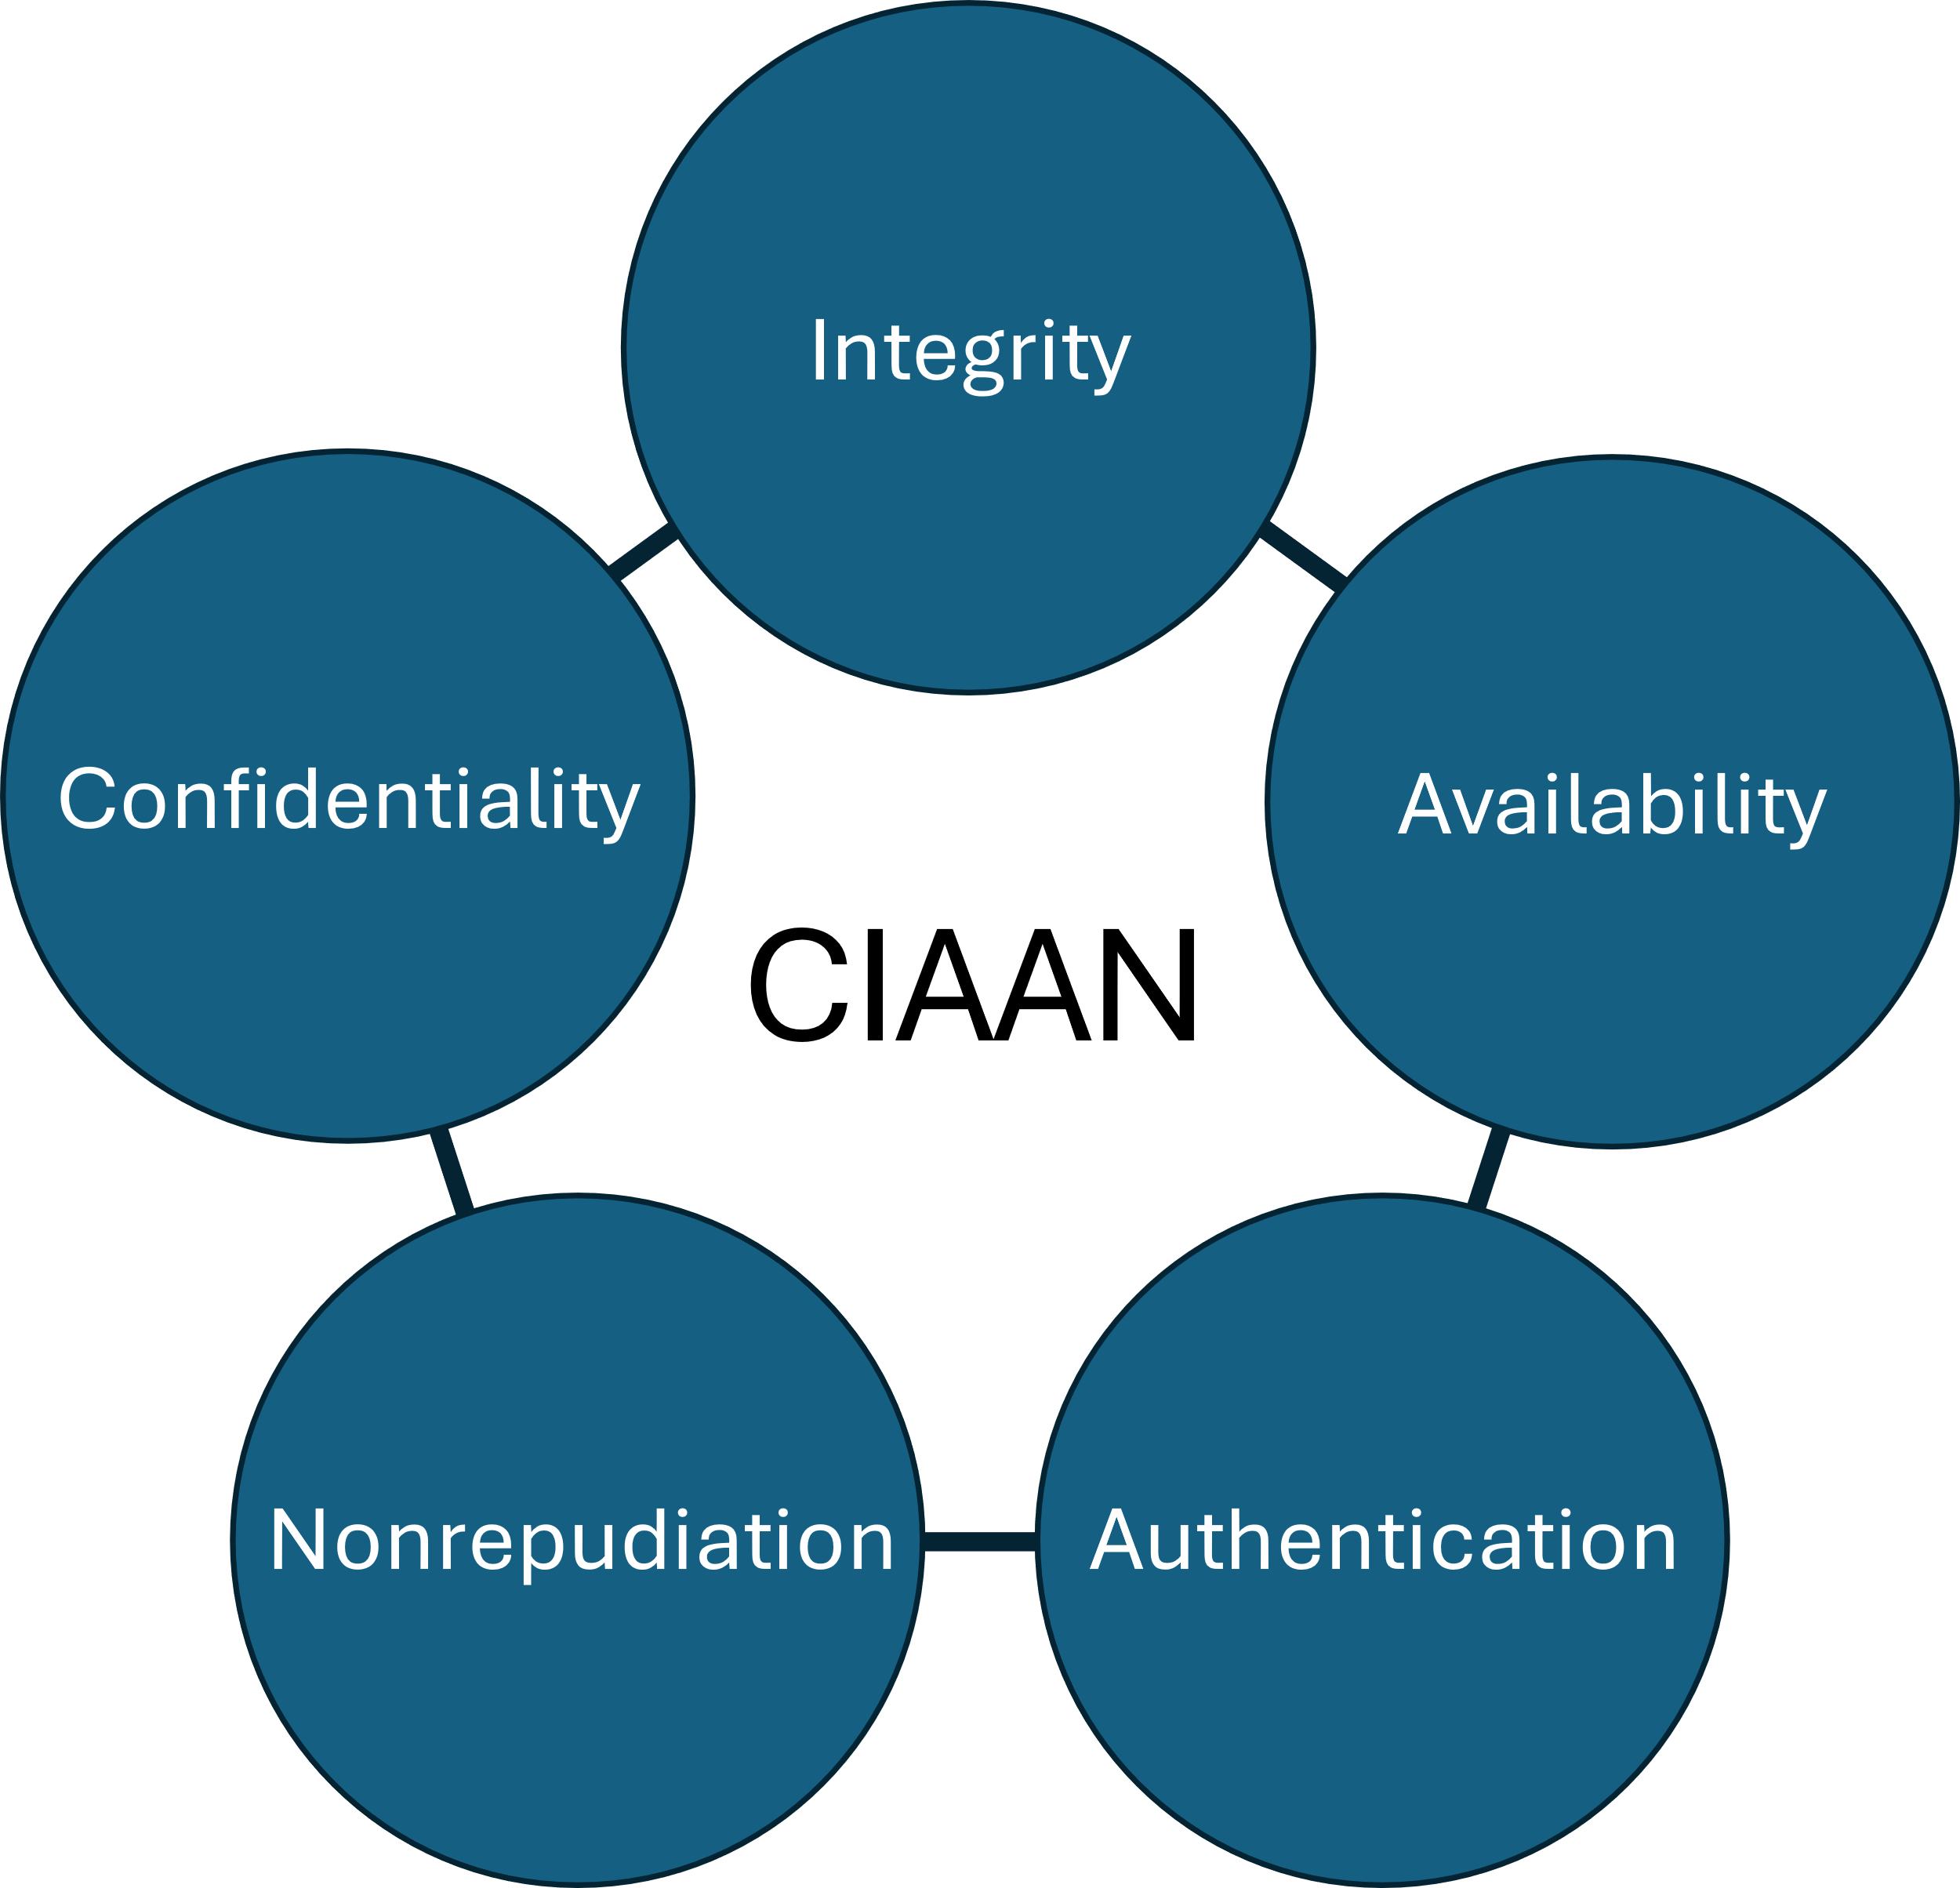
CIAAN Pentad

Slide 14
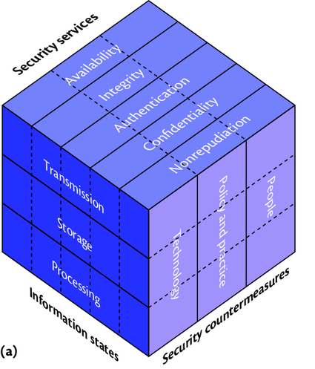
Maconachy, Schou, Ragsdale (MSR) Cube
Information Assurance
Maconachy, Schou, Ragsdale and Welch, A Model for Information Assurance: An Integrated Approach, Proceedings of the 2001 IEEE Workshop on IAS, USMA, West Point, NY 5-6 June 2001.
Notes:
See the referenced paper for a complete description of this model. It provides a way of categorizing and systematically thinking through different types of information assurance and security problems. We’ll walk through each of these main dimensions to make sure we understand them.
--------------------------------
Notes from prior semesters:
Simple examples: (1) your transaction with Newegg, (2) carrying data on a usb drive, (3) the courier who took sets of backup tapes from U of U to a disposal facility—but went home overnight instead. (tapes contained 100,000+ SSNs etc.). Aluminum cases containing tapes looked like gun cases! Stolen overnight. Outcome: spent millions notifying all those whose info was compromised. They did recover the tapes a couple weeks later. Future mitigation: encrypt the backup data.
Example of Fedex service to move 10 exabytes of Data SF to NY overnight (alternative 1 Gbs line)
Example of an information attack: Apple engineer leaves a prototype iPhone 4 in a bar prior to release.
Information: Confidential data about the iPhone 4
State? Transmission/storage
Services?
Countermeasures?

Slide 15
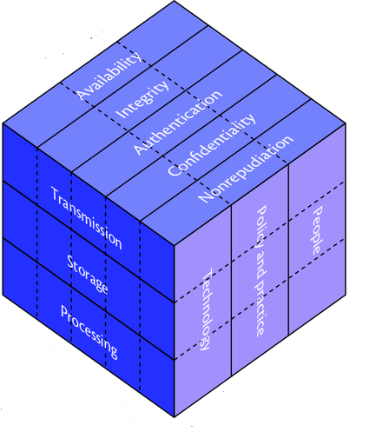
Security Services
Availability
Timely, reliable access to data and information services for authorized users.
Integrity
The assurance that data can not be created, changed, or deleted without proper authorization.
Authentication
Ensuring that those who access information are who they say they are.
Confidentiality
The assurance that information is not disclosed to unauthorized persons, processes or devices.
Non-Repudiation
The assurance that the sender of the data is provided with proof of delivery and the recipient is provided with proof of the sender’s identity, so neither can later deny having processed the data.

Slide 16
Information States: Where is the data?
Transmission (in transit)
Time in which the data is in transit between processing/process steps.
Storage (at rest)
Time during which data is on a persistent medium such as a hard drive or tape.
Processing (in process)
Time during which the data is actually in the control of a processing step or in RAM.
Notes:
Note: Information may be in more than one state, as when a file is sent across the web: a copy of it is on the original server, while another copy of it is “in transit”

Slide 17
Security Countermeasures: Who can enforce/check security?
People
Security and IT Staff
Proper Training for All Staff
Security Mindset
Policy and Practice
Reduce vulnerabilities through standard practices
Technology
Firewalls, intrusion detection, email filters, redundancy, backups

Slide 18
Sidenote:
There is often a tension between usability and security
E.g., dual authentication, captcha, password complexity requirements
Notes:
See https://jnd.org/when_security_gets_in_the_way/ for a full discussion

Slide 19
Diagnose an Attack
Scenario: Attacker uses SQL injection to gain access to another person’s account from which they get personal information.
Notes:
Which factors on each dimension are involved?

Slide 20
Exercise: Use the “Cube” to diagnose and remedy the SQL Injection attack.
Information Assurance
Notes:
See the referenced paper for a complete description of this model. It provides a way of categorizing and systematically thinking through different types of information assurance and security problems. We’ll walk through each of these main dimensions to make sure we understand them.
--------------------------------
Notes from prior semesters:
Simple examples: (1) your transaction with Newegg, (2) carrying data on a usb drive, (3) the courier who took sets of backup tapes from U of U to a disposal facility—but went home overnight instead. (tapes contained 100,000+ SSNs etc.). Aluminum cases containing tapes looked like gun cases! Stolen overnight. Outcome: spent millions notifying all those whose info was compromised. They did recover the tapes a couple weeks later. Future mitigation: encrypt the backup data.
Example of Fedex service to move 10 exabytes of Data SF to NY overnight (alternative 1 Gbs line)
Example of an information attack: Apple engineer leaves a prototype iPhone 4 in a bar prior to release.
Information: Confidential data about the iPhone 4
State? Transmission/storage
Services?
Countermeasures?

Slide 21
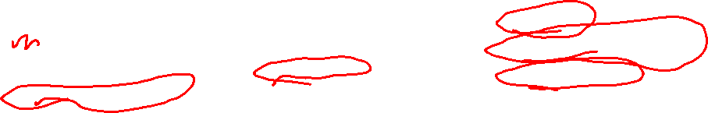
Diagnose an Attack
Scenario: Attacker uses SQL injection to gain access to another person’s account from which they get personal information.
Security Services
Availability
Integrity
Authentication
Confidentiality
Nonrepudiation
Which services were compromised?
Information States
Transmission
Storage
Processing
In which states were data when compromised?
Countermeasures
People
Policy & Practice
Technology
Which measures could protect against this attack?

Slide 22
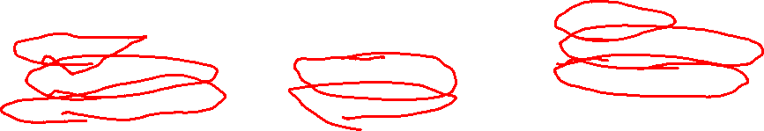
Diagnose an Attack
Scenario: A professor is victimized by a spear-phishing attack in which a trojan installs a key logger on their computer. The attacker uses the key logger to steal their passwords, log into the school’s data system remotely, and change grades.
Security Services
Availability
Integrity
Authentication
Confidentiality
Nonrepudiation
Which services were compromised?
Information States
Transmission
Storage
Processing
In which states were data when compromised?
Countermeasures
People
Policy & Practice
Technology
Which measures could protect against this attack?

Slide 23
Study Questions
Find a news story about a security breach. Use the “cube” to diagnose what happened and prescribe a remedy.
How do the following terms relate to one another: vulnerability, exploit, risk, threat, consequence
What are the five key security services?

