Slide 1

Final Exam Review
IT210A – S18

Slide 2
Finals
Take-Home Final (Today through Wednesday)
Open book, open notes, open internet, no collaboration or personal help.
10 Questions: Written Response
Should take 1 ½ to 3 hours.
In-Class Final (Wednesday)
Will take class and lab time on Monday (8:00am to 9:50am)
Should take 1 hour but you will have nearly 2.
Closed book, closed internet, closed neighbor, etc.
You may prepare One Page of Notes (double sided) before the exam.

Slide 3
From LearningSuite:
This is an "open book" exam. You may use the internet, including search, in read mode. That is, you can search for keywords but do not post questions from the exam to any website whether it's a forum or AI. You may not communicate with any person (in-person or via the Internet) about the contents of this exam.
You may use any resources presented in class including LearningSuite, slide decks, labs, and so forth.
The exam consists of 10 questions, each with a written (essay) response that you will enter into LearningSuite. You may choose to compose your answers in a word processor and then paste them into the provided answer space.
You may save the exam, leave, and continue later. It need not be completed in one sitting.
There is no time limit except that you must submit the exam before the due date/time. We expect this to take 1½ to 3 hours to complete.

Slide 4
From LearningSuite:
Comprehensive exam. You are permitted one page of personal notes, prepared in advance. This exam should be taken in-class without looking at any other resources or talking to anyone. There are 60 questions. All are selected response (multiple choice, true/false, matching, etc.) You are given 2 hours for the test but only one hour should be required.

Slide 5
In-Class Final: Fall 2023
No significant correlation between time spent and final score.

Slide 6
Command-Line (BASH)
cd, ls, dir, cp, mv
mkdir
ifconfig/ipconfig
man/info
sudo
apt-get
chmod
chown

Slide 7
HTML
<head>, <body>
<p>, <div>, and other block elements
<span>, <em>, <strong> and other inline elements
<img>, <audio>, <video> and other media elements

Slide 8
Block Elements DIV, P, TABLE Stack Vertically
Inline Elements SPAN, EM, IMG
Flows/wraps from one line to next
Notes:
Image from https://www.webdesignerdepot.com/2012/09/when-pages-are-not-paper-the-designers-guide-to-layout-code/ which is a great article on the topic.
Note that you can override the default display style (i.e., whether it is a block or inline) using the “display” property. For example:
div { display: inline; }

Slide 9
CSS
Location
Inline (in a “style” attribute)
Embedded (in a <style> element)
External (linked)
Selectors: element, #id, .class
Position: static, absolute, fixed, relative
Commonly-used properties
font (font-family)
color
background-color

Slide 10
JavaScript
Location
Inline (e.g. <button onclick="doOnClick(event)" >
Embedded (in a <script> element)
External <script src="script.js">
DOM (Document Object Model)
HTML Local Storage
Event Handling
Inline handler (like above)
element.onclick = doOnClick;
element.addEventListener("click", doOnClick)
Which method is preferred? Why?

Slide 11
JavaScript can access
The Document Object Model (DOM)
localStorage and sessionStorage
cookies (unless HttpOnly)
Media (like the Camera, Mic, and Screen Capture)
Other advanced features

Slide 12
JavaScript Object Notation (JSON)
“syntax for storing and exchanging text information”
Similar, in purpose, to XML, but faster and easier to parse
Language and platform independent
JSON Example
{
"employees": [
{"firstName": "John", "lastName": "Doe"},
{"firstName": "Anna", "lastName": "Smith"},
{"firstName": "Peter", "lastName": "Jones"}
]
}
Notes:
See http://www.hunlock.com/blogs/Mastering_JSON_(_JavaScript_Object_Notation_) for an excellent overview.

Slide 13
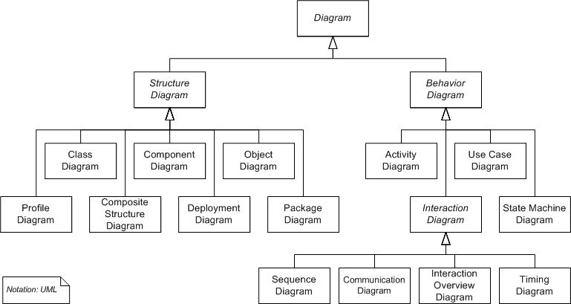
UML Diagram Types
Notes:
14 diagram types in several sub-trees
No, you don’t need to memorize them. Look them up and use them as needed.
We’ll focus on the ones circled: Class Diagrams, Activity Diagrams, and Sequence Diagrams, in this class.

Slide 14
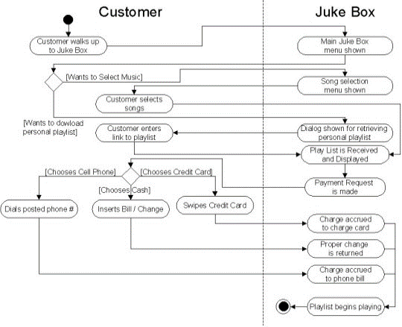
Juke Box with Partitions
Also called swim-lanes
Notes:
Partitions = Swim Lanes
These will be required for many of our labs, since they are helpful in characterizing what different things do (e.g., server, database, client)

Slide 15
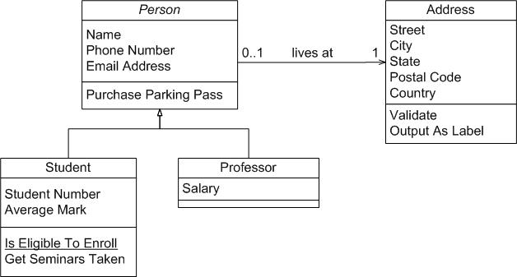
UML Diagrams – Class (Analogous to Entity-Relationship Model)
*

Slide 16
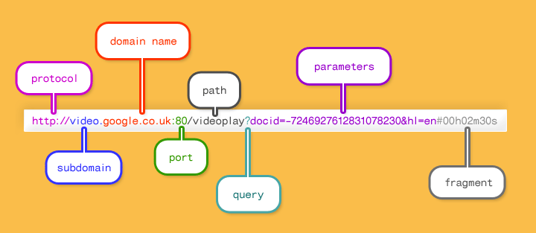
Detailed URL Example
Notes:
See http://doepud.co.uk/blog/anatomy-of-a-url.php for a full description of the parts. Image from there.
Understanding these parts of a URL has important security implications: see http://www.20thingsilearned.com/en-US/url/1

Slide 17
Networking
TCP/IP
OSI
7. Application
Application
OSI 7-Layer Model
TCP/IP Model
IP, TCP, UDP
Mapping to OSI 7-Layer
6. Presentation
5. Session
4. Transport
Transport (TCP, UDP)
3. Network
Internetwork (IP)
2. Data Link
Link (Network Interface)
1. Physical

Slide 18
IP Addresses
Notation (E.g. 192.168.100.1)
Network ID / Host ID – subnet mask. E.g. 255.255.0.0
Network Address Translation
Public and Private IP Addresses
Addressing IP Address Shortage
Network Address Translation
Dynamic IP Address Assignment (DHCP)
IP v6

Slide 19
Domain Name Service (DNS)
Goal of DNS Server: “domain name resolution” – map a domain name (e.g., www.byu.edu) to an IP address (128.187.16.242)
No single DNS Server includes all of the billions of IP addresses. Instead, there is a process put in place wherein your ISP’s “DNS Resolver” server can:
Return the answer if it is “cached” (recently accessed and “remembered” for a specific amount of time: TimeToLive)
If it doesn’t have the answer, it queries other DNS servers from the root until it gets the right answer or an error.
Notes:
DNS Servers are like the phone book of the Internet, where names correspond with domain names and phone numbers correspond with IP addresses. This database of matched pairs is called a “whois” database.
Note: you can bypass this process by typing in the IP address of a web domain directly, but it’s typically harder to remember IP addresses and they may change over time (i.e., a different IP address can be associated with a domain name).
See https://dyn.com/blog/dns-why-its-important-how-it-works/ for a detailed description of types of DNS servers.

Slide 20
DNS Records
A: The IPv4 address of a domain name.
AAAA: The IPv6 address of a domain name.
CNAME: An alias of another domain name.
MX: The mail servers for a domain name.
TXT: Custom information for a domain name.
There are others but these are the most commonly used.

Slide 21
HTTP
Stateless (each request is independent)
GET vs. POST
HTTP and HTTPS

Slide 22
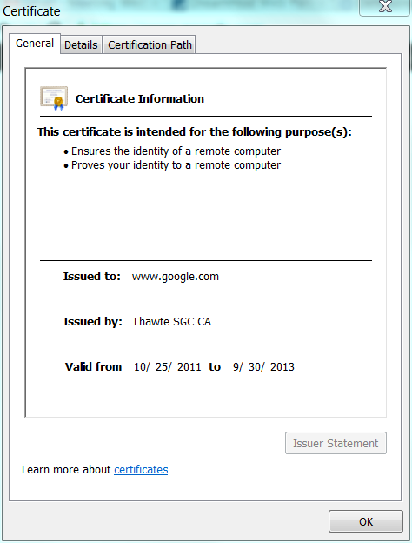

Public Key Certificates and Certificate Authorities
Trusted 3rd Party
Certificate Authority
Notes:
Demo: go to https://www.verisign.com
See green URL → SSL established
Click on “Verify” under logo
→ see some certificate info
Click on the green bar too
Encryption models don’t account for how to distribute the keys to various parties. There are many unanswered questions: “How, for example, does one site obtain another party's public key? How does a recipient determine if a public key really belongs to the sender? How does the recipient know that the sender is using their public key for a legitimate purpose for which they are authorized? When does a public key expire? How can a key be revoked in case of compromise or loss?” – see http://www.garykessler.net/library/crypto.html
“The basic concept of a certificate is one that is familiar to all of us. A driver's license, credit card, or SCUBA certification, for example, identify us to others, indicate something that we are authorized to do, have an expiration date, and identify the authority that granted the certificate.”

Slide 23
SQL
Database – Table – Record – Field
SELECT … FROM … WHERE … ORDER BY
JOIN (involves multiple tables in one query)
Relational Database Management Systems (RDBMS) typically accept SQL queries.
Examples, MySQL, MariaDB, Oracle, PostgreSQL, Microsoft SQL Server, etc.
SQL Server Account Rights
Each application accesses the server through an account.
Which rights are required for an application?
Which rights should not be assigned?

Slide 24
Protecting Against SQL Injection Attacks
Good: Escape the string before inserting it into a SQL Query
$mysqli -> real_escape_string($myvar)
Better: Use Prepared Statements and pass parameters separately
$stmt = $conn -> prepare("INSERT INTO MyGuests(firstname,lastname,email)VALUES(?,?,?)"); $stmt->bind_param("sss",$firstname, $lastname, $email); $firstname = "Bill" $lastname = "Preston" $email = "bill@wyldstallyns.music"
See the excellent resources in the Articles column of LearningSuite

Slide 25
PHP
Server-Side Scripting
Gateway to databases and other server-side services.
Session Management

Slide 26
Cookies
One way to manage state
Scope
To a second-level domain or lower.
Setting and Clearing
Set in HTTP or in JavaScript
HTTP Cookies can be set by the domain of the page (first party) or by anything referenced by the page (third party).
Clear by setting the expiration date in the past
Persistence
An expiration date makes a cookie persistent other cookies clear when you close the browser.
Security/Privacy
Third-party cookies are increasingly blocked because they can be used for tracking.
Cookies can be manipulated on the browser so cryptographic techniques are often used to prevent forgery.

Slide 27
Applied Cryptography
Base Algorithms
Symmetric (Secret Key) Encryption
Asymmetric (Public Key) Encryption
Cryptographic Hash
Applications
HTTPS
Uses all three
Digital Signatures
Uses hashes and asymmetric encryption
Password Security
Uses hashes (with salt and multiple repetitions)

Slide 28
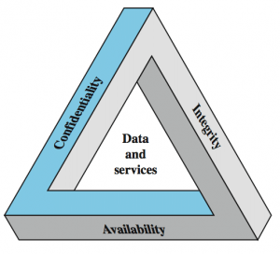
CIA Triad
Notes:
Has nothing to do with the U.S. Central Intelligence Agency

Slide 29
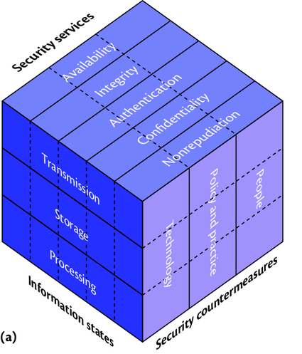
Maconachy, Schou, Ragsdale (MSR) Cube

Slide 30
Diagnose an Attack
Scenario: A professor is victimized by a spear-phishing attack in which a trojan installs a key logger on their computer. The attacker uses the key logger to steal their passwords, log into the school’s data system remotely, and change grades.
Security Services
Availability
Integrity
Authentication
Confidentiality
Nonrepudiation
Which services were compromised?
Information States
Transmission
Storage
Processing
In which states were data when compromised?
Countermeasures
People
Policy & Practice
Technology
Which measures could protect against this attack?

Slide 31
Network Performance
Bandwidth (width of the pipe)
Latency (length of the pipe)
Propagation delay
Queue delay
Processing time delay
Calculating transfer time
File size is in Bytes: KiB, MiB, GiB, etc.)
Bandwidth is in bits: bps, Kbps, Mbps, etc.)
8 bits per byte.

Slide 32
Improving Web Page Performance
Reduce Image Resolution
Data Compression
Reduce the Number of Components (images, scripts, CSS files, etc.)
Utilize Caching and Content Delivery Networks
Optimized Perceived Performance by ensuring early appearance of key components.

