Slide 1
Welcome, NodeJS, Fetch IT&C 210B – S20

Slide 2
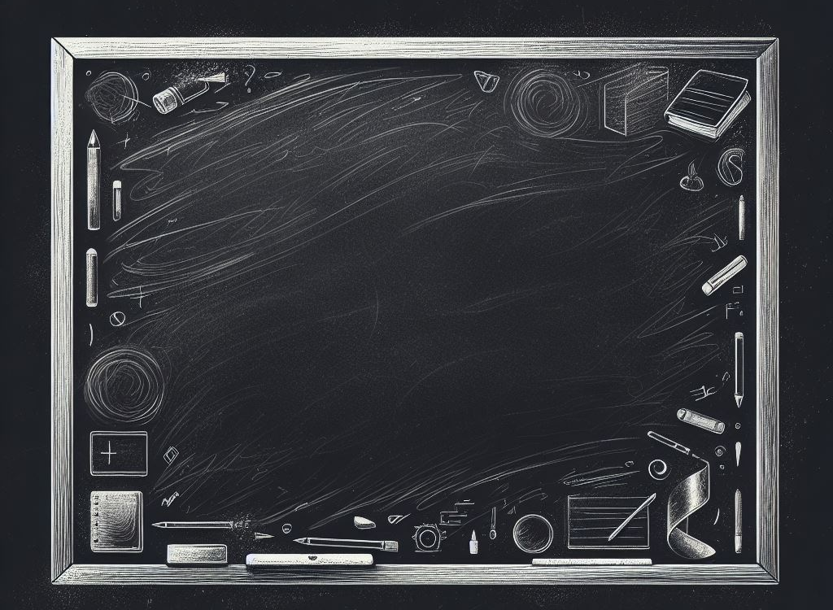
Welcome to IT&C 210B!
A Clean Slate
Grades back to zero.
3 more grace days
New classmates
Rhythm continues
Image: DALL-E 3

Slide 3
Rhythm of the Class
Monday
Class: Lecture/Demo plus live Q&A, presented by Prof Redd
Lab Period
Wednesday
Class
Lab Period: TA Kickoff of next lab assignment
Lab Pass-off due
Friday
Class
In-Class Quiz (Some Weeks)
Lab Period
Homework or Lab Writeup due (alternating weeks)
Except that next week has nothing due! So use it to get a head start on the balance of the term!

Slide 4
Getting Started
First Steps in the Content Tab
Get your development environment set up and running
Instructions in LearningSuite > Content
Windows: WSL2 and Docker Desktop
Mac: Docker Desktop
Begin work on Lab 4A and Lab 4B.

Slide 5
Node.js
JavaScript host that includes:
Chrome’s Javascript Runtime environment (V8 virtual machine) written in C++
Javascript libraries to help with networking tasks
Asynchronous, event-driven, single-threaded model
Additions to the included basic library
Add-ons written in C++
Packages/Modules written in JavaScript
Notes:
See http://www.nodebeginner.org/ for an excellent tutorial for beginners
Also see http://debuggable.com/posts/understanding-node-js:4bd98440-45e4-4a9a-8ef7-0f7ecbdd56cb for a briefer introduction

Slide 6
Express.js
Web application framework for Node.js
http.js manages the HTTP protocol – communication with browsers and other clients.
Express.js manages static files (html, css, images, etc.) and dynamically-generated web content.
This will become important later; but for now, we’re using node for client programming.

Slide 7
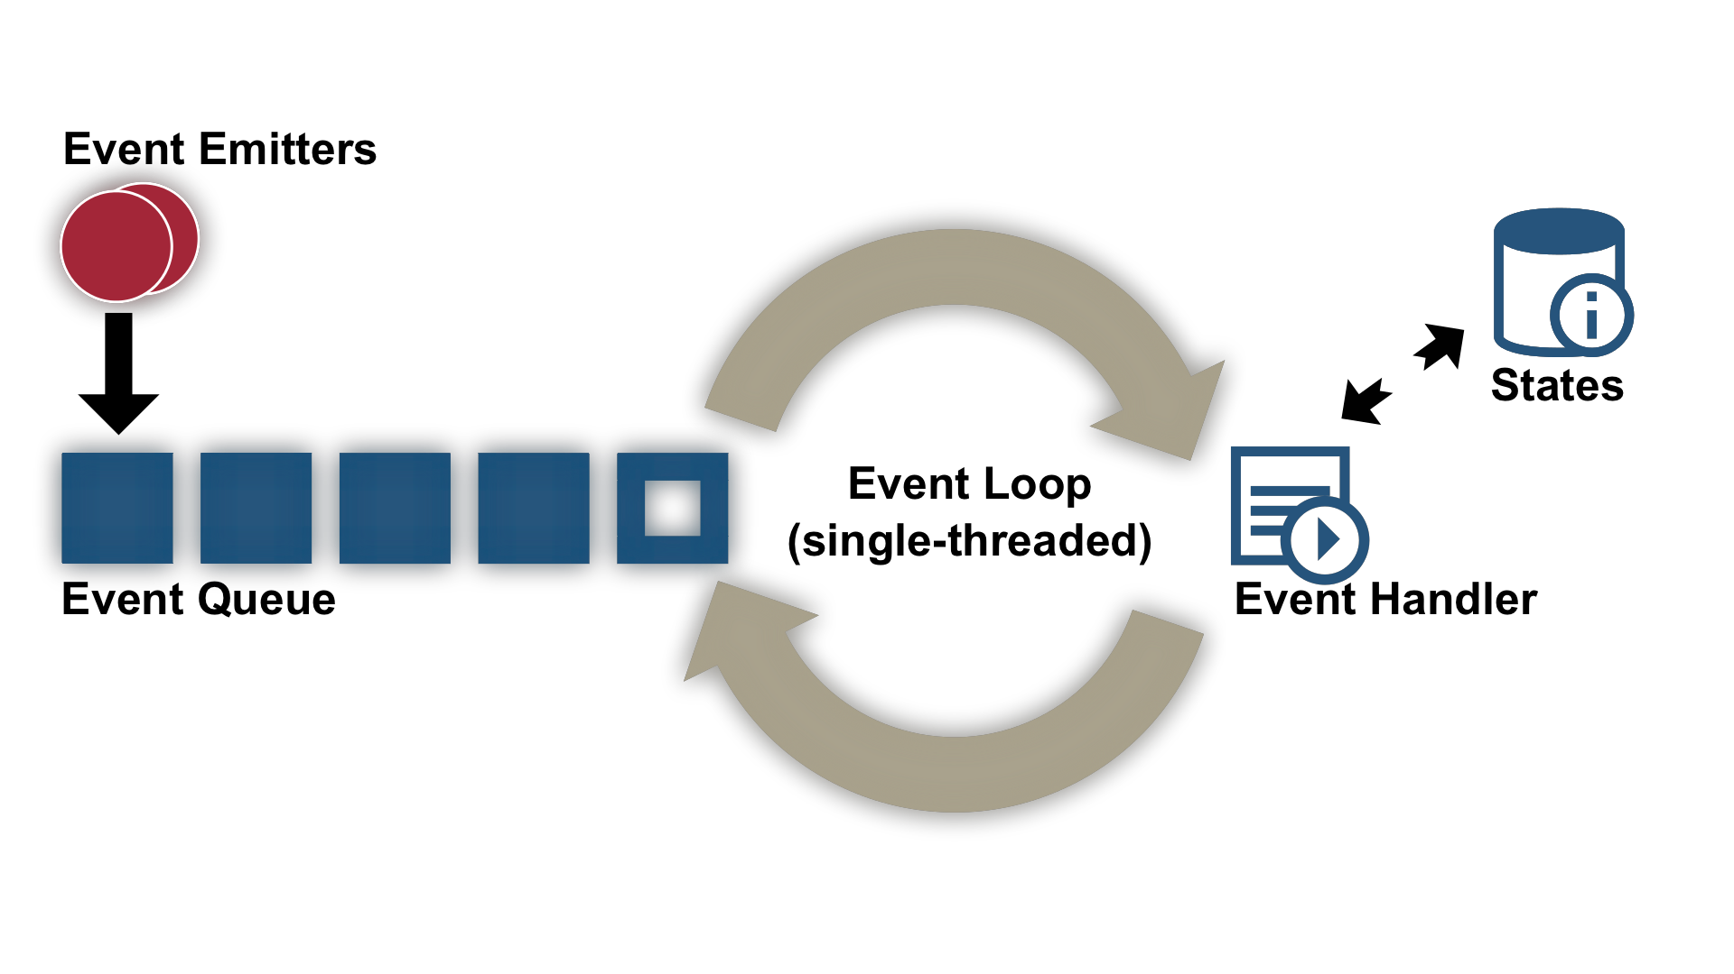
JavaScript is Event-driven
Event = change in state (e.g., user clicks on button, data is received, page is loaded)
Event Loop continuously checks for new events, including those that trigger callbacks
Notes:
Image from http://berb.github.io/diploma-thesis/community/042_serverarch.html , which has an excellent discussion of the different server architectures and their implications.

Slide 8
Asynchronous Functions
An asynchronous function doesn’t return data. Rather, it returns a promise to deliver the data.
When the asynchronous function finishes its work, it puts an event in the queue to call any callback functions attached to the promise.
Why do we care? Because fetch() is asynchronous, and we need to call fetch to access data.

Slide 9

JavaScript fetch()
fetch() is the preferred method for calling a web server from JavaScript, whether from Node.js or from browser JavaScript.
Previously there were XMLHttpRequest and various wrappers including jQuery.ajax. If you work with old code you may encounter these.
Image: DALL-E 3

Slide 10
fetch() Returns a Promise
A JavaScript Promise has several methods, but we only really care about then(onFulfill, onReject)
onFulfill: A function that is called when the fetch succeeds. Fetch passes a Response object to onFulfill.
onReject: A function that is called when the fetch fails. It’s optional!

Slide 11
Promises can be chained.
This is helpful because Response.text() and Response.json() are asynchronous. That is, they return promises, not the actual text or object.
Summary:
fetch() returns a promise of a Response object.
Response.text() returns a promise of a string containing the body of the HTTP response.
Response.json() returns a promise of an object that is the parsed JSON response.

Slide 12
One more thing…
Any response from the web server will result in onFulfill() being called with a Response object. That includes:
404 Not Found
400 Invalid Request
500 Server Error
Etc.
In your code. Check Response.ok to be sure that the response was in the 200 (success) range.

Slide 13

Demo: Using Fetch
https://byu-itc-210.github.io/walkthrough/Node-Fetch

Slide 14
Study Questions
What two things is Node.js made up of?
What does it mean that fetch() returns a promise of a response rather than the response itself?
Why should fetch() return a promise? (So that the browser and/or JavaScript can do other things while waiting for the response from the web server.)
What kinds of errors are detected by checking Response.ok?
What kinds of errors are detected by OnRejected or catch?

